Slide 1
Android Development Environment
19.3.2013

Slide 2
Environment/tools
Windows
Eclipse IDE for Java Developers (v3.5 Galileo)
Java Platform (JDK 6 Update 18)
Android SDK Tools, Revision 4

Slide 3
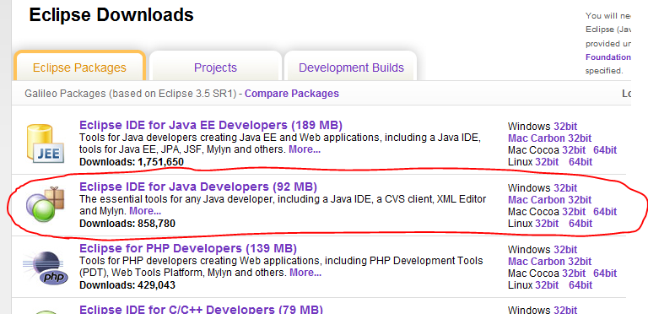
Step 1. Install Eclipse IDE
Download "Eclipse IDE for Java Developers (92 MB)" from here http://www.eclipse.org/downloads/

Slide 4
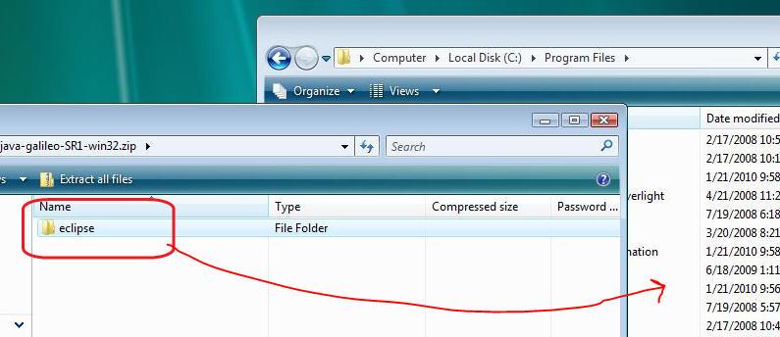
This is a zip file and does not require installation.
Just copy the eclipse folder into your programs directory

Slide 5
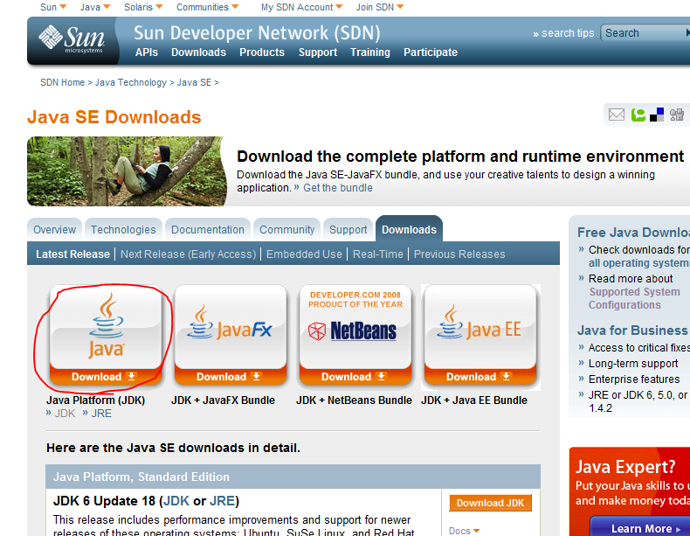
Step 2: Install Java Platform
Download the installation file from Sun from here http://java.sun.com/javase/downloads/index.jsp

Slide 6
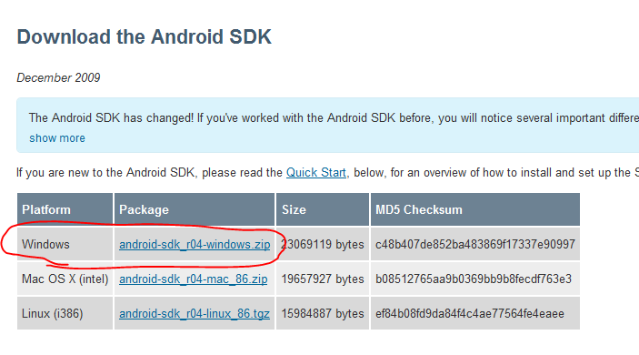
Step 3: Download Android SDK Tools
Download the installation package:
android-sdk_r04-windows.zip
From:
http://developer.android.com/sdk/index.html

Slide 8
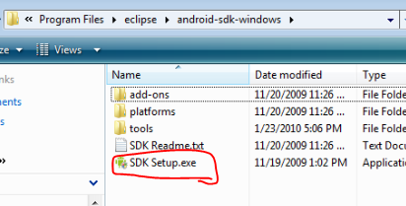
Step 4: Configure Android SDK
Launch "SDK-Setup.exe" located in the Android SDK install folder"

Slide 9
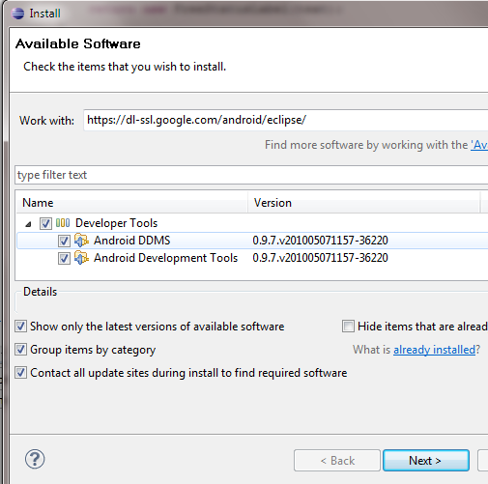
Setup ADT plugin
Install Eclipse ADT plugin
Install all the plugins in the repository
Restart needed after installation

Slide 10
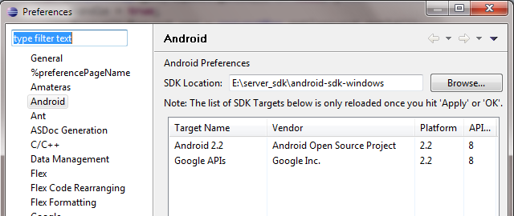
Configure ADT Plugin
Open eclipse Window->Preferences, select Android
Setup the SDK location as the folder where you extracted the downloaded SDK zip file

Slide 11
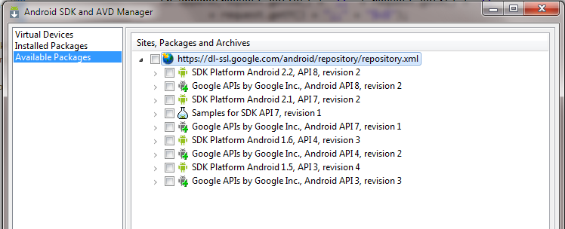
Setup SDK APIs
Open Window->Android SDK and AVD Manager
Click Available Packages and then choose proper APIs to install, the latest may be the best

Slide 12
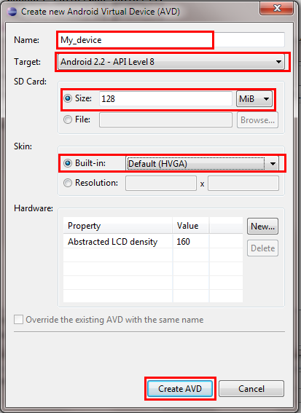
Setup Emulators
After SDK APIs installation, click Virtual Devices
Click new, there will be a dialog
input a name
choose a running target and a skin
specify the SD card size

Slide 13
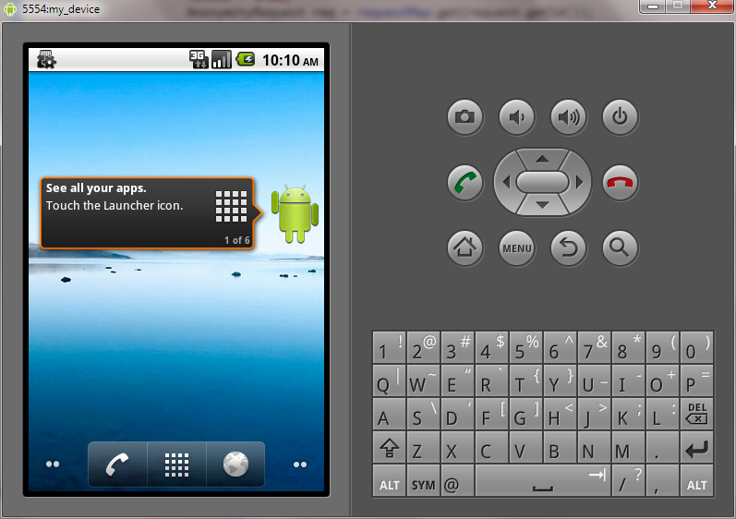
Ready…
Now you may start the AVD
Click start to start the new AVD
First start-up may take a very long time

