Slide 1

Location and Maps
19.3.2013

Slide 2
Content
Getting Location
Getting Google Map In application
Test on Emulator/Device

Slide 3
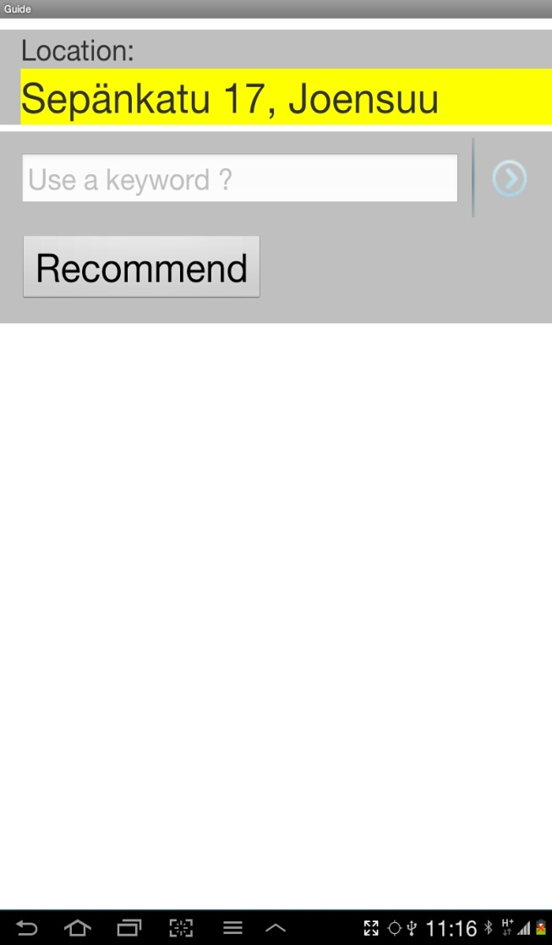
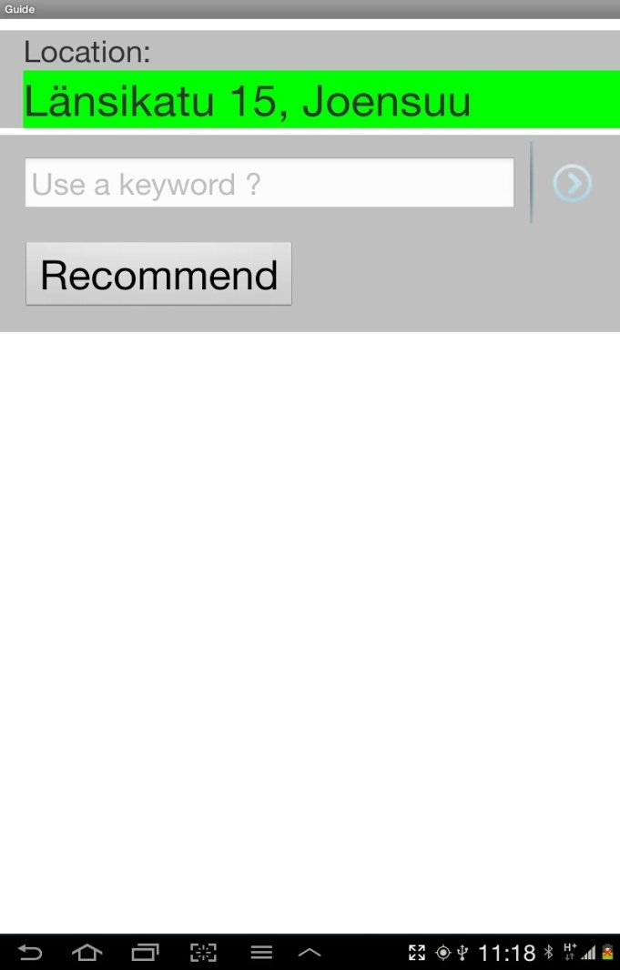
Getting Location

Slide 4
Getting Location
Location Manager,
Location Listener
Is Better Location?
(New, old)
Use old location
No
New location
Yes
Get Location providers
GPS & Network
Is GPS Provider?
Yes
No
Location with
Green Background
Location with
Yellow Background
Location listener
Update location Listener after some interval
Display Current Location

Slide 5
Getting Location
Location Manager,
Location Listener
The LocationManager provides access to the system location services
Get Location providers
GPS & Network
Location listener
On Location change, LocationListener is used for receiving notifications from the Location Manager
Update location Listener after some interval

Slide 6

Location Manager

Slide 7
Location Listener
MyLocationListener class implements LocationListener
LocationListener implements events:
.onLocationChanged ( Location Update )
.onProviderDisabled ( GPS Off )
.onProviderEnabled (GPS On )

Slide 8
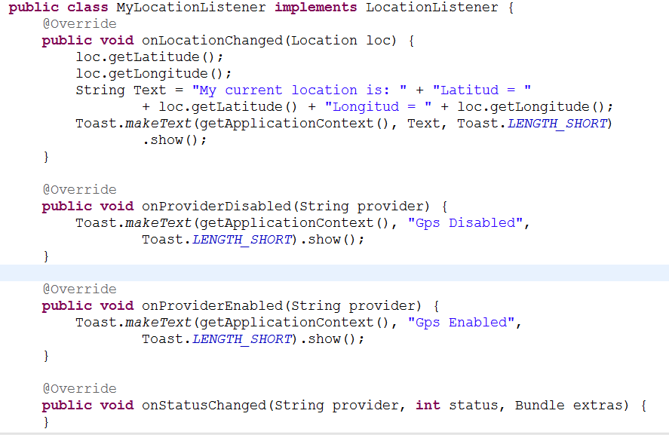
On Location Update
onProviderDisabled (GPS Off)
  onProviderEnabled (GPS On)

Slide 9

Modify the AndroidManifest.xml File
Enter the following lines before the application tag:

Slide 10
Getting Location
New location
Is Better Location?
(New, old)
Use old location
No
Yes
Is GPS Provider?
Yes
No
Location with
Green Background
Location with
Yellow Background
Display Current Location

Slide 11
Current Location
Network:
GPS:

Slide 12
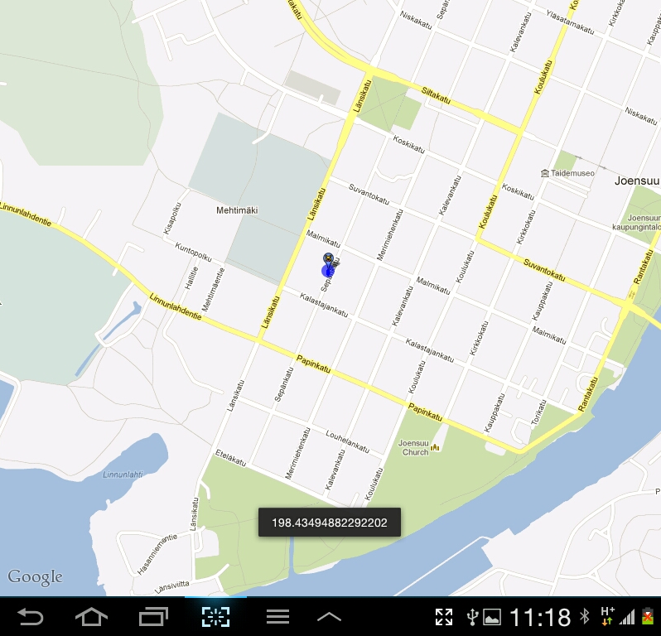
Selecting location
old but accurate or new but inaccurate?
Accuracy
×
×
Old
location
New
location

Slide 13
Google Map
  Google API as the project build target
  Map API Key in order to be deployed

Slide 14
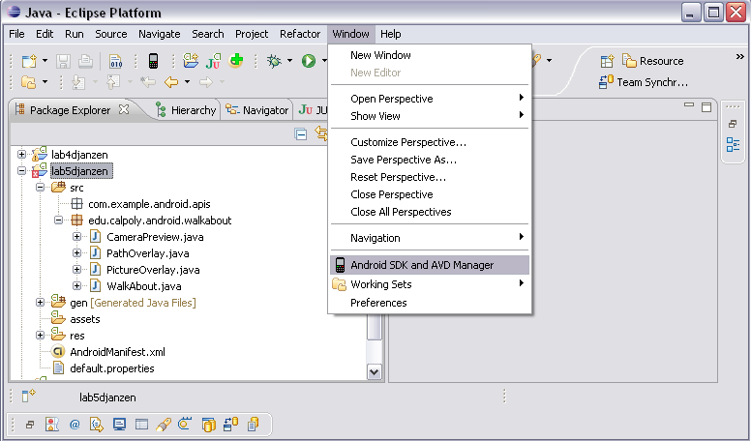
Add Google API in Eclipse
http://developer.android.com/sdk/adding-components.html

Slide 15
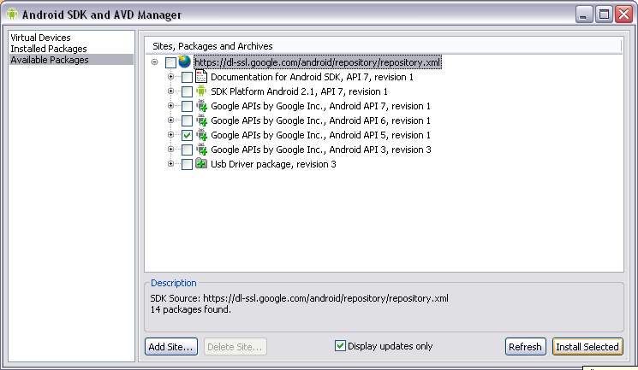
Add Google API in Eclipse
Use API 4 for SDK 1.6
  http://developer.android.com/guide/appendix/api-levels.html

Slide 16
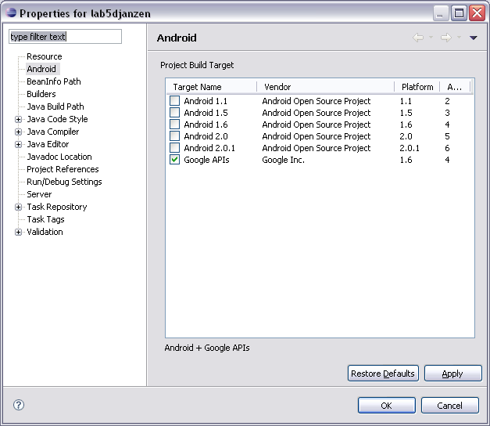
Add Google API in Eclipse
Set Google API as the Project Build Target
  Right-click on the project, select Properties

Slide 17
Get Google Map API Key
Use following link get Google map API key:
http://mobiforge.com/developing/story/using-google-maps-android

Slide 18
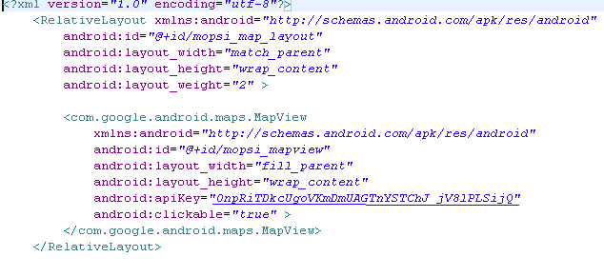
Add API key in MapLayout .xml file
API KEY

Slide 19
Map Services
Provided by an external library:
  Include the com.google.android.maps package.
Modify the AndroidManifest.xml:

Slide 20
Map Activity and Map View
Map Activity
  Maps API add-on provides a Map Activity class
  Helps managing the Map functions using Map View
Map View
  Basic functionality of map controller
  Zooming and panning

Slide 21
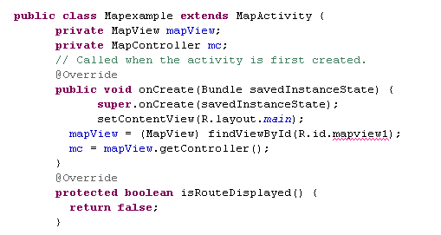
Map Activity And Map view
Provides map functionality
Control map by program
Display map
Control map

Slide 22
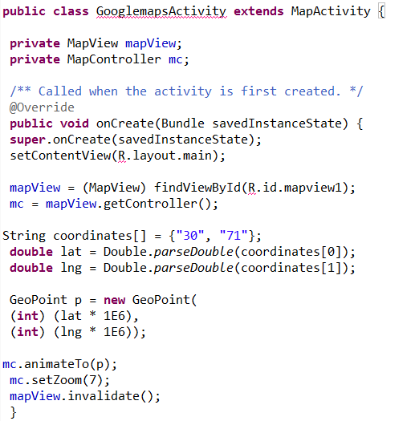
Map Activity And Map view
Provides map functionality
Control map by program
Display map
Generate geo points using latitude and longitude
Animate map
to given location

Slide 23

Example

Slide 24
Test on emulator
To test in Eclipse:
→ Switch to DDMS view.
→ Find the location controls in the Emulator Control tab.
→ Click the GPX tab and click Load GPX.
→ Locate and select the GPX file.
→ Click Play to begin sending coordinates to the Emulator.

Slide 25
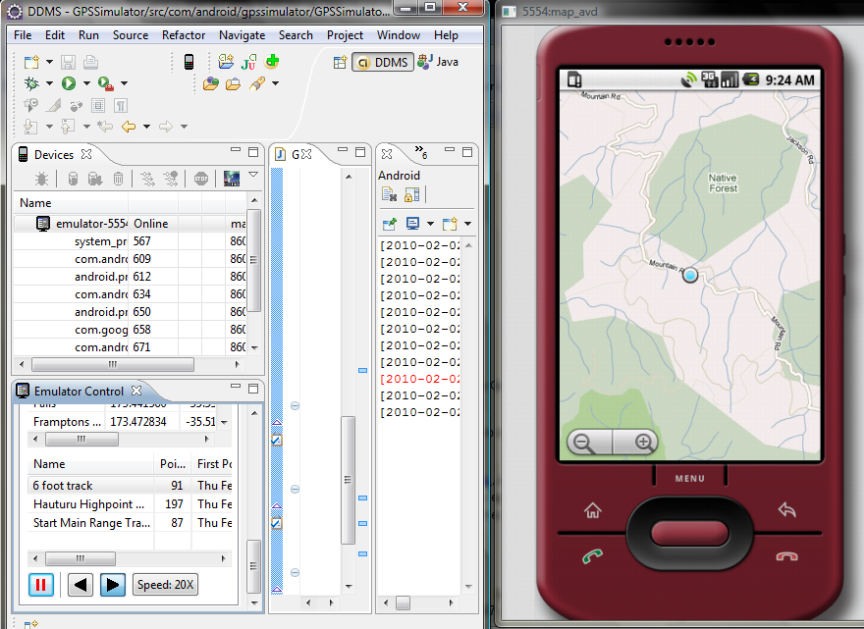
Test on emulator

Slide 26
Questions?

