Slide 1
Clustering of location-based data
Mohammad Rezaei
May 2013

Slide 2
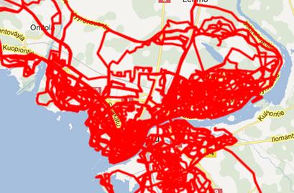
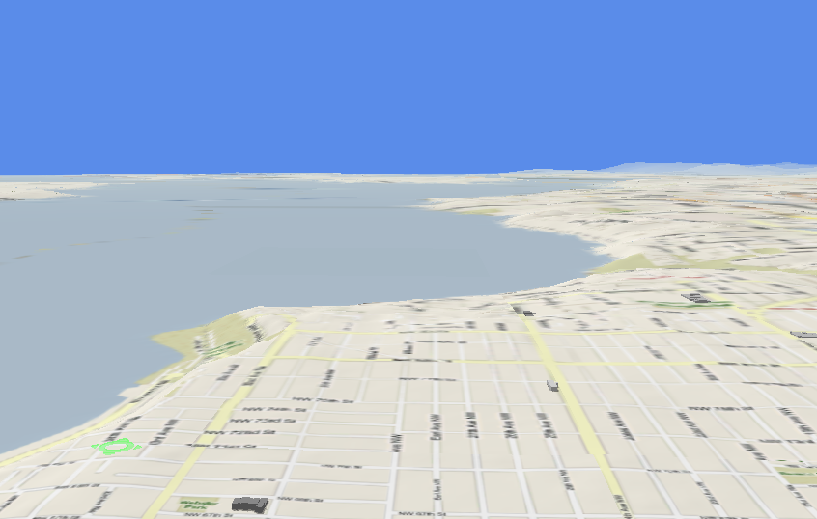





Data mining and Clustering
- Huge amount of location-based Data
- Need for mechanisms to extract knowledge
- Clustering as an important field in spatio-temporal data mining

Slide 3
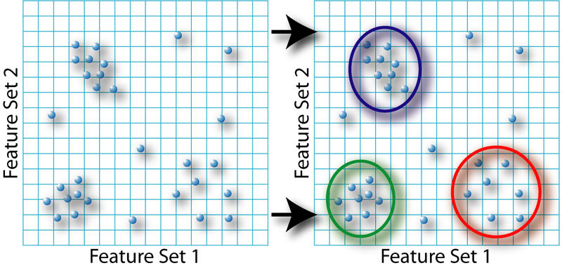
Clustering

Slide 4
Some applications
Routing
Interesting places
Recommendation of services
Marketing management
Users with same interests
Visualization

Slide 5
Clustering Problems in Mopsi
  Clutter of markers on the map
  Similar services or photos in a list
  Categorization of services
  Distribution of users’ locations
  Timeline view of photos
  Clustering of events

Slide 6
Clutter of markers

Slide 7
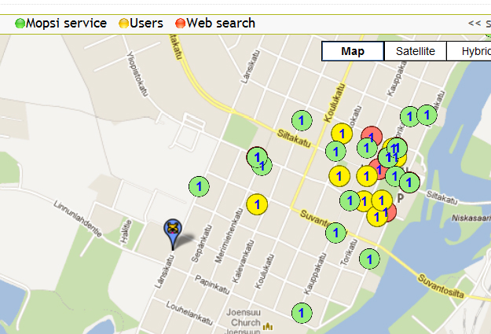
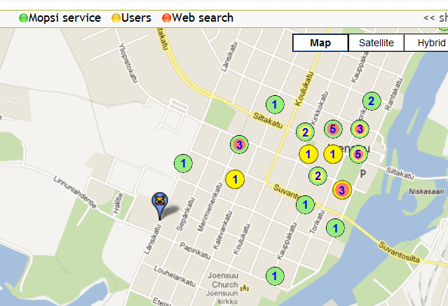
Search results
Clustering

Slide 8
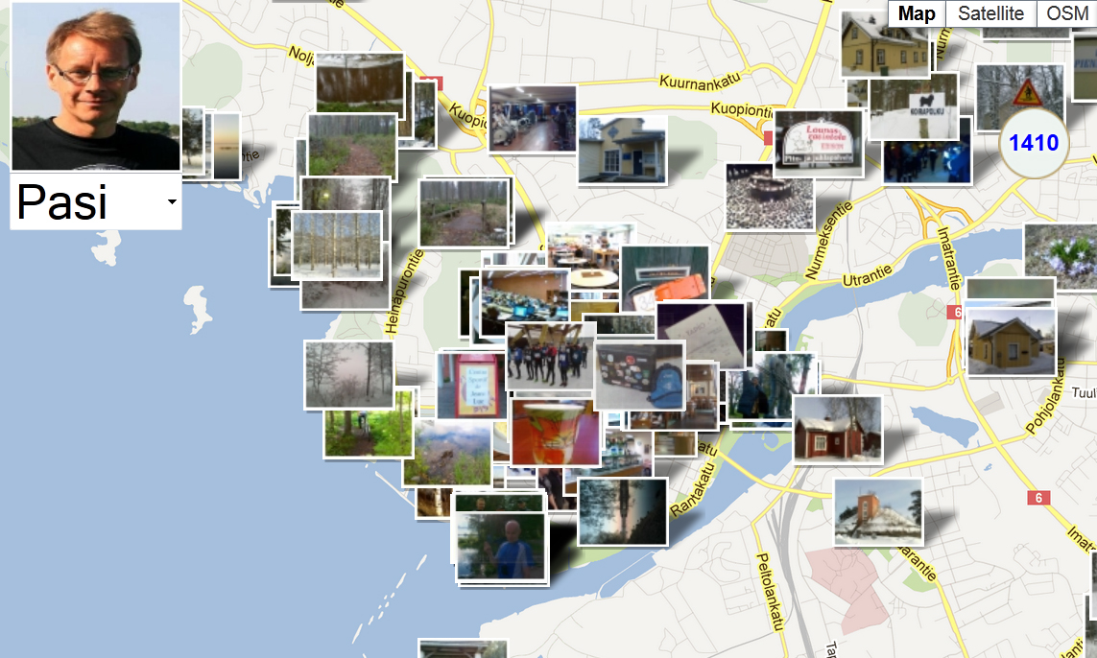
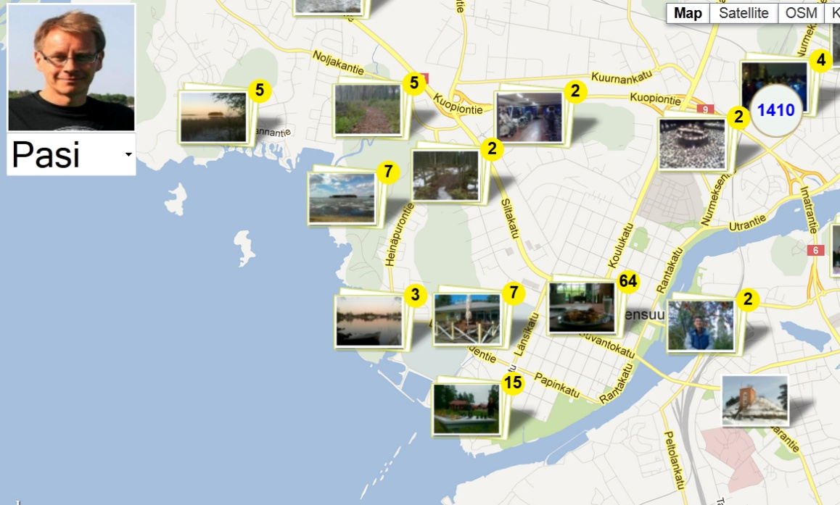
Photos

Slide 9
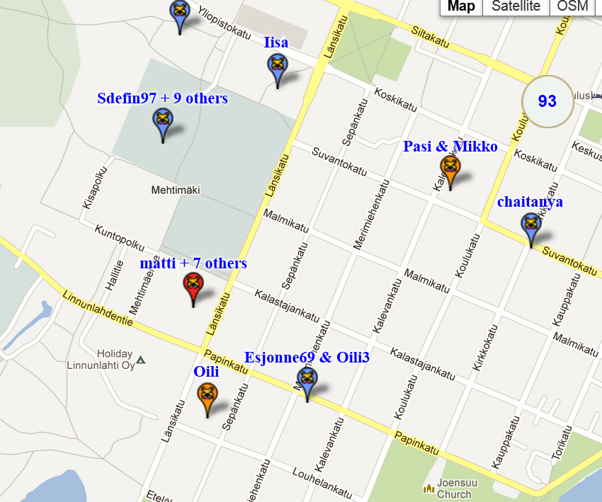
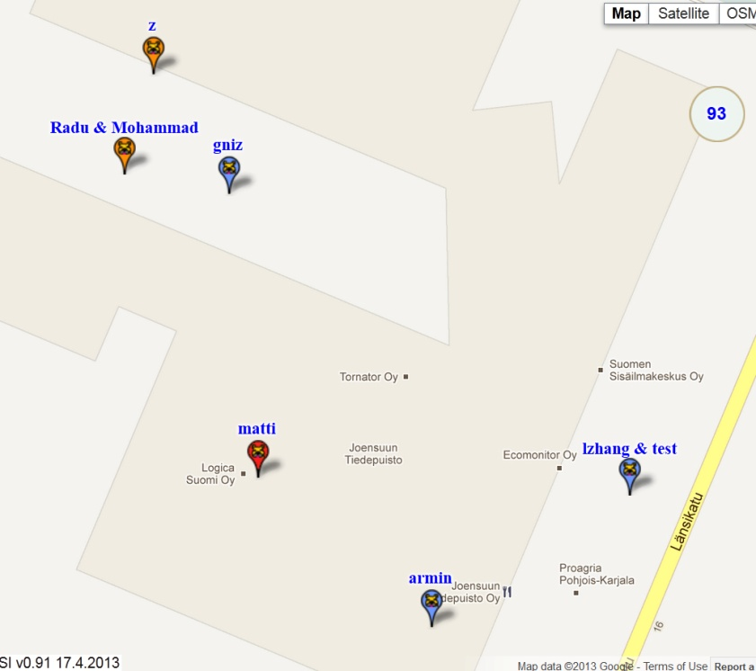
Users

Slide 10
Solutions
Grid based clustering
Distance based clustering

Slide 11
Google Maps version 3.0
Using location in pixels for grid-base clustering
22 zoom levels
256*256 in zoom level 0 to 536870912* 536870912 in zoom level 21
≈ 60*10¹² cells in the zoom level 21 with cell size(60,80)

Slide 12
Some issues
Photos are added or deleted dynamically
Querying for a certain time, certain user or according to photo description
Different zoom levels, moving map

Slide 13
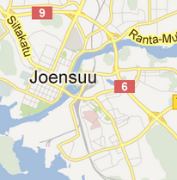
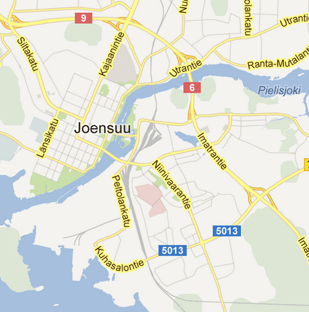
Hierarchical Clustering on server

Slide 14
Hierarchical Clustering on server
Individual clustering for different zoom levels
Clustering of whole data
How to extract clusters for a specific query?
Are clusters for a lower zoom level can be derived from higher level?

Slide 15
Client side clustering
Query from server (Resulting N objects)
Take the zoom view
Not too many cells
Taking objects in the zoom view and do clustering only for them (M objects)
It takes O(N) to find out the objects in the zoom view!

Slide 16
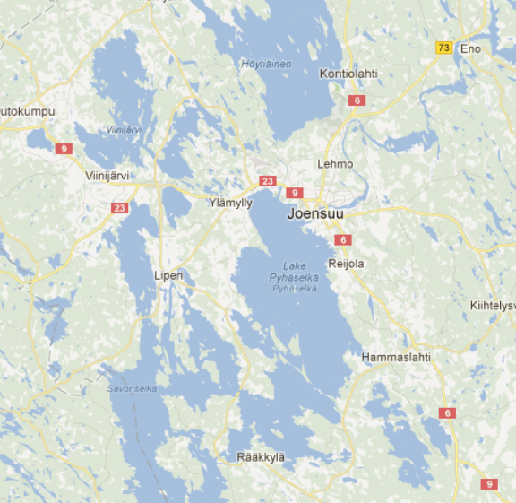
Grid based clustering
Input
  location (lat, lon) of markers
  Width and height of markers (H_{m},W_{m})
  Width and height of cells in the grid (H, W)
Output
Location of clusters
W
H
W_{m}
H_{m}
Location of the marker

Slide 17
Representation - Middle of cell
-No overlap
-Locations can be misleading

Slide 18
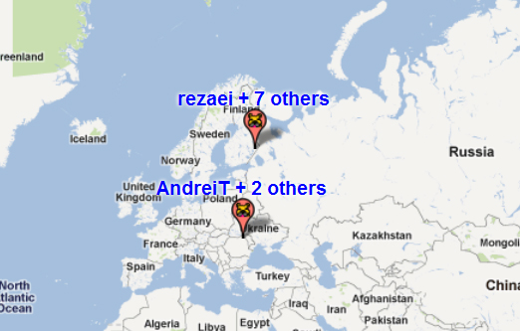
Representation- First object

Slide 19
Representation – Average Location

Slide 20
Proposed approach
Grids start from beginning of the whole map
Extend the grid in current zoom view
By moving map clusters do not
change
Average location for representative
By moving map clusters
do not change
(x_{min}, y_{min})
W
H
(x_{max}, y_{max})

Slide 21
Algorithm
(x_{min}, y_{min})
1
2
3
4
5
nRow = ceil((x_{max}-x_{min})/W)
nColumn = ceil((y_{max}-y_{min})/H)
nCell = nRow * nColumn
Clusters = all cells // empty clusters
For all the markers
row = floor((y-y_{min})/gridHeight)
column = floor((x-x_{min})/gridWidth)
cellNum = row*nColumn + column
Add the marker to Clusters[cellNum]
Update the cluster: Clusters[cellNum]
1
2
3
4
5
1
W
2
6
H
7
8
9
10
3
11
4
18
19
20
5
25
(x_{max}, y_{max})
(x,y)
Cell number

Slide 22
Merging algorithm- Average location as representative
MergeClusters(clusters)
change the order of clusters descending according to the size of clusters
set parent of each cluster, the same cluster
k=1 (K is number of clusters)
while (k < K )
if ( k is not “processed” )
checkNeighbors(k);
mark the cluster k “processed”
k=k+1
CheckNeighbors(k)
cluster1=clusters[k]
For all 8 neighbors
cluster2 = one of the neighbors //
if cluster2 is not an empty cell
checkNeighbor(cluster1, cluster2)

Slide 23
Merging algorithm
checkNeighbor(cluster1, cluster2)
find the distance d between the two clusters
if d<T // distance threshold T
while ( cluster2 is “processed” ) // means it has been merged
cluster2 = clusters[cluster2.parent]
MergeClusters(cluster1, cluster2);
MergeClusters(cluster1, cluster2)
n1 and n2: size of the clusters
(x1,y1) and (x2,y2): location of clusters
x=(n1*x1+n2*x2)/(n1+n2)
y=(n1*y1+n2*y2)/(n1+n2)
x1 ← x and y1← y
mark the second cluster “processed”
cluster2.parent = k

Slide 24
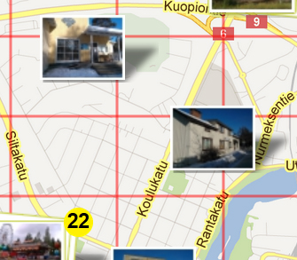
Grid based clustering
Width and height of a cell
H>H_{m} and W>W_{m}
Minimum distance of the markers to avoid overlap
W_{m}
H_{m}
Marker
d
Location of marker

Slide 25
Distance based clustering
Input
  location (lat, lon) of markers
  Width and height of markers (H_{m}, W_{m})
Output
location of clusters
Time complexity: O(N²)

Slide 26
Algorithm
i= 0;
While (i<N) // N=number of markers
if ( marker i is not clustered )
Label marker i as clustered
Calculate distance (d_{j}) to other non-clustered markers
for all markers j
If d_{j}<T // T: distance threshold
merge the markers i and j
Label marker j as clustered
i = i+1;

Slide 27
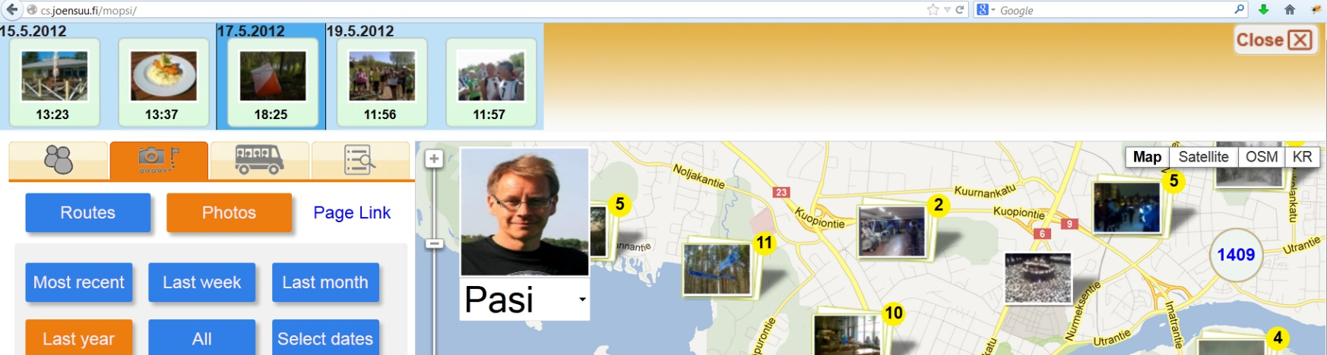
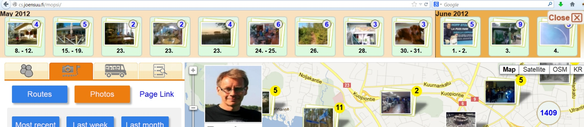
Timeline view of photos
Displaying n photos in a limited space

Slide 28
Timeline view of photos
Input
Timestamps
Number of clusters
Output
Partitions
Algorithm
K-means

Slide 29
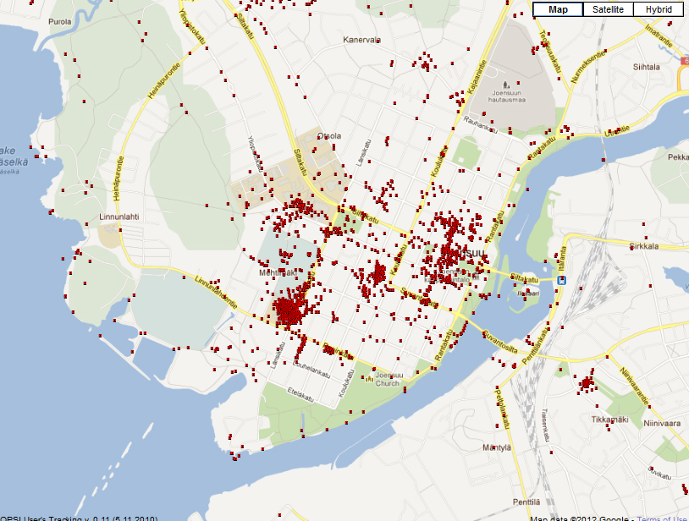
Location clusters
Swim
hall
Walking
street
Market
place
Science
park
Homes
of users
Shop

Slide 30
Clustering of trajectories

Slide 31
Similarity or distance
Start and end of the routes

Slide 32
Similarity or distance
Speed, length, accelaration, time, etc
30 km/h
70 km/h
72 km/h
50 km/h
60 km/h
These two routes are more similar in speed than others

Slide 33
Similarity or distance
Closeness of points and shape
(Comparing whole route or segments of the routes)
t1
t2
T1
t3
t4
t7
t5
t6
t8
T2
Closest pair distance
t1
t2
t3
t4
t1
t2
t3
T1
t4
t7
t5
t6
t8
T2
t1
Sum of pair distance
t2
t3
t4

Slide 34
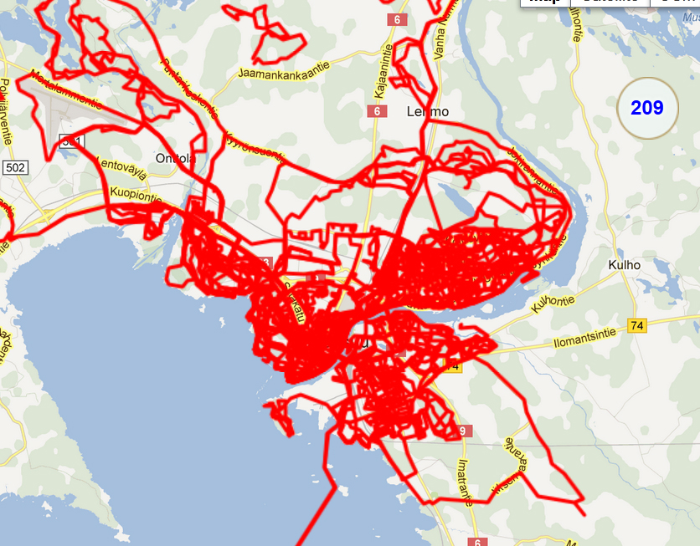
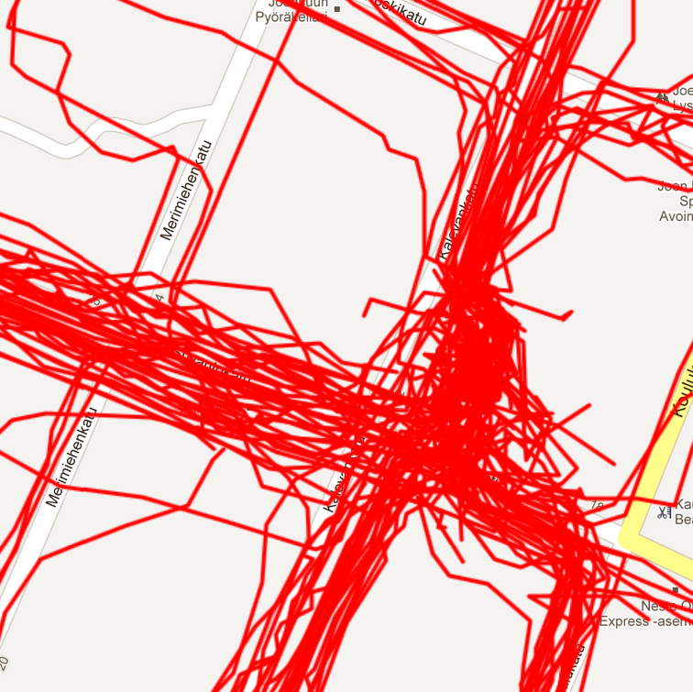
Cluttering problem for routes

