Slide 1
Platform Independent Frameworks
31.03.2013

Slide 2
Contents
Mobile App Developer’s challenges
Platform Independent solutions
Mobile Web Based Apps
Cross Platform Mobile Tools (XMT)
Mobile Web Based Apps
Cross Platform Mobile Tools (XMT)
XMT Case Study: Location Aware App using Cordova
Architecture
Installation
Development
Deployment

Slide 3
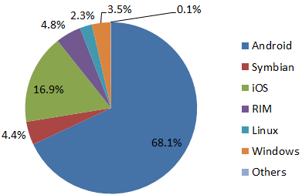
Mobile App Developer’s Challenge
Reaching large number of users in diverse and continually evolving Mobile OS (MOS) landscape
1996
1999
2000
2007
Palm OS
RIM Blackberry
Symbian
Apple iOS
2008
Android
2009
Palm Web OS
Bada
2010
Windows Phone OS
1997-1998
2001-2006
2011
MeeGo
Year of release of MOS used popularly for app development today
Src: Mobile operating system, Wikipedia
Not sufficient to build only for one platform.
E.g.: From 2012 Market share, it would be wise to target Android, iOS, RIM and Windows users.
Market Share 2012

Slide 4
Multi Platform Challenge
Difficulties of developing for so many platforms
Time consuming.
Requires detailed knowledge of each platform.
Develop familiaritiy with different development environments.
Increased development costs.

Slide 5
Platform Independent Solutions
Mobile web apps
Apps in which all or some parts of software (including UI) downloaded from the Web each time it is run.
Cross-platform mobile development tools (XMTs)
Tools to build native apps for deployment on different platforms with minimal customization for each platform.

Slide 6
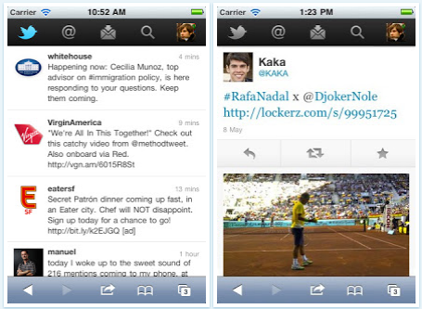
Mobile Web Apps
All or some parts of software downloaded from the Web each time it is run.
Accessible from all Web-capable mobile devices.
Programmed in browser rendered language like HTML, Javascript .
Example : Twitter
Twitter Mobile Web App
Src: Twitter web app announcement

Slide 7
Mobile Web App Vs Native App
 | Mobile Web App | Native App
Deployment | Accessed via mobile browser. No new software. Page loaded on user request. All users on same version. | Downloaded onto mobile device. Runs as standalone. Users can choose version.
Development | Common code base across platforms. E.g.HTML5 / Javascript / CSS3 and similar web technologies. Can’t access all of device’s features (yet). | Each platform uses different programming language. E.g. Java for Android, Objective-C for iOS. Better integration with platform features and hardware like standard widgets, camera, GPS.
Performance | Slower due to content and UI fetch with every request. Slightly alleviated with offline caching. | Faster as UI already downloaded.
App Search | No easy means for app search. | Marketplaces to help find app.
Monetization | Requires paywall or subscription set up. | Handled by platform’s app store.
Ref: Native app Vs Mobile Web App

Slide 8
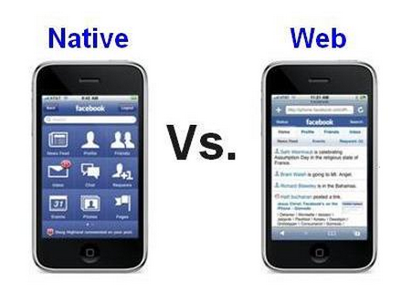
Mobile Web Apps
Example : Facebook
Src: Webfirst.com

Slide 9
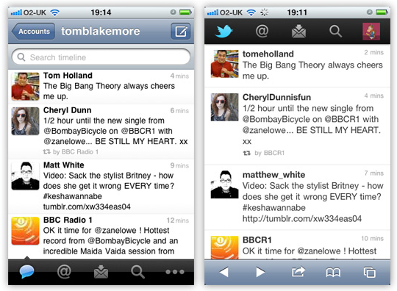
Mobile Web Apps
Example: Twitter
Src: Acknowledgement.co.uk

Slide 10
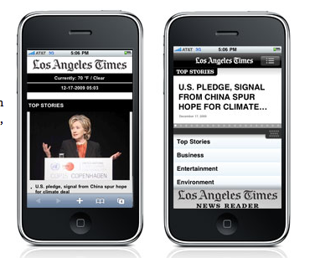
Mobile Web Apps
Example: L.A. Times
Src: LATimesBlog

Slide 11
Future of Mobile Web Apps
“Medium to large publishers to place equal focus, particularly those in news and sport categories.”
- Study by Global Intelligence Alliance
Recommended literature:
Native or Web Application?
White paper by Global Intelligence Alliance

Slide 12
Cross-Platform Mobile Dev Tools (XMT)
XMTs are tools that aim to develop apps deployable on multiple platforms with very little code change.
Popular XMT vendors
PhoneGap Acquired by Apache as Apache Cordova
RhoMobile Developed by Motorola Solutions
Titanium Developed by Appcelerator

Slide 13
Comparison of Top 3 XMTs
 | Programming Language | GUI Designer | Debugger | Emulator
Apache Cordova | HTML, Javascript, Native code for further extensibility (i.e. Java for Android, Xcode for iOS) | No | No | Platform SDK
RhoMobile | Ruby, Native code for further extensibility | No | Yes | Own
Appcelerato Titanium | HTML, Javascript, Ruby, PHP, Python, Native code for further extensibility | No | Yes | Platform SDK

Slide 14
XMT App Vs Platform Specific App
 | XMT Native App | Platform Specific Native App
Deployment | Reduced deployment cost. Faster deployment across platforms. | Increased cost to build app for each platform.
Development | Most XMTs use web scripting languages like HTML5 and Javascript that are widely used. Might not support all features provided in native platform. Inefficient coding and bloated code due to developer not availing of optimization in native code. | Each platform uses different programming language. E.g. Java for Android, Objective-C for iOS. Better integration with platform features and hardware like standard widgets, camera, GPS.
Performance | Possibly slower compilation and rendering due to churning out code compatible with platform. | Faster.

Slide 15
Demo using Cordova
Build location aware system using Apache Cordova (formerly PhoneGap) for Android.
Architecture
Set up
Development
Deployment

Slide 16
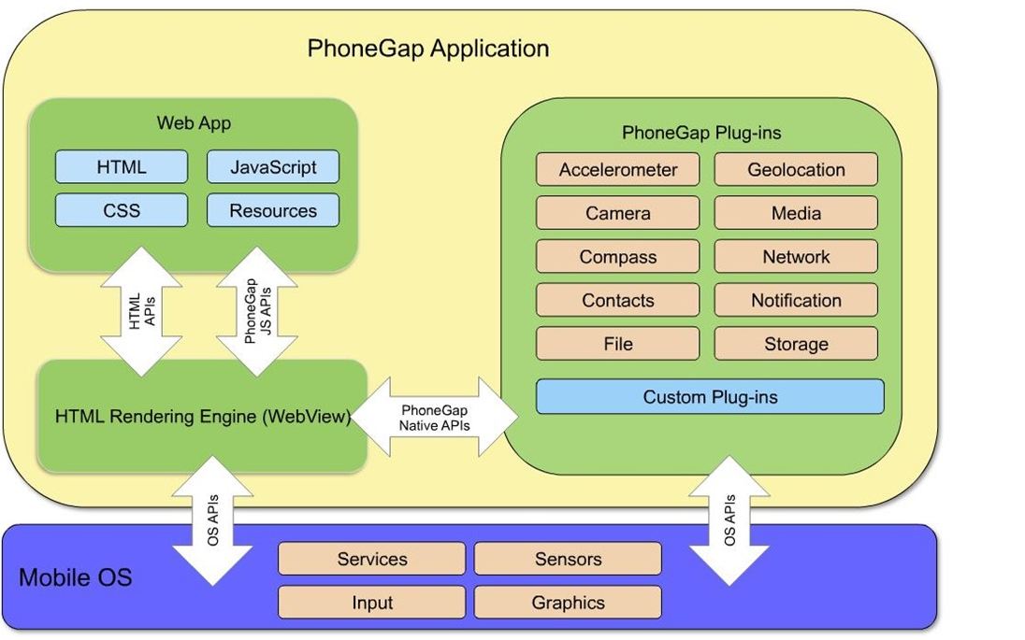
Cordova (PhoneGap) - Architecture
Src: By IBM

Slide 17
Cordova (PhoneGap) - Architecture
Every cordova application has the following components
UI Layer in HTML/CSS/Javascript (JS)
Bridge between JS and Native code allowing communication from HTML application and native platform.
Bridge between Native code and JS allowing communication from native platform and HTML application.

Slide 18
Cordova - Installation
Set up Eclipse and Android Tools as previously instructed.
Download latest copy of Cordova and extract contents.
http://phonegap.com/download/

Slide 19
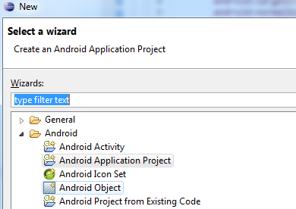
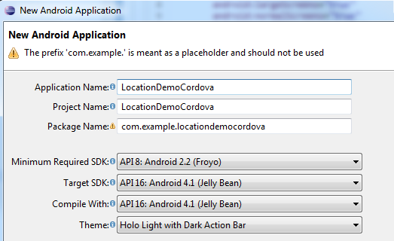
Cordova - Development
Create new Android project in Eclipse.
New -> Other ->
Enter application details as shown.

Slide 20
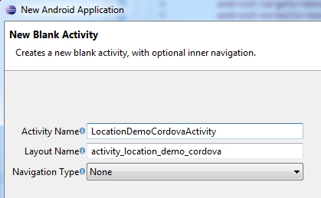
Cordova - Development
Click Next in subsequent screens till New Blank Activity Screen.
Enter Activity name.
Click Finish.

Slide 21
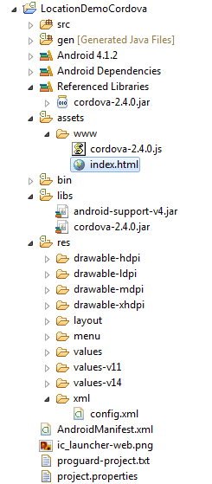
Cordova - Development
Copy cordova-2.4.0.jar from installed copy to /libs.
Copy cordova-2.4.0.js from installed copy to /assets/www.
Copy xml directory from installed copy to /res.
Create index.html under /assets/www.

Slide 22
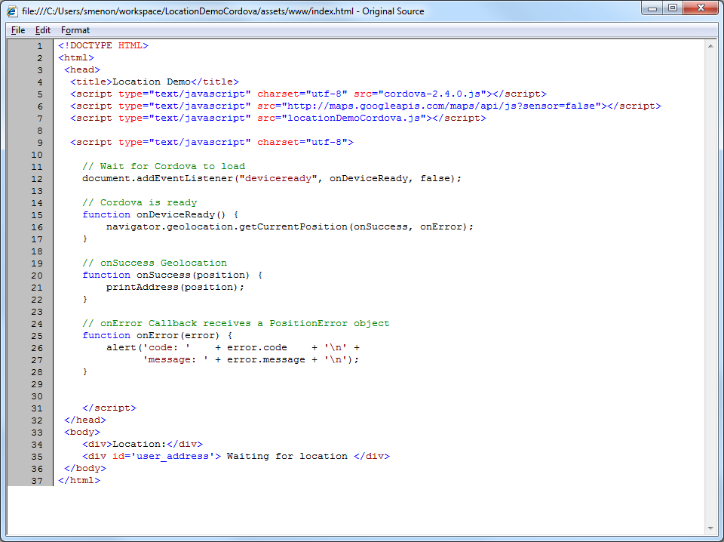
Index.html Sample Code
Students encouraged to write their own logic. This is only for reference.

Slide 23
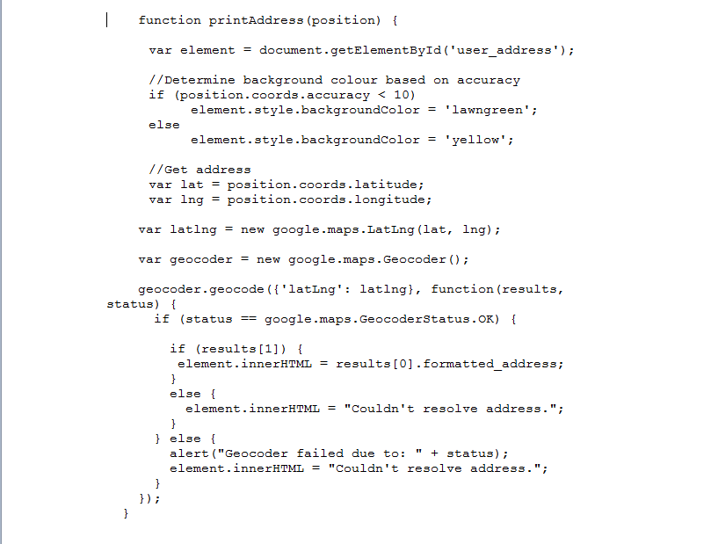
Index.html Sample Code

Slide 24
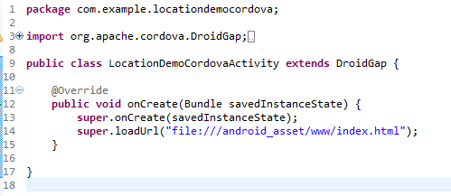
Cordova - Development
Modify newly created class LocationDemoCordovaActivity.
Extend DroidGap provided by Cordova framework. This is main Android Activity class that is used to launch the specific html file.
Layout is specified in html and loaded with loadUrl instead of Android’s setContentView()

Slide 25
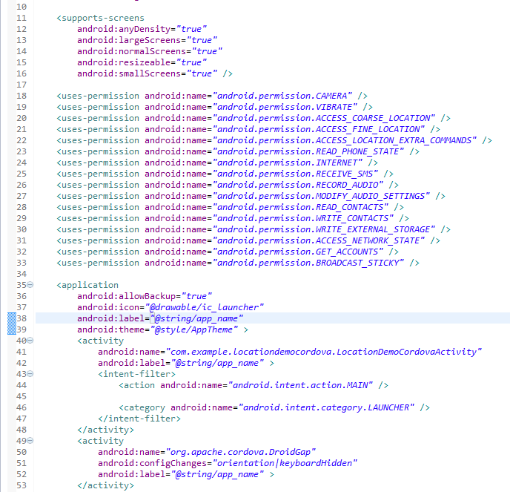
Cordova - Development
Copy the permissions required by Cordova.

Slide 26
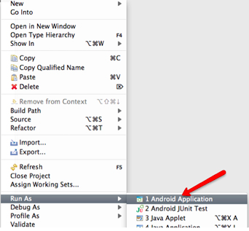
Cordova - Deployment
Run as Android Application from Eclipse

Slide 27
Cordova Output

Slide 28
References
Mobile web application Best Practices
Native vs Mobile App Comparison
Tips to build mobile web apps the right way
MobiThink-Native vs Web Apps
Cordova guide
Cordova tutorial

Slide 29
Thank You!

