Slide 1
Server - Client Communication
8.4.2013

Slide 2
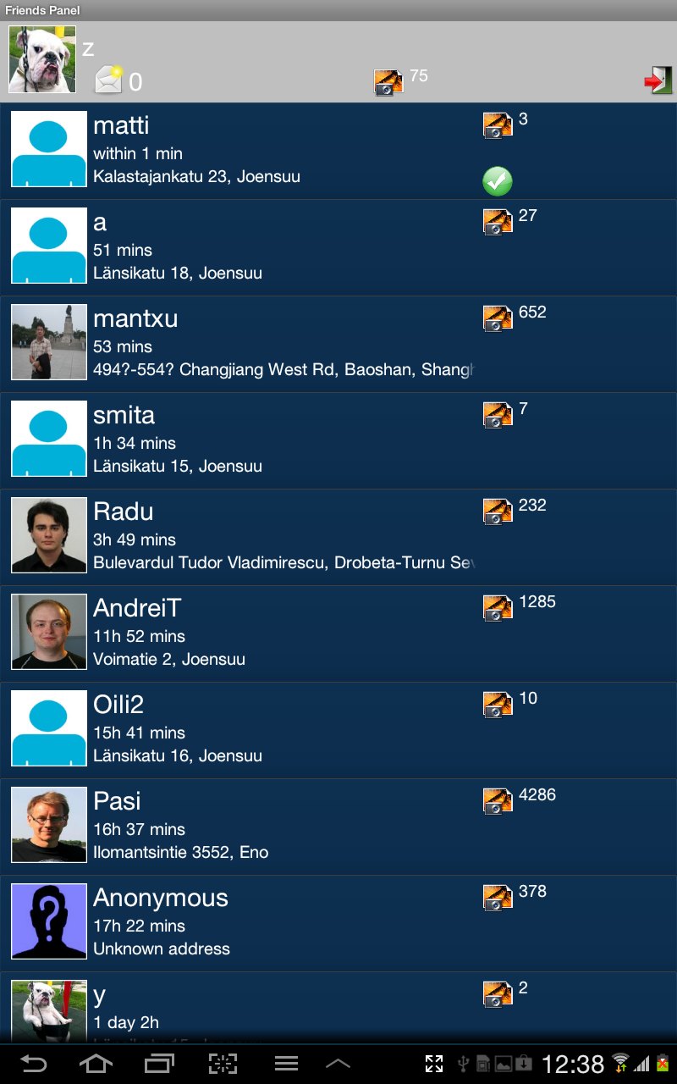
Getting data from server

Slide 3
Required permissions
To access the Internet your application requires
android.permission.INTERNET
To check the network state your application requires android.permission.ACCESS_NETWORK_STATE

Slide 4
Network on Android
Network java.net package contains
HttpURLConnection class including
Apache HttpClient library

Slide 5
Apache HttpClient library
A client-side HTTP transport library
Purpose
to transmit
receive HTTP messages
server-client communication

Slide 6
Apache HttpClient library
User Provide a request object
Http Client
send request to the target server
return a corresponding response object
or throw an exception if execution was unsuccessful
one or several HTTP request / HTTP response

Slide 7
Introduction to JSON
JavaScript Object Notation
Independent data exchange format
Limited to text and numeric values
Binary values are not supported

Slide 8
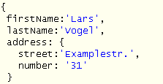
JSON
An JSON object is a set of key (string) / value (string/numerical) pairs which starts with "{" and ends with "}"

Slide 9
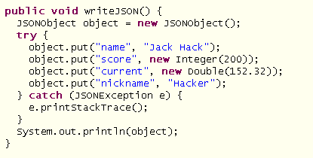
JSON
Android includes the
json.org libraries
Writing JSON is very simple
Just create the JSONObject
Use the toString() method
Work easily with JSON files

Slide 10
Steps
Request Object from user
Send Request to Server
Create JSON array
Getting response from server
Display Response in String format

Slide 11
Flow
1. Send request to server
2. Request Object from user
Request Object
3. Creat JSON array
JSON array
4. Getting response from server

Slide 12
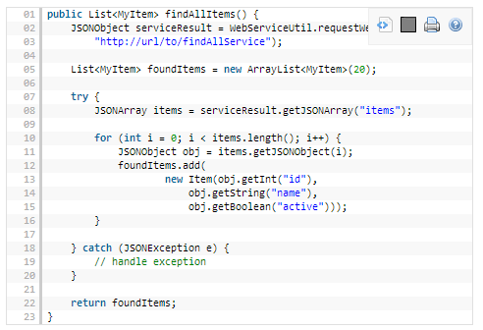
Parsing JSON

Slide 13
Result data from server

Slide 14
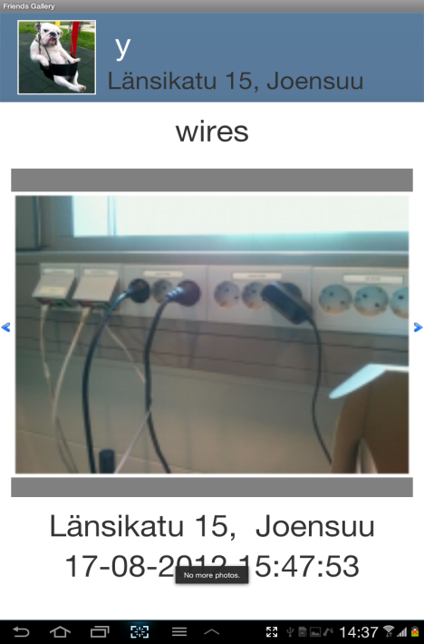
Display Image from server

Slide 15
Display Image from link
Link (String)
Convert string to URI
Send Request to server and Receive response
HttpEntity , BufferedHttpEntity:
Bitmap factory
Display Image

Slide 16
Display image from link
1. Convert string to URI
2. Send Request to server and Receive response

Slide 17
Display image from link
3. HttpEntity: Get http message in streamed form
4. BufferedHttpEntity: Used to save content of entity
5. Bitmap factory : Creates Bitmap objects from various sources, including files, streams, and byte-arrays

Slide 18
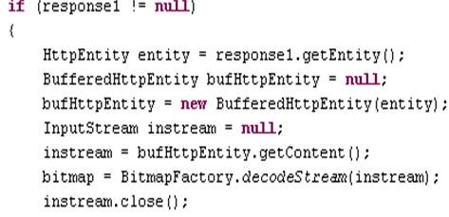
.

Slide 19
Result

