Slide 1
Database for Location-Aware Applications
Mohammad Rezaei
School of Computing
University of Eastern Finland
8.4.2013

Slide 2
Outline
Introduction to spatial database
MySQL and spatial data
Modeling
Querying
Indexing

Slide 3
Spatial Database
Database that:
Stores spatial objects
Manipulates spatial objects

Slide 4
Spatial data
Data which describes location or shape
Buildings
Roads
Rivers
Pipelines
Power lines
Forests
Parks
Lakes

Slide 5
Why spatial database?
Standard database issues for spatial data
Excessive amounts of space
Long queries
Spatial databases
Efficient storage and retrieval
Analysis of spatial data

Slide 6
Spatial data
Entities are represented as
Points
Lines
Polygons

Slide 7
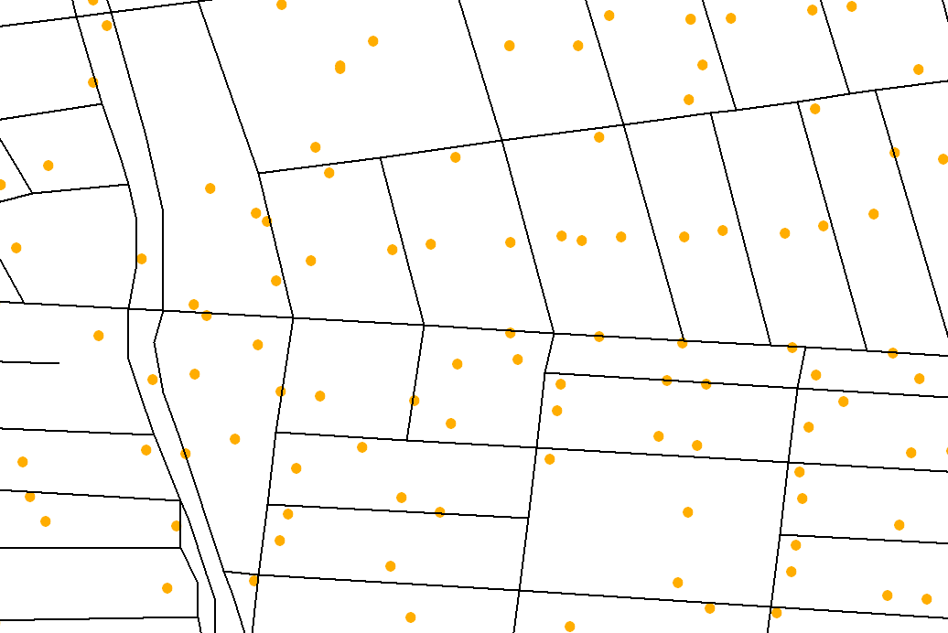
Roads are represented as Lines Mail Boxes are represented as Points

Slide 8
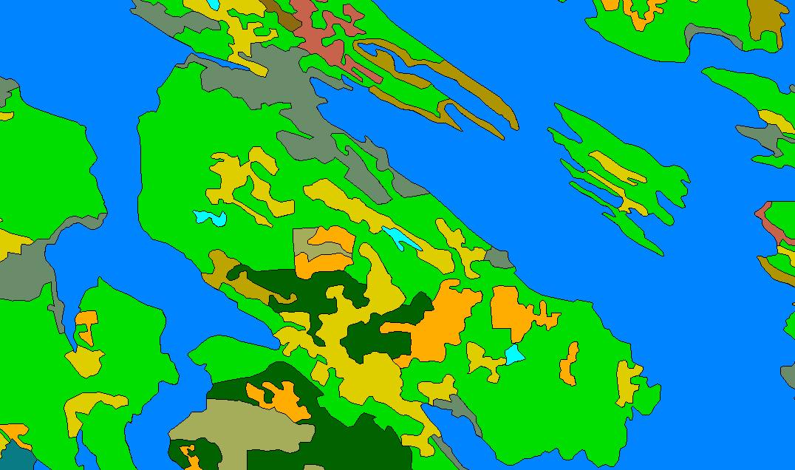
Topic Three
Land Classifications are represented as Polygons

Slide 9
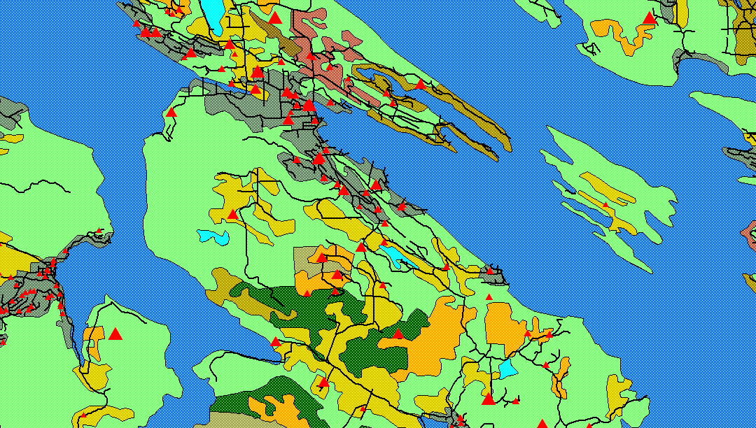
Topic Three
Combination of all the previous data

Slide 10
Spatial relationships
Topological relationships: adjacent, inside
Direction relationships: above, below
Metric relationships: distance

Slide 11
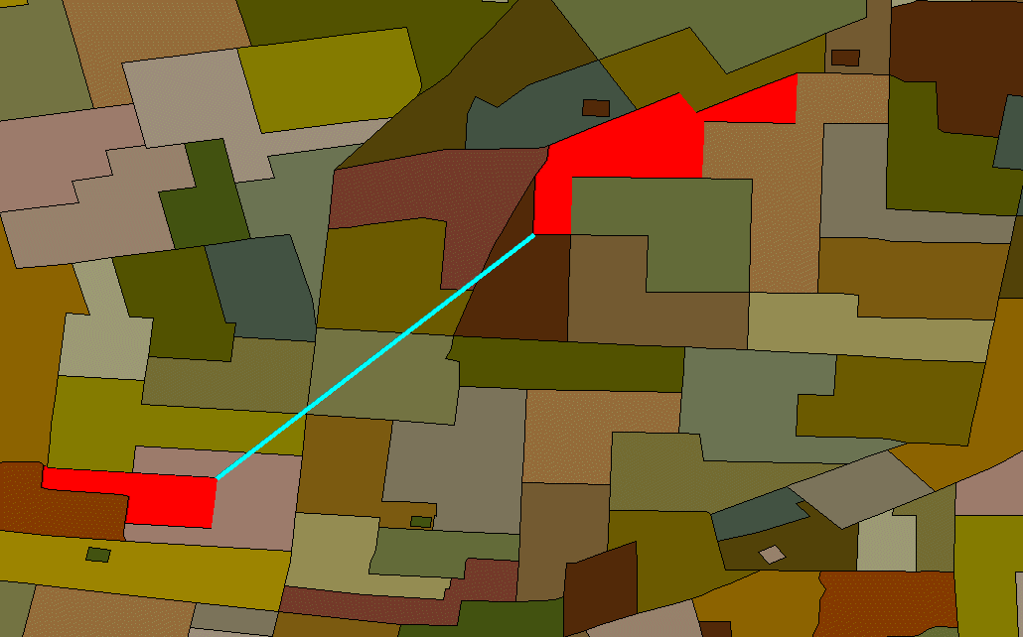
Spatial Relationships
Distance between office and shopping centers

Slide 12
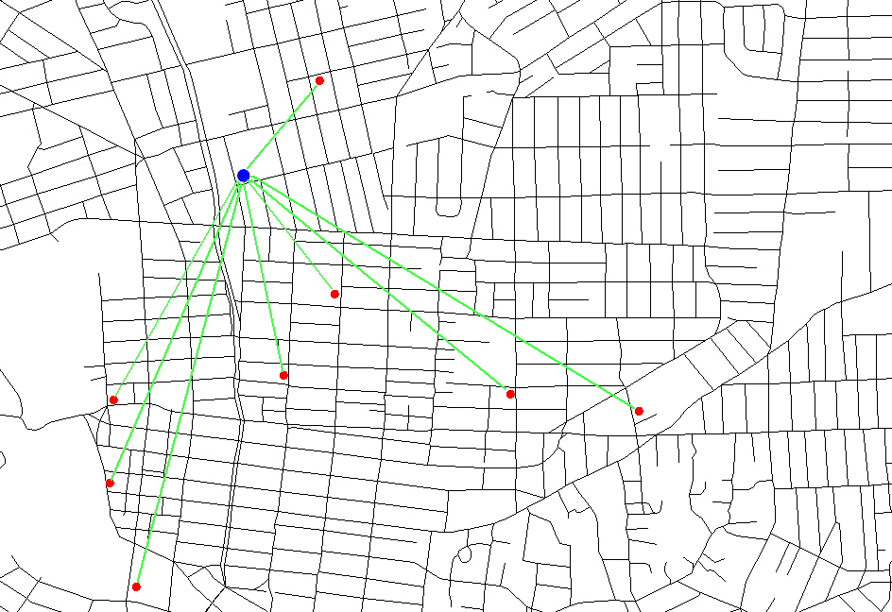
Spatial Relationships
Distance to various pubs

Slide 13
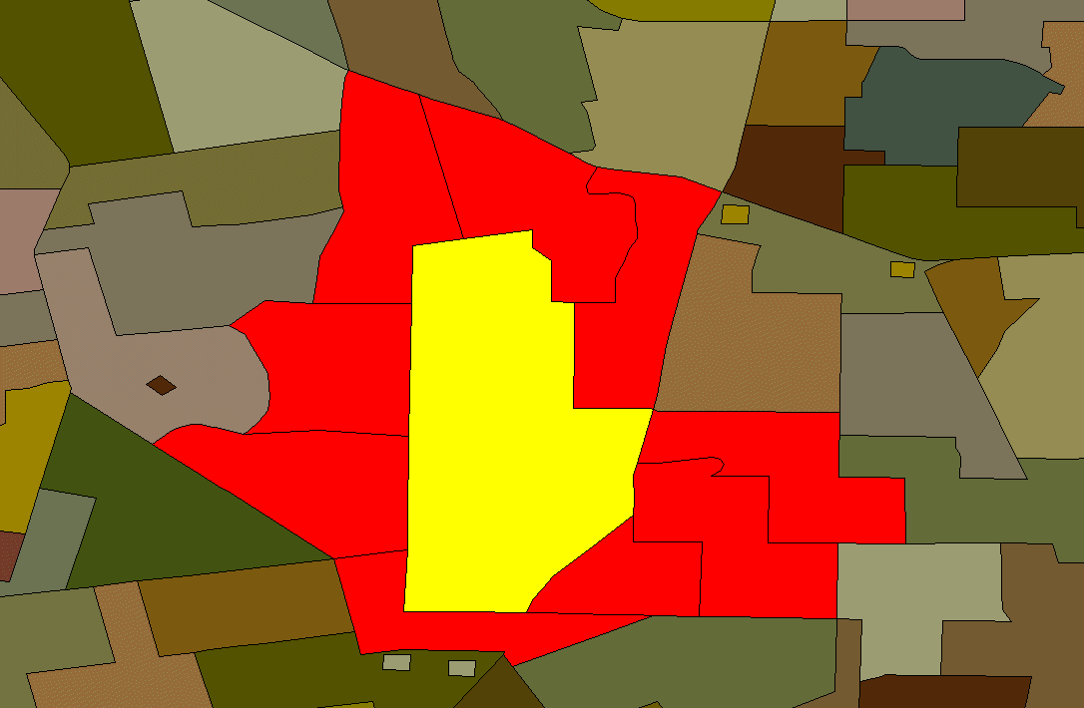
Spatial Relationships
Adjacency: All the lots which share an edge

Slide 14
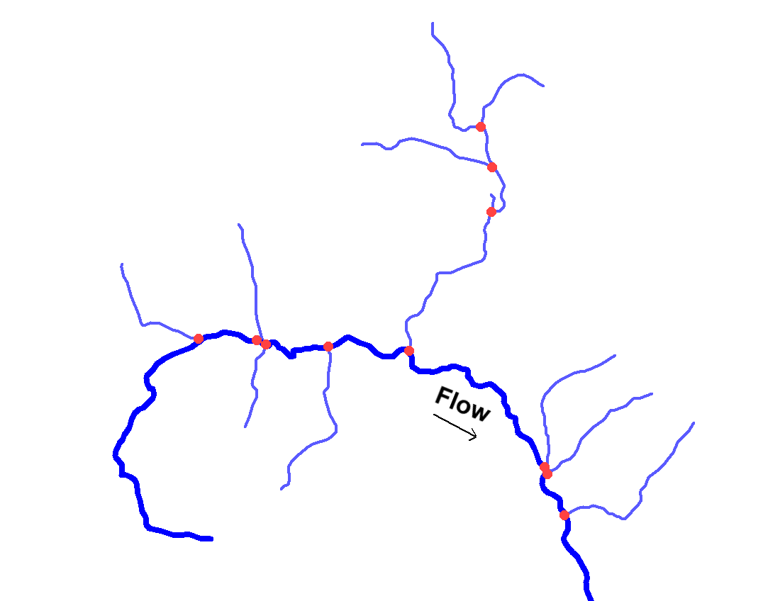
Connectivity: Tributary relationships in river networks

Slide 15
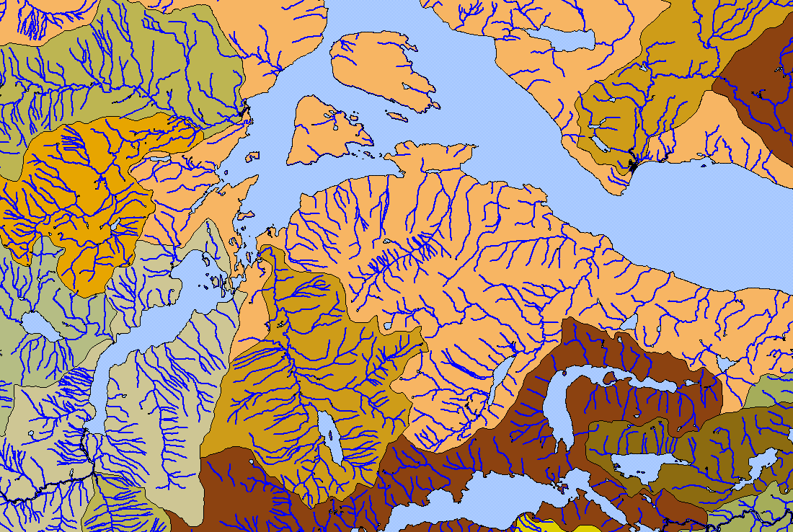
Spatial Relationships
Containment: Rivers inside watersheds and land (islands) inside lakes

Slide 16
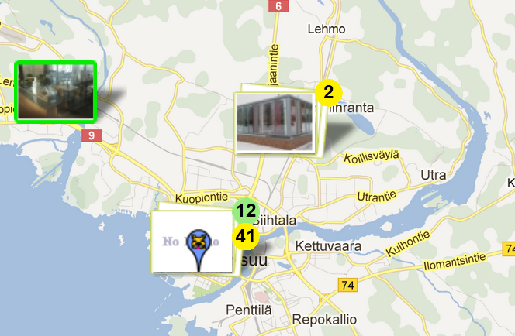
Spatial data in Mopsi
Local service
Photo
User’s location
Bus stop
Route or trajectory
Point
http://cs.uef.fi/mopsi

Slide 17
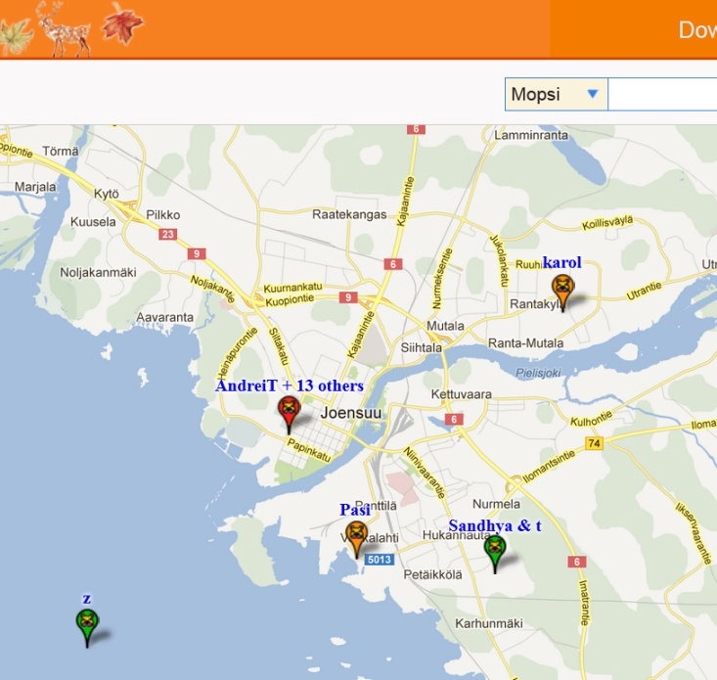
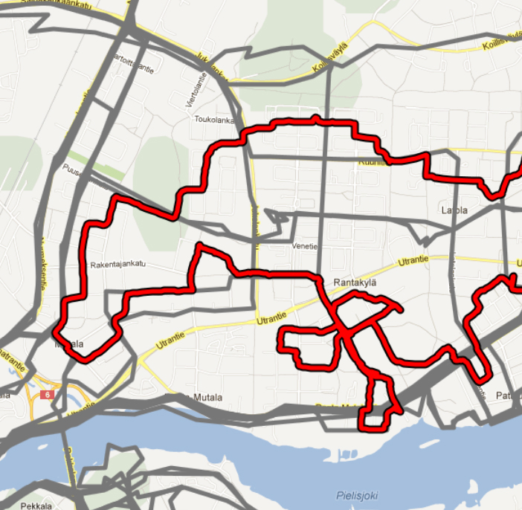
Spatial data - examples
Point: (Lat, Lon, Time)
Trajectory: {(Lat, Lon, Time)}

Slide 18
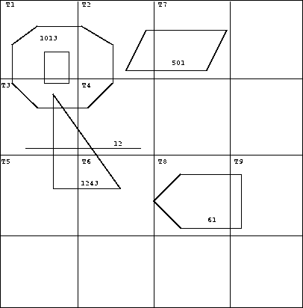
Spatial relationships
EXT = {lines, regions}
GEO = {points, lines, regions}
Relationship | Inputs | Output
inside | geo, regions | bool
intersect, meets | ext1, ext2 | bool
adjacent, encloses | regions, regions | bool
intersection | lines, lines | points
intersection | regions, regions | regions
plus, minus | geo, geo | geo
contour | regions | lines
dist | geo1, geo2 | real
perimeter, area | regions | real

Slide 19
spatial operations
Area
Length
Intersection
Union
Buffer

Slide 20
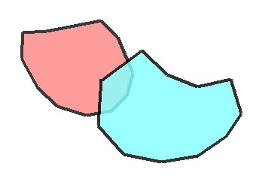
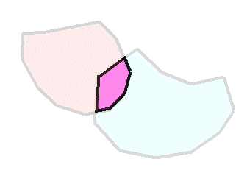
Original Polygons
Union
Intersection

Slide 21
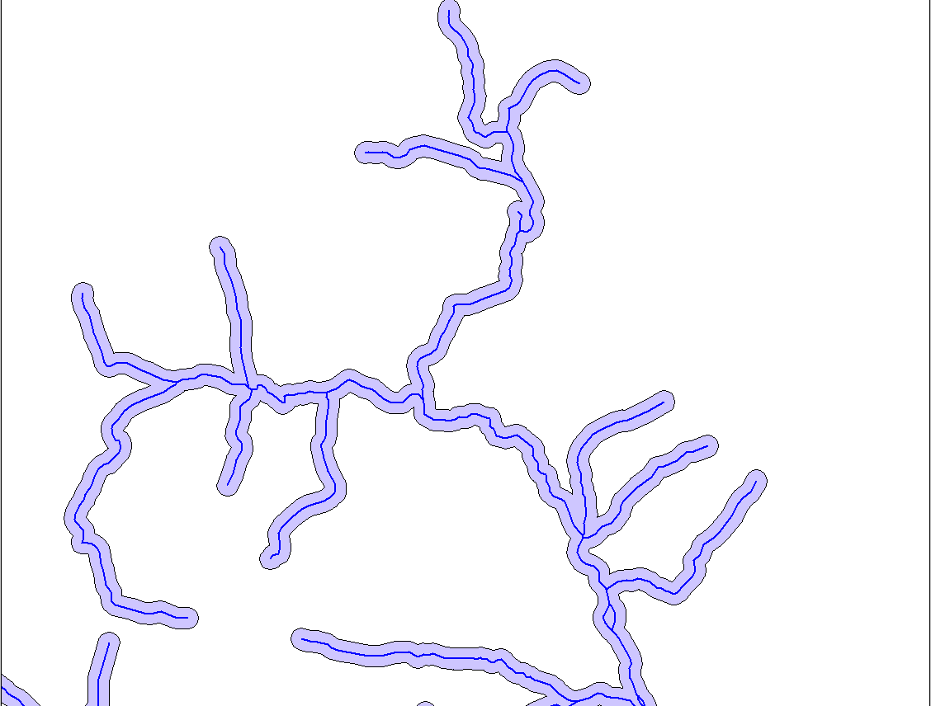
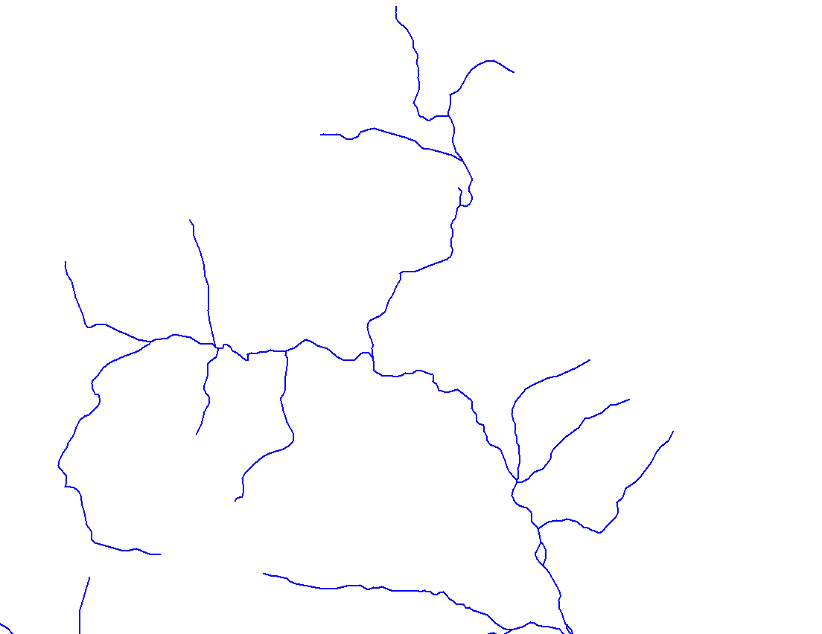
Original river network
Buffered rivers

Slide 22
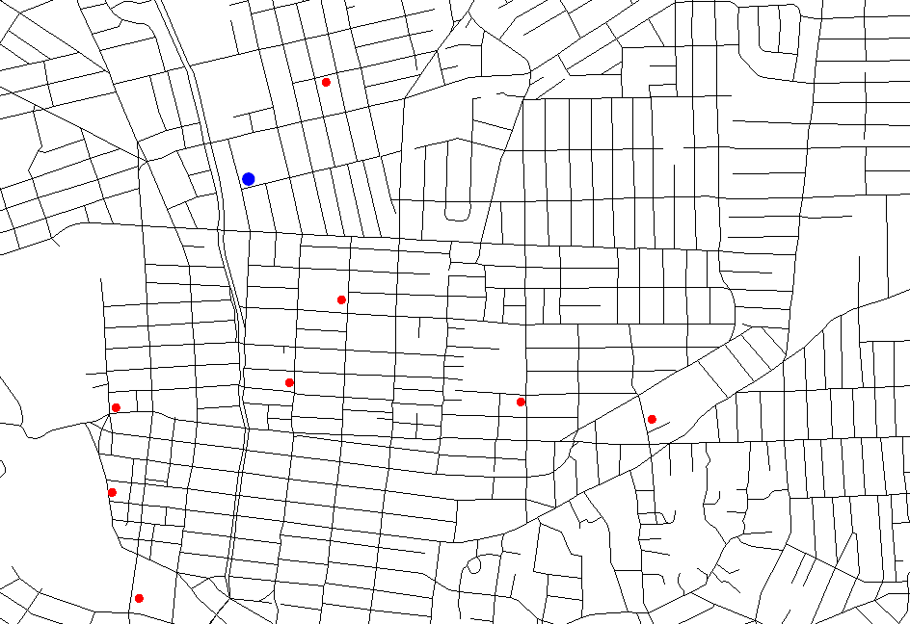
Advantages of Spatial Databases
… WHERE distance(<me>,pub_loc) < 1000
SELECT distance(<me>,pub_loc)*$0.01 + beer_cost … ... WHERE touches(pub_loc, street)
… WHERE inside(pub_loc,city_area) and city_name = ...

Slide 23
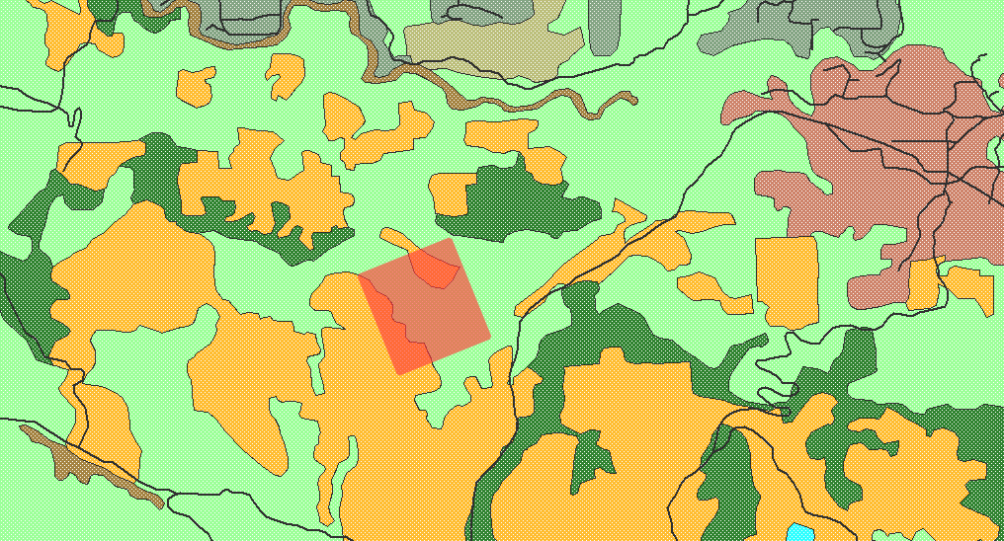
Advantages of Spatial Databases
Simple value of the proposed lot
Area(<my lot>) * <price per acre> + area(intersect(<my log>,<forested area>) ) * <wood value per acre> - distance(<my lot>, <power lines>) * <cost of power line laying>

Slide 24
Use of spatial data
Geocodable addresses
Customer location
Store locations
Transportation tracking
Statistical/Demographic
Cartography
Epidemiology
Crime patterns
Weather Information
Land holdings
Natural resources
City Planning
Environmental planning
Information Visualization
Hazard detection

Slide 25
Spatial data in a RDBMS
Spatial data is usually related to other types of data
Allows one to encode more complex spatial relationships
Fire Hydrant: number of uses, service area, last maintenance date.
River: flow, temperature, fish presence, chemical concentrations
Forested Area: monetary value, types of trees, ownership

Slide 26
Advantages of Spatial Databases
Able to treat your spatial data like anything else in the DB
transactions
backups
integrity checks
less data redundancy
fundamental organization and operations handled by the DB
multi-user support
security/access control
locking

Slide 27
Advantages of Spatial Databases
Offset complicated tasks to the DB server
organization and indexing done for you
do not have to re-implement operators
do not have to re-implement functions
Significantly lowers the development time of client applications

Slide 28
Disadvantages of Spatial Databases
Cost to implement can be high
Some inflexibility
Incompatibilities with some GIS software
Slower than local, specialized data structures
User/managerial inexperience and caution

Slide 29
Examples of SDBMS
MySQL
PostGIS
PostgreSQL DBMS
SpatiaLite
IBM DB2
Oracle
Microsoft SQL Server

Slide 30
MySQL and spatial data
Supported in the version 5.0.16 and followings
Mostly not according to the OpenGIS specifications
Minimum bounding rectangles rather than the actual geometries for spatial relationships
Intersection of the line and the polygon

Slide 31
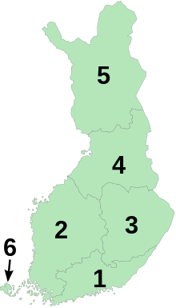
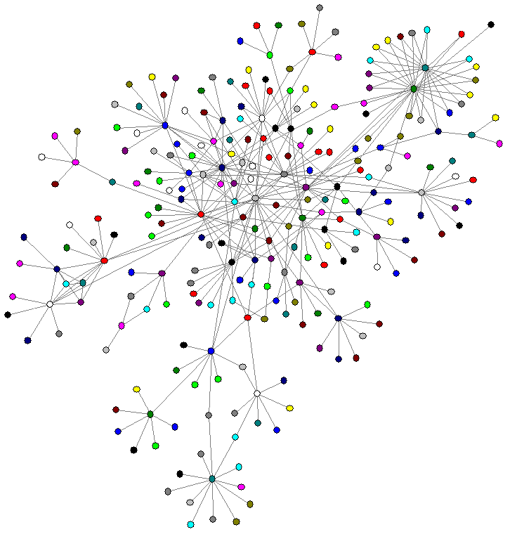
Modeling
Single objects
Point, Polyline, Region (e.g. house, river, city)
Spatially related collections of objects
Partition
Network
Provinces of Finland, 1997–2009
From Wikipedia

Slide 32
MySQL – spatial data types
Single geometry values
GEOMETRY (geometry values of any type)
POINT
LINESTRING
POLYGON
Collections of values
MULTIPOINT
MULTILINESTRING
MULTIPOLYGON
GEOMETRYCOLLECTION (collection of objects of any type)

Slide 33
MySQL – spatial data types
INSERT INTO services ( SERV_ID, Title, Location )
VALUES ( 1,
’Brk-backmanin Rautakauppa',
GeomFromText( 'POINT(60.84152027 26.233295)' ) )

Slide 34
MySQL – examples (put sentence like drawing lines or ploygon)
SET @g = 'LINESTRING(0 0,1 1,2 2,3 2)';
INSERT INTO geom VALUES (GeomFromText(@g));
SET @g = 'POLYGON((0 0,10 0,10 10,0 10,0 0),(5 5,7 5,7 7,5 7, 5 5))';
INSERT INTO geom VALUES (GeomFromText(@g));
10
0
10

Slide 35
MySQL – examples
SET @g = 'GEOMETRYCOLLECTION(POINT(3 4),LINESTRING(0 0,1 1,2 2,3 2,4 4))';
INSERT INTO geom VALUES (GeomFromText(@g));

Slide 36
Differences between Spatial and non- spatial Querying
Non-spatial
“List all the restaurants in Mopsi open on Sundays”
“List all the photos in Mopsi with given description”
Spatial
“List the restaurants within one kilometer from Science Park”
“List all routes with the length more than ten kilometers”

Slide 37
Selection – MySQL examples
create table Points (name VARCHAR(20), location Point NOT NULL, SPATIAL INDEX(location), description VARCHAR(300) )
name | location | description
point1 | GEOMETRY – 25B | Starting point
SELECT AsText(location) FROM Points
POINT(31.5 42.2)
SELECT name, AsText(location) FROM Points WHERE X(location) < 10

Slide 38
Selection – MySQL examples
SELECT AsText(Envelope(GeomFromText('LineString(1 1,2 2)')))
Result: POLYGON((1 1,2 1,2 2,1 2,1 1))
Points inside an area
All cities in East Finland?
SET @ef = “polygon of eastern Finland”
SELECT AsText(cities.center) FROM cities WHERE Intersects(cities.center, GeomFromText(@ef) );

Slide 39
Spatial indexing
Optimizes spatial queries
Simplification of queries
Speeding up
Notes:
Rivedere la seconda!!!

Slide 40
Approaches
Dedicated spatial data structures (e.g. R-tree)
Mapping to 1-D space and using standard indexing (e.g. B-tree)

Slide 41
Spatial indexing methods
Grid (spatial index)
Z-order (curve)
Quadtree
Octree
UB-tree R-tree:
R+ tree
R* tree
Hilbert
R-tree
X-tree
kd-tree
m-tree
Cover tree

Slide 42
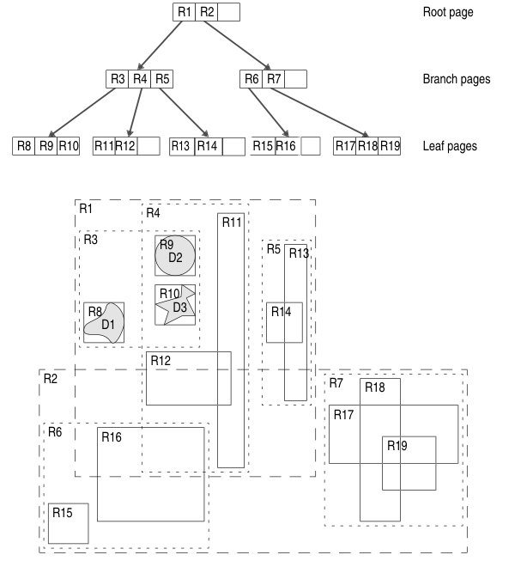
R-tree
Any-dimensional data
Each node bounds it’s children
The height is always log(n)
How to…
Search
Insert
Delete
Split an overfilled node
Update (delete and re-insert)
From http://publib.boulder.ibm.com

Slide 43
Split in R-tree
After underflow or overflow
Goal: Minimize the resulting node’s MBRs
Methods: Exhaustive, quadratic, linear
Quadratic Method
1- select two entries that are worst to be in one group, and put them in two different groups
2- For the remaining: Pick the one that would make the biggest difference in area when put to one of the two groups and add it to the one with the least difference

Slide 44
Insertion in R-tree
1- Find place
A node which would be least enlarged
2- Insert
If no room, split the node
3- Update
- Adjust all MBRs
- In case of node split: Add new entry to parent node (If no room in parent node, invoke SPLITNODE again)

Slide 45
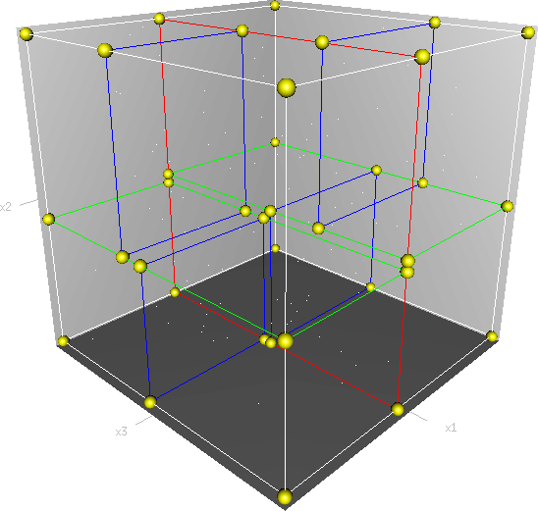
KD-tree
A recursive space partitioning tree
Partition along x and y axis in an alternating fashion
y
d
d
c
e
b
f
f
b
c
a
e
a
x

Slide 46
References
Spatial Databases, A TOUR, Shashi Shekhar and Sanjay Chawla,
Prentice Hall, 2003 (ISBN 013-017480-7)
PostGIS in Action, Regina. O Obe, Leo. S. Hsu
http://dev.mysql.com/doc
MySQL 5.6, section 12.18, MySQL 5.5, section 12.17

