Slide 1
LAMAD
Symbian Qt install and deploy
19.3.2013

Slide 2
Installing Qt SDK and deploying Qt applications

Slide 3
Getting Qt
The easiest way to get started is to download the Qt SDK
It contains
Qt headers and documentation
Pre-built Qt libraries and tools
The QtCreator integrated development environment
Notes:
The easiest way to get started is to download the Qt SDK. It contains all the things needed to get started developing with Qt.

Slide 4
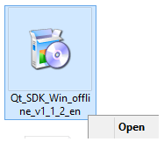
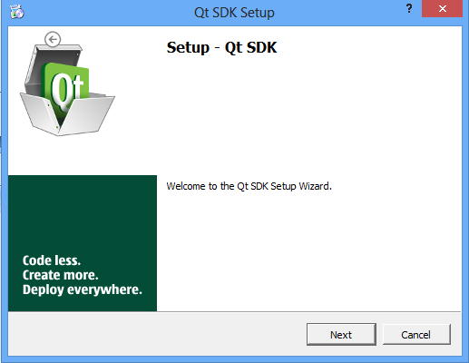
Download and installation
Go to http://www.developer.nokia.com/Develop/Qt/Tools to download Symbian Qt SDK
Register and download the Qt SDK for Symbian
Run the downloaded installer
Notes:
The windows installer is an ordinary installer.
If choosing custom paths, it is wise to choose a path without spaces in it, as this can confuse the build system in some cases.

Slide 5
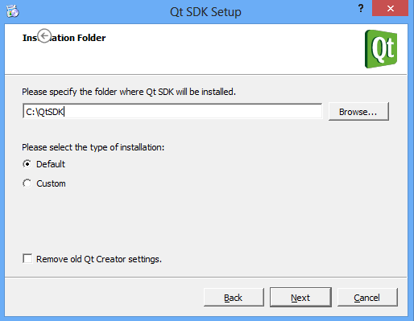
Download and installation
4. Click through the installer
Note: If you need to debug on S60 3rd or 5th edition phone, install version 1.1.2 of the SDK from: http://www.developer.nokia.com/info/sw.nokia.com/id/84801bfe-8517-4287-9829-014c6f572127/Qt_SDK_1_1_2.html

Slide 6
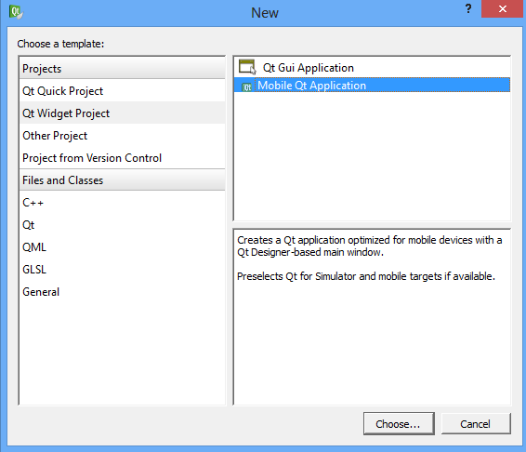
Project setup
Create a new project and choose Mobile Qt App

Slide 7
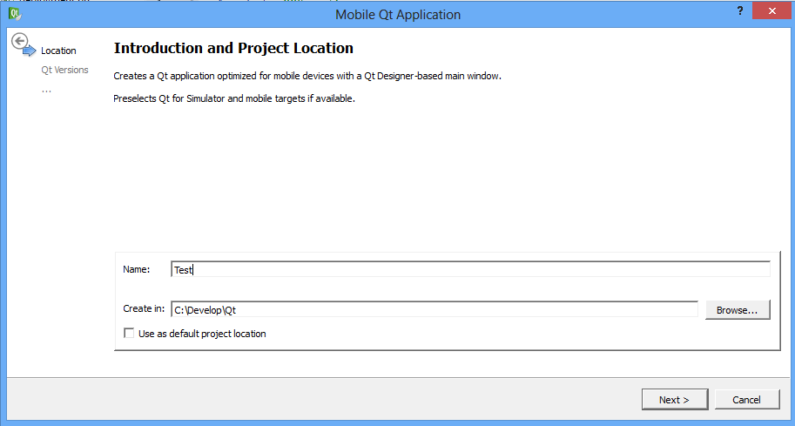
Project setup
Choose project name and path

Slide 8
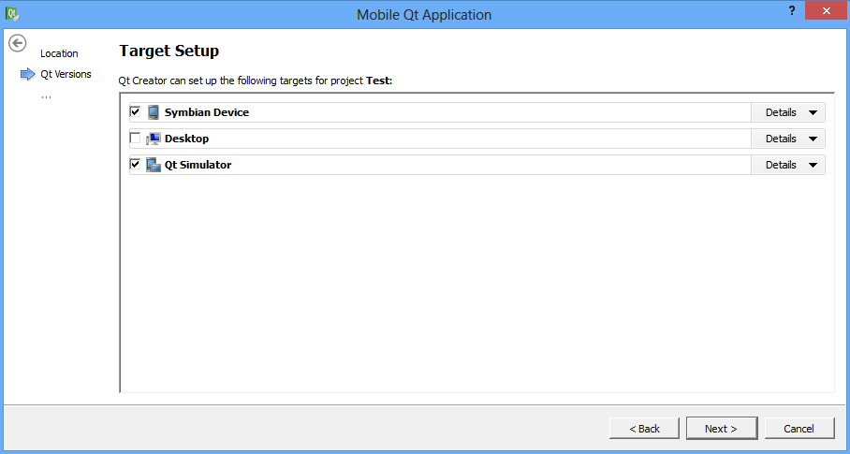
Project setup
Choose Symbian Device and Qt Simulator as targets and finish the project creation

Slide 9
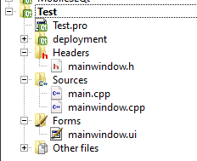
Auto-generated files
Project info file
Main screen source files
main.cpp file
Main screen designer file
Main screen startup code

Slide 10
Auto-generated main.cpp file
#include "mainwindow.h”
#include <QtGui/QApplication>
int main(int argc, char *argv[]) {
// instatiate application object
QApplication app(argc, argv);
// instatiate main screen
MainWindow mainWindow;
// set orientation to auto
mainWindow.setOrientation(MainWindow::ScreenOrientationAuto);
// show main screen
mainWindow.showExpanded();
// start event loop
return app.exec();
}

Slide 11
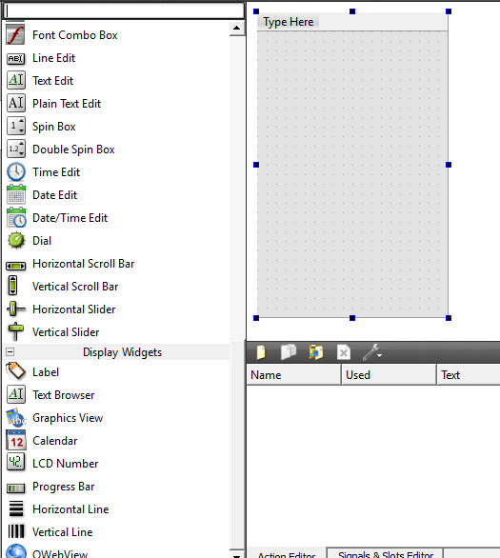
Visual designer
Double click on mainwindow.ui to open visual designer
Put components on the screen by drag and drop

Slide 12
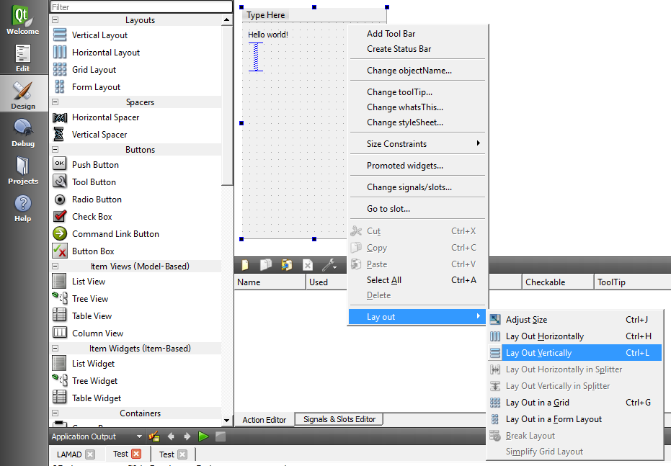
Hello world example
Place UI components and choose a layout

Slide 13
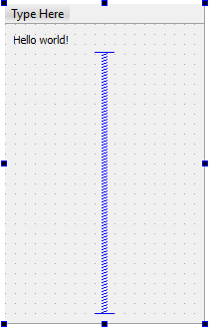
Hello world example
The window (screen) has a label, a vertical spacer and vertical layout

Slide 14
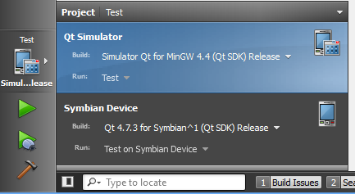
Run on simulator
Choose Qt Simulator from the bottom-left corner and click run (green triangle button)

Slide 15
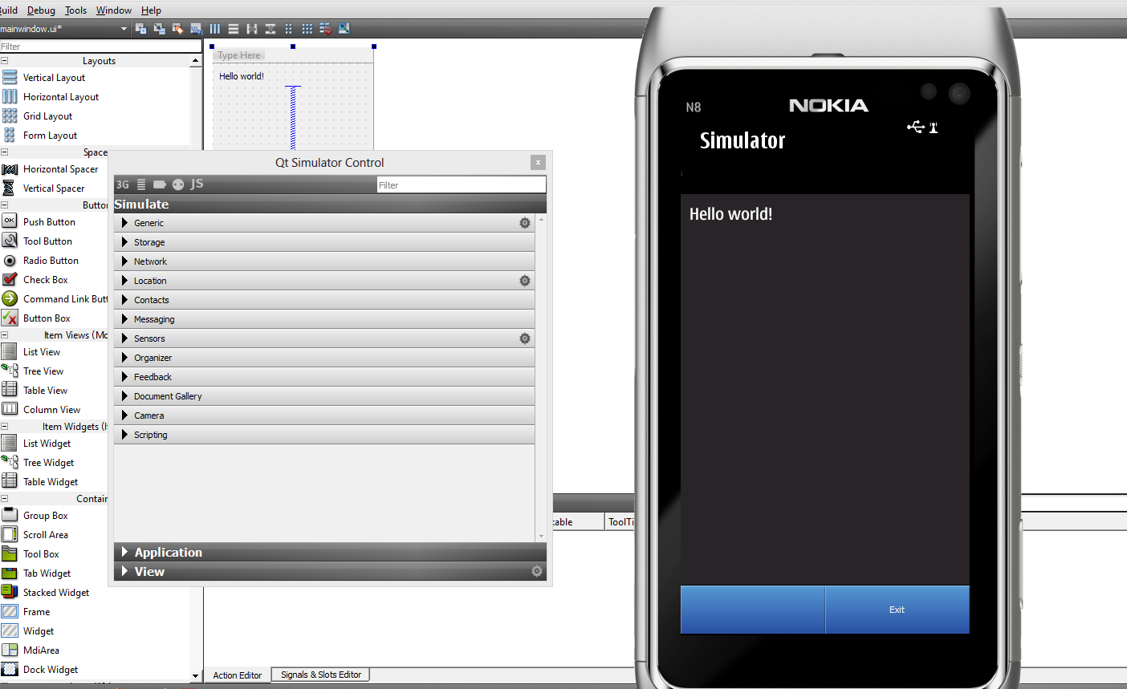
Run on simulator
Example will look like this:

Slide 16
Build and run on phone
You need to install Nokia Suite: http://www.nokia.com/global/support/nokia-suite/
Debugging can be done using TRK and CODA applications
You can find the tools in C:\QtSDK\Symbian\sis
For S60 3rd and 5th edition install TRK on the phone
For Symbian^3 install CODA on the phone

Slide 17
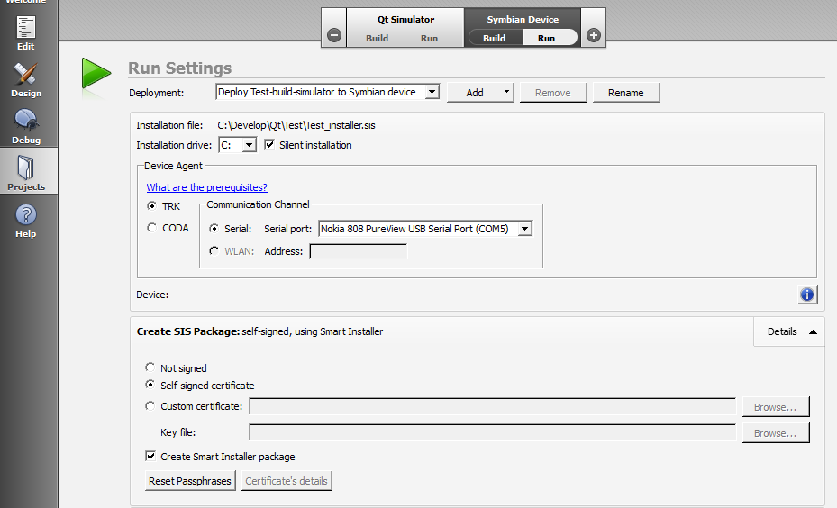
Build and run on phone
Click here for run settings
Phone appears here if it’s connected
and TRK runs on it
Click here for project settings
Check this if you want to include
Qt installation with your binary package
“Smart Installer” checks if Qt is installed
on the phone and downloads packages if not

Slide 18
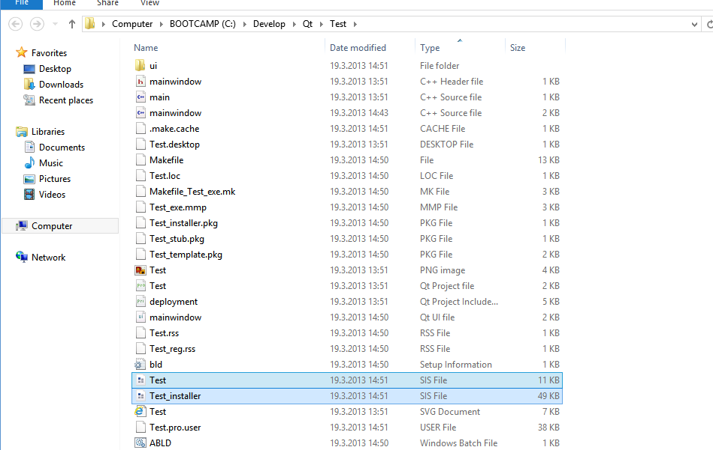
Install or distribute binaries
Application binary
Application binary with Qt “smart installer”

Slide 19
Or run on device
Choose Symbian Device from the bottom-left corner and click run (green triangle button)

Slide 20
Issues
PROBLEM
Camera does not work on Qt for S60 3rd edition
SOLUTION
Force the installation of Qt library 4.7.3 and Qt Mobility library 1.1.3
You can find the files you need in the SDK folders
Distribute your SIS file with the 2 files and DO NO USE “Smart Installer”
Qt library 4.7.3 and Qt Mobility library 1.1.3 must be installed just ONCE on a device

