Slide 1
Tracking & Login Data persistence
17.04.2013

Slide 2
User tracking

Slide 3
Positioning methods
Method | Pros | Cons
Cell tower triangulation | - works indoors - works almost globally - pretty accurate in cities (100 m) | - inaccurate in rural areas (1-10 km)
Cell ID database | - no receiver needed on device - works almost globally - good accuracy in cities | - 3rd party database needed for IDs - inaccurate in rural areas
Global Positioning System | - works globally - good, consistent accuracy (10 m) - commonly supported | - doesn't work indoors - weak accuracy in cities ('canyon effect') - consumes battery life - slow initialization (30-60 s)
Assisted GPS | - speeds up initialization - improves accuracy | - not commonly supported on devices other than smart-phones - lack of standards - requires internet connection
Wireless positioning | - works indoors - accurate in cities | - WiFi receiver needed on device - doesn't work in rural areas or areas without WiFi - 3rd party database needed for IDs

Slide 4
Many methods – one location
Each method provides some estimate
Determining which to use is a trade-off
Accuracy
Speed
Battery-efficiency

Slide 5
Positioning accuracy
Location estimates not consistent in accuracy
The most recent location not always the best
How to decide which one to use?

Slide 6
Positioning accuracy
When validating the accuracy consider
Timestamps of the results
Claimed accuracy of the results
Positioning method used

Slide 7
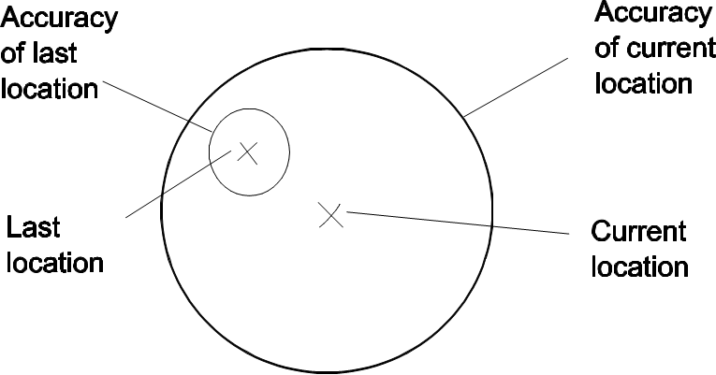
Positioning accuracy

Slide 8
If user is moving
User location has to recorded every 2-4 s
Sending each point individually would create too many connections

Slide 9
If user is moving
Data needs to be sent in batches:
20 points
……………………………….
OK
Create JSON Array
Send to Server
Remove from queue

Slide 10
User tracking
Start tracking
Start desired positioning methods
Maintain a "current best estimate" of location by filtering out new, but less accurate estimates
Take advantage of the last best location estimate
Stop listening for location updates

Slide 11
User tracking

Slide 12
GPS is power-hungry
3-4 hours
Symbian
5-8 hours
Windows Phone
Android
iPhone

Slide 13
GPS is power-hungry
Reduce the size of the window of location updates
Set the location providers to return updates less frequently
Restrict a set of providers
GPS only when needed

Slide 14
GPS is power-hungry

Slide 15
User tracking
PHP, MySQL
MOPSI
Start Tracking
Reply
Server
Points Queue
Uploads points to Server
5
4
3
2
1
Adds points into the Queue
Saved Successfully ?
OK
LOCATION PROVIDER
GPS/Network/
WiFi
Delete points
Error
Resend The points

Slide 16
User login

Slide 17
Checking user credentials
User credentials need to be cached for offline mode and for fast login
Input username and password
Check if the credentials exist
FAIL
OK
User: Radu
Pass: *****
Warning
Attempt to login with cached data
FAIL
FAIL
Login
Attempt to login on the server
OK
OK
Update cached data with valid credentials
Load user settings

Slide 18
Application Start
Login Screen
user name &
password
Remember me?
No
Online?
No
Yes
Yes
Welcome Screen
Connect to Server
Login Fail
user name
&
password
Cache User
Existing User?
No
Update in memory
Yes
Login Successful

Slide 19
Data persistence

Slide 20
Private data
In appication’s local folder
Cannot be read by other apps or when connecting phone to computer
Usually limited storage space (hundreds of MB)
For storing user settings, private data and local databases

Slide 21
Public data
In phone’s file system
Can be read by any application or by connecting phone to computer
Large storage space (usually several GB)
To be used for storing large data (photos, sounds, video)

Slide 22
Options for data storage
Shared Preferences
Store private primitive data in key-value pairs
Files
Store private data on the device memory
Store public data on the shared external storage
SQLite Databases
Store structured data in a private database
Network Connection
Store data on the web with your own network server

