Slide 1
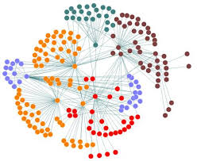
Mopsi – Facebook (Social Network Analysis)
Chaitanya Khurana
May, 2013

Slide 2
Index
System diagram
Mopsi-Facebook features
Facebook data for Recommendation System
Access token & other minor issues
Suggestions based on Friends network
Different companies use NA.

Slide 3
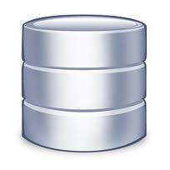
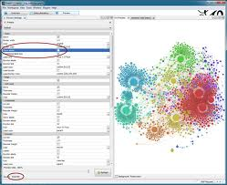
1. System Diagram
Facebook Server Mopsi Server
SQL Commands
Database
Mopsi Database
Export to local
Local
Gephi Local Database
Mopsi-Facebook
Application
FB
API

Slide 4
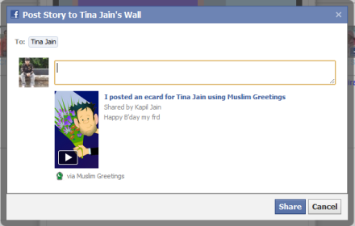
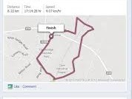
2. Mopsi-Facebook Features
2.1 Registration & Authentication using Facebook
2.2 Publish photo on Facebook
2.3 Publish route on Facebook
2.4 Mopsi-Facebook Network

Slide 5
2.1 Registration & Authentication
For Registering, we are storing four parameters in Mopsi Database.
1. Facebook user id
2. Email id
3. Access Token
4. User’s Facebook Name
For Authentication,
1. Active access token is used for authentication.
2. Planning to display Facebook name and User’s Facebook photograph on web when a person is logged in to Mopsi Facebook

Slide 6
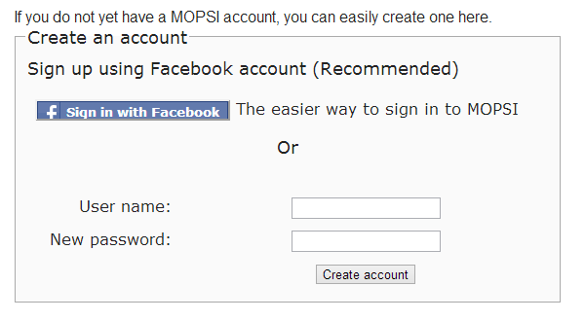
Signup/Login Button
Easy signup/login with Facebook

Slide 7
Authentication/Registration using Facebook

Slide 8
Authentication/Registration using Facebook
Popup generated by Facebook. If user presses button “Go to App”,
Facebook allows the application to fetch user data.

Slide 9
2.2 Publish photo on Facebook
Description
Location taken automatically by
Mopsi
This link redirects to the
Mopsi system which allows
us to see Photo on Map

Slide 10
Facebook photo on Map (Mopsi)
Facebook photo on Map in Mopsi
with location

Slide 11
Photo album of Mopsi user in Facebook
Mopsi-Facebook
user
Photo Album
on Facebook
created by
Mopsi-Facebook
user.

Slide 12
2.3 Publish route on Facebook
Distance &
Mode of Transport
Starting location
& final location
Time, distance & speed of user
Image of route
covered by user.
If we click on this,
we can see the route
and analyze it in
Mopsi System.

Slide 13
User’s route on Mopsi
Route
Details of Route

Slide 14
2.4 Mopsi-Facebook Network
2.4.1 Front end for fetching Facebook data
2.4.2 Back end for storing fetched data
2.4.3 Key points related to graph generation
2.4.4 My Facebook Network
2.4.5 Mopsi-Facebook current Network

Slide 15
2.4.1 Front End for fetching FB data
5 PHP files, 4 classes and 6 Methods
PHP files - index.php, Facebook.php, Base_Facebook.php, facebookFriends.class.php & facebookAuthentication.class.php.
Facebook.php and Base_facebook.php contains many methods which are used for accessing data from Facebook API.
4 classes - Facebook, BaseFacebook, FacebookAuthentication and FacebookFriends

Slide 16
2.4.1 Front End for fetching FB data
6 Methods
getAccessToken()
getUser()
api(‘/’. $userID)
getFacebookFriends($access_token,$userID,$fullname_facebook_user)
checkFacebookFriends($userID)
checkFBauth($userID,$email,$access_token,$fullname_facebook_user)

Slide 17
2.4.2 Back end for storing fetched data
Tables
Table 1: facebook_friends (id, friends)
Table 2: facebook_nodes (id, label)
Table 3: facebook_edges (source, target)
Table 4: Staff (Email, Facebook_uid, FB_access_token, Facebook_name)

Slide 18
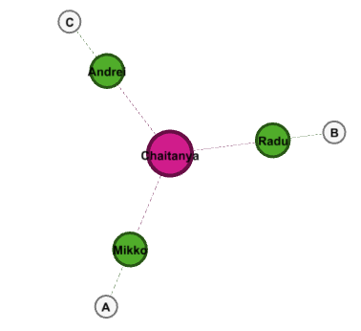
2.4.3 Key points related to graph generation
Facebook allows fetching friends who are up to 1 degree of separation.
Example –
Chaitanya – Facebook User
We can select green nodes
White nodes are 2 degrees away
so they cannot be fetched!
C is friend of Andrei
B is friend of Radu
A is friend of Mikko

Slide 19
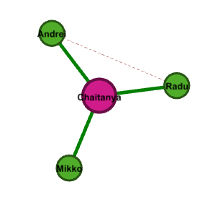
2.4.3 Key points related to graph generation
Two links in the complete graph:
Direct links (links between me and my friends)
Friend-Friend link
(links between my
friends)

Slide 20
2.4.3 Key points related to graph generation
Example:
Nodes (N = 530)
Execution time
Fetching Direct links take 1 to 2 sec (maximum) – Direct links are 530.
Fetching Direct + Friend-Friend link took nearly 3 min. Number of indirect links depends. In my case, it was 3,000 (approx.)

Slide 21
2.4.3 Key points related to graph generation
To fetch friends network a user must be logged in to Facebook.
It means the user will allow/authorize the app to fetch the data.
It cannot be done in background (when the user is logged out)

Slide 22
2.4.4 My Facebook Network

Slide 23
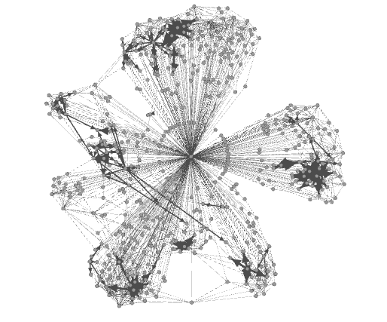
2.4.4 My Facebook Network
Operation 1 – Layout
ForceAtlas 2 Layout
- Scaling: 30.0

Slide 24
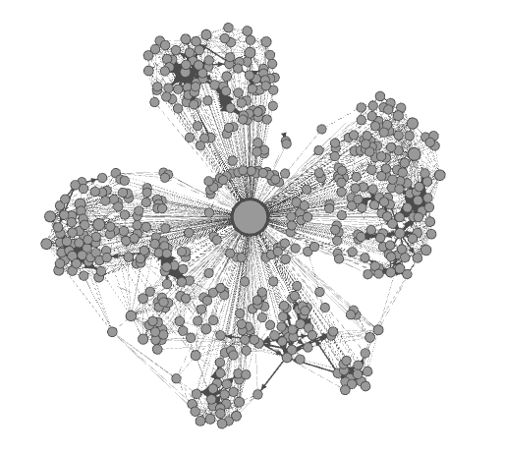
2.4.4 My Facebook Network
Operation 2 – Average Degree (3.314)
Chaitanya Khurana
Size of node varies
according to the
node degree.
Min Size: 20
Max Size: 80

Slide 25
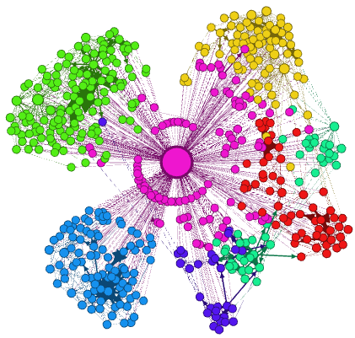
2.4.4 My Facebook Network
Operation 3 – Modularity (Communities - 7)
Green - College Friends/ Teachers
Pink – Friends whom I don’t know or
never seen outside Facebook
Blue – Friends of Finland/ UEF
Yellow - Friends of school
Red - Friends of Political Party
Different colour - My relatives
Purple – Neighbours

Slide 26
2.4.4 My Facebook Network
Communities
A brief observation:
Whenever geographical
location changes, I
connect with new friends
and hence a new
Community.

Slide 27
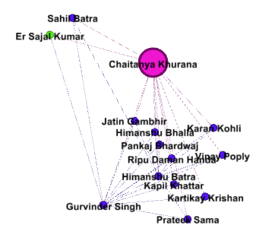
2.4.4 My Facebook Network
Operation 4 – Ego Network
Node ID: 1373260832 (Gurvinder Singh)
Depth: 1

Slide 28
2.4.4 My Facebook Network
Operation 4 – Ego Network
Node ID: 1373260832 (Gurvinder Singh)
Depth: 1
Connected to one of
my college friend in
green.
At Depth 2, he is
connected to everyone.

Slide 29
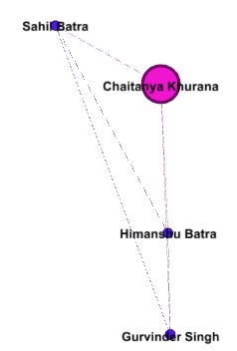
2.4.4 My Facebook Network
Operation 5 – Intersection of two Ego Networks
Node ID: 1373260832 (Gurvinder Singh)
Depth: 1
Node ID: 100000806157535 (Sahil Batra)
Depth: 1

Slide 30
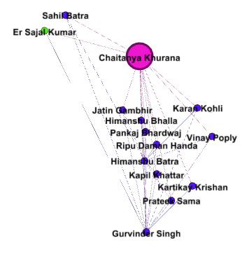
2.4.4 My Facebook Network
Operation 5 – Intersection of two Ego Networks
Node ID: 1373260832 (Gurvinder Singh)
Depth: 2
Node ID: 100000806157535 (Sahil Batra)
Depth: 2

Slide 31
2.4.5 Mopsi-Facebook current Network
Total Mopsi Nodes: 178
Total Facebook Nodes: 4792
Total Edges: 7651

Slide 32
Operation 1 – Layout (ForceAtlas 2)

Slide 33
Operation 2 – Degree (1.595)
Sami Pietinen
Keytianny Nunes
Nikola Manojlovic
Айлин Нерминова
Eva Koudelkova
Kullervo Talvisilta
Chandan Shahi
Vlad Manea
Jesika Matysik
Tereza SmÄ›tÃ¡kovÃ¡
Radu Mariescu-Istodor
Iulian Marius
Mariola Zawadzka
Zhentian Wan
Chaitanya
Karol
Alexandra JakovljeviÄ‡
Adam GaliÅ„ski
Pasi Franti
Monika Scheffern
Oili Kohonen
Ding Liao
მარიამ კობალავა
Hao Chen

Slide 34
(Betweenness Centrality)
Operation 3 – Betweenness Centrality (Brokers)
Low
Medium
High
Nikola Manojlovic
Chandan Shahi
Radu Mariescu-
Istodor
Vlad Manea
Chaitanya
Karol
Oili Kohonen

Slide 35
Operation 4 – Modularity (Communities-131)

Slide 36
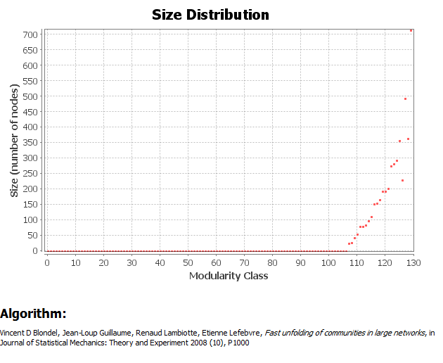
Analysis of Communities

Slide 37
Operation 5 – Giant Component
Nodes: 2286 (47.78%)
Edges: 5012 (67.8%)
Sami Pietinen
Chandan Shahi
Radu Mariescu-Istodor
Vlad Manea
Zhentian Wan
Chaitanya
Karol
Pasi Franti
Oili Kohonen
Hao Chen
Ding Liao

Slide 38
Operation 6 – Ego Network (of any node in the network)
Node ID: 13 (Pasi Franti)
Depth: 1
Connected to 69 nodes i.e. 1.44% of total nodes
Pasi Franti

Slide 39
Operation 6 – Ego Network (of any node in the network)
Node ID: 13 (Pasi Franti)
Depth: 2
Connected to 609 nodes i.e. 12.73% of total nodes
Pasi Franti

Slide 40
Operation 6 – Ego Network (of any node in the network)
Node ID: 13 (Pasi Franti)
Depth: 3
Connected to 2004 nodes i.e. 41.89% of
total nodes
Note: Even at 3 degrees of separation,
Pasi node (having lower Betweenness
Centrality ) could not reach the value
of Giant component (47.78%)
But, when I compared with Radu node
(having highest Betweenness centrality)
it could reach the value of Giant component
(47.78%)

Slide 41
3. Facebook data for Recommendation System
User’s & Friend’s hometown
User’s & Friend’s work history
User’s & Friend’s checkins (With Latitude and Longitude)
User’s & Friend’s current location
User’s posts & likes & comments etc..
Note:
All these details can be taken if the user is logged in
(active access token & session)
We need to design database and decide limit because
data is very huge.

Slide 42
Snapshot of Checkins data
Street, City,
Country, Latitude,
Longitude & zip

Slide 43
Snapshot of Work data
Employer, location
& position

Slide 44
Snapshot of Posts, likes and comments
Friends tagged in the story

Slide 45
4. Access Token & other minor issues
Access Token is like a ‘temporary password’ which can be used to get and post user data.
Categories of permissions associated with each access token:
- User Data Permissions
- Friends Data Permissions
- Extended Permissions

Slide 46
User Data Permissions

Slide 47
Friends Data Permissions

Slide 48
Extended Permissions

Slide 49
Issues in Mopsi-Facebook
Access Token
Issue 1: Long duration access tokens currently cannot be stored in database.
Issue 2: Removal of offline_access
Issue 3: Access token becomes invalid in 4 conditions.
Issue 4: If we modify the permissions in the application, we need the updated access token.

Slide 50
Issues with solutions
Issue 1: Long duration access tokens currently cannot be stored in database.
Solution: Instead of using Varchar we can use
Text as data type.
Issue 2: Removal of offline_access
https://developers.facebook.com/roadmap/offline-access-removal/
Solution: Long lived access token = 60 days
Redirect the user to the auth dialog and get a valid access token.

Slide 51
Issues with solutions
Issue 3: Access token becomes invalid in 4 conditions.
- The token expires after expires time
- The user changes her password which invalidates the access token.
- The user de-authorizes your app.
- The user logs out of Facebook.
https://developers.facebook.com/blog/post/2011/05/13/how-to--handle-expired-access-tokens/

Slide 52
Issues with solutions
Issue 4: If we modify the permissions in the application, we need the updated access token.
Add permissions for user location, checkins, posts etc.
Solution for Issue 3 & 4: Redirect the user to the auth dialog and get a valid access token.

Slide 53
Frequent changes in Facebook API
Facebook API – constantly evolving.
Short history of changes (Almost every month)
April 3, 2013
March 6, 2013
February 6, 2013
January 9, 2013
https://developers.facebook.com/roadmap/completed-changes/
Conclusion:
We need to constantly update according to changes done in Facebook API to prevent any break in the functioning of the system.

Slide 54
5. Suggestions for Mopsi FB

Slide 55
Sorting of Friends

Slide 56
6. Facebook uses Network Analysis

Slide 57
6. Facebook uses Network Analysis
In NLP, Latent Dirichlet allocation (LDA) is a generative model that allows sets of observations to be explained by unobserved groups that explain why some parts of the data are similar

Slide 58
6. Facebook uses Network Analysis

Slide 59
6. Facebook uses Network Analysis

Slide 60
6. Facebook uses Network Analysis

Slide 61
6. Facebook uses Network Analysis

Slide 62
6. Facebook uses Network Analysis

Slide 63
6. Facebook uses Network Analysis

Slide 64
6. LinkedIn uses Network Analysis
Tries to find who is potential influencer in the network.
What happens to the content people share on LinkedIn? Is something just static? Or is it something that is picked up?
Predicting where people are going to move next for job. (Already done for US)

Slide 65
6. LinkedIn uses Network Analysis
Use Migration pattern in real life and use part of it as a signal to recommend jobs to the people.
Identify the gap between “Job openings” and “Unemployment” and reducing it.
Evaluate the gap between what you need for the job and what you have and then suggest skills which should be taken to get jobs.

Slide 66
Thank You!

