Slide 1
GPS Trajectories Analysis in MOPSI Project
Minjie Chen
SIPU group
Univ. of Eastern Finland

Slide 2
Introduction
A number of trajectories/routes are collected of users’ position and time information uses a mobile phone with built-in GPS receiver.
The focus of this work is to design efficient algorithm (analysis, compression, etc) on the collected GPS data.

Slide 3
Outline
Route reduction
Route segmentation and classification
Other topics
GPS trajectory compression

Slide 4
Route Reduction
To save the time cost of route rendering, we propose a multi-resolution polygonal approximation algorithm for estimating approximated route in each scale with linear time complexity and space complexity
For one route, we give its corresponding approximated route in five different scale in our system

Slide 5
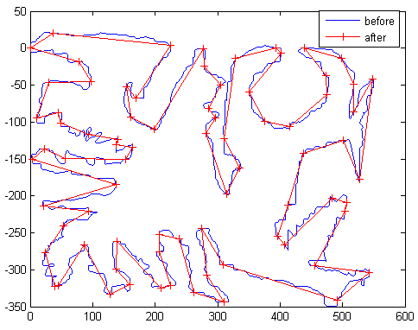
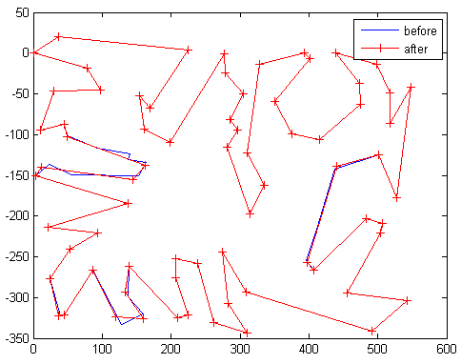
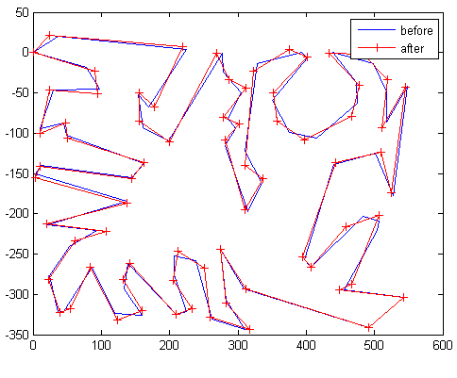
Polygonal approximation
Initial approximated route with M’ =78
Approximated route (M =73) after reduction
⊿_{ISE}(P’) = 1.1*10⁵
Approximated route after fine-tune step
⊿_{ISE}(P’) = 6.6*10⁴
An example of polygonal approximation for the 5004 points route

Slide 6
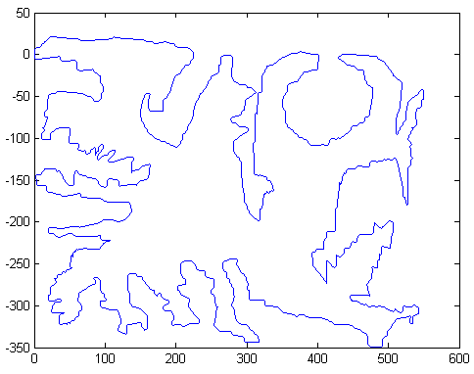
Multi-resolution Polygonal approximation
5004 points, original route

Slide 7
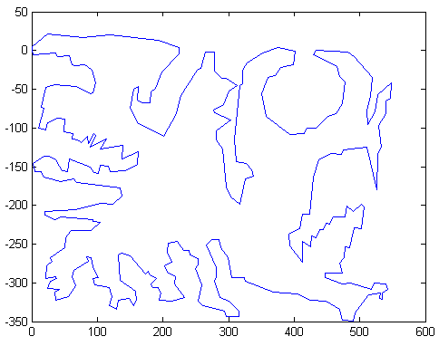
Multi-resolution Polygonal approximation
294 points, scale 1

Slide 8
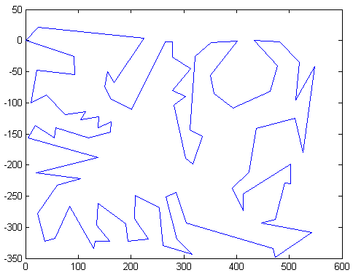
Multi-resolution Polygonal approximation
78 points , scale 2

Slide 9
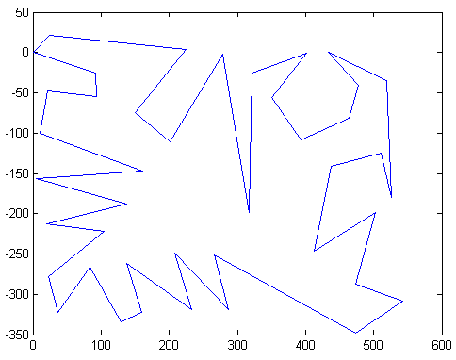
Multi-resolution Polygonal approximation
42 points , scale 3

Slide 10
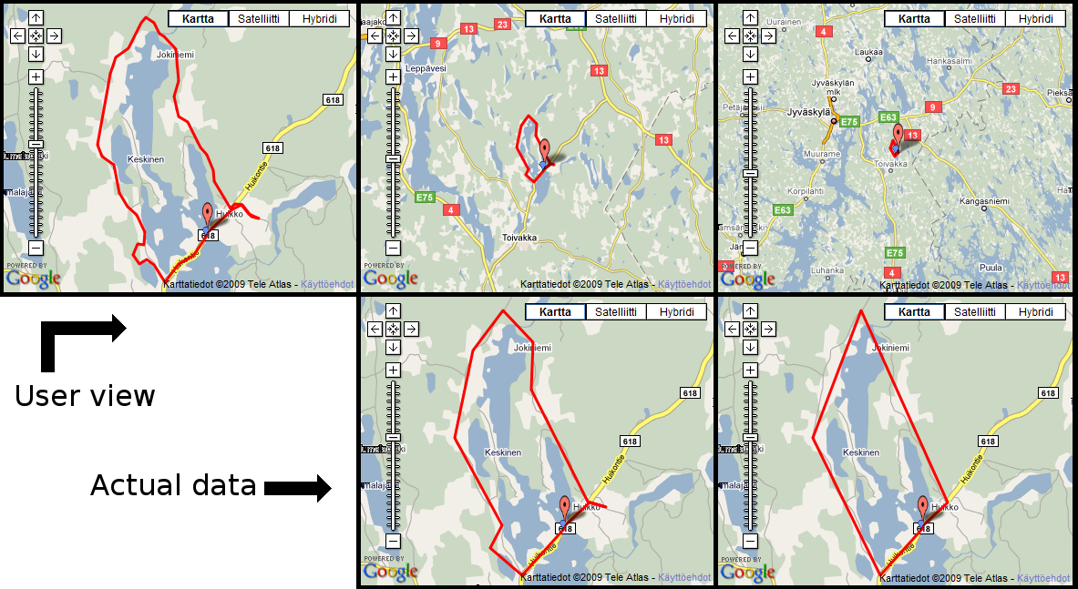
Example in MOPSI
44 points
13 points
6 points
The original route has 575 points in this example

Slide 11
Time Cost (s) of route reduction
 | points | Read file | Segment routes | Wgs->utm | MRPA | Output file | Total
Sadjad | 9579 | 0.04 | 0.01 | 0.01 | 0.02 | 0.08 | 0.16
Karol | 47428 | 0.15 | 0.01 | 0.04 | 0.09 | 0.28 | 0.57
Andrei | 49707 | 0.16 | 0.02 | 0.04 | 0.14 | 0.64 | 1.02
Pasi | 130506 | 0.42 | 0.02 | 0.11 | 0.30 | 1.19 | 2.04
Ilkka | 277277 | 1.01 | 0.06 | 0.24 | 0.71 | 1.72 | 3.74

Slide 12
Time cost (map data)
3s processing time even for
a curve with 2,560,000 points

Slide 13
Route segmentation and classification
The focus of this work is to analyze the human behaviour based on the collected GPS data.
The collected routes are divided into several segments with different properties (transportation modes), such as stationary, walking, biking, running, or car driving.

Slide 14
Methodology
Our approach consists of three parts:
GPS signal pre-filtering
A change-point-detection for route segmentation
An inference algorithm for classification the properties of each segments.

Slide 15
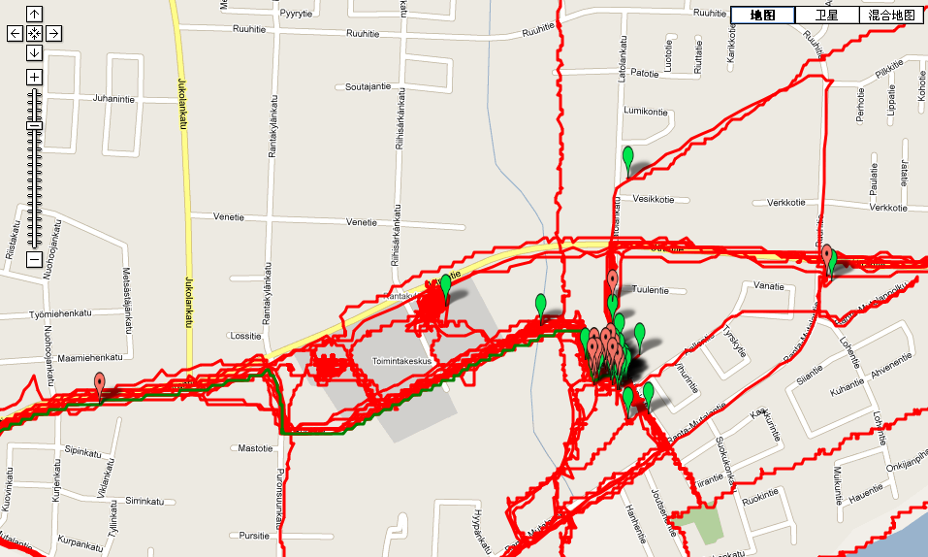
GPS signal pre-filtering
GPS signal has an accuracy around 10m, design efficient filtering algorithm is important for route analysis task
Our proposed algorithm has two steps: outlier removal and route smooth
No prior information is needed (e.g. road network)

Slide 16
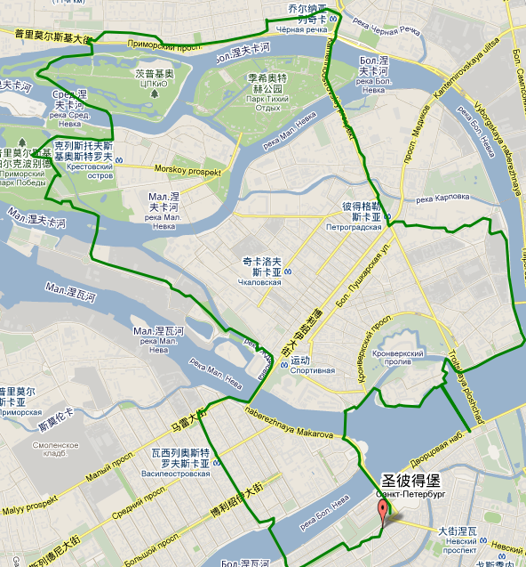
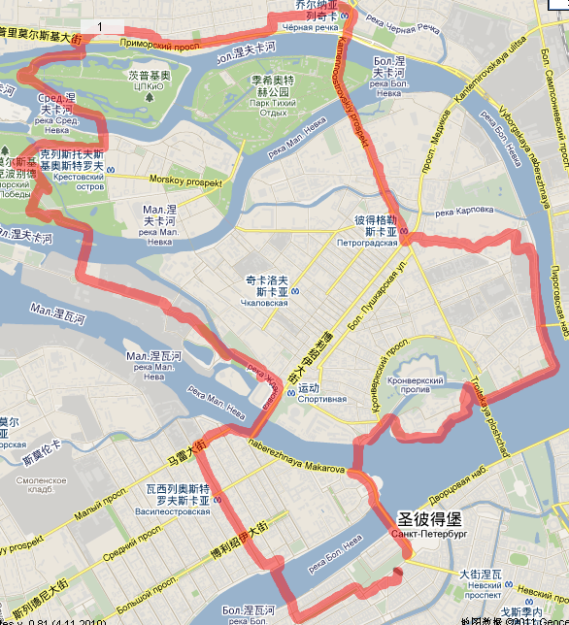
Outlier removal
Points with impossible speed and variance are detected and removed.
Outlier point is removed after filtering

Slide 17
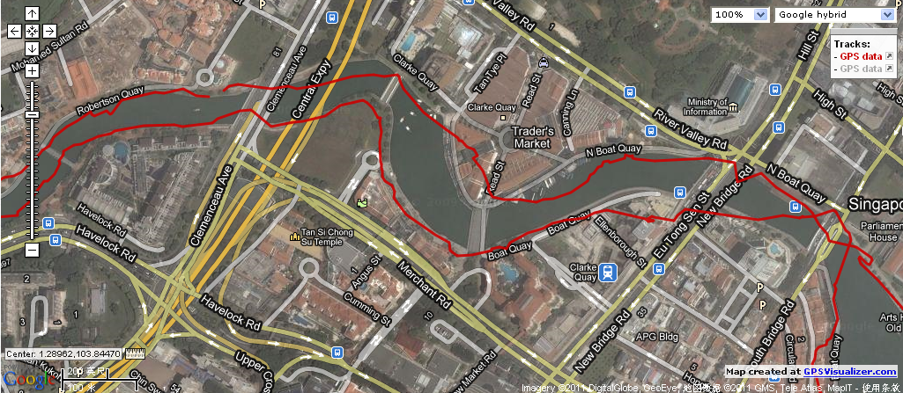
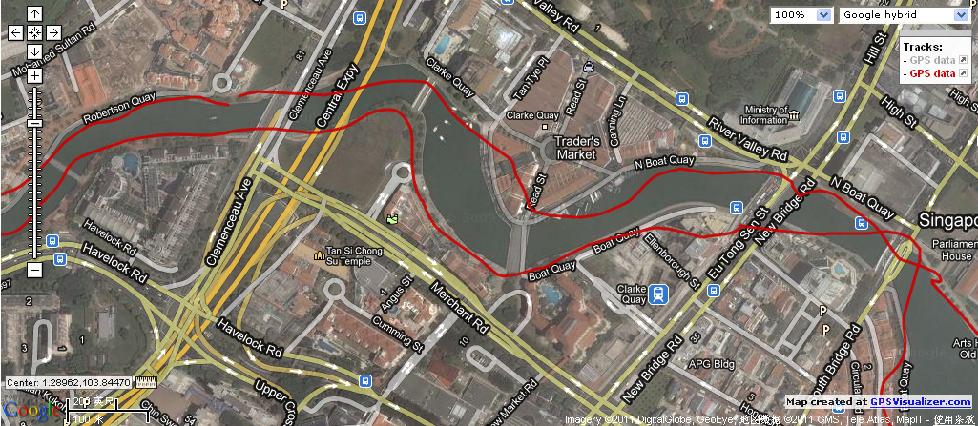
Example
Before
After
filtering

Slide 18
Route Segmentation
Considered as a change-point detection problem
Our solution has two steps: initialization and merging.
We minimize the sum of speed variance for all segments by dynamic programming.
Adjacent segments with similar properties are merged together by a pre-trained classifier.

Slide 19
Result
Route 1: ski
Route 2: Jogging and running with non-moving interval
Route 3:Non-moving
Route 4: Jogging and running with non-moving interval

Slide 20
Route Classification
In classification step, we want to classify each segments as stationary, walking, biking, running, or car driving
Training a classifier on a number of features (speed, acceleration, time, distance) directly is inaccurate.
We also consider the dependency of the properties in neighbor segments by minimizing:

Slide 21
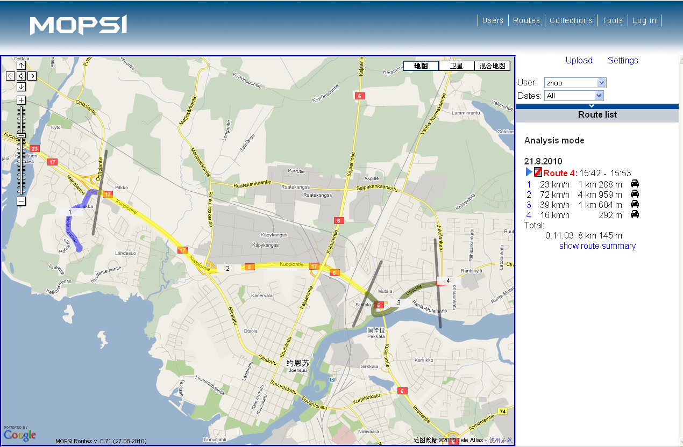
Examples of route analysis
Highway?
detect some speed change

Slide 22
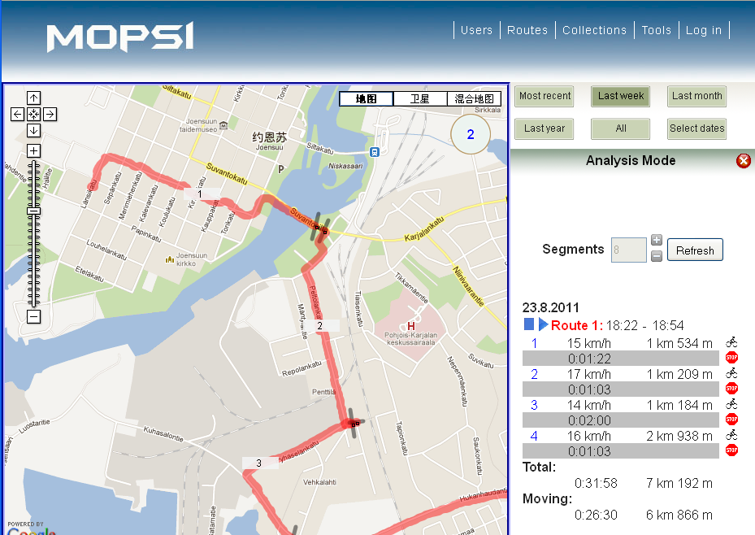
Examples of route analysis
Detecting
stopping area

Slide 23
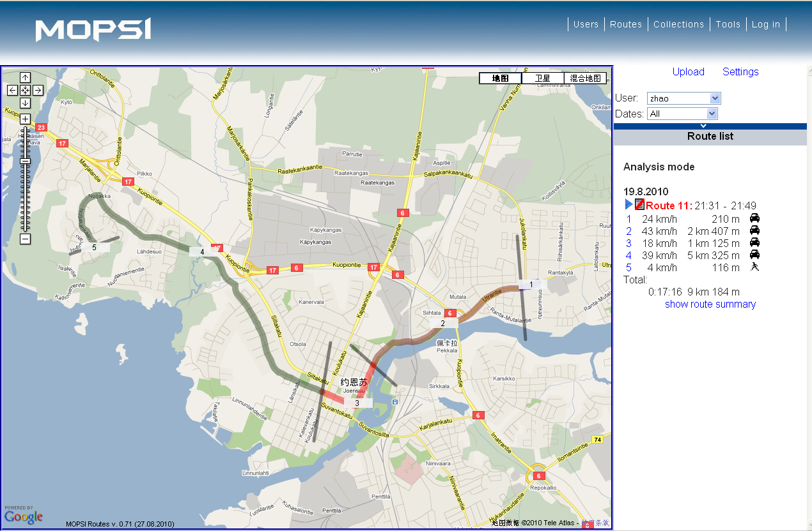
Example
Speed slow down
in city center

Slide 24
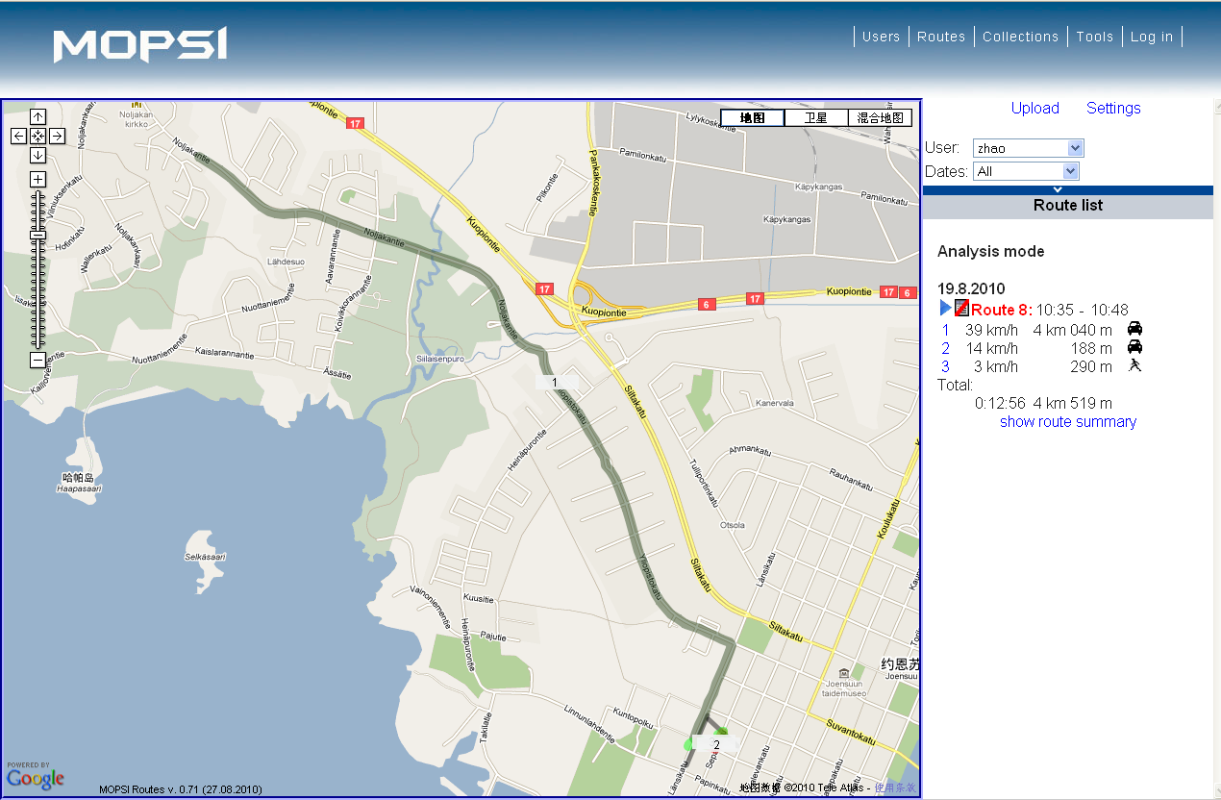
Example
Other info,
Parking place?

Slide 25
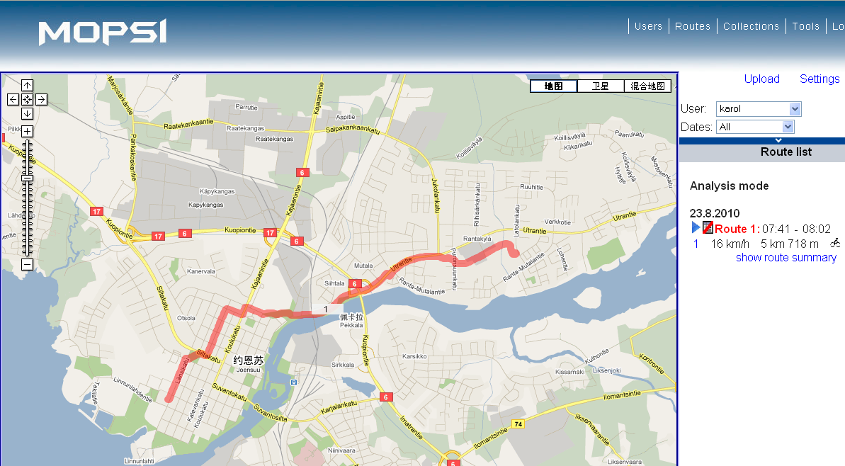
Example
Karol come to office by bicycle every day?

Slide 26
Future work
Route analysis
Similarity search

Slide 27
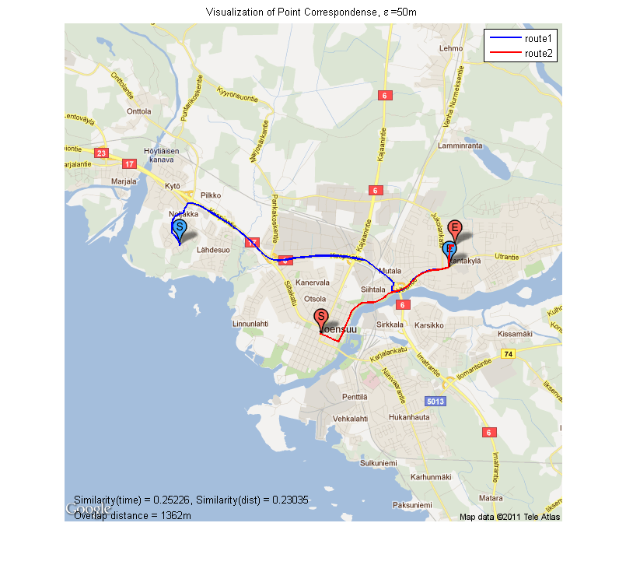
Similarity of two GPS trajectories
We extend the Longest Common Subsequence Similarity (LCSS) criterion for similarity calculation of two GPS trajectories.
LCSS is defined as the time percentage of the overlap segments for two GPS trajectories.

Slide 28
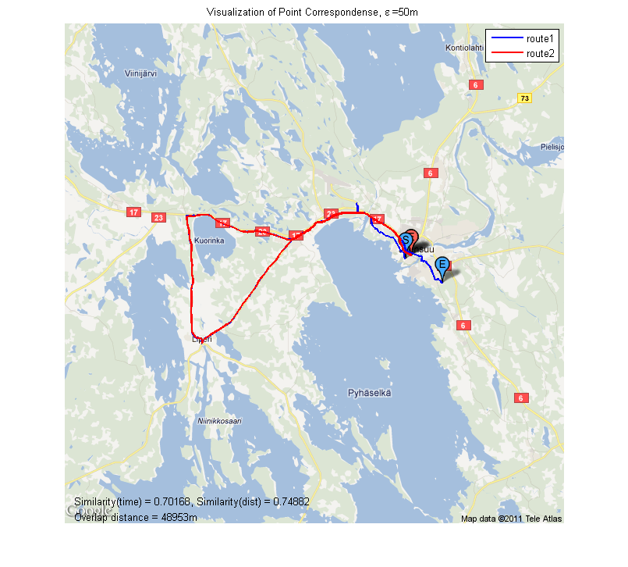
Similarity of two GPS trajectories (example)
Similar travel interests are found for different users

Slide 29
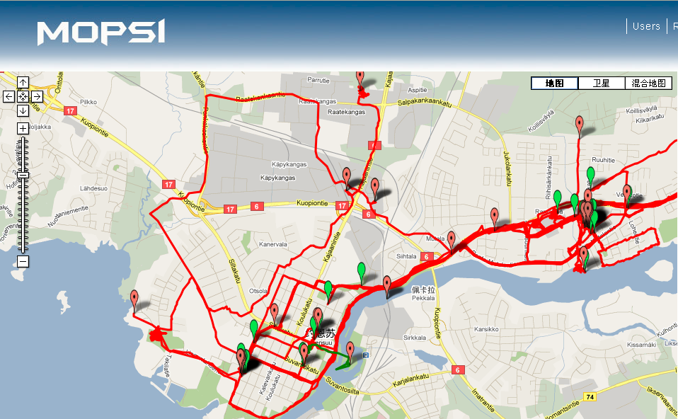
Route Analysis: contextual information and no-moving part
A → B 2 routes
Starting Time:
16:30-17:00
B → A 6 routes
Starting Time:
7:50-8:50
We can guess:
A is office
B is home
Cluster B
Cluster A
nonmoving part in Karol’s
routes, maybe his favorite shops

Slide 30
Route Analysis: New path not on the map
Common stop points
(Food shops)
Start points
(Home of the user)
Commonly used route which is not existing in the street map
There are some lanes Karol goes frequently, but it doesn’t exist on Google map, road network can be updated in this way.

Slide 31
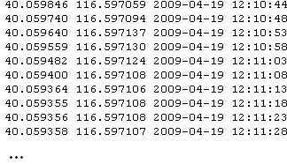
GPS trajectory compression
GPS trajectories include Latitude, Longitude and Timestamp .
Storage cost is around 120KB/hour if the data is collected at 1 second interval. For 10,000 users, the storage cost is 30GB/day, 10TB/year.
Compression algorithm can save the storage cost significantly

Slide 32
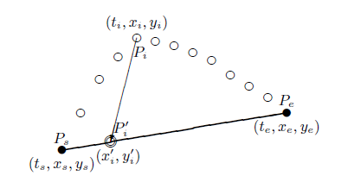
Simple algorithms for GPS trajectory compression
Reduce the number of points of the trajectory data, with no further compression process for the reduced data.
Difference criterions are used, such as TD-TR, Open Window, STTrace.
Synchronous Euclidean distance (SED) is used as the error metrics.

Slide 33
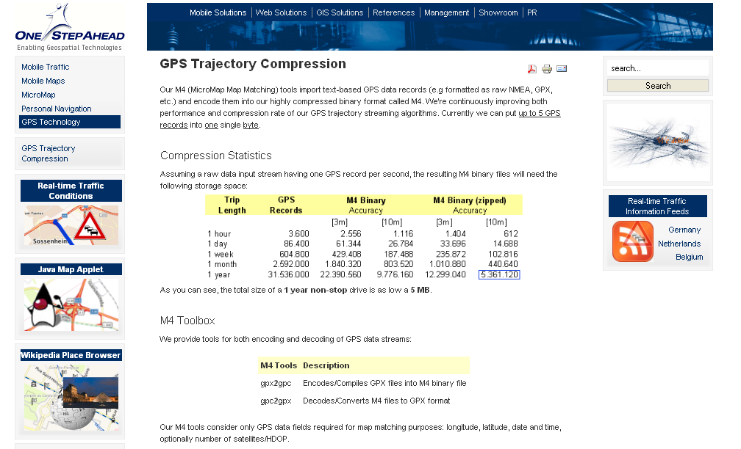
Performance of existing algorithms

Slide 34
Our algorithm
Optimizes both for the reduction approximation and the quantization.
Dataset: Microsoft Geolife dataset, 640 trajectories, 4,526,030 points
Sampling rate: 1s,2s,5s
Transportation mode: walking, bus, car and plane or multimodal.
The size of uncompressed file : 43KB/hour(binary) , 120KB/hour(txt), 300+KB/hour(GPX)

Slide 35
Result

Slide 36
Result

Slide 37
Result

Slide 38
Result: Compression performance
 | Uncompressed (KB) | Max SED = 1m (KB) | Max SED = 3m (KB) | Max SED =10m (KB)
1 Hour | 43.2 | 0.75 | 0.39 | 0.19
1 Day | 1,036 | 18 | 9.36 | 4.56
1 Month | 31,104 | 540 | 280.8 | 136.8
1 Year | 378,432 | 6,570 | 3,416 | 1,664
Compression Ratio |  | 57.6 | 110.7 | 227.4

Slide 39
Result: Time cost and average SED
 | Max SED = 1m | Max SED = 3m | Max SED = 10m
Ave_SED(m) | 0.43±0.05 | 1.41±0.10 | 4.81±0.36
Encoding time (second/10000 points) | 3.44±2.63 | 1.52±1.08 | 0.65±0.45
Decoding time (second/10000 points) | 3.44±2.65 | 1.61±1.15 | 0.68±0.47

Slide 40
Questions?

Slide 41
Comparison
We also compare the performance of proposed method with the state-of-the-art method TD-TR¹.
Compression performance (KB/hour)
 | TD-TR + WinZip | Proposed
Max SED = 1m | 2.04±1.31 | 0.75±0.42
Max SED = 3m | 1.16±0.72 | 0.39±0.21
Max SED = 10m | 0.61±0.41 | 0.19±0.12
1.N. Meratnia and R. A. de By. "Spatiotemporal Compression Techniques for Moving Point Objects", Advances in Database Technology, vol. 2992, pp. 551–562, 2004.

Slide 42
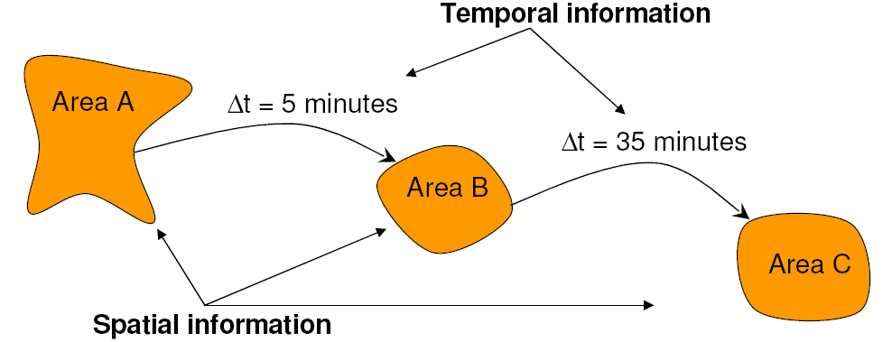
Trajectory Pattern (Giannotti et al. 07)
A trajectory pattern should describe the movements of objects both in space and in time

Slide 43
Sample T-Patterns
Data Source: Trucks in Athens – 273 trajectories)

Slide 44
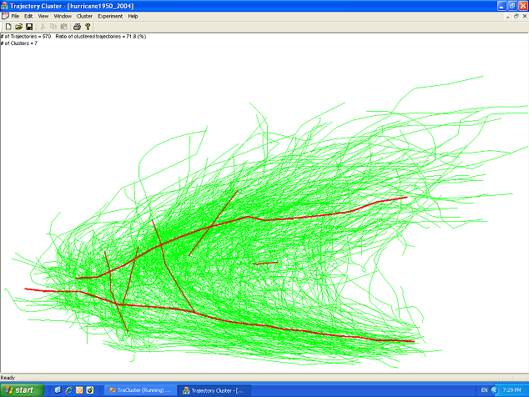
Trajectory Clustering (Lee et al. 07)
7 Clusters from Hurricane Data
570 Hurricanes (1950~2004)
A red line: a representative trajectory

Slide 45
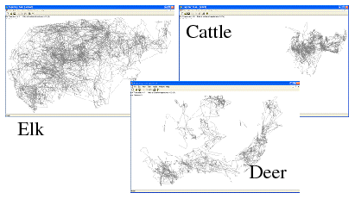
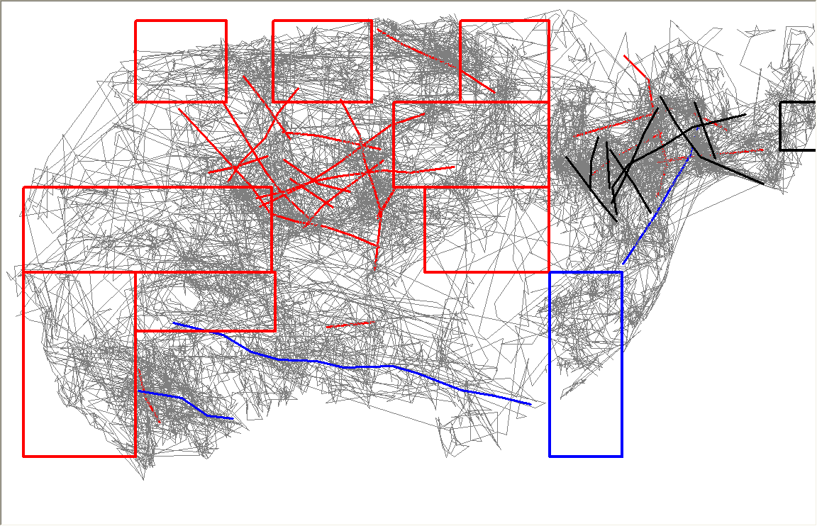
Features:
10 Region-Based Clusters
37 Trajectory-Based Clusters
Data (Three Classes)
Accuracy = 83.3%

Slide 46
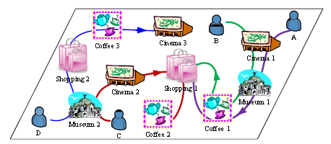
Find users with similar behavior (Yu et al. 10)
Estimate the similarity between users: semantic location history (SLH)
The similarity can include : Geographic overlaps(same place), Semantic overlaps(same type of place), Location sequence.

