Slide 1
World-wide location-based search using OpenStreetMap
Andrei Tabarcea, Matti Mononen
6.03.2013

Slide 2
Andrei Tabarcea
Joint PhD degree candidate for University of Eastern Finland and Technical University of Iasi, Romania
ECSE grant 2012 & 2013
Proposed graduation 2014, supervisor prof. Pasi Fränti
Thesis “Location-based applications”
Research part of Mopsi project http://cs.uef.fi/mopsi

Slide 3
Publications 2012-2013
A. Tabarcea, K. Waga, Z. Wan and P. Fränti, "O-Mopsi: Mobile Orienteering Game Using Geotagged Photos", Int. Conf. on Web Information Systems & Technologies (WEBIST'13), Aachen, Germany, 8-10 May 2013.
K. Waga, A. Tabarcea, R. Mariescu-Istodor and P. Fränti, "Real Time Access to Multiple GPS Tracks", Int. Conf. on Web Information Systems & Technologies (WEBIST'13), Aachen, Germany, 8-10 May 2013.
K. Waga, A. Tabarcea, R. Mariescu-Istodor and P. Fränti, "System for real time storage, retrieval and visualization of GPS tracks", Int. Conf. System Theory, Control and Computing (ICSTCC 2012), Sinaia, Romania, Vol. 2, October 2012.
K. Waga, A. Tabarcea, M. Chen and P. Fränti, "Detecting movement type by route segmentation and classification", IEEE Int. Conf. on Collaborative Computing: Networking, Applications and Worksharing (CollaborateCom'12), Pittsburgh, USA, 2012
K. Waga, A. Tabarcea and P. Fränti, "Recommendation of points of interest from user generated data collection", IEEE Int. Conf. on Collaborative Computing: Networking, Applications and Worksharing (CollaborateCom'12), Pittsburgh, USA, 2012.

Slide 4
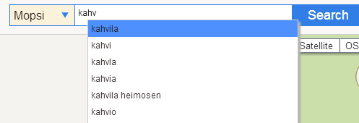
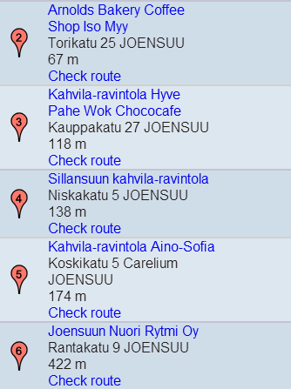
Location-based search
How to find location-information in web-pages?

Slide 5
Site hosting information
domain: uef.fi descr: ITÄ-SUOMEN YLIOPISTO (UNIV OF EASTERN FINLAND) descr: 22857339 address: TIETOTEKNIIKKAKESKUS (IT-CENTRE)/Jarno Huuskonen address: PL 1627 address: 70211 address: KUOPIO FINLAND phone: +358 44 7162810 status: Granted created: 26.5.2010 modified: 19.8.2011 expires: 26.5.2015 nserver: ns-secondary.funet.fi [Ok] nserver: ns1.uef.fi [Ok] nserver: ns2.uef.fi [Ok] dnssec: no

Slide 6
HTML tags
geo-tags, address-tags, vcards for Google Maps etc.
<HTML>
<HEAD profile"="http://geotags.com/geo>
<META name="geo.position" content="62.35;29.44">
<META name="geo.region" content="FI">
<META name="geo.placename" content="Joensuu">
<META http-equiv="Content-Type" content="text/html; charset=iso-8859-1">
<link rel="stylesheet" href="http://www.joensuu.fi/tkt/sivutyyli.css" type="text/css">
<TITLE>Pages of Pasi Fränti</TITLE>
</HEAD>

Slide 7
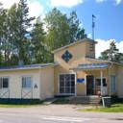
Natural language descriptions
 | Scouts' Youth Hostel (8.3 km from Joensuu Airport) Show map
 | Good, 7.4 Latest booking: January 23 Scouts’ Youth Hostel is located at the outfall of River Pielisjoki, 1.5 km from Joensuu city centre. It offers free Wi-Fi and rooms with shared bathroom and kitchen facilities. OlgaSaint-Petersburg, Russia "Great price for the nice room. Friendly stuff, cozy atmosphere. But a bit loud." | from € 46

Slide 8
Postal addresses

Slide 9
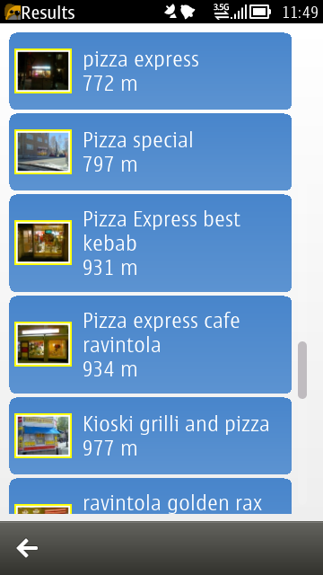
Mopsi search
Input:
user location (lat, lon)
keywords
Output: list of services containing:
name/title
website
address (street, number. city)
location (lat, lon)
image
other info (opening hours, telephone etc.)
Main idea:
preprocess the search results of an external search engine (Google, Yahoo, Bing etc.) by detecting postal address in order to find the location

Slide 10
Proposed steps
Convert user location (lat, lon) into user address = Geocoding step
Search with the query "keyword+city" using an external search engine API and download the first k results (web pages) = Web page retrieval step
Detect addresses and additional informatio from the downloaded web pages = Data mining step
Ranking the results (distance, relevance etc.) = Ranking step
Display the search results to the user
lat, lon
1. Geocoder
2.
Web page retrieval
web pages
3.
Data mining
result list
4. Result ranking
User
keywords
5. ranked result list

Slide 11
Geocoding
Convert user location (lat, lon) into user address using:
lat, lon
Geocoder
Web page retrieval
web pages
Data mining
result list
Result ranking
User
keywords
ranked result list

Slide 12
Web page retrieval
Download k webpages from the query <keyword, city> using API of:
lat, lon
Geocoder
Web page retrieval
web pages
Data mining
result list
Result ranking
User
keywords
ranked result list

Slide 13
Ranking
Main criterion:
distance from the user’s location
Future idea:
relevance to user’s profile and history
lat, lon
Geocoder
Web page retrieval
web pages
Data mining
result list
Result ranking
User
keywords
ranked result list

Slide 14
Data mining
Main idea:
Find location information in HTML pages by detecting postal addresses
Steps:
Parse and segment the HTML page
Identify addresses and locations
Identify the services the addresses are pointing to (name/title)
Retrieve extra information (photos, opening hours, telephone etc.)
lat, lon
Geocoder
Web page retrieval
web pages
Data mining
result list
Result ranking
User
keywords
ranked result list

Slide 15
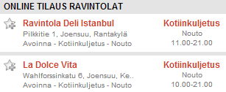
Parsing HTML pages
Extract text from HTML pages
Segmentation of web pages using DOM tree
ONLINE TILAUS RAVINTOLAT
Ravintola Deli Istanbul
Kotiinkuljetus Nouto
11.00-21.00
Pilkkitie 1, Joensuu, Rantakylä
Avoinna - Kotiinkuljetus - Nouto
La Dolce Vita
Kotiinkuljetus Nouto
10.00-21.00
Wahlforssinkatu 6, Joensuu, Ke..
Avoinna - Kotiinkuljetus - Nouto

Slide 16
Postal address detection
Rule-based pattern matching algorithm
Starting point: the detection of street-names
An address-block candidate is constructed by detecting:
street names and number
postal codes
municipal names
We will use OpenStreetMap database for global detection
Street names
Telephone
numbers
City names
Street
numbers
Notes:
30-60 seconds (~1 minute)
You can see above a typical web-page that can be found by our search engine, in which I highlighted the various address elements (red – street-names, green numbers, blue - municipalities, magenta – telephone numbers) along with the detected address blocks (cyan).

Slide 17
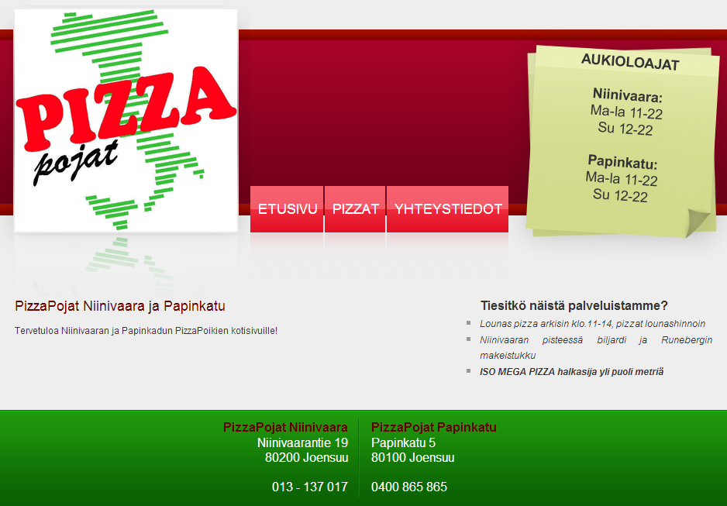
Web page example - Homepage

Slide 18
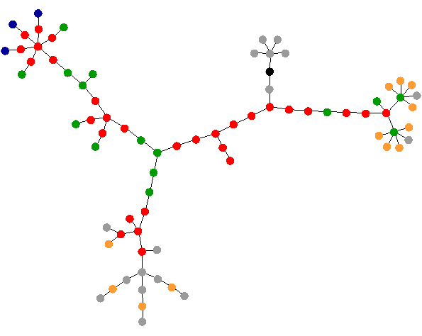
DOM tree
blue: links (the A tag) red: tables (TABLE, TR and TD tags) green: dividers (DIV tag) violet: images (the IMG tag) yellow: forms (FORM, INPUT, TEXTAREA, SELECT and OPTION tags) orange: linebreaks and blockquotes (BR, P, and BLOCKQUOTE tags) black: HTML tag, the root node gray: all other tags

Slide 19
DOM subtree
<body>
<tr>
<div>
<tr>
<td>
PizzaPojat Niinivaara
<html>
<table>
<td>
<table>
<div>
Niinivaarantie 19
<table align="center“>
<tr>
<td>
<div id="footerleft">
<h3>PizzaPojat Niinivaara</h3>
<p>Niinivaarantie 19</p>
<p>80200 Joensuu</p>
<br />
<p>013 - 137 017</p>
</div>
<td>
</tr>
</table>
013 - 137 017
80200 Joensuu
<br/>

Slide 20
Web page example - Catalog

Slide 21
Web page example - Catalog
Miami
Bosbor kebab
Fiesta

Slide 22
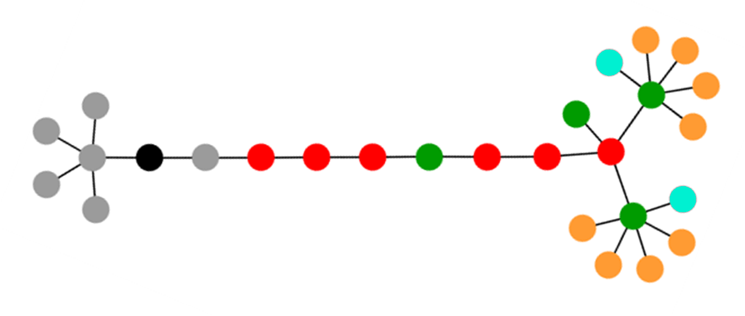
Implementation
Convert HTML pages to xHTML for using xQuery
Detect addresses and postal codes
Break the DOM tree into subtrees
Use heuristics and regular expressions to detect extra information from the subtree (service name, telephone, opening hours etc.)
<body>
<tr>
<div>
<tr>
<td>
PizzaPojat Niinivaara
<html>
<table>
<td>
<table>
Niinivaarantie 19
013 - 137 017
80200 Joensuu
<br/>

Slide 23
Questions?
Thank you

Slide 24
DOM tree example
Niskakatu 11 80100 Joensuu
Pizza Master - Joensuu
Puh. 0400 281700
Yhteystiedot
Avoinna
<td>
Pizza Master - Joensuu
Ma-To 10.30-22.00
<tr>
Pe-La 10.30-04.00
<table>
SU 12.00-22.00
<div>
<a href>
<html>
<body>
<img>
<head>

