Slide 1
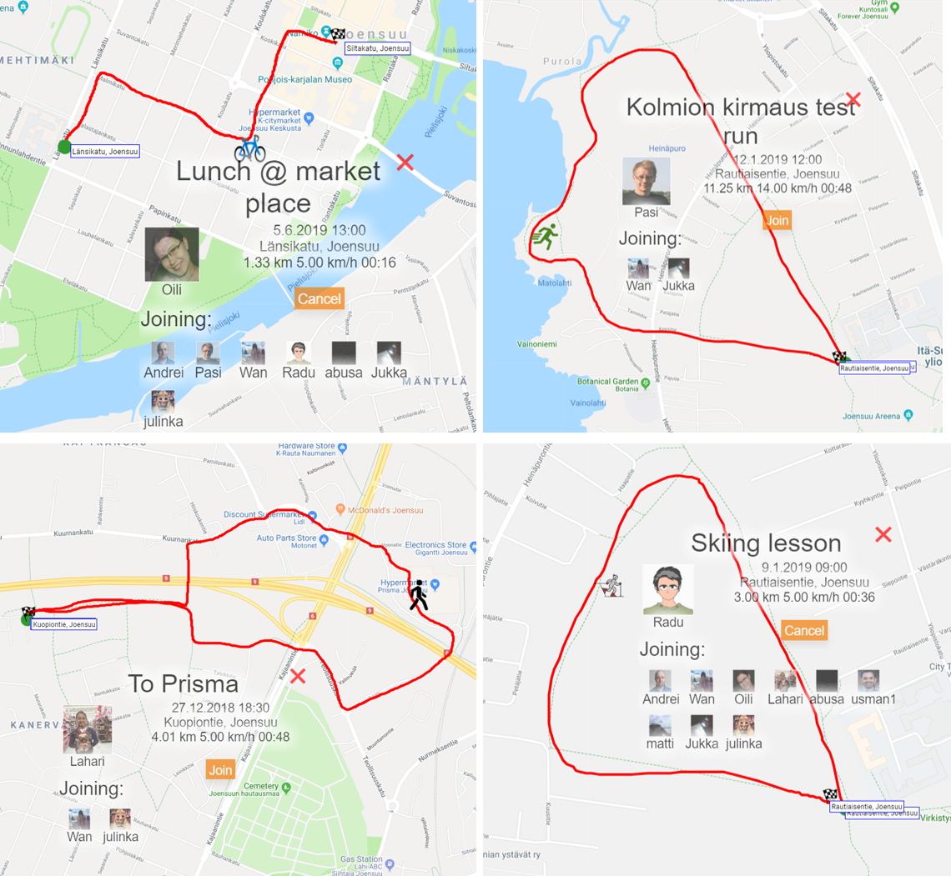
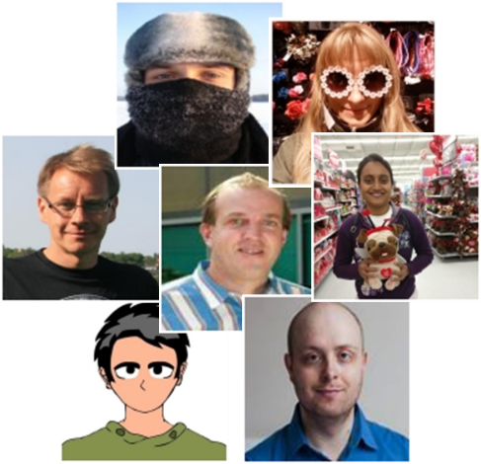

Activity event recommendation and attendance prediction
Journal of Location Based Services, 13 (4), 2019.
?
Radu Mariescu-Istodor, Abu S.M. Sayem and Pasi Fränti
31.1.2019

Slide 2
Active Events

Slide 3
Active Events

Slide 4
User Profiling

Slide 5
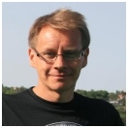
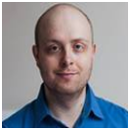
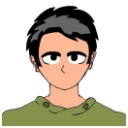
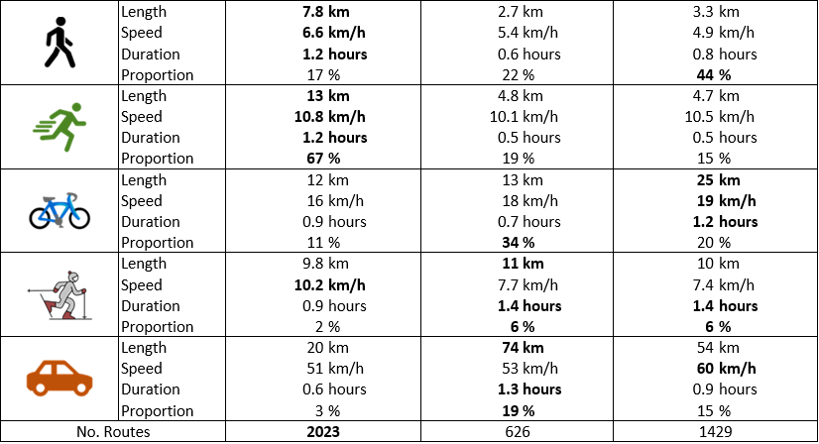
Movement

Slide 6
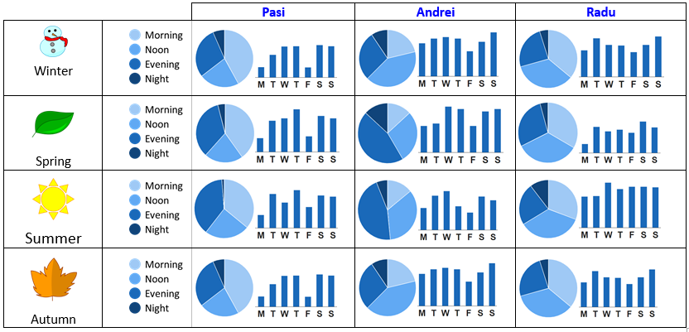
Availability

Slide 7



Other characteristics
Meetings
Photos
Services

Slide 8
Features

Slide 9
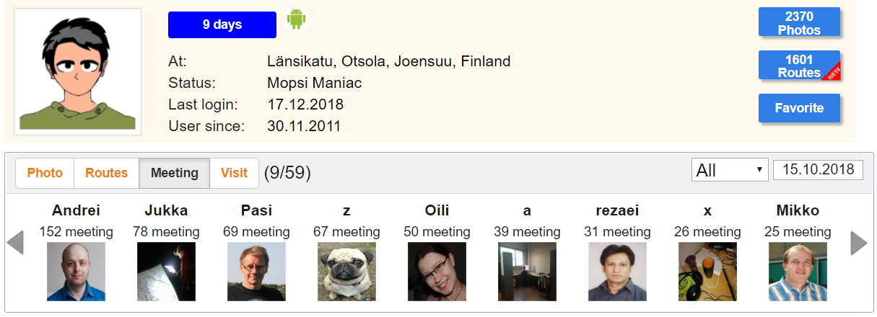
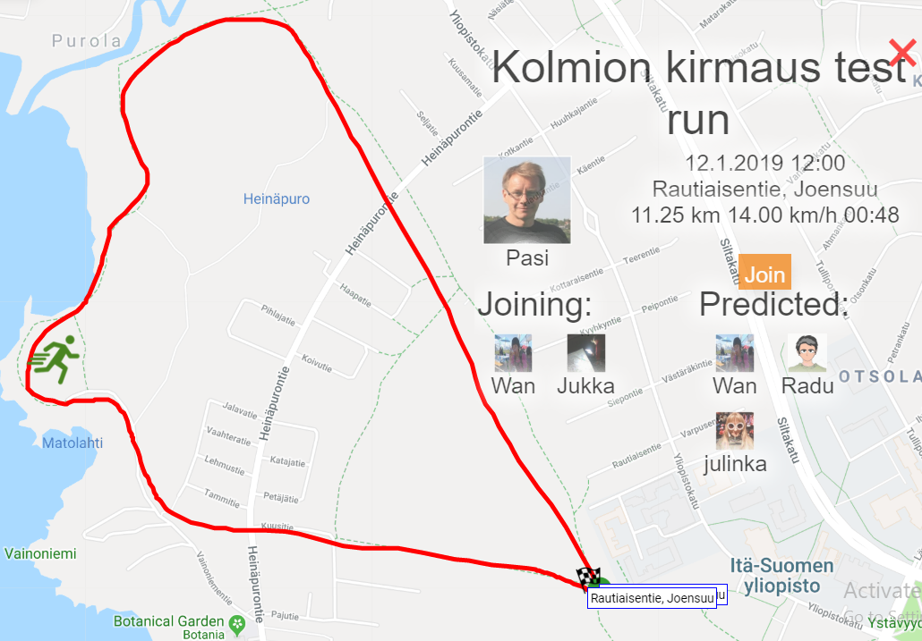
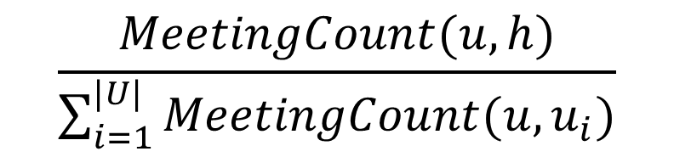

Feature 1 – Community
$$\frac{MeetingCount(u,h)}{\sum_{i=1}^{|U|}{MeetingCount(u,u_{i})}}$$
$$\frac{69}{537}$$

Slide 10


Feature 2 – Suitability Type
$$\frac{1}{|R|}\sum_{i=1}^{|R|}{\left(SameType\left(e,r_{i}\right) AND SameSeason(e,r_{i})\right)}$$
$$\frac{76}{1429}$$

Slide 11
Feature 3 – Suitability Skill

Slide 12
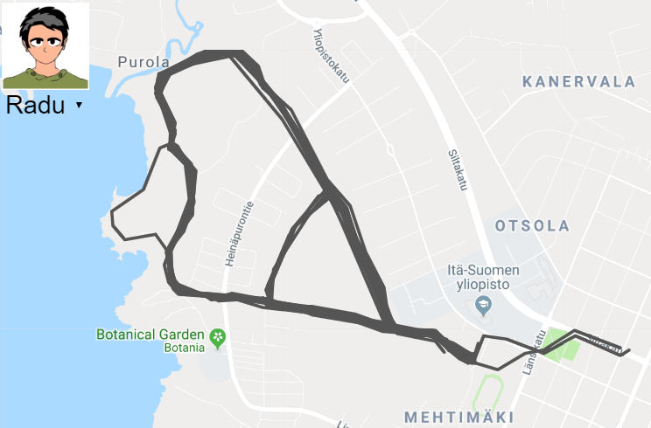
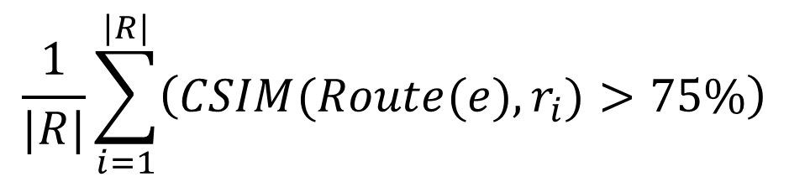
Feature 4 – Familiarity
$$\frac{1}{|R|}\sum_{i=1}^{|R|}{\left(CSIM(Route(e),r_{i})>75\%\right)}$$

Slide 13
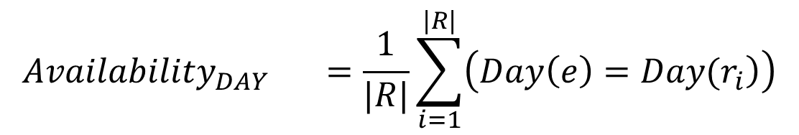
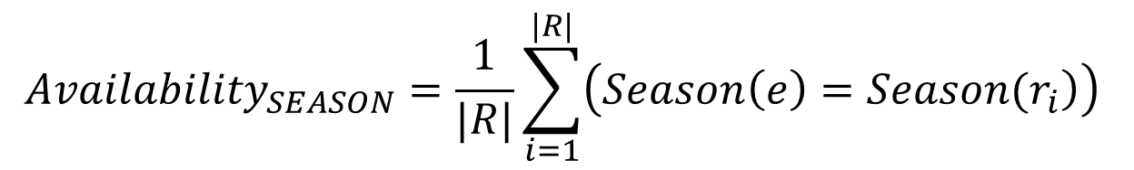
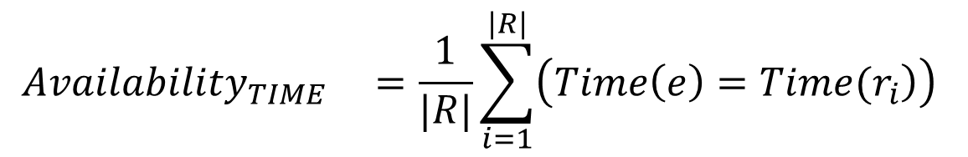
Features 5 - 7 – Availability
$${Availability}_{DAY} =\frac{1}{|R|}\sum_{i=1}^{|R|}{\left(\left.Day\left(e\right)={Day(r}_{i}\right)\right)}$$
$${Availability}_{TIME} =\frac{1}{|R|}\sum_{i=1}^{|R|}{\left(\left.Time\left(e\right)={Time(r}_{i}\right)\right)}$$
$${Availability}_{SEASON}=\frac{1}{|R|}\sum_{i=1}^{|R|}{\left(\left.Season\left(e\right)={Season(r}_{i}\right)\right)}$$

Slide 14
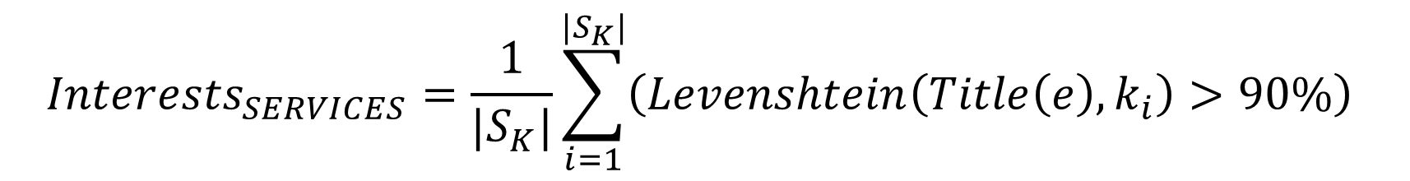
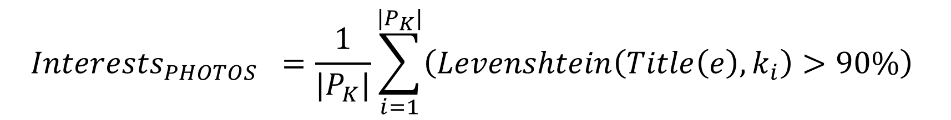
Features 8 - 9 – Interests
Photos
Services
$${Interests}_{SERVICES}=\frac{1}{|S_{K}|}\sum_{i=1}^{|S_{K}|}{\left(Levenshtein\left(Title\left(e\right),k_{i}\right)>90\%\right)}$$
$${Interests}_{PHOTOS} =\frac{1}{|P_{K}|}\sum_{i=1}^{|P_{K}|}{\left(Levenshtein\left(Title\left(e\right),k_{i}\right)>90\%\right)}$$

Slide 15
Data

Slide 16
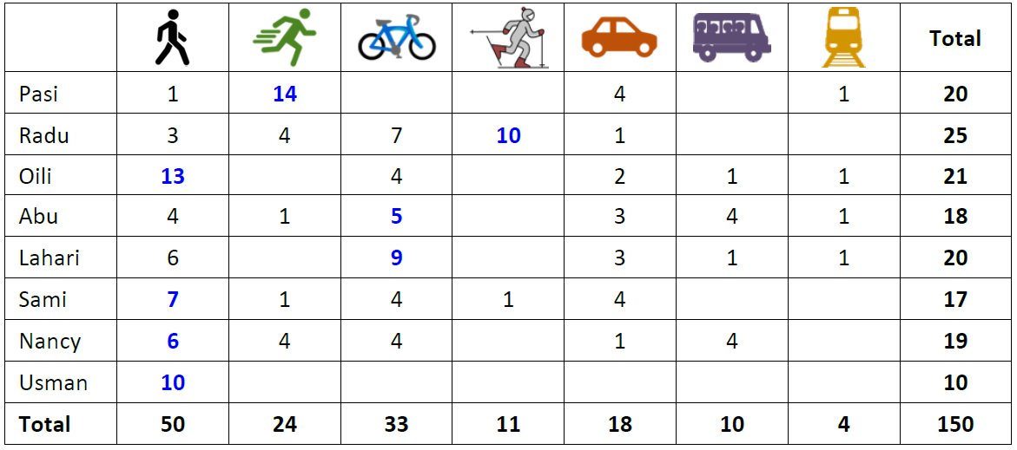
Events dataset

Slide 17
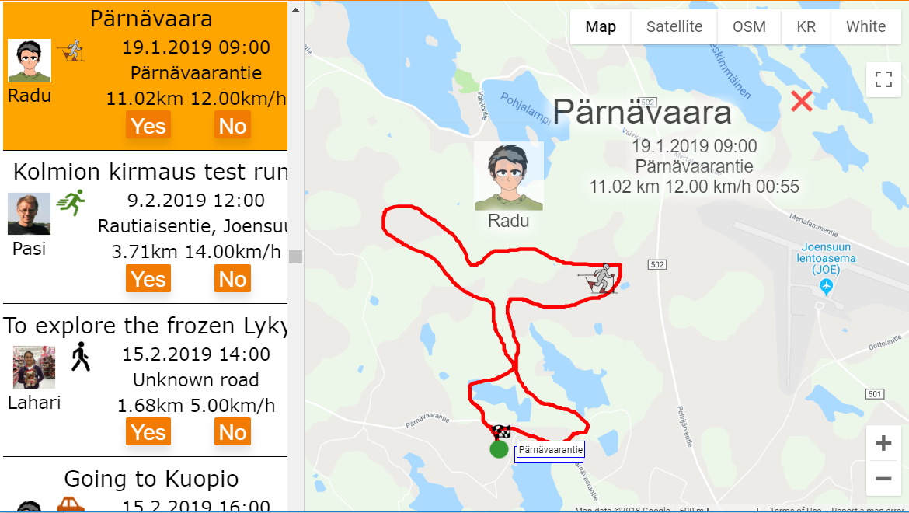
Data collection tool

Slide 18
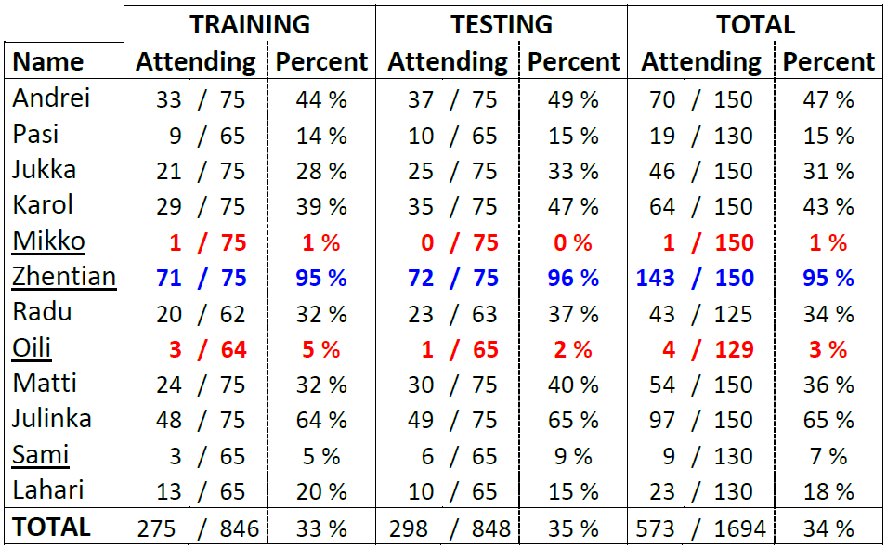
Attendees

Slide 19
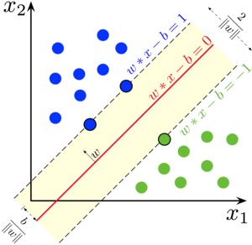
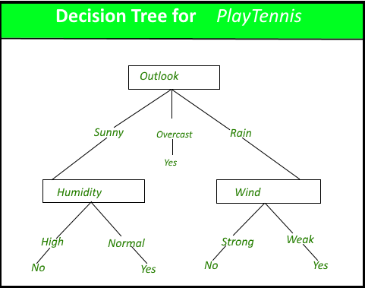
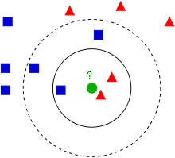
Classifiers
SVM
Decision Tree
KNN
Sources: Google

Slide 20

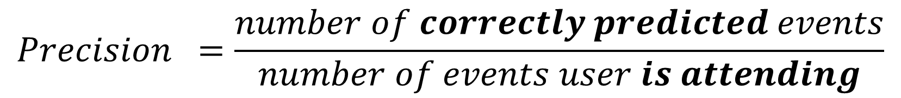
Evaluation measures
$$Precision =\frac{number of correctly predicted events}{number of events user is attending}$$
$$Accuracy =\frac{number of correctly predicted events}{total number of events}$$

Slide 21
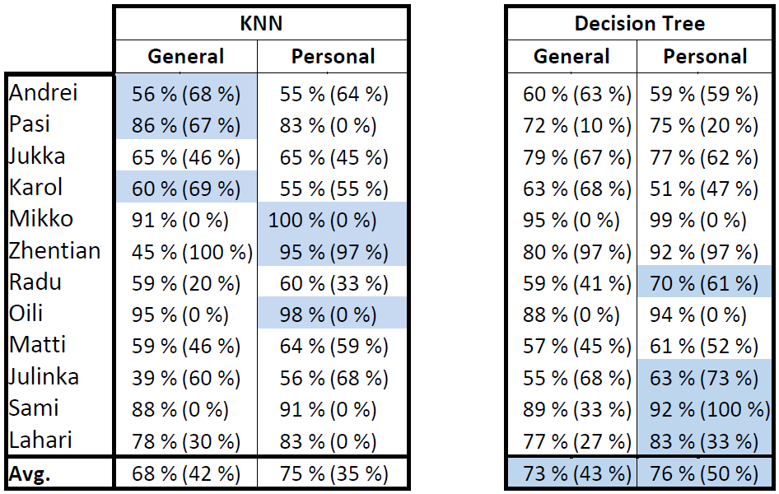
Classification performance

Slide 22
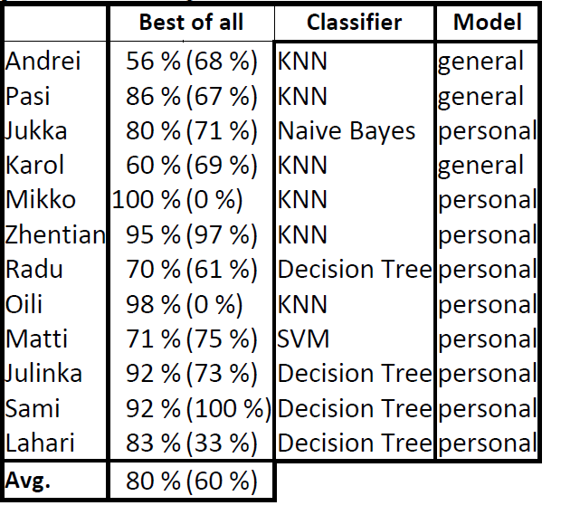
Classifier ensemble

Slide 23
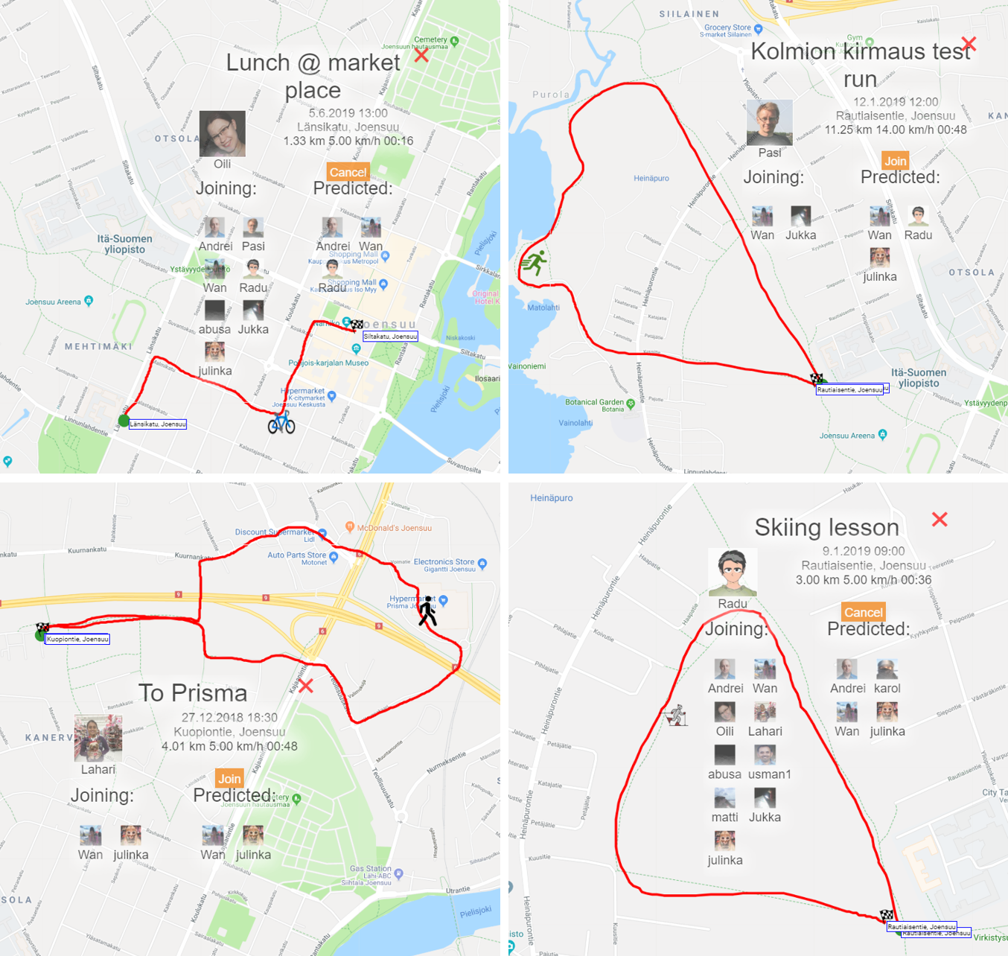
Qualitative Evaluation

Slide 24
Qualitative Evaluation

Slide 25
Thank You !
Radu Mariescu-Istodor
radum@cs.uef.fi

