Slide 1
Keyword extraction from web pages
Himat Shah and Pasi Fränti
20.2.2023
H. Shah and P. Fränti
Combining statistical, structural, and linguistic features for keyword extraction from web pages
Applied Computing and Intelligence, 2022.

Slide 2
Introduction

Slide 3
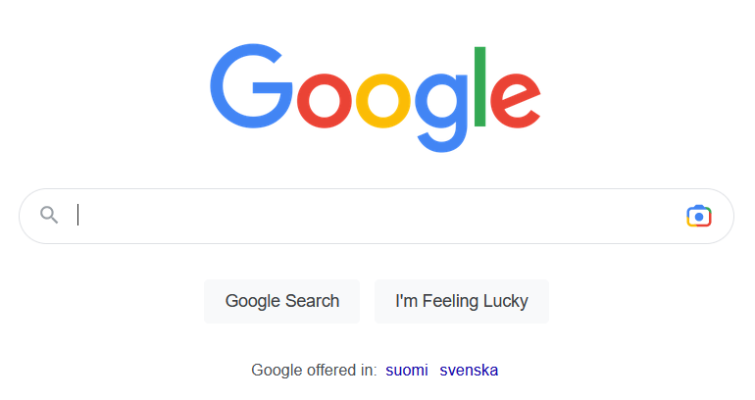

Slide 4
Content of Web Page Hypertext Markup Language (HTML, XHTML)
Logo image
Navigation bar
Title
Keywords
Images
Text

Slide 5
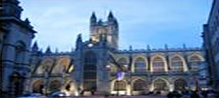
Content summarization
Title: Rosso restaurant, City pharmacy
Keywords: restaurant; food; lunch; dinner
Representative Image:
Short description:
Mon-Fri: 16.00-22.00
Sat: 12.00-22.00
Phone: 013 227 874

Slide 6
Keyword extraction
Tove
Muumipeikko
Extraction is limited to the set of words.
Annotation is more general approach.

Slide 7
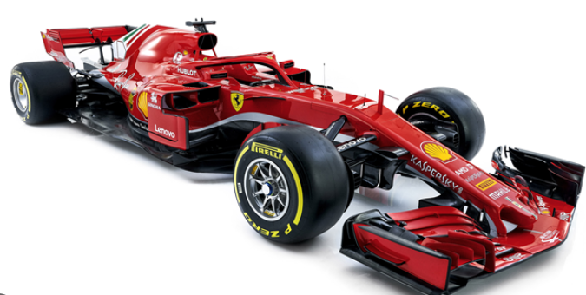
Keyword or key phrases
Eiffel tower
New York
Formula one

Slide 8
Challenges in web pages
No standard structure
Irrelevant text, tags, styling
Multiple topics, multilingual
Language dependent, NLP time consuming

Slide 9
Overall process

Slide 10
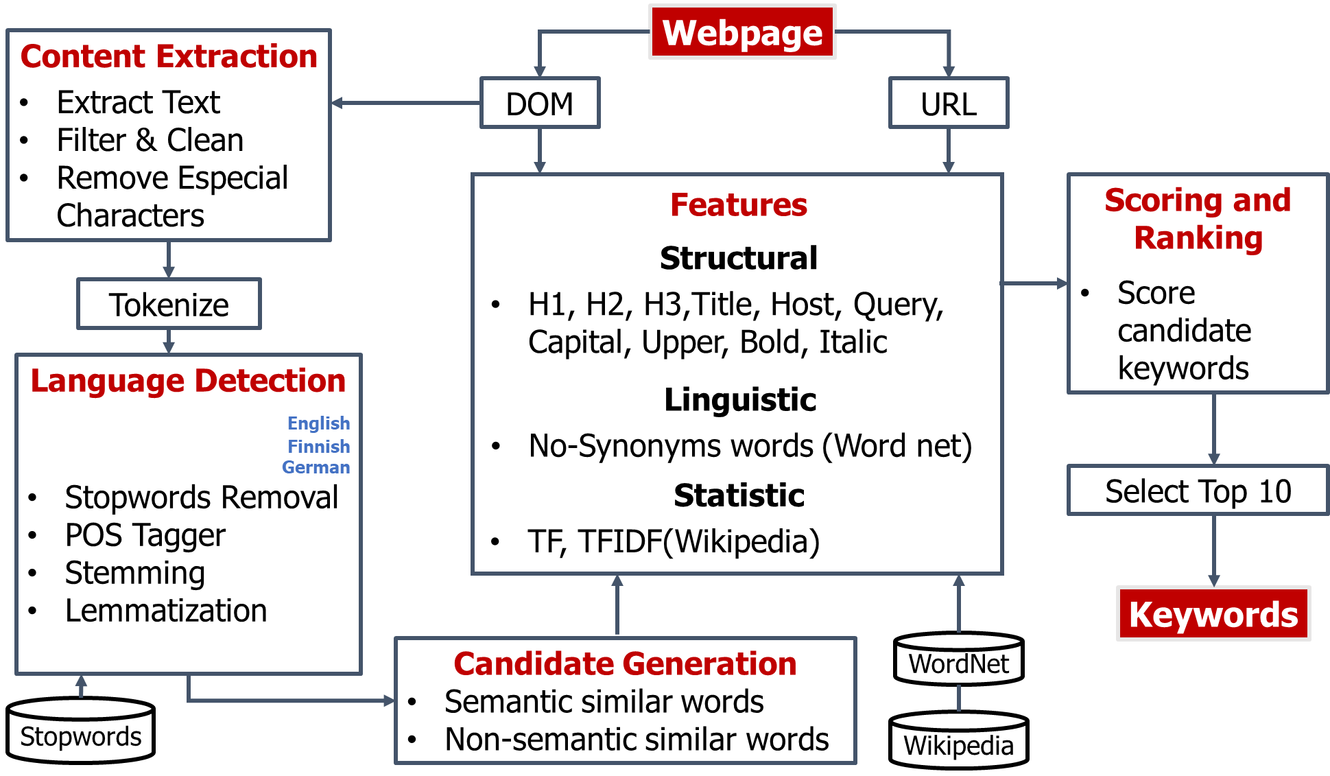
Framework for the keyword extraction

Slide 11
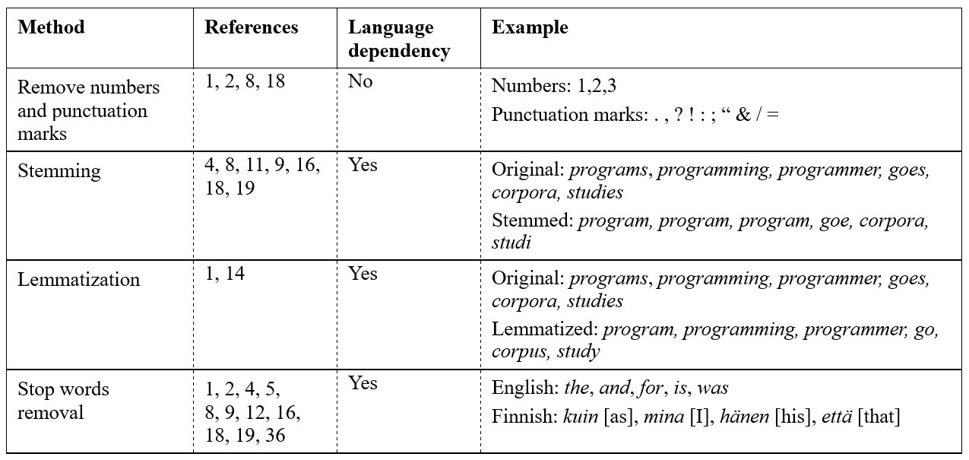
Pre-processing methods

Slide 12
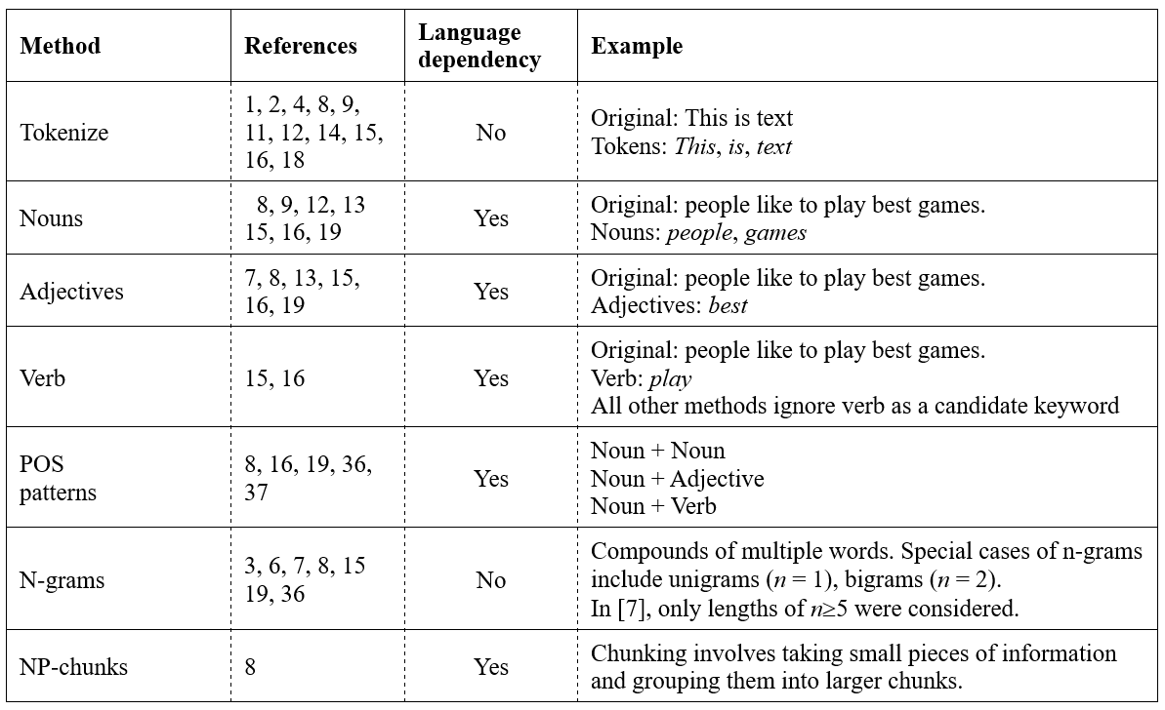
Candidate word selection

Slide 13
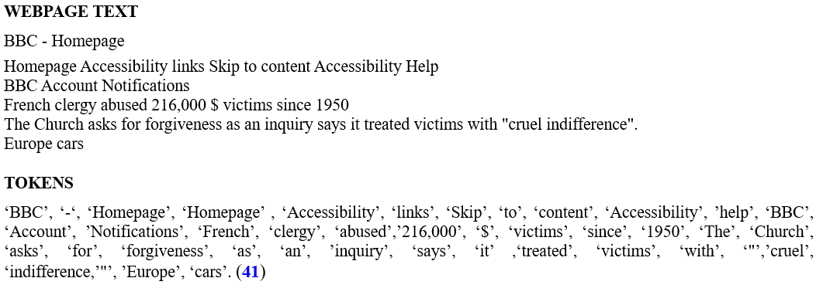
Tokenization

Slide 14
Cleaning + stop word removal

Slide 15
Stem and lemmatization
+ candidate selection

Slide 16
Features

Slide 17
Three types of features
More frequent,
more important
Statistical
Structural
Linguistic
Position in page,
visual emphasis
use of tags
Meaning of word,
position in sentence

Slide 18
Statistical features

Slide 19
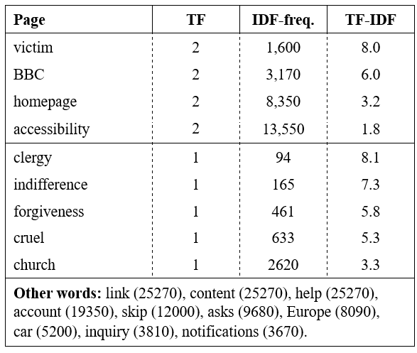
TF-IDF calculations

Slide 20
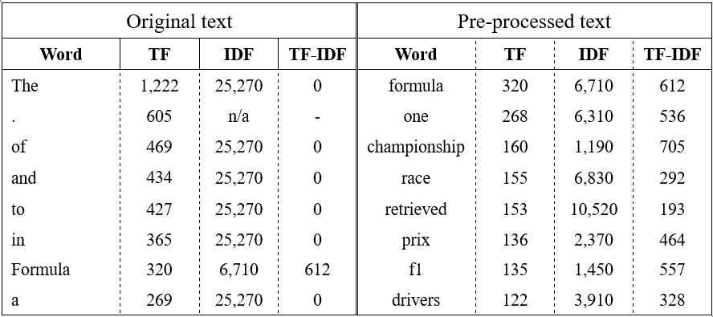
Normalization using Wikipedia

Slide 21
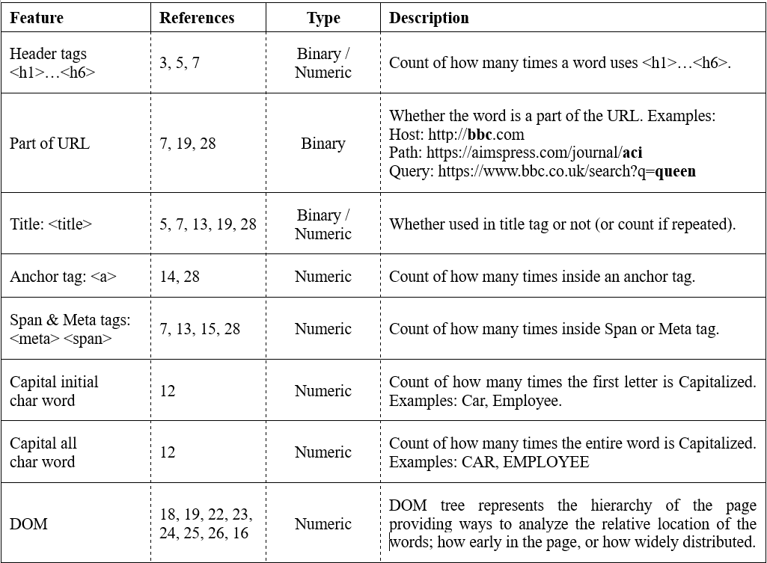
Structural features

Slide 22
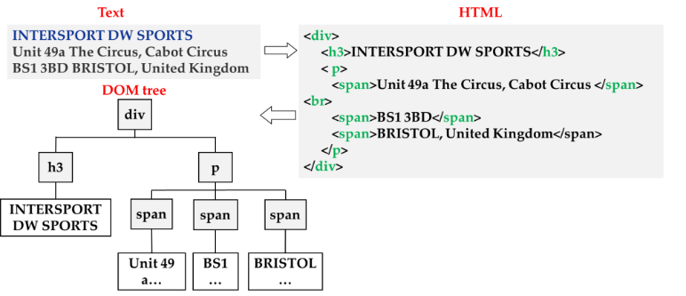
Extracting structure by DOM tree

Slide 23
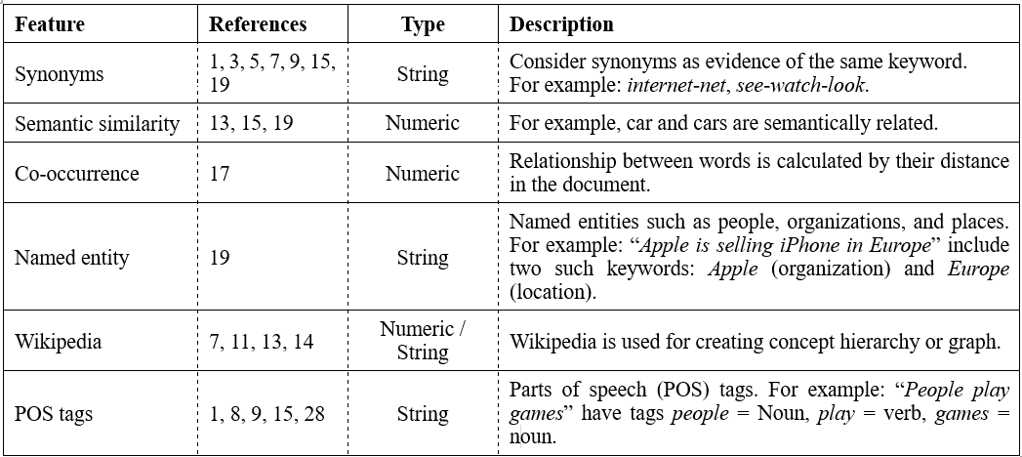
Linguistic features

Slide 24
Part-of-speech (POS) tagging
Navigation
Feeling Social? Find us on
Facebook
Sydney Waterfront Restaurant Restaurant Milsons Point
Aqua Dining offers a quintessential Sydney dining experience
with unrivalled harbour views that sweep from Luna Park to the world famous Sydney Harbour Bridge and the Sydney Opera
House.
NNP=Proper noun, singular
NNPS=Proper noun, plural
NN=Noun, singular or mass
VBG=Verb, gerund
VB=Verb, base form
PRP=Personal pronoun
DT=Determiner
CC=Coordinating conjunction
JJ=Adjective
NNP
VBG
NNP
VB
PRP
IN
NNP
NNP
NNP
NNP
NNP
NNPS
NN
NNP
NNP
VBZ
DT
JJ
NNP
NN
NN
IN
JJ
NN
NNS
WDT
NN
IN
NNP
NNP
IN
DT
NN
JJ
NNP
NNP
NNP
CC
DT
NNP
NNP
NNP

Slide 25
Experiments

Slide 26
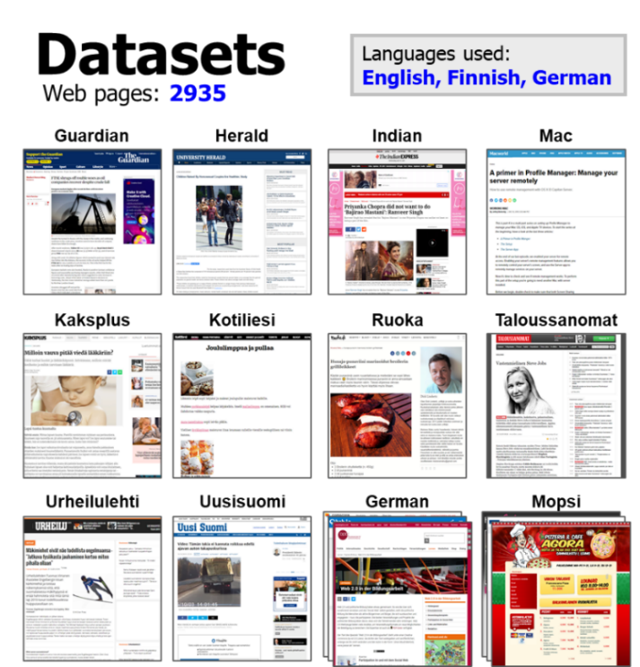
ENG
FIN
GER

Slide 27
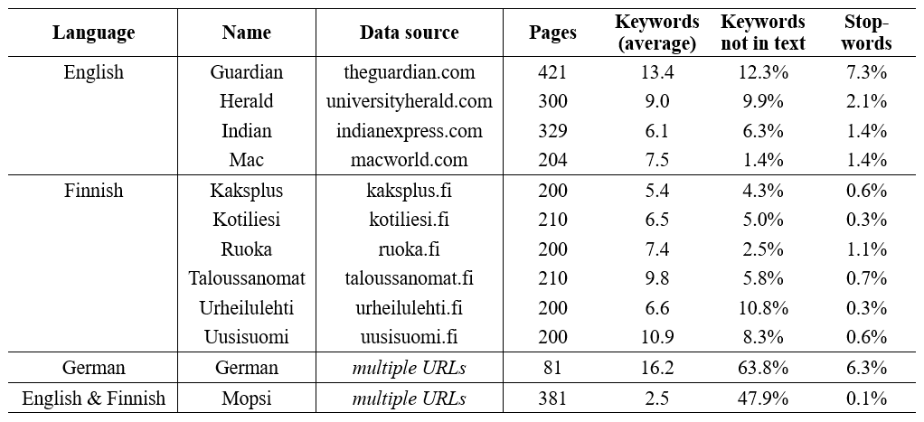
Properties of the datasets

Slide 28
Evaluation measures
Incorrect
detections
Precision = TP / (TP+FP)
Recall = TP / (TP+FN)
Missed
Correct
detections
F-measure = 2⋅precision⋅recall / (precision+recall)
Their soft variants* used also
* P. Fränti and R. Mariescu-Istodor
Soft precision and recall
Pattern Recognition Letters, 2023.

Slide 29
Statistical features
The results are still rather modest
Pre-processing is essential

Slide 30
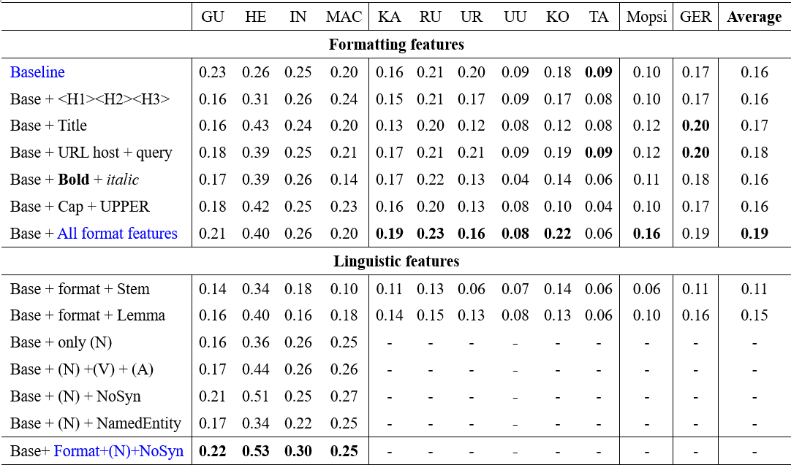
Structural + linguistic features

Slide 31
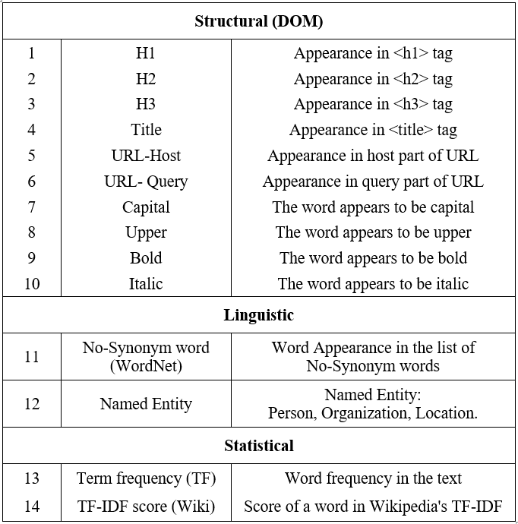
Best combination: ACI-rank

Slide 32
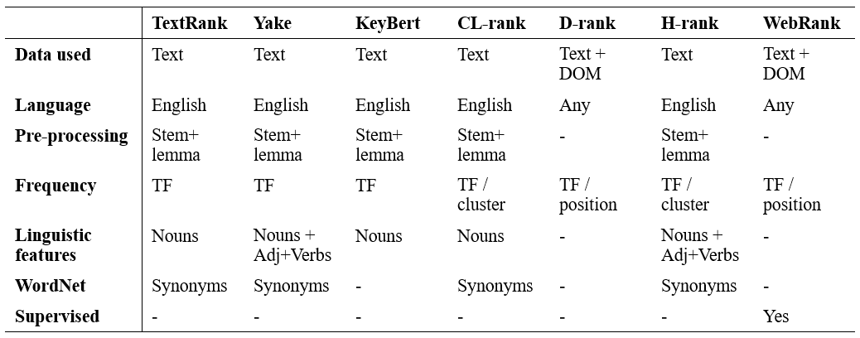
Summary of existing methods

Slide 33
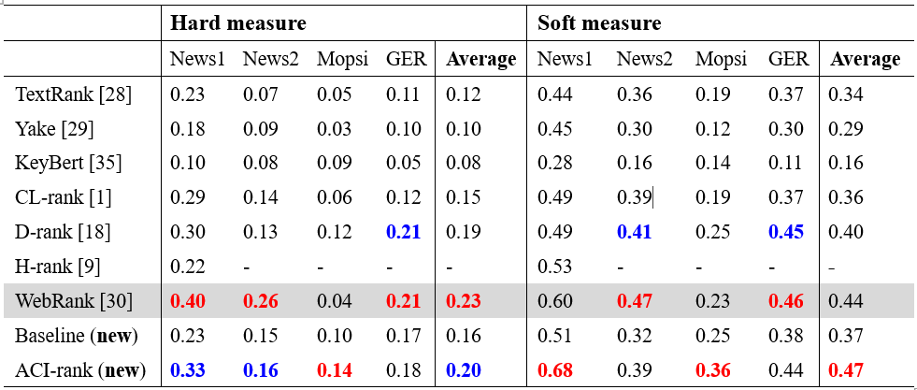
Comparison
Red refers to the best overall result, and blue refers to best result among the unsupervised methods.

Slide 34
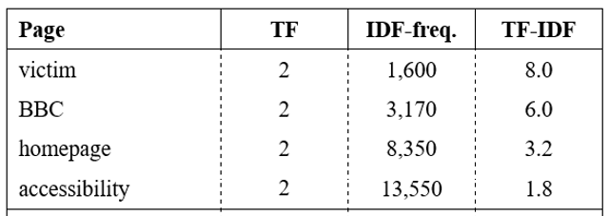
Conclusions
Simple term frequency with stop removal works ok.
Pre-processing very important.
Frequency-based baseline: 0.16 (hard) and 0.37 (soft)
ACI-rank: 0.23 (hard) and 0.44 (soft)
Statistical:
Structural:
Linguistic:

Slide 35
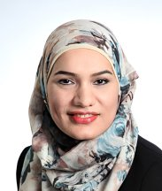
Acknowledgements
Himat Shah: for the keyword extraction papers in his PhD work
Najlah Gali & Mohammad Rezaei: for the earlier work in keyword, title and image extraction
Florian Berger for collecting us the newspaper data sets

