Slide 1
Web mining: address, title and image
Andrei Tabarcea
Najlaa Gali
23.1.2015

Slide 2


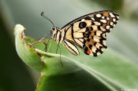

Content of web pages
Web Content Mining
Text
Audio
Image
Video
Structured record
Table

Slide 3

What are we looking for?
Address
Title
Representative image

Slide 4
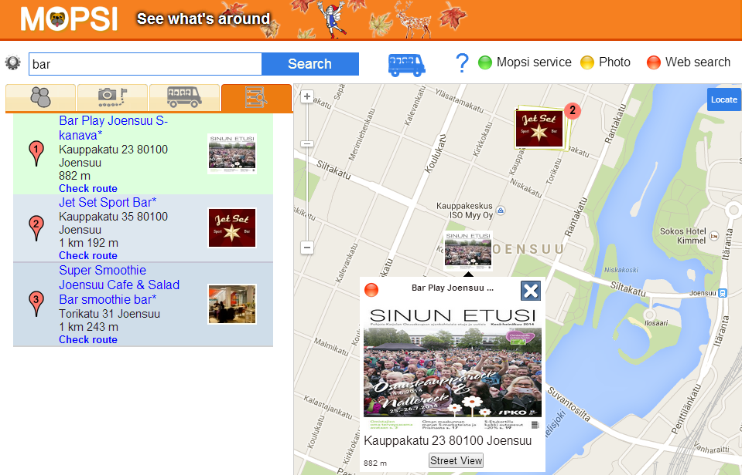
What do we find?
Title
Address
Image
Calculating distance

Slide 5
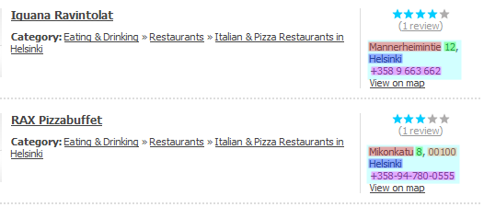
Address detection
Street name
number
postcode
city
Joen Pizza Special Y-tunnus: 2129577-6 Käyntiosoite: Koskikatu 17 80100 JOENSUU Puhelin: 013-220246 Virallinen toimiala: Kahvila-ravintolat
Street names
Telephone
numbers
City names
Street
numbers
Notes:
30-60 seconds (~1 minute)
You can see above a typical web-page that can be found by our search engine, in which I highlighted the various address elements (red – street-names, green numbers, blue - municipalities, magenta – telephone numbers) along with the detected address blocks (cyan).

Slide 6
Extracting service title from single and brand webpages

Slide 7
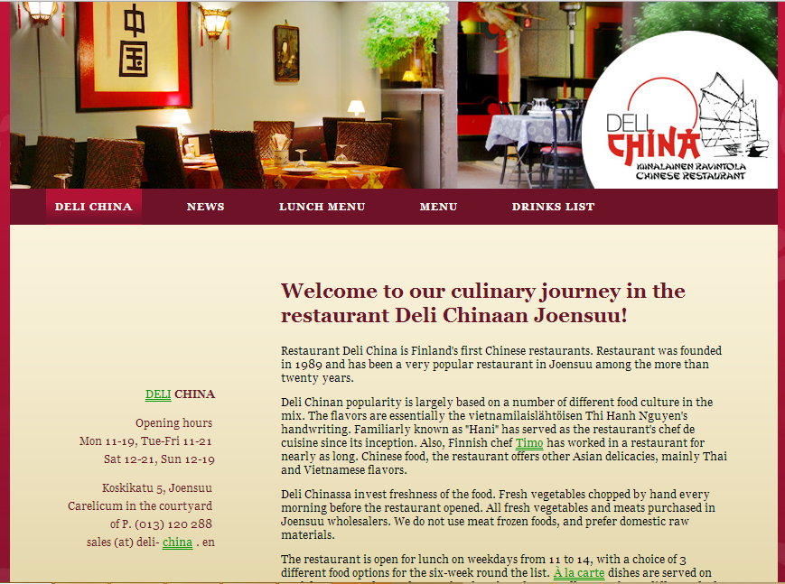

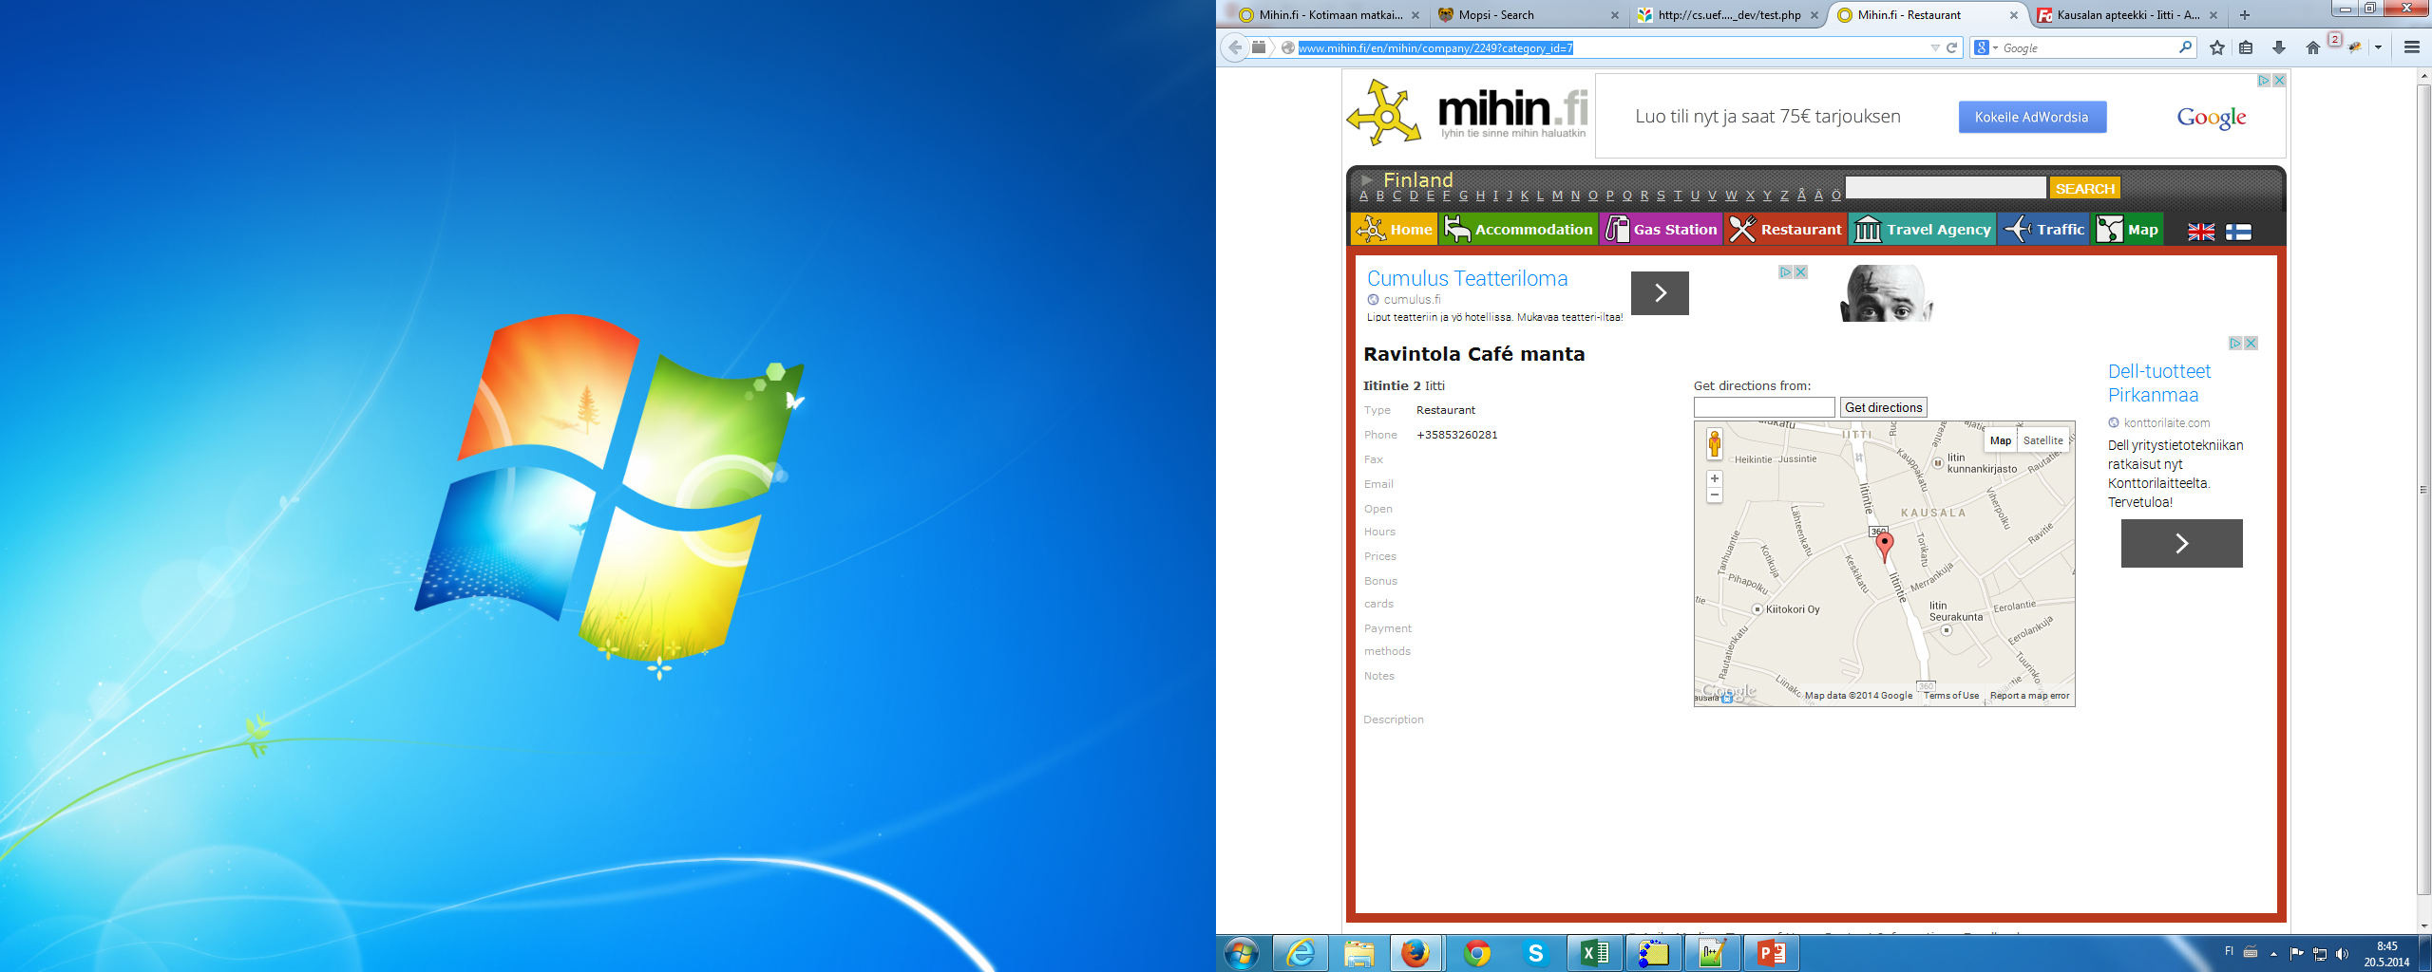
What types of websites are there?
Single service
Brand
Services directory

Slide 8
Single service or brand website?
Scheme
host
path
http://www.example.com/path
Yes
Path?
No
Service directory
detector
No. of postal addresses>1
Yes
No
Yes
No
Service directory
Brand
Single service

Slide 9
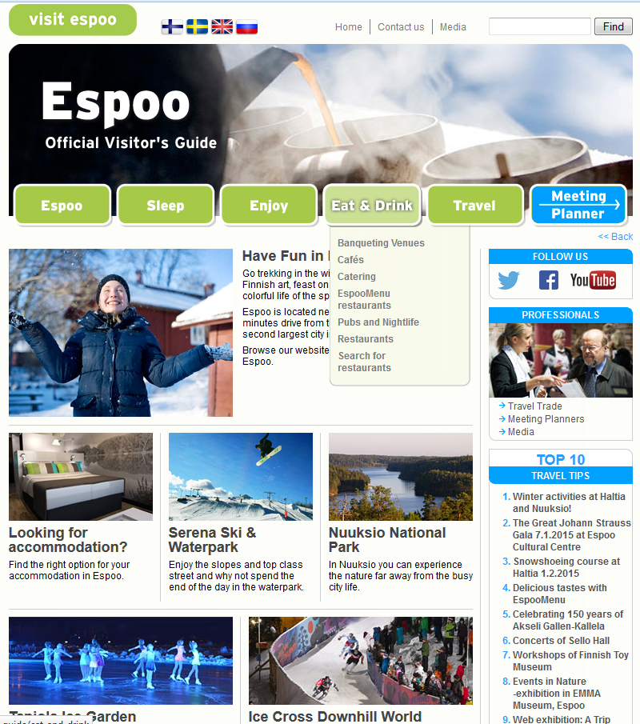
Service directory or brand website?
Menu bar
Nested list
Minor list

Slide 10
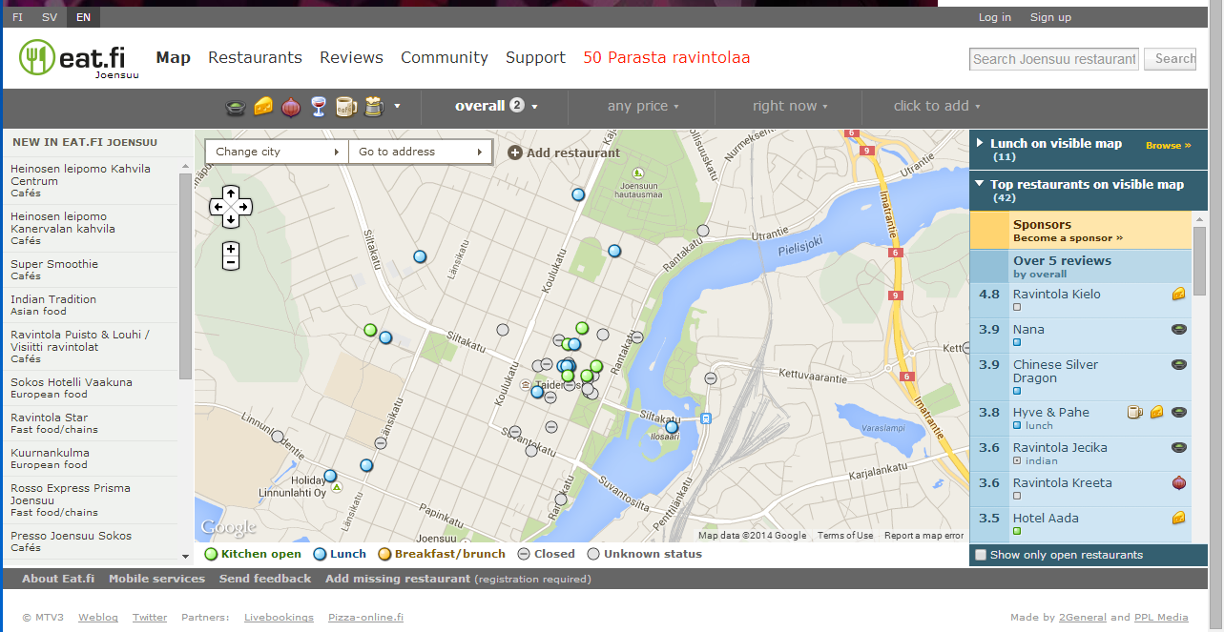
1: Download the webpage
http://eat.fi/en/joensuu/restaurants
Menu bar
Minor list

Slide 11

2: Match menu bar text with predefined categories
Predefined categories
Tavel & Toursim
Law & Government
Hotels & Accommodation
People & Society
Food & Drink
Auto & Vehicles
Real Estate
Business & Industrial
:
Menu text
Map
Restaurants
Reviews
Community
Support
50 Parasta
Sub- categories
Match
Restaurant/s
Not match
Cafe/s
Food
Pizzerias
Bakeries
Match=1 (not enough)

Slide 12
3: Match minor list text with sub- categories
List text
Heinosen leipomo kahvila centrum-Cafes
Heinosen leipomo Kanervalan kavila -Cafes
Super Smoothie-Cafes
Indian Tradition-Asian food
Ravintola Puisto & Louhi-Cafes
Sokos Hotelli Vaakuna-European food
Ravintola Star-Fast food/chains
Kuuranankulma-European food
Rosso Express Prisma Joensuu-Fast food/chains
Presso Joensuu Sokos-Cafes
Buffa Joensuu Prisma-Fast food/chains
Deli Istanbul-Fast food/chains
Ravintola Aura-Cafes
Linnunlahti Catering -Cafes
MTV3 osti Eat.fi
Eat.fi rikkoo jalleen ennatyksia
Miksi rekisteroityminen kannaattaa
Sub- categories
Restaurant/s
Cafe/s
Food
Pizzerias
Bakeries
Drink/s
Etc…
= > 4 matches
Service directory

Slide 13
Service title for single and brand pages
Step 1: Extract text from <title>.... </title> &
<meta>.... </meta>
Step 2: Segment text into phrases
Step 3: Score phrases based on their
    position of occurrence in title and meta tags
    occurrence in headers tags
    position of occurrence in webpage link
Step 4: Select the two highest scored phrases as title for the service

Slide 14
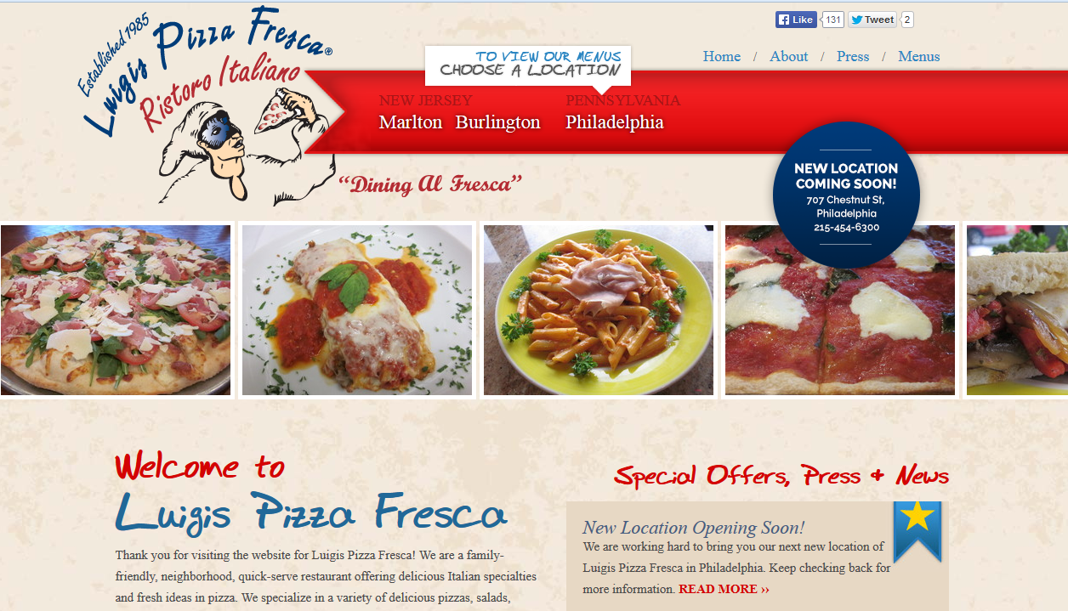
Scoring title phrases
http://www.luigispizzafresca.com/philadelphia.php
Service title: Luigis Pizza Fresca
Extracted title: Luigis Pizza Fresca- Philadelphia
<title>Luigis Pizza Fresca | Marlton, Burlington, Philadelphia, Old City, Margate</title>
Title keywords | Title- score | Headers-score | link-score | Total scores
Luigis Pizza Fresca | 0.1 | 1 | 0 | 1.1
Marlton | 0.1 | 0 | 0 | 0.1
Burlington | 0 | 0 | 0 | 0
Philadelphia | 0 | 0.03 | 1 | 1.03
Old City | 0 | 0 | 0 | 0
Margate | 0 | 0 | 0 | 0

Slide 15
Extracting services titles from service directories

Slide 16
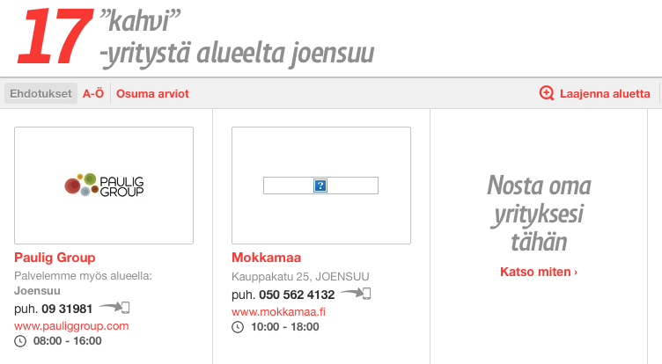
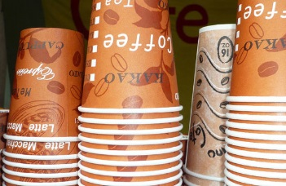


Visual appearance
DOM Tree
HTML
BODY
DIV
SECTION
OL
LI
LI
LI
DIV
DIV
A
A
H4
SPAN
SPAN
A
SPAN
A
H4
SPAN
SPAN
A
SPAN
H4
Katso…
IMG
A
SPAN
Puh.
STRONG
A
www…
SPAN
IMG
A
SPAN
Puh.
STRONG
A
www…
SPAN
Nosta…
Paulig
Group
STRONG
09..
Lisää…
08:00-16:00
Mokkamaa
Kauppakatu
25,
JOENSUU
Palve..
050..
Lisää…
10:00-16:00
Address
Joensuu

Slide 17
Scoring based on appearance
CSS Attributes | Score
color, background-color | + perceptual color difference (0 to 10)
font-size | + (node font size - address node font size)
font-weight | +3 if bold or >500
text-transform | +5 if uppercase
Tags | Score
H1 | +7
H2 | +6
H3 | +5
H4, A | +4
H5, H6, B, STRONG | +3
I, EM | +2
Others | 0

Slide 18
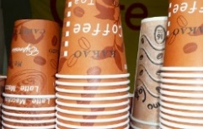
Scoring based on distance

Slide 19
Extracting representative images

Slide 20
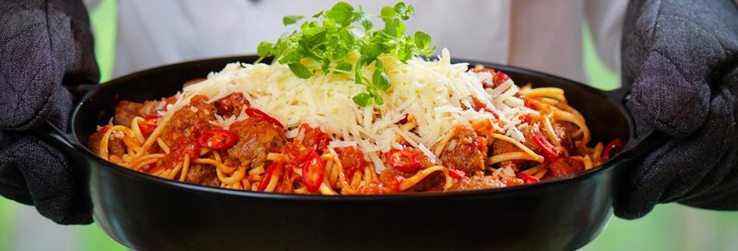
Image attributes
src | http://www.martina.fi/sites/martina.fi/files/styles/fiiliskuva/pu blic/Valitse%20alikansio/Ravintolat/ravintola-martina-paakuv a-pasta.jpg?itok=z8DMqAu2
alt | Ravintola Martina Joensuu
title | --
from | html
format | jpg
width | 920
height | 313
size | 287.96 px
Aspect ratio | 2.94
Parent tag | <div>
Class | header_fiilis
Class of parent | content clearfix

Slide 21
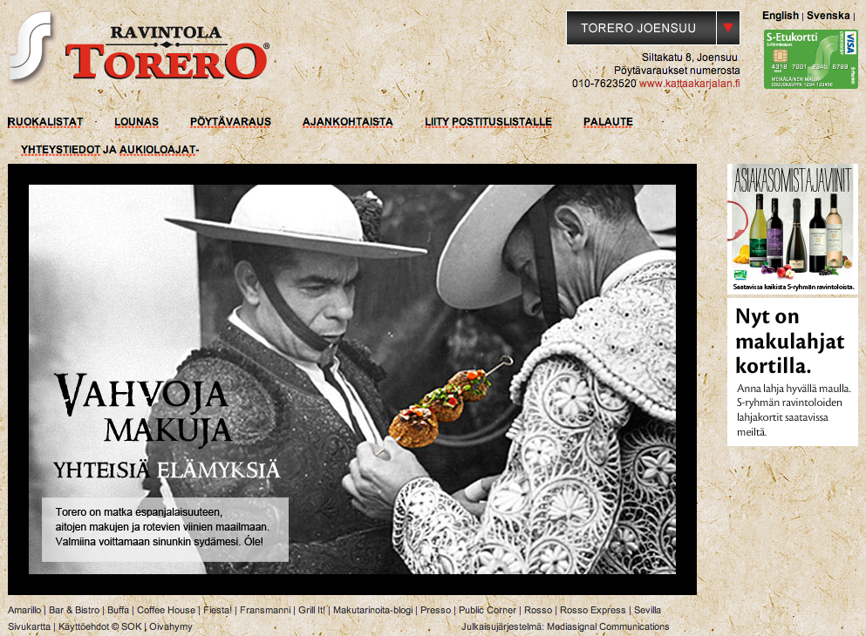
Image categorization
Logo
Representative image
Banner
Advertisement
Formatting

Slide 22
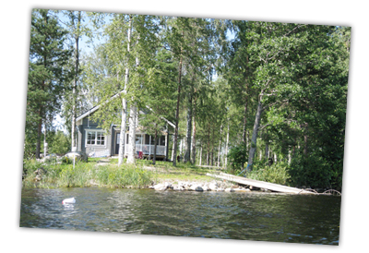
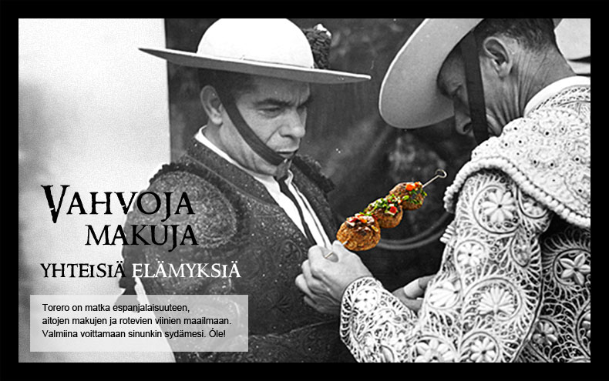
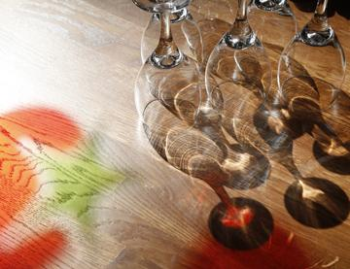
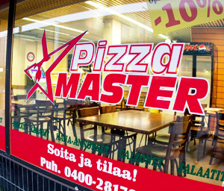
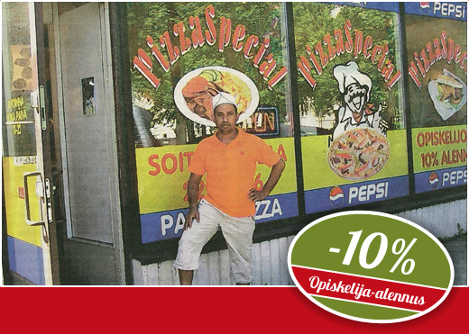
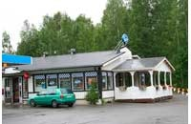
Representative images
Images that have their content directly related to the content or the topic of a web site

Slide 23







Logos
Images that are the logo of the company or institution that owns the web site
Rules:
URL, class or id contains ‘logo’
it’s contained in <h1> <h2>

Slide 24


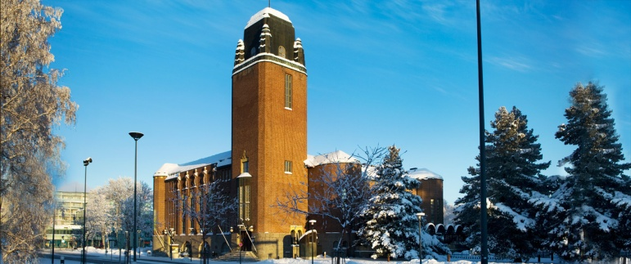


Banners
Images that are banners, headers, footers
Rules:
URL, class or id contains 'banner', 'header', 'footer', 'button’
high image ratio
not advertisement , formatting or logo

Slide 25





Advertisements
images that are advertising products or services which are not the main topic of the web site
Rules:
URL, class or id contains 'free', 'now', 'buy', 'join', 'adserver', 'click', 'advertisement', 'affiliate', 'adv', 'hits', 'counter’
Comes from well known adv. server

Slide 26






Formatting and icons
Images that are used as backgrounds, decorators or icons

Slide 27
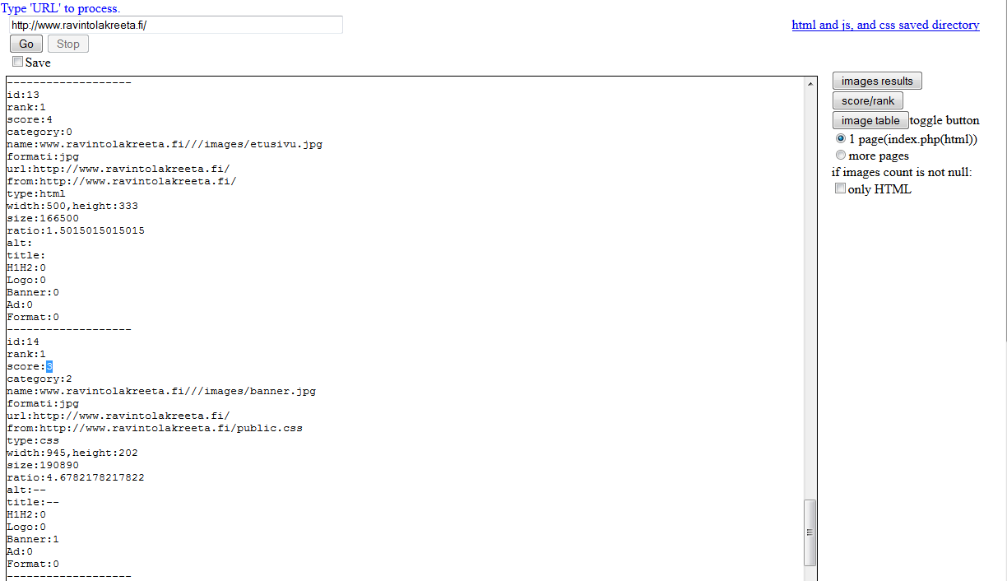
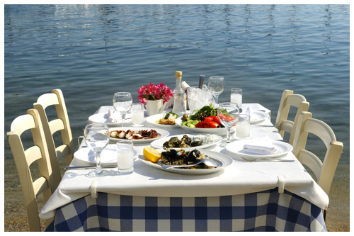

Image scoring

Slide 28








Web page link
Analyze page source code
Analyze root page source code
Get all images
Analyze image features
Categorize images
Rank images
Get representative image

Slide 29
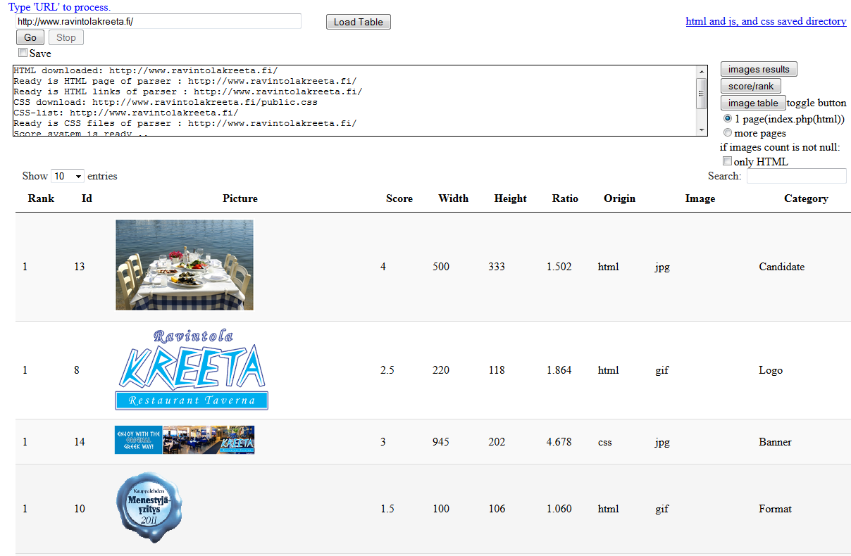
Image selection

Slide 30
Thank you!

