Slide 1
Inferring Road Networks from GPS Trajectories
Radu Mariescu Istodor

Slide 2
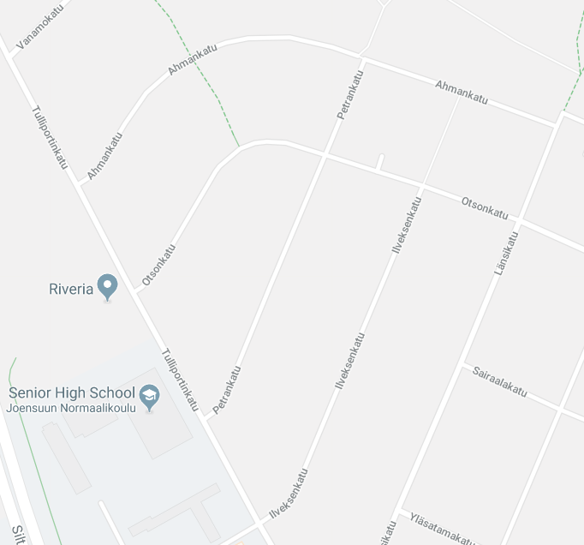
GPS Trajectory
END
Latitude : 62.2351
Longitude : 29.4123
Timestamp : 10.10.2018
: 19:05
START
Google map

Slide 3
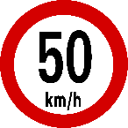
GPS Trajectories
Road Network
Geometry
Intersections
Länsikatu

Slide 4
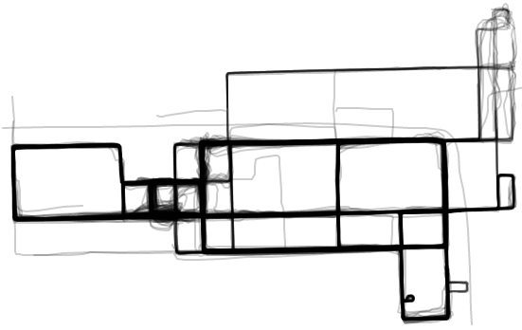
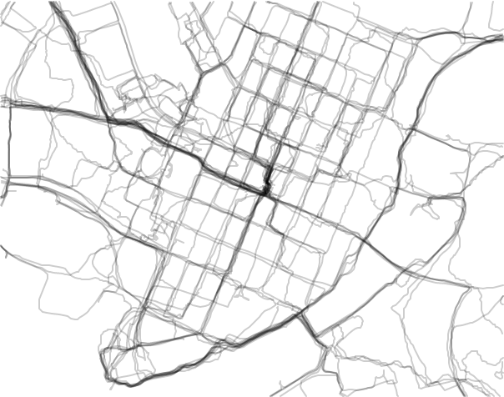
Satellite Images
→ GPS Trajectories
Chicago
Joensuu
MOPSI
Notes:
Talk Chicago, errors, etc.
Talk Joensuu, Mopsi, Pasi’s trajectories…

Slide 5
Proposed Method
Mariescu-Istodor, Radu, and Pasi Fränti.
"Cellnet: Inferring road networks from gps trajectories."
ACM Transactions on Spatial Algorithms and Systems (TSAS) 4, no. 3 (2018).
Step 1
Detecting
Intersections
For each of these I will:
Teach the background
Show how we did it*
Give you a challenge ☺
*most important steps only
Step 2
Creating
Roads
Notes:
If I ask you if there is an intersection

Slide 6
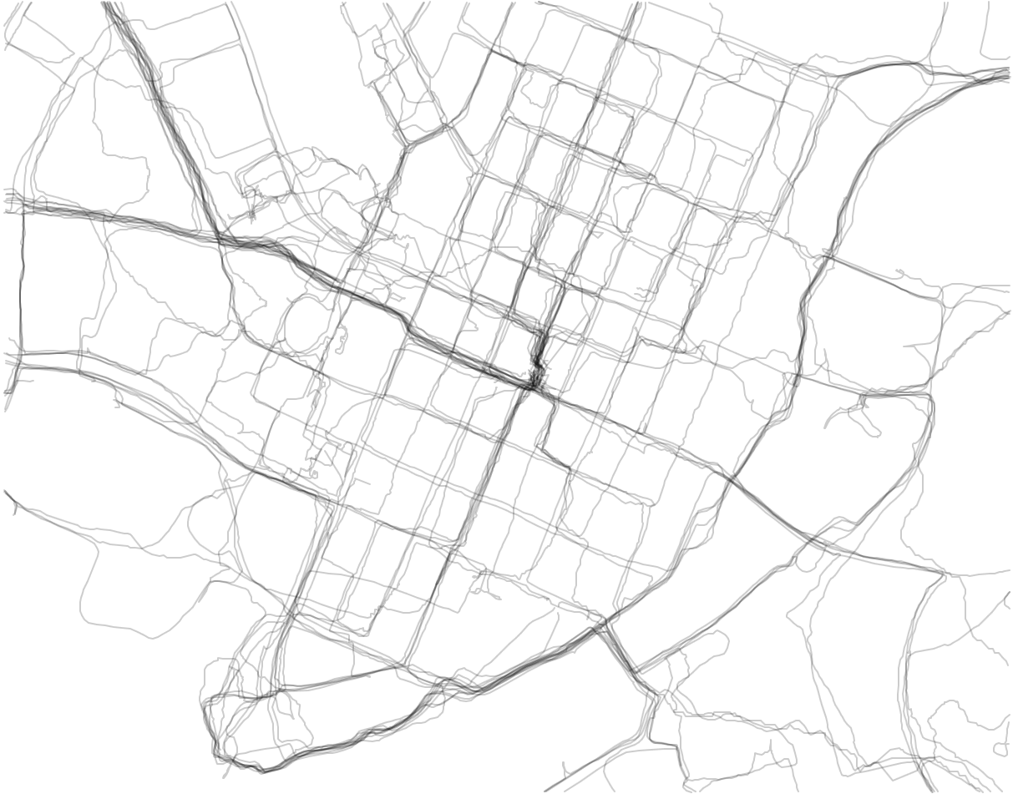
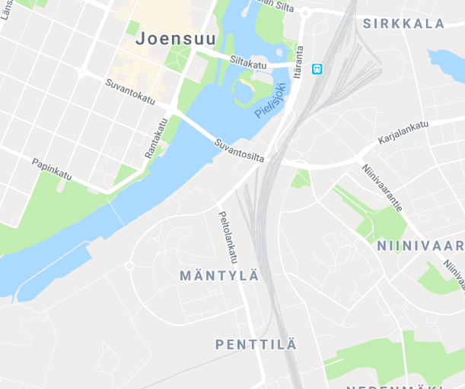
Detecting Intersections
Fathi, Alireza, and John Krumm.
"Detecting road intersections from GPS traces."
Geographic Information Science (2010).
NO
Descriptor
Ground truth
Notes:
If I ask you if there is an intersection

Slide 7
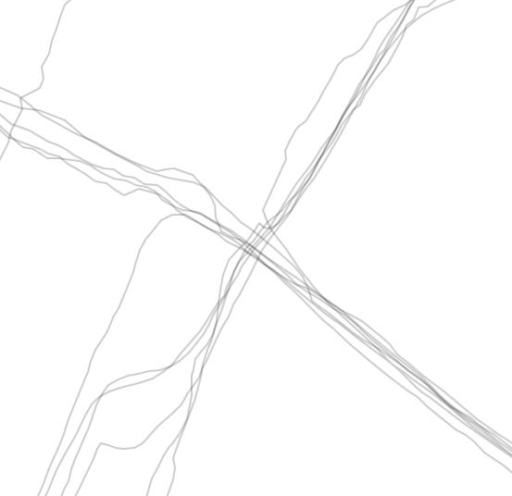
Detecting Intersections
Fathi, Alireza, and John Krumm.
"Detecting road intersections from GPS traces."
Geographic Information Science, pp. 56-69 (2010).
YES
Ground truth

Slide 8
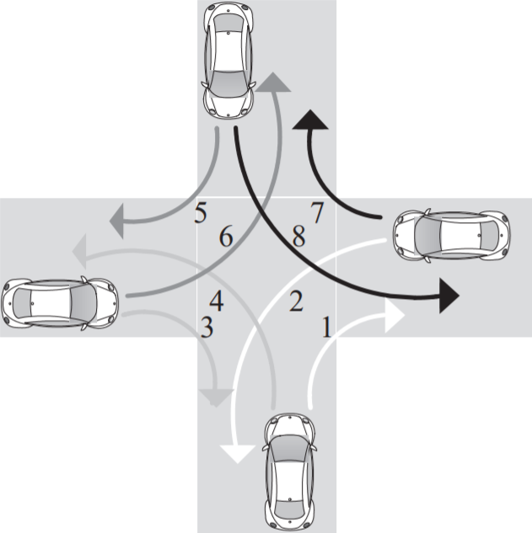
Detecting Intersections
Karagiorgou, Sophia, and Dieter Pfoser.
"On vehicle tracking data-based road network generation."
Advances in Geographic Information Systems (2012).
Turning patterns
Notes:
Other work is based on analysing movement patterns.
Different intersection models are investigated and are tried to be fit to the underlying data.

Slide 9
Detecting Intersections
PROPOSED
Mariescu-Istodor, Radu, and Pasi Fränti.
"Cellnet: Inferring road networks from gps trajectories."
ACM TSAS (2018).
YES
80
25
Splits
Notes:
How we cluster?
http://cs.uef.fi/~radum/
What happens if two?
How about parameters, talk about other methods.

Slide 10
Detecting Intersections
PROPOSED
Mariescu-Istodor, Radu, and Pasi Fränti.
"Cellnet: Inferring road networks from gps trajectories."
ACM TSAS (2018).
YES
Still works…
Random Swap
Fränti, Pasi, and Juha Kivijärvi.
"Randomised local search algorithm for the clustering problem."
Pattern Analysis & Applications (2000).

Slide 11
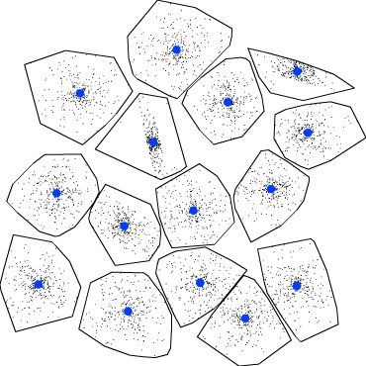
Sum of squared errors vs. Validity Indices
F-ratio
Rate-distortion method
Silhouette Coefficient (SC)
Davies-Bouldin index (DBI)
Bayesian Information Criterion (BIC)
Minimum description principle (MDL)
SSE
Validity
Index
Silhouette Coefficient
80
25
Rousseeuw, Peter J., and L. Kaufman.
"Finding groups in data."
(1990)
5
10
15
20
No. Clusters
S2 (synthetic) dataset
cs.uef.fi/sipu/datasets
Notes:
How we cluster?
http://cs.uef.fi/~radum/
What happens if two?
How about parameters, talk about other methods.

Slide 12
Creating Roads

Slide 13
Creating Roads
Davies, Jonathan J., Alastair R. Beresford, and Andy Hopper. "Scalable, distributed, real-time map generation." Pervasive Computing (2006).
Skeleton
Threshold
Visual

Slide 14
Creating Roads
Cao, Lili, and John Krumm. "From GPS traces to a routable road map." Advances in geographic information systems (2009).
Merging

Slide 15
Creating Roads
Edelkamp, Stefan, and Stefan Schrödl. "Route planning and map inference with global positioning traces." Computer Science in Perspective (2003).
Clustering

Slide 16
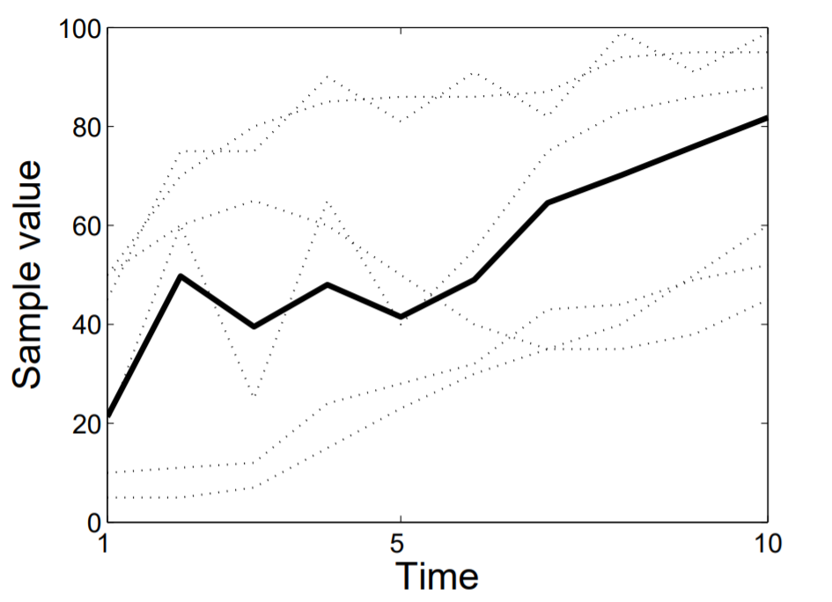
Creating Roads
PROPOSED
Mariescu-Istodor, Radu, and Pasi Fränti.
"Cellnet: Inferring road networks from gps trajectories."
ACM TSAS (2018).
DTW averaging
Hautamäki, Ville, Pekka Nykänen, and Pasi Fränti.
"Time-series clustering by approximate prototypes."
ICPR pp. 1-4. (2008).

Slide 17
Accepted connections
length (α) ≃ length (α)

Slide 18
Accepted connections
Mariescu-Istodor, Radu, and Pasi Fränti.
"Grid-based method for GPS route analysis for retrieval."
ACM TSAS (2017).
length (α) ≃ length (α)
sim (α, α) = 0
sim (α, α) = 96%

Slide 19
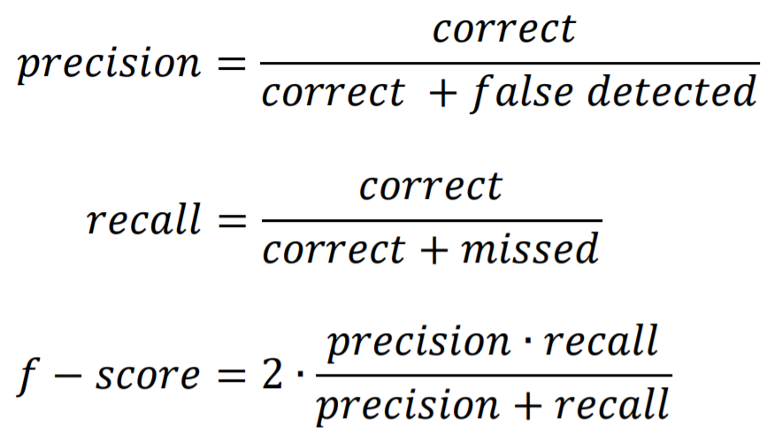
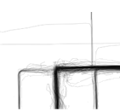
Evaluation
Chicago
42 %
28 %
10 %
87 %
P = .97
R = .27
P = .17
R = .94
P = .07
R = .70
P = .92
R = .83
46 %
38 %
19 %
58 %
Joensuu
P = .56
R = .38
P = .24
R = .87
P = .13
R = .33
P = .68
R = .49
Visual
Clustering
Merging
CellNet

Slide 20
Challenge 1 (detecting intersections):
http://cs.uef.fi/paikka/Radu/labeler/noClusters.php?dataset=chicago
http://cs.uef.fi/paikka/Radu/labeler/noClusters.php?dataset=joensuu
Challenge 2 (creating roads):
http://cs.uef.fi/mopsi/routes/segments
http://cs.uef.fi/mopsi/routes/segments/chicago.php
http://cs.uef.fi/mopsi/routes/segments/joensuu.php
Other useful links:
http://cs.uef.fi/mopsi/routes/network
http://cs.uef.fi/mopsi/routes/dataset
Thank You .
Radu Mariescu-Istodor
radum@cs.uef.fi

Slide 22
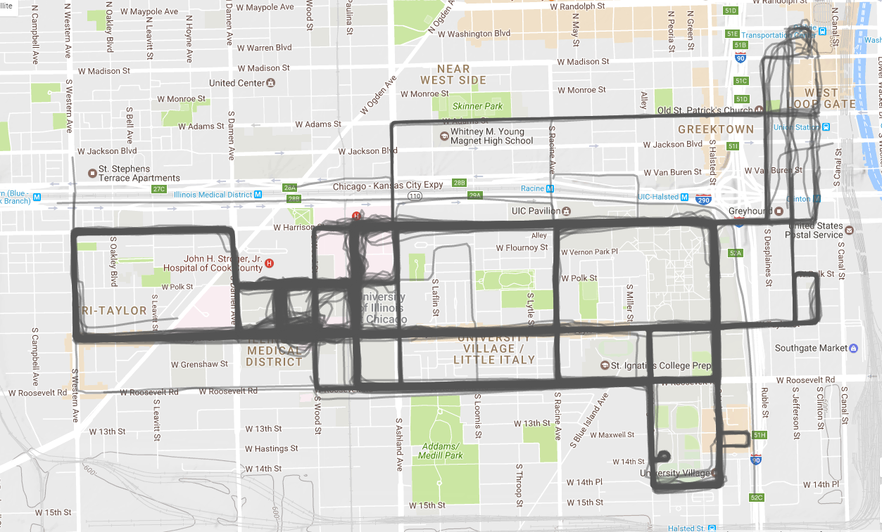
Choosing the test locations

Slide 23
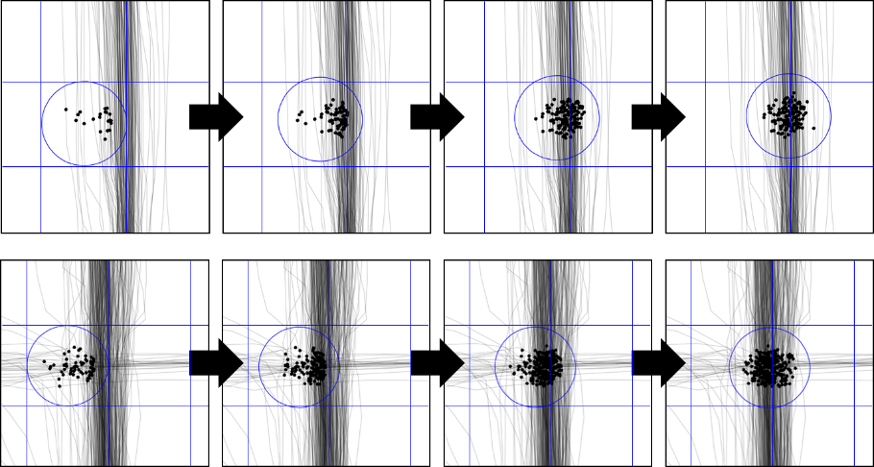
Choosing the test locations
Mean shifting

Slide 25
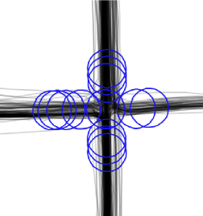
Too many detections!

Slide 27
Non-intersections
Roundabout

Slide 29
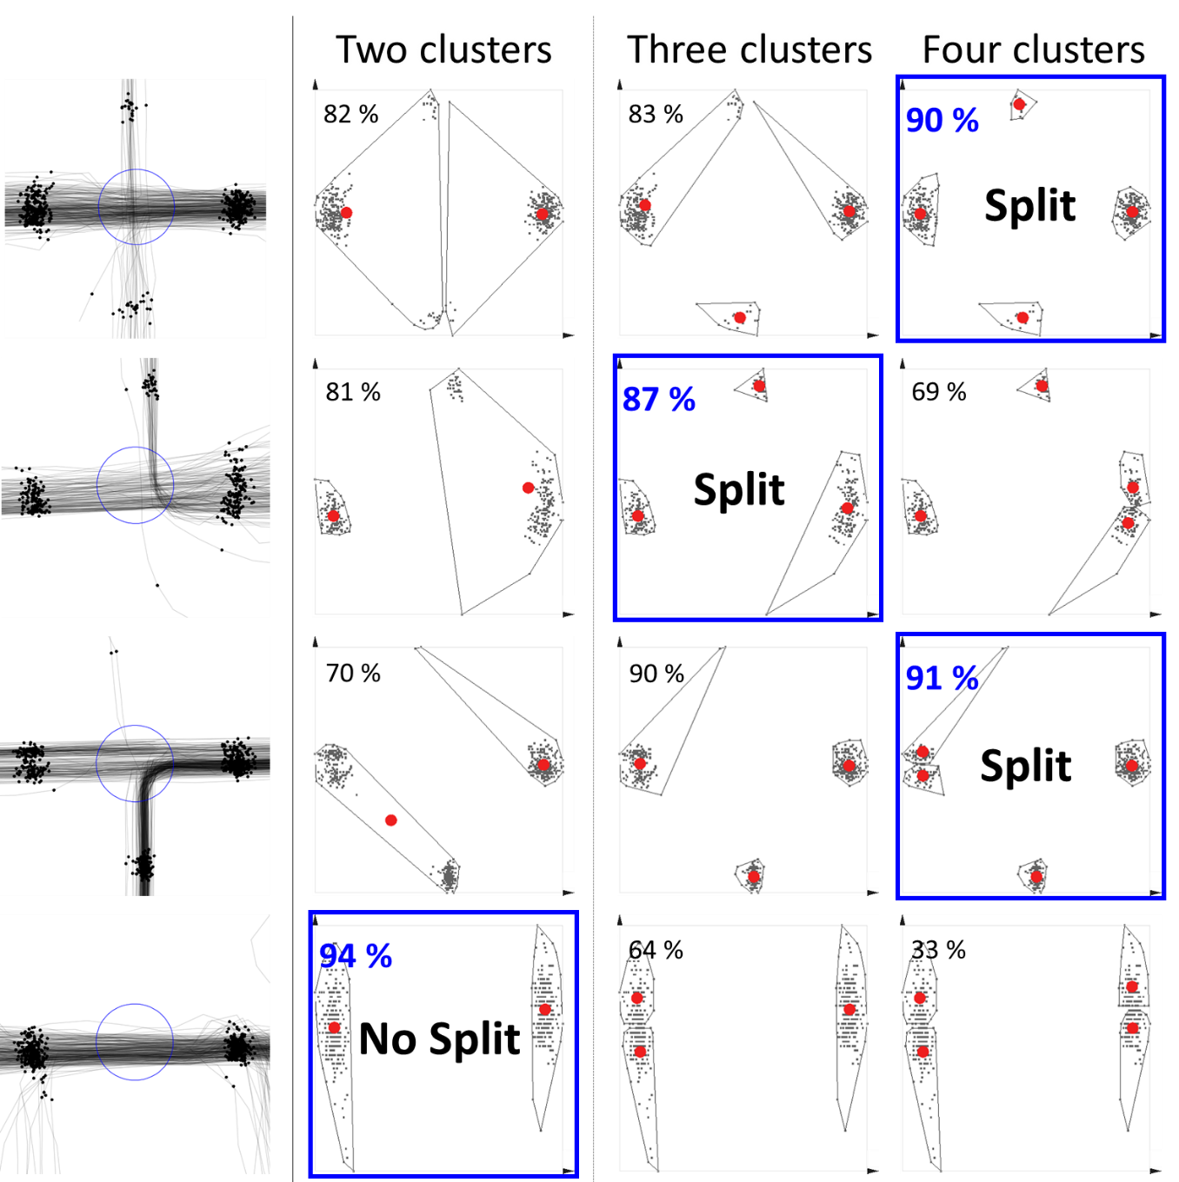
Silhouette Coefficient:

Slide 31
Silhouette coefficient [Kaufman&Rousseeuw, 1990]
Cohesion: measures how closely related are objects in a cluster
Separation: measure how distinct or well-separated a cluster is from other clusters
cohesion
separation

Slide 32
Silhouette coefficient
Cohesion a(x): average distance of x to all other vectors in the same cluster.
Separation b(x): average distance of x to the vectors in other clusters. Find the minimum among the clusters.
silhouette s(x):
s(x) = [-1, +1]: -1=bad, 0=indifferent, 1=good
Silhouette coefficient (SC):

Slide 33
Silhouette coefficient
x
x
cohesion
a(x): average distance in the cluster
separation
b(x): average distances to others clusters, find minimal

Slide 35
Detecting Intersections
- no intersection case -
NO

