Slide 1
Pokemon Go
LAMAD
Radu Mariescu-Istodor
28.11.2018

Slide 2
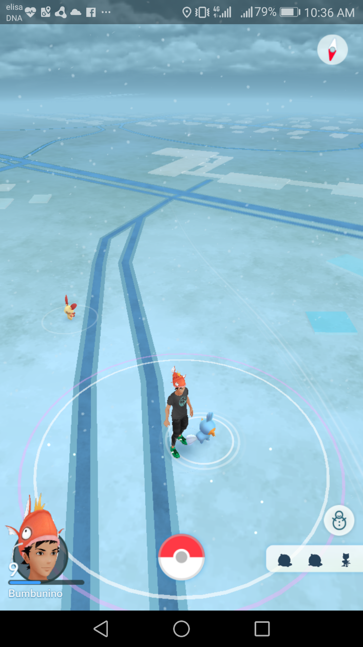
What is it?
Some kind of navigation app…
Custom map
Custom avatar
Augmented objects
Collection

Slide 3
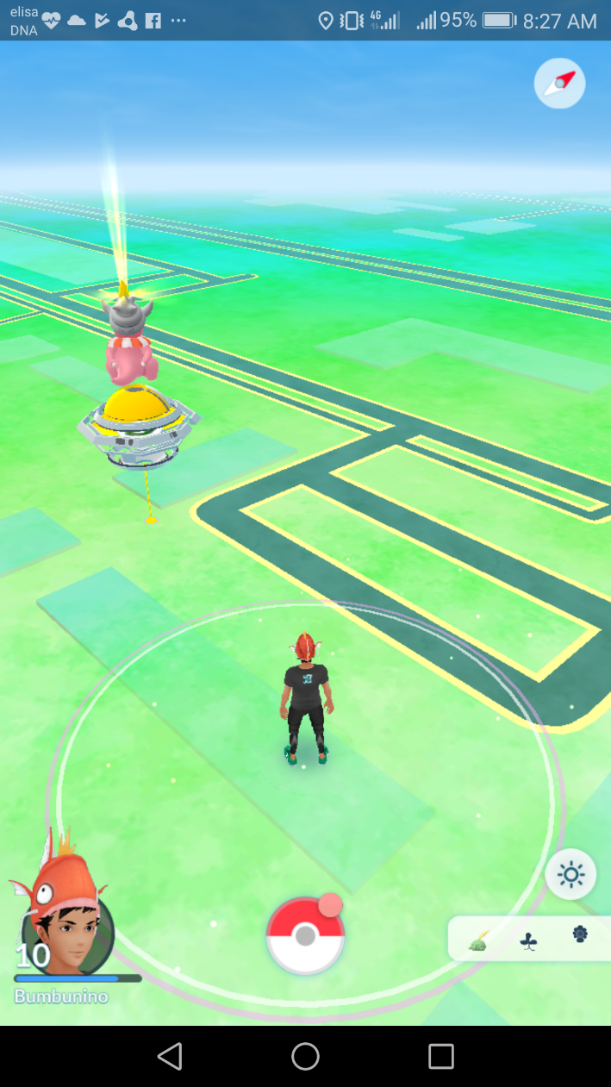
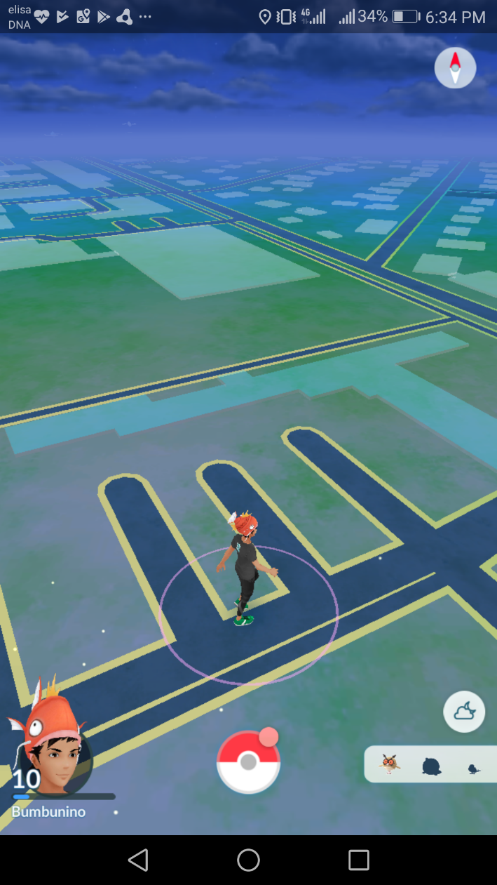
Custom map

Slide 4
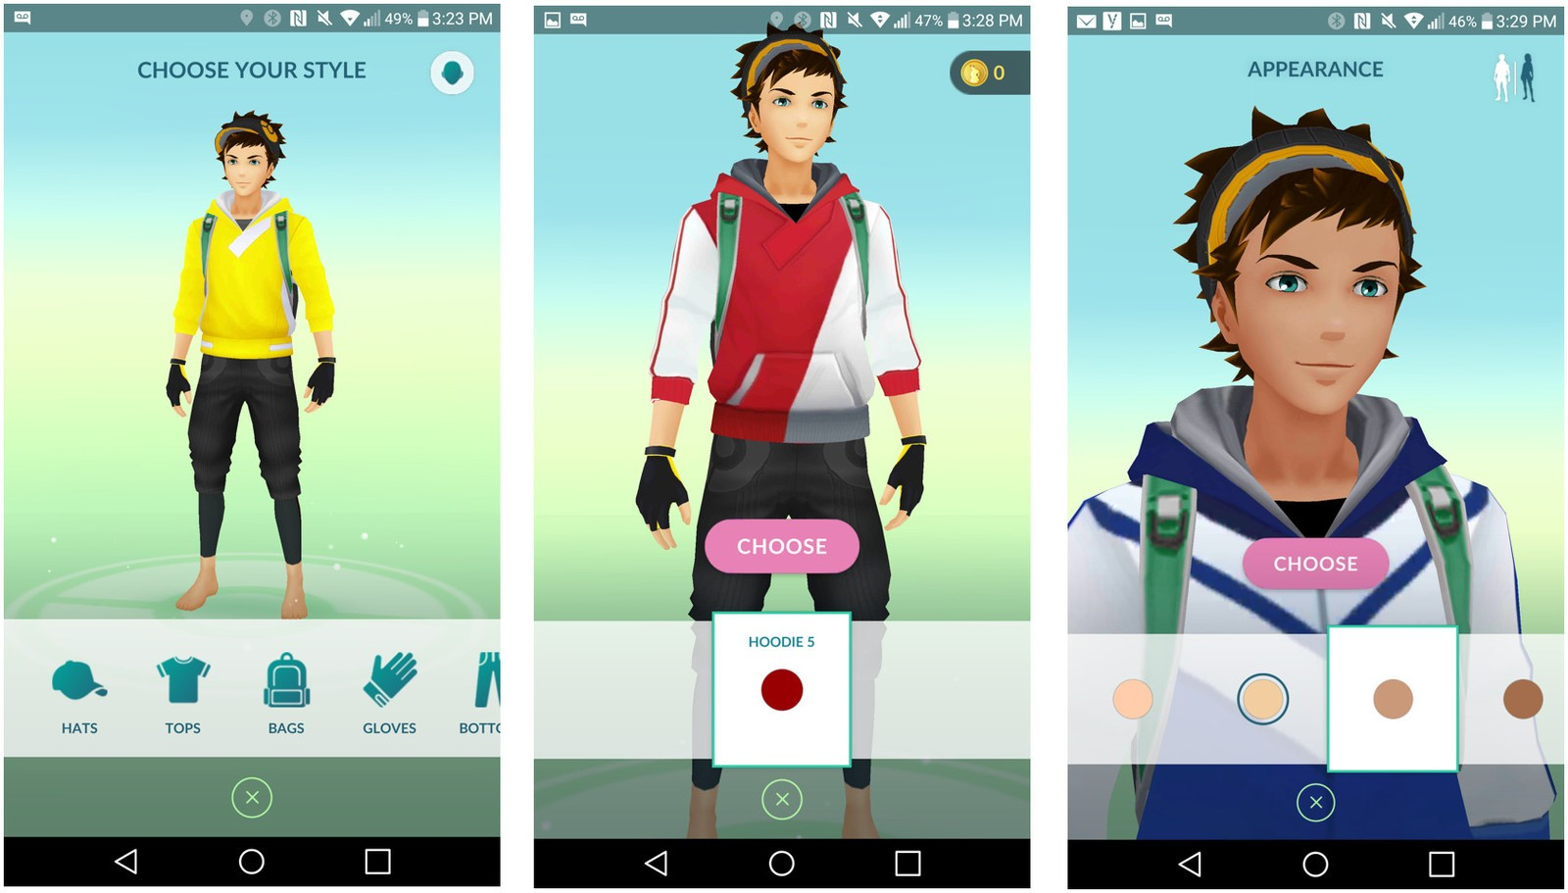
Custom avatar

Slide 5
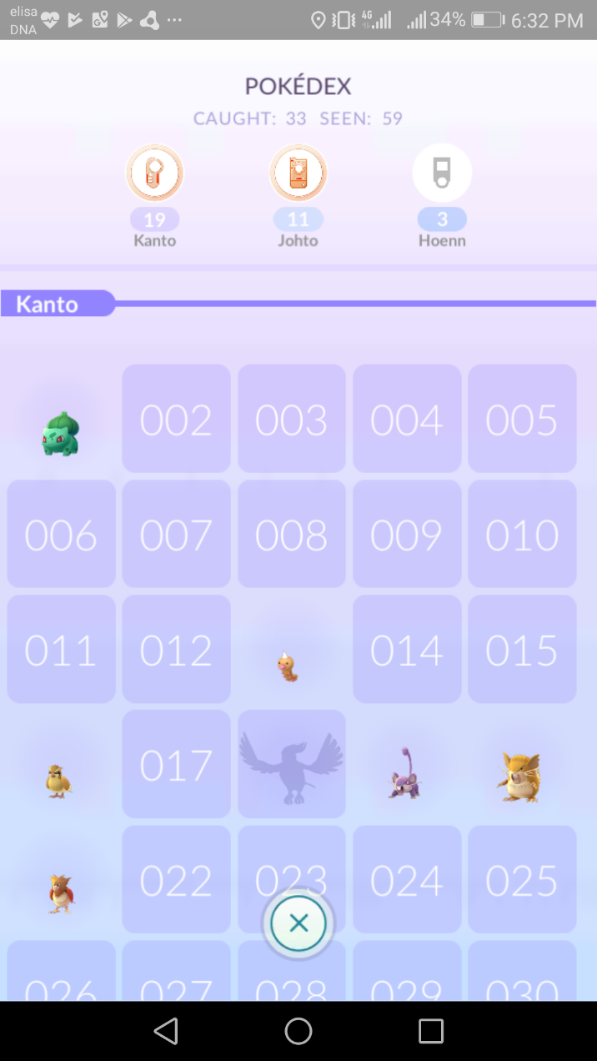
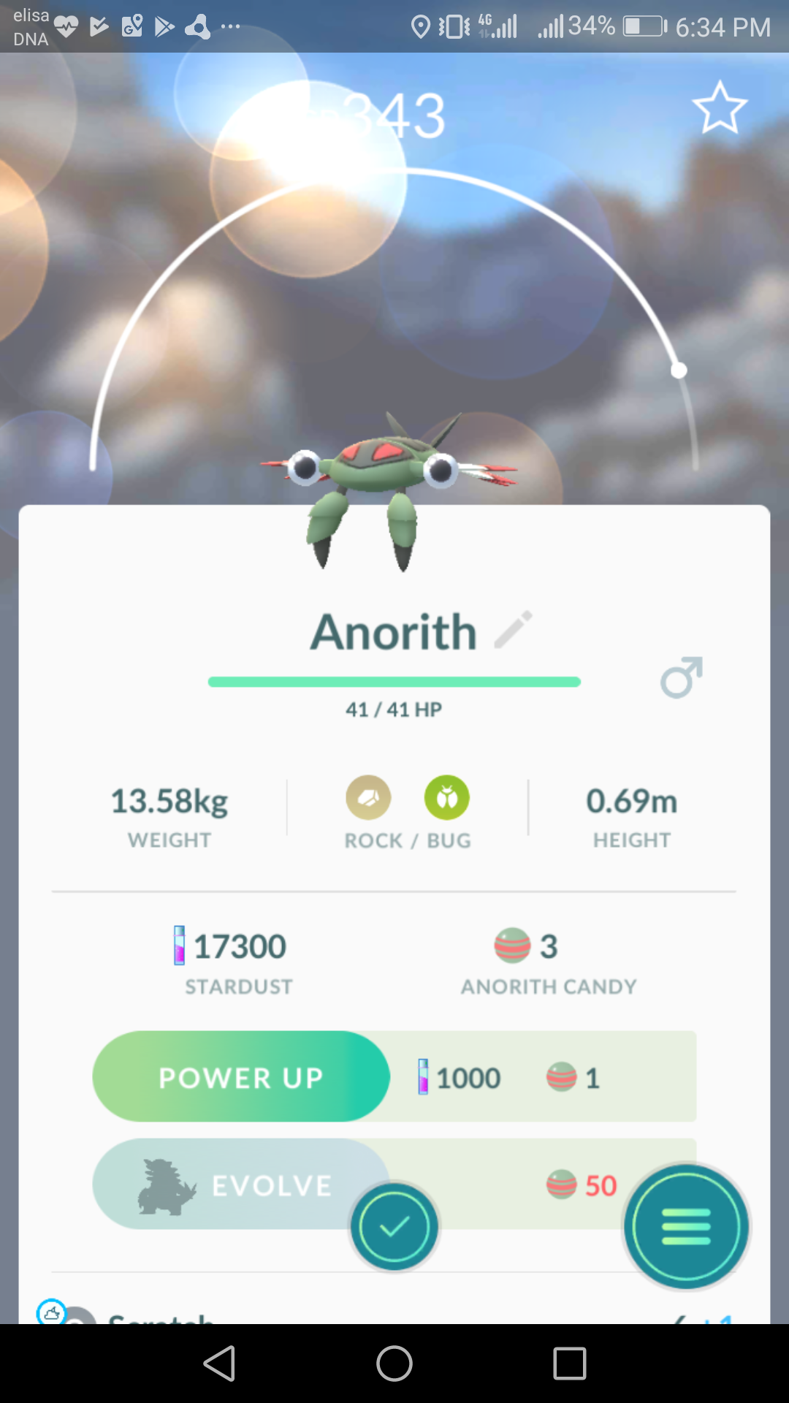
Collection

Slide 6
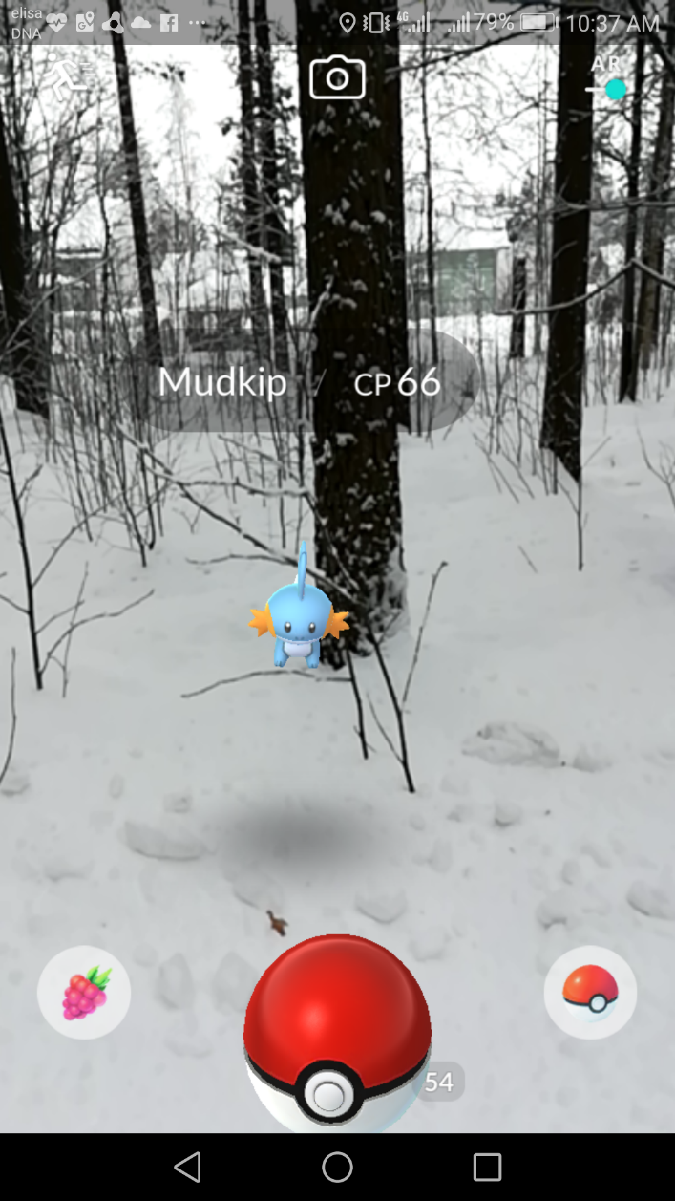
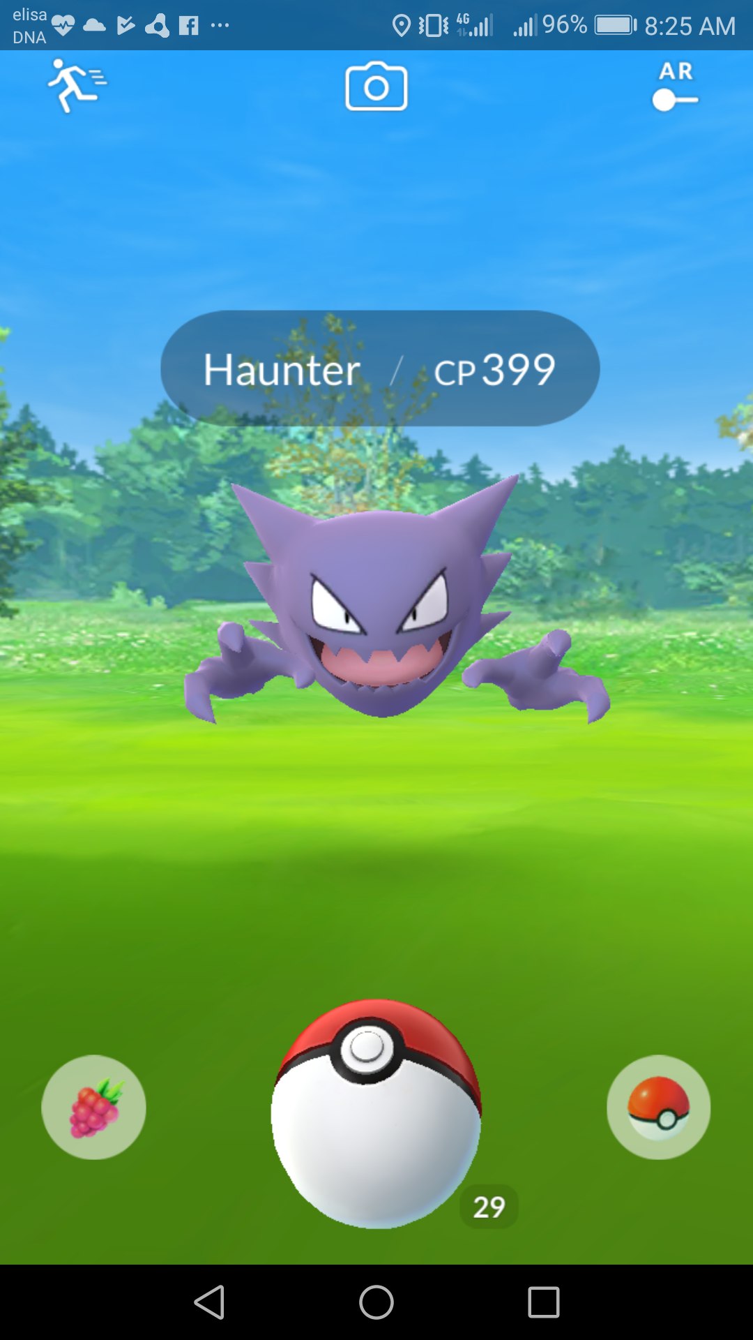
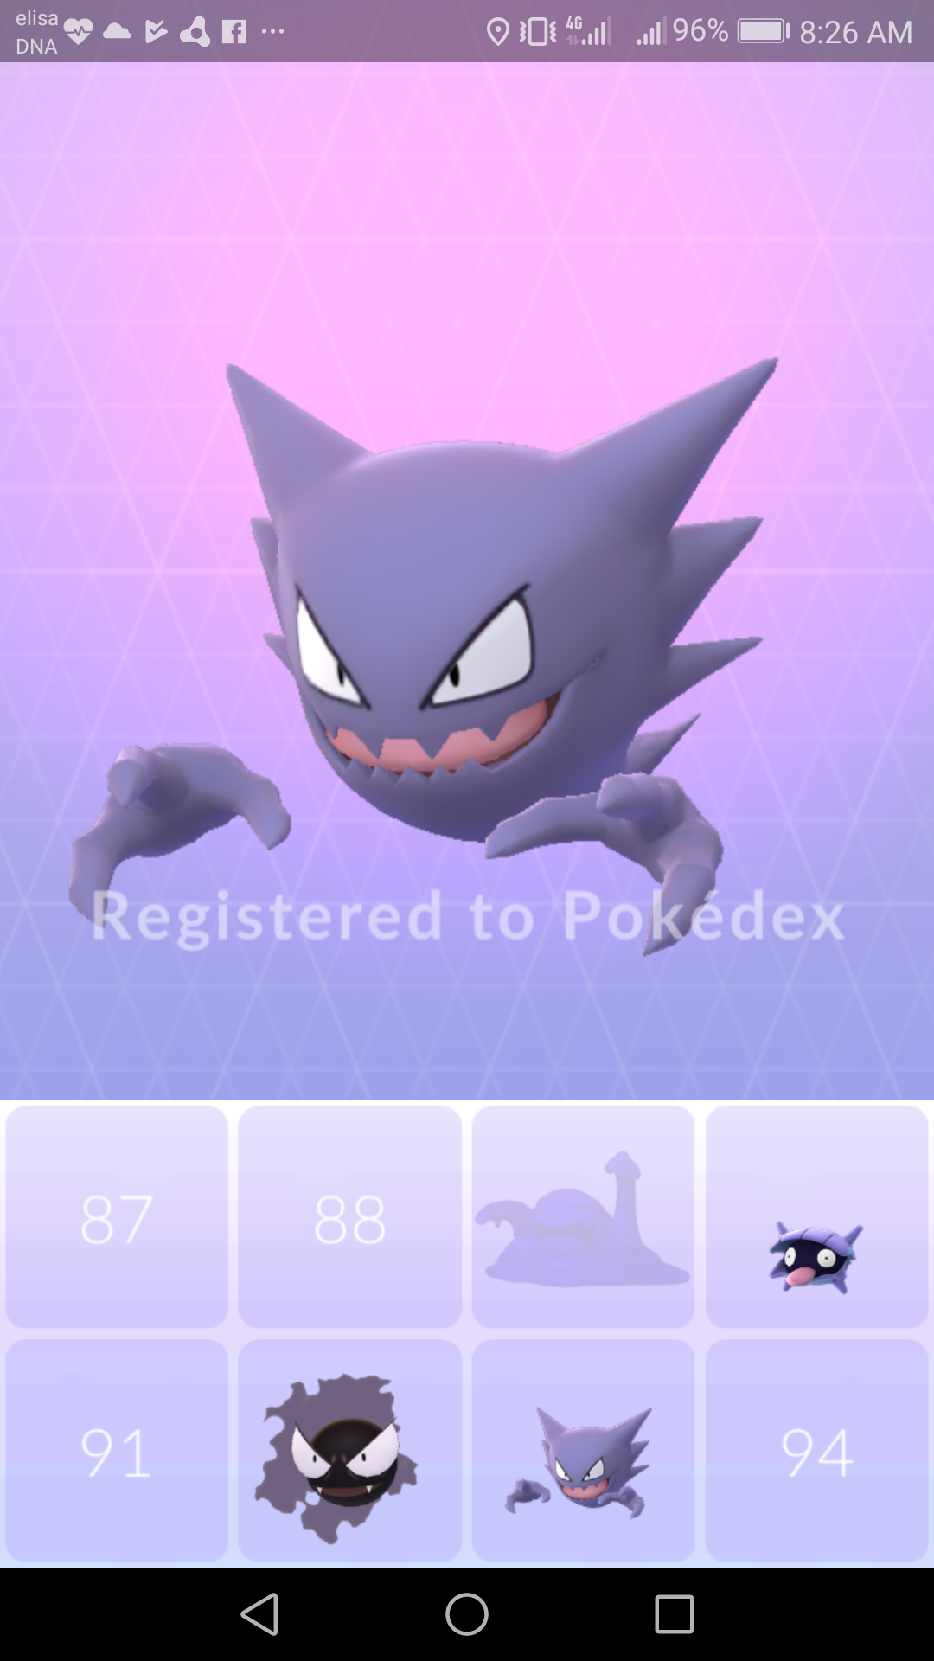
Augmented objects

Slide 7
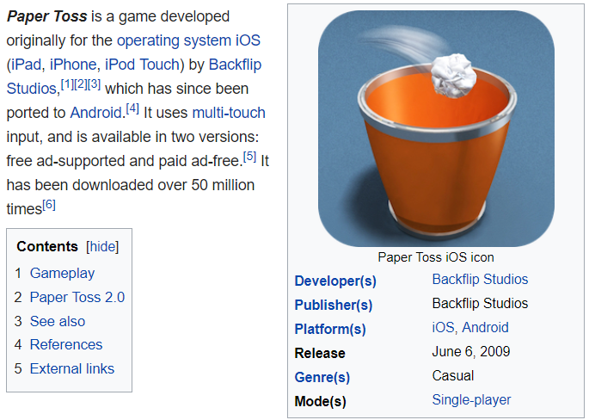
Catching - Inspiration

Slide 8
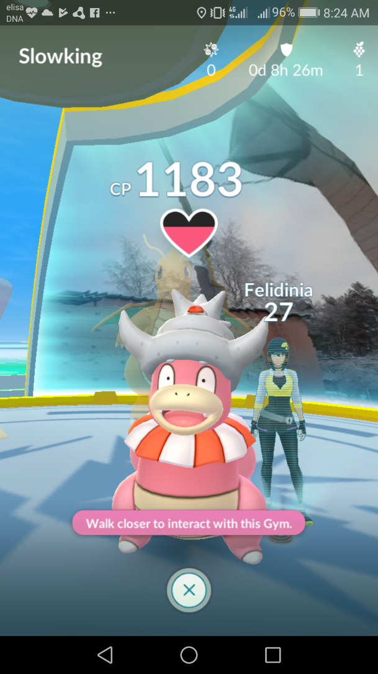
Many other features
In-app purchases
Battles
Evolving
Hatching
…

Slide 9
Why it was such a hit?
Not hard to play
Very popular franchise
Because of all the Problems !!!

