Slide 1
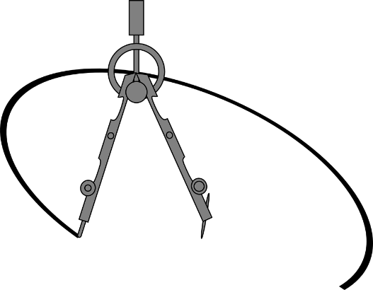
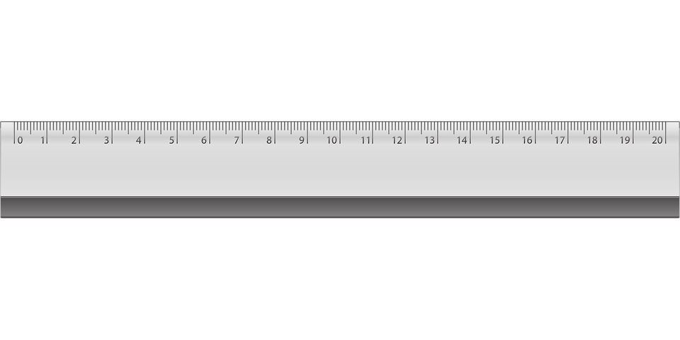
Projections and distances
LAMAD
Radu Mariescu-Istodor
23.10.2018

Slide 2
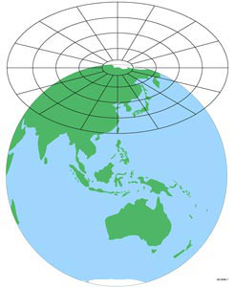
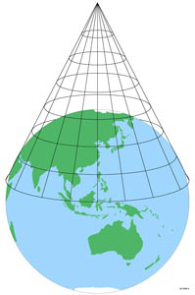
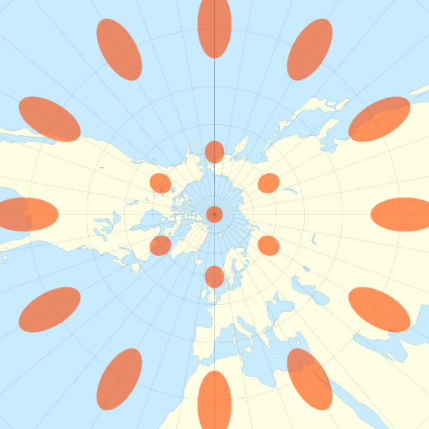
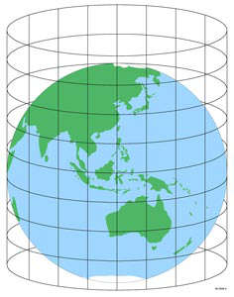
Projections
Azimuth
Sources: Wikipedia
Notes:
Tissot’s indicatrix of deformation

Slide 3
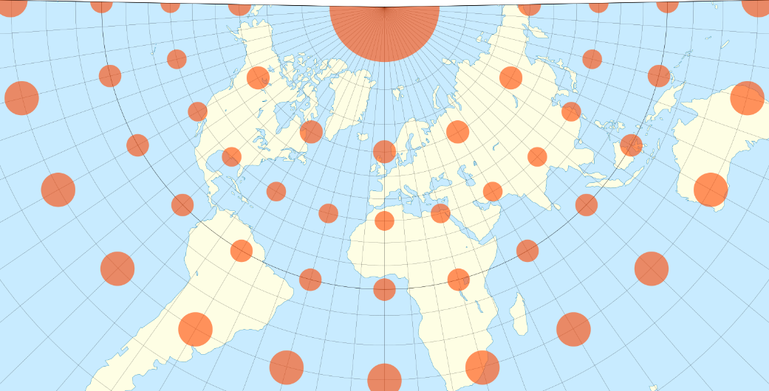
Projections
Conic
Notes:
Tissot’s indicatrix of deformation

Slide 4
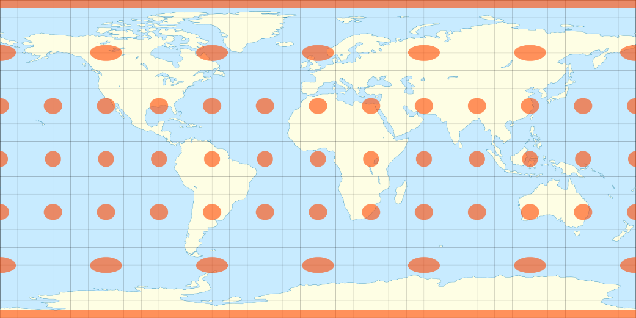
Projections
Equirectangular
Cillindric
Notes:
Tissot’s indicatrix of deformation

Slide 5
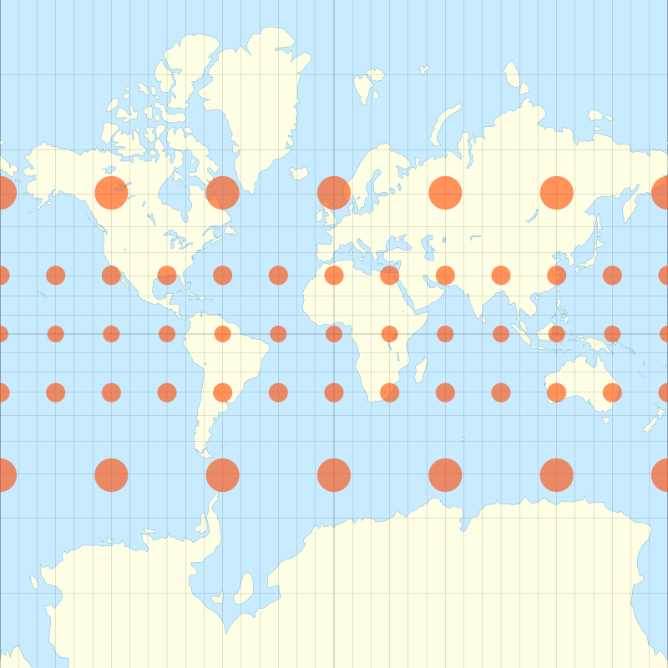
Projections
Mercator
Preserves directions
Compromises scale
Cillindric
Notes:
Tissot’s indicatrix of deformation

Slide 6
Demo 1

Slide 7
Earth
R = 6371 km
PRIME
MERIDIAN
62ºE
23ºN
EQUATOR
23ºS

Slide 8
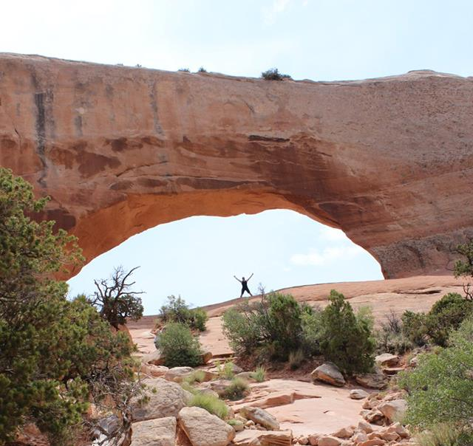
Coordinates
R = 6371 km
y
Tuusniemi
62.81N 28.49E
y
WGS
World Geodetic System
x
z

Slide 9
Coordinates
R = 6371 km
Tuusniemi
62.81N 28.49E
y
r
z
x = 1389 km
r
y = 5667 km
x
z = 2558 km
r = 2911 km

Slide 10
Demo 2

Slide 11
Distances
p₁ = (x₁, y₁, z₁)
Tuusniemi
62.81N 28.49E
Euclidean
p₂ = (x₂, y₂, z₂)
Haversine
Dubai
25.20N 55.43E

Slide 12
Demo 3

