Slide 1
Case study: Strava + Waze
LAMAD
Radu Mariescu-Istodor
14.11.2018

Slide 2
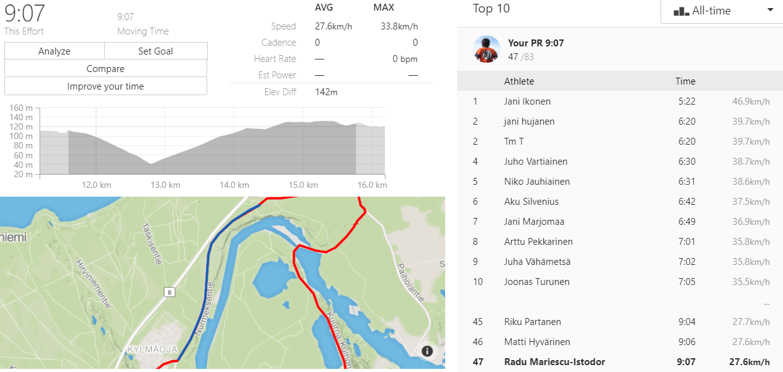
Strava: Segments

Slide 3
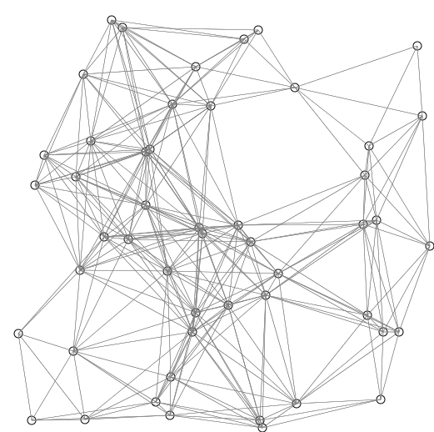
Waze: Dijkstra’s algorithm
function Dijkstra(Graph, source):
create vertex set Q
for each vertex v in Graph:
dist[v] ← INFINITY
prev[v] ← UNDEFINED
add v to Q
dist[source] ← 0
while Q is not empty:
u ← vertex in Q with min dist[u]
remove u from Q
for each neighbor v of u:
alt ← dist[u] + length(u, v)
if alt < dist[v]:
dist[v] ← alt
prev[v] ← u
return dist[], prev[]
https://www.wikipedia.org

Slide 4
Waze: Objective functions
100 m
Notes:
Shortest 2 km
Shortest by car 3 km
Is shortest really the needed important
Turning speed into account

