Slide 1
SuperTracker
Radu Mariescu-Istodor
8.5.2018

Slide 2
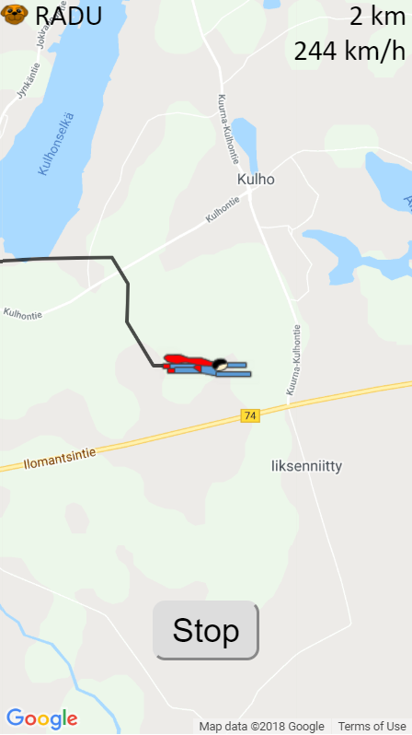
More super than other apps

Slide 3
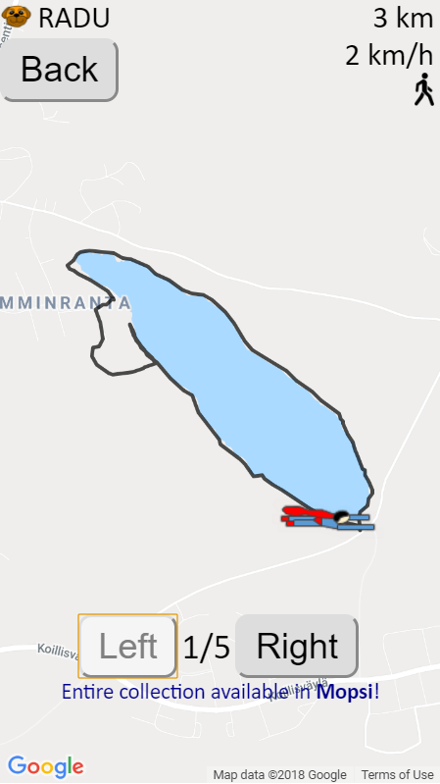
Features
Custom, rotating marker
Mopsi login
View collection
Movement type detection
Voosh

Slide 4
I learned…
Google Maps API in browser is different from the one in Android.
…

