Slide 1
GPS Trajectories
LAMAD
Radu Mariescu-Istodor
7.5.2018

Slide 2
Contributions
[P1]
Route Similarity [P2] and [P3]
Route Search [P3] and [P4]
Road Network Extraction [P5]
Route Visualization
Notes:
In the next 15 minutes, I will talk about our 4 main contributions, starting with
How to visualize, or display routes efficiently on the map
Then we discuss similarity functions applicable to routes…
and see how they are useful when searching inside large route collections
Finally we show how to extract the road network from a route collection

Slide 3
Route Visualization [P1]
K. Waga, A. Tabarcea, R. Mariescu-Istodor & P. Fränti
“Real Time Access to Multiple GPS Tracks”
Webist 2013, Aachen, Germany, pp. 293-299
Notes:
We begin with route visualization, where I present to you...

Slide 4
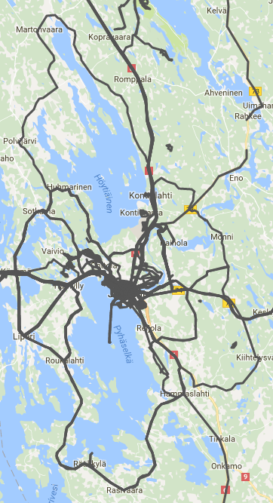
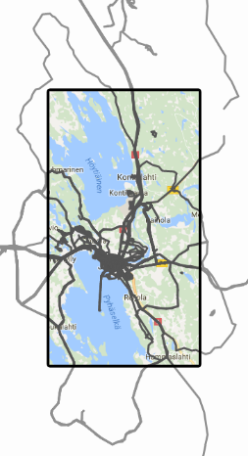
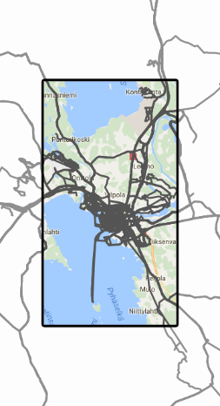
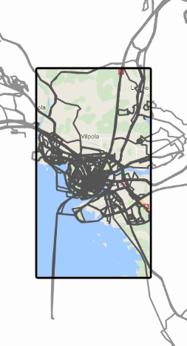
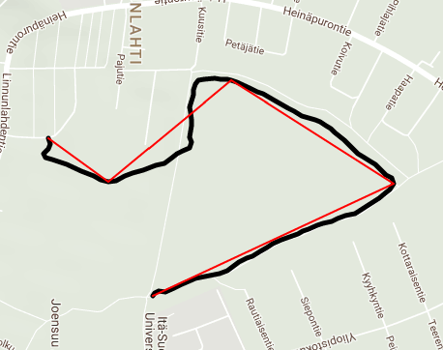
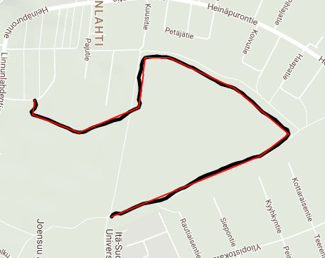
System Workflow
Original route
351 pts
5 pts
25
x
15
x
10 pts
1,235
1,383,318
53,194
Routes
Points
KB
810
761,649
31,288
Routes
Points
KB
M. Chen, M. Xu and P. Fränti
“A Fast O(N) Multiresolution Polygonal Approximation Algorithm for GPS Trajectory Simplification”
IEEE Transactions on Image Processing, 21 (5), 2770-2785, May 2012
Notes:
My personal route collection.
It has over 1,000 routes and over a million points. The amount of data is about 50 MB, which is about the same size as 25 good quality photo files.
The map shows only the routes in and around Joensuu but the data on this screen alone is still 31 MB, equivalent to about 15 photos.
Loading this much data would not be very user friendly... And even so, browser might crash.
We use polygonal approximation to...
Blink middle part to illustrate changes

Slide 5
System Performance
<
½
Min Zoom
Med Zoom
Max Zoom
No Approximation
8,114
312
11,928
458
18,775
721
761,649
31,288
Points
KB
0.9%
1.4%
2.3%
Notes:
We see that using polygonal approximation at 3 different levels, the routes look pretty much the same, but the number of points is
Only a fraction of the original value.
The most points are needed when showing the Joensuu region, where I have allot of routes. But even here, the data is equivalent to half the size of a photo.

Slide 6
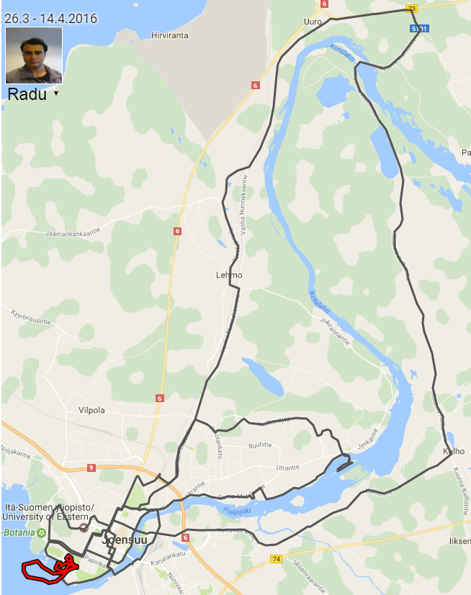
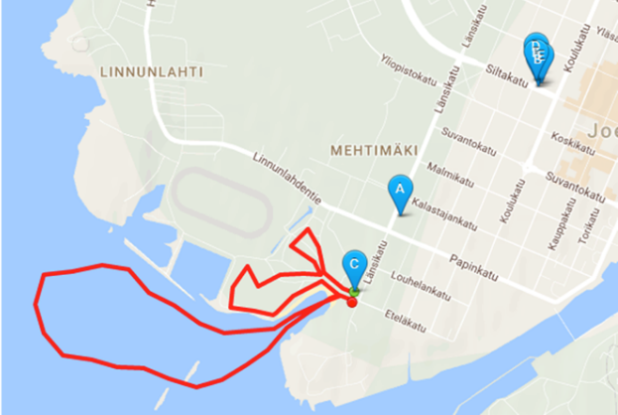
Different Solutions
6 ROUTES
Lehmo
Kulho
Notes:
There are a couple of solutions who attempt to show multiple routes on the map.
Sports tracker shows only the start location. It uses color coding to indicate the movement type of the route.
Runtastic also shows the starting point, but allows to click on the markers to display routes one by one.
Let’s look now at the same collection using Mopsi. It gives more information than the other two applications. In fact, this is the part of the map shown by the other software, where the route starting points are.

Slide 7
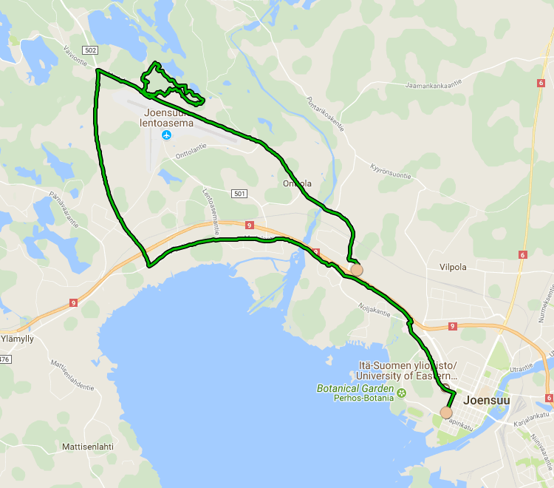
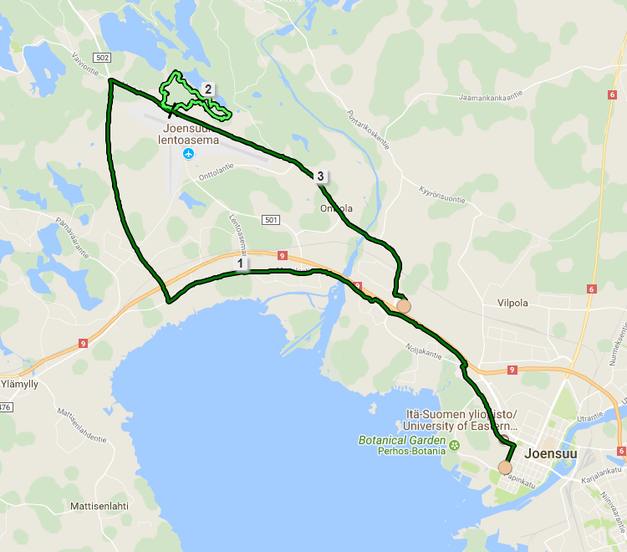
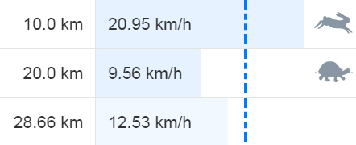
Route Analysis
20
5 km/h
17 km/h
10
19 km/h
K. Waga, A. Tabarcea, M. Chen and P. Fränti
“Detecting movement type by route segmentation and classification”
CollaborateCom'12, Pittsburgh, USA, 2012
Notes:
We can see that the 20 km mark s in the middle of my orienteering but also contains some cycling, making the speed for that segment difficult to interpret.
We continue to speak…

Slide 8
Route Similarity [P2] and [P3]
R. Mariescu-Istodor, A. Tabarcea, R. Saeidi & P. Fränti
“Low complexity spatial similarity measure of GPS trajectories”
Webist 2014, Barcelona, Spain, pp. 62-69
R. Mariescu-Istodor & P. Fränti
“Grid-based method for GPS route analysis for retrieval”
ACM Transactions on Spatial Algorithms and Systems
(to appear)
Notes:
about our proposed similarity measure…

Slide 9
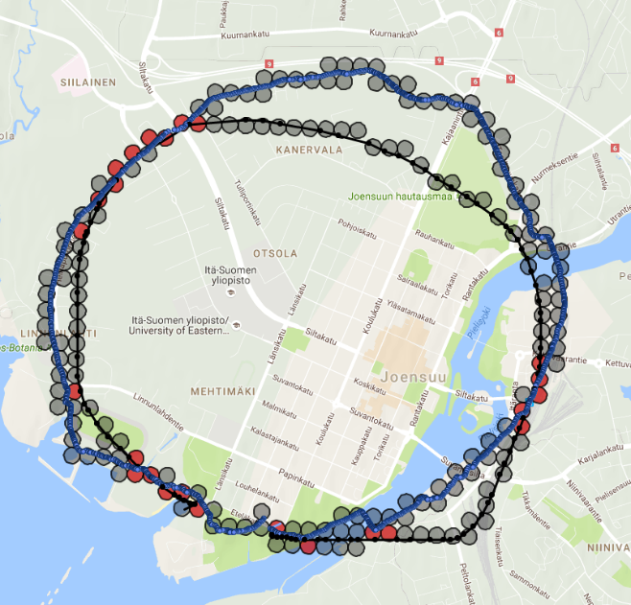
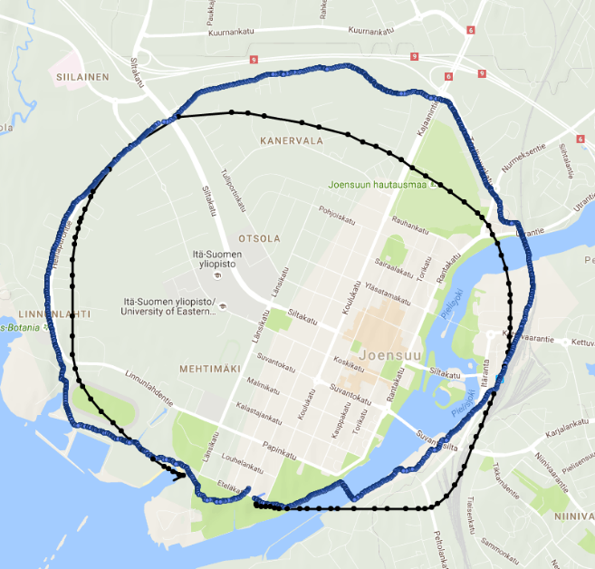
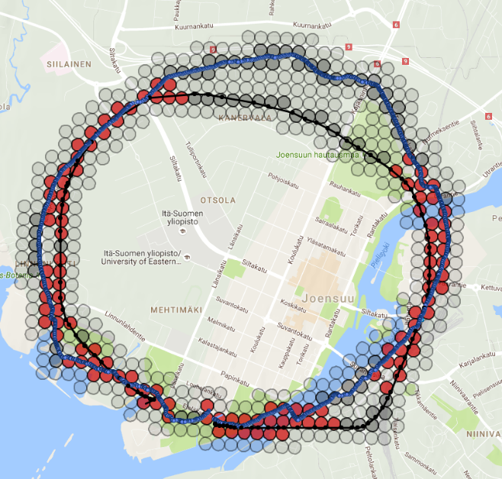
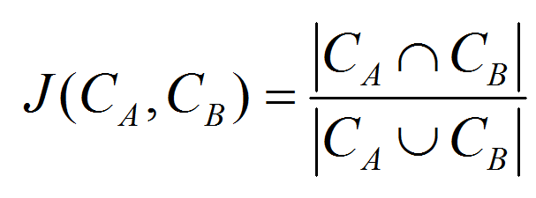
C-SIM
62 %
13 %
Notes:
C-SIM.
Where we use a grid, and we count the number of cells the two routes have in common, as a proportion of all the cells that the routes pass through.
This measure is not useful as such because two routes that are nearby may pass through the same cells, but this is not necessarily the case.
Therefore, our measure uses also the dilated (or neighboring) region of the routes when computing the similarity.

Slide 10
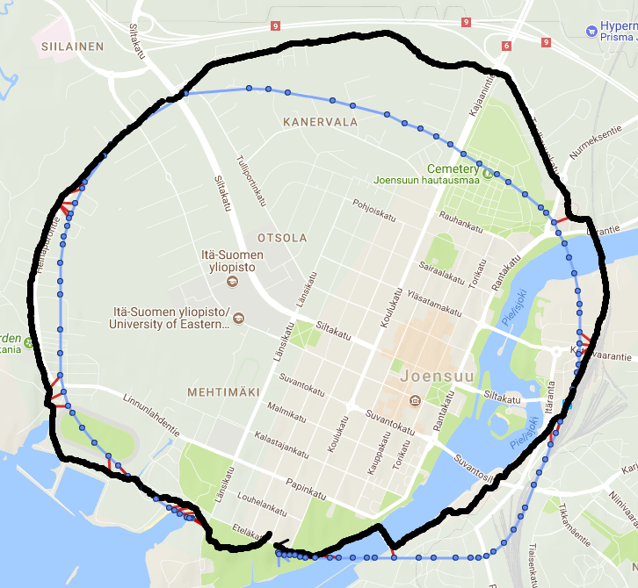
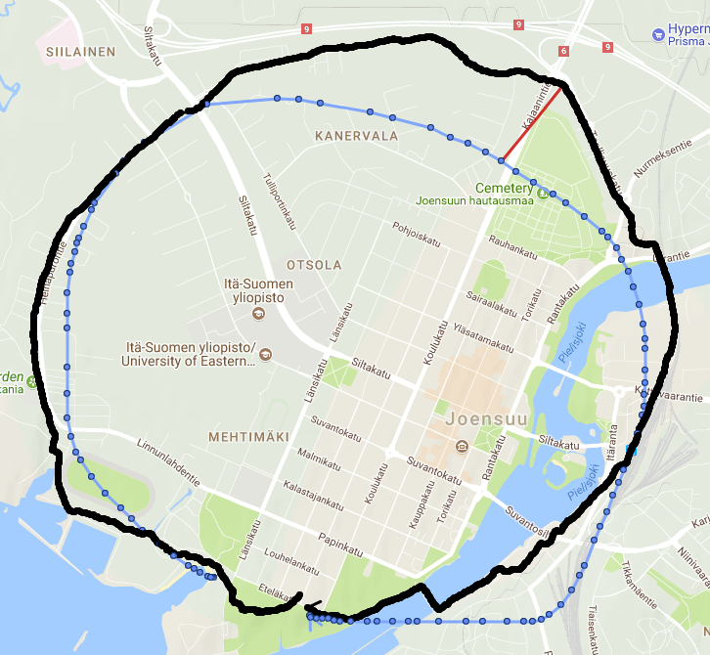
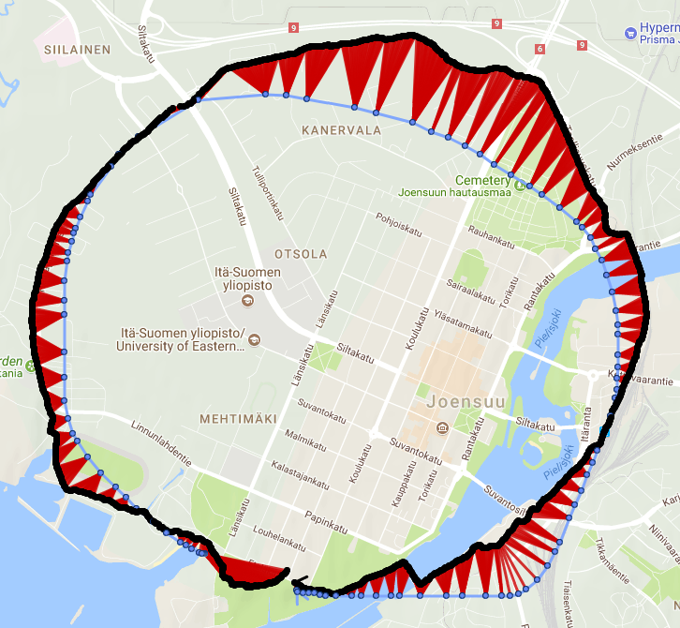
Different Similarity Measures
LCSS
Frechet
DTW
3 %
10 %
33 %

Slide 11
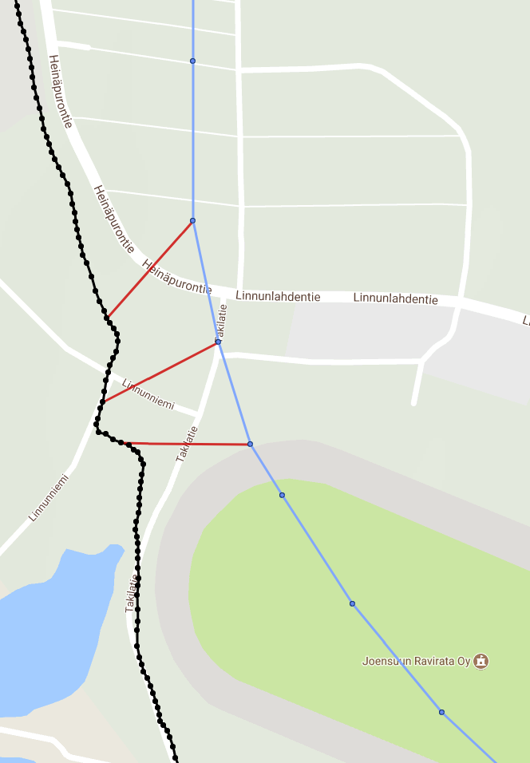
Longest Common Subsequence
ε
LCSS
50 m
Different
Sampling
Rate
3 %
S1: MOPSI
S2: MAPS

Slide 12
Frechet Distance
500 m
ε
Sim=10 %
- 50 m

Slide 13
Dynamic Time Warping
150 m
ε
Sim=33 %
- 50 m

Slide 14
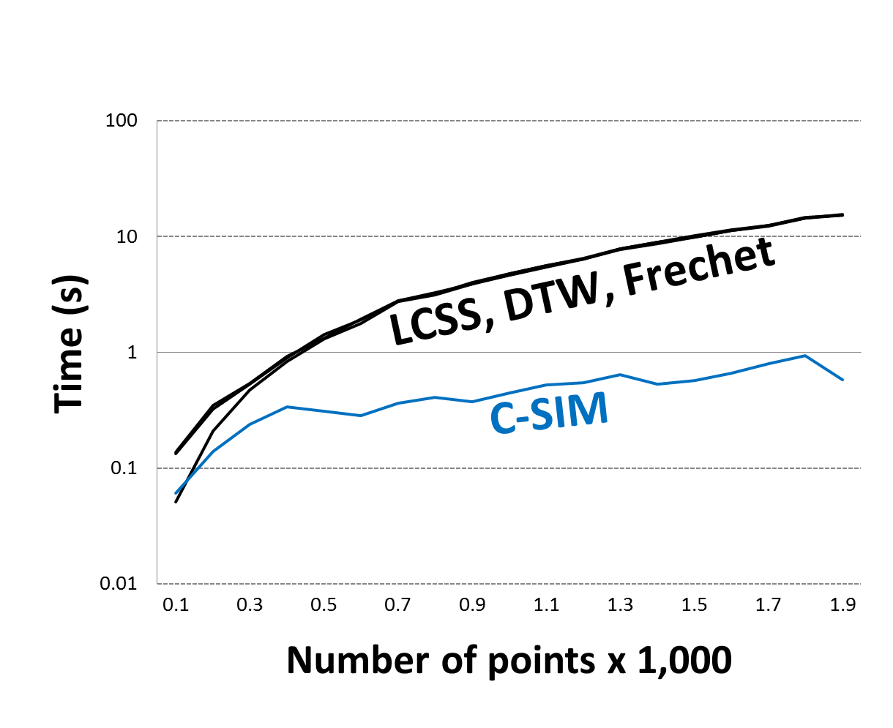
C-SIM is Faster

Slide 15
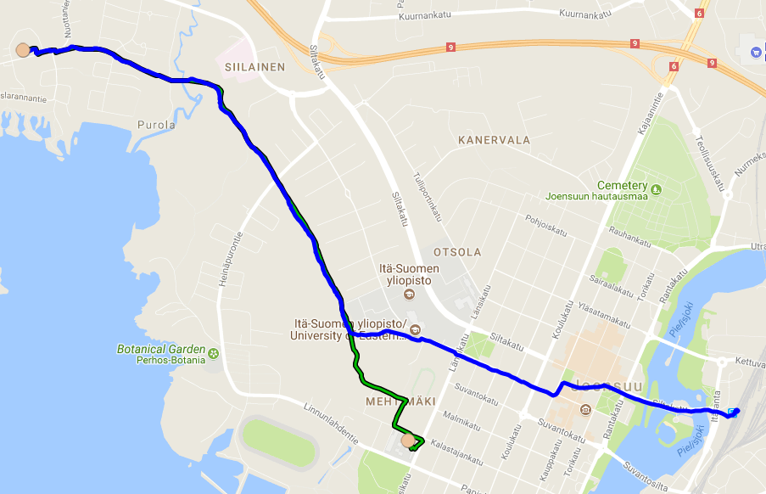
Other Grid Operations
50% Similarity
80 % Inclusion
Notes:
Inclusion is an asymetric version.

Slide 16
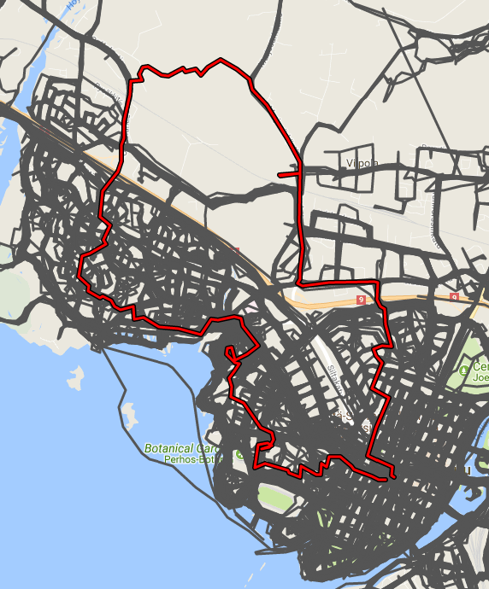
Other Grid Operations
15 % Novel
Notes:
Inclusion is an asymetric version.

Slide 17
Route Search [P3] and [P4]
R. Mariescu-Istodor & P. Fränti
“Grid-based method for GPS route analysis for retrieval”
ACM Transactions on Spatial Algorithms and Systems
(to appear)
R. Mariescu-Istodor & P. Fränti
“Gesture input for GPS route search”
S+SSPR 2016, Merida, Mexico, pp. 439-449

Slide 18
???

Slide 19
Usability
[P1] Traditional
113 s
[P4] Gesture
67 s
41 % faster
Notes:
19

Slide 20
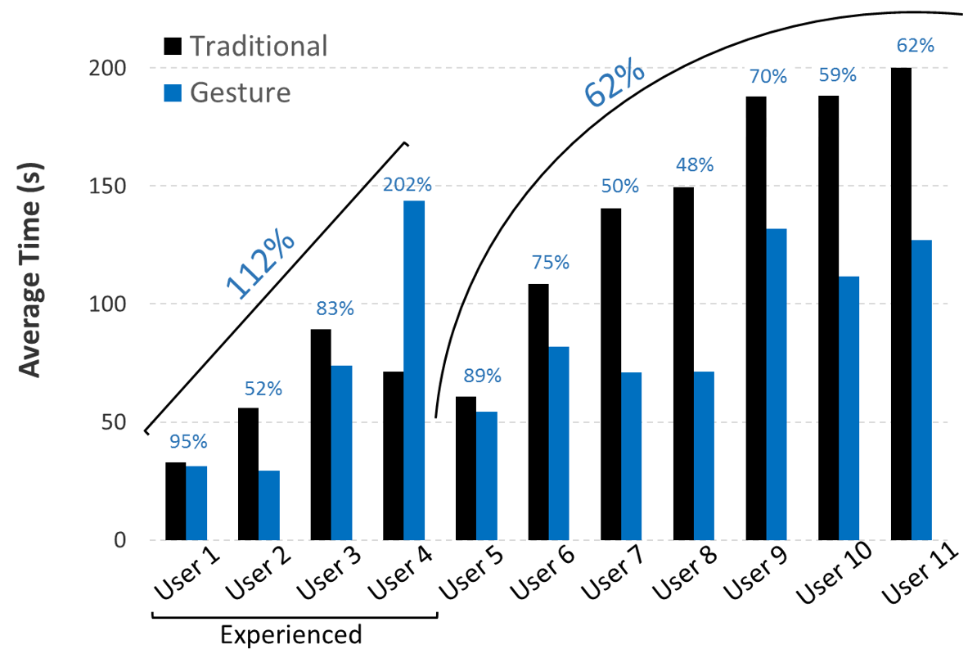
Usability
[P1] Traditional
113 s
[P4] Gesture
67 s
41 % faster
Notes:
20

Slide 21
Road Network Extraction [P5]
R. Mariescu-Istodor & P. Fränti
“CellNet: Inferring road networks from GPS trajectories”
ACM Transactions on Spatial Algorithms and Systems
(submitted)
Notes:
Let’s move on to what we can learn from the routes.
To extract the road network, we find first the intersections.

Slide 22
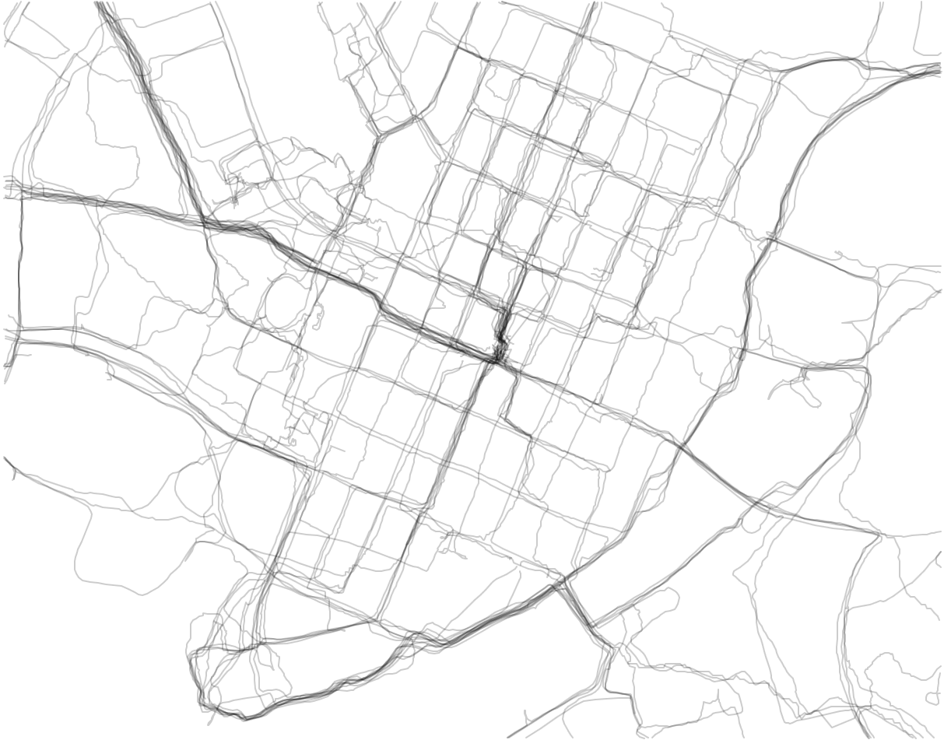
Finding Intersections
No Intersection

Slide 23
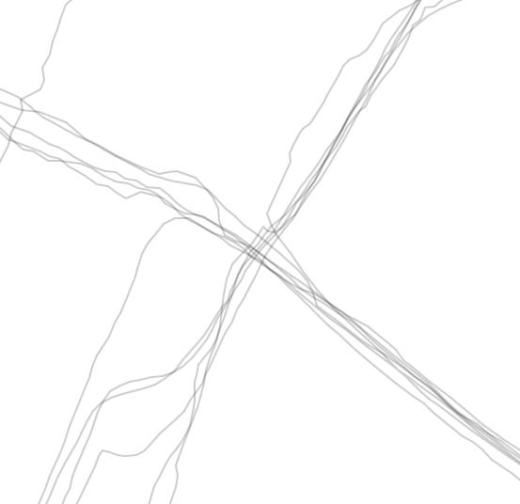
Finding Intersections
Intersection

Slide 24
Creating Segments

Slide 25
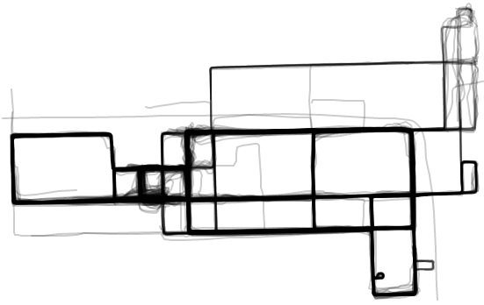
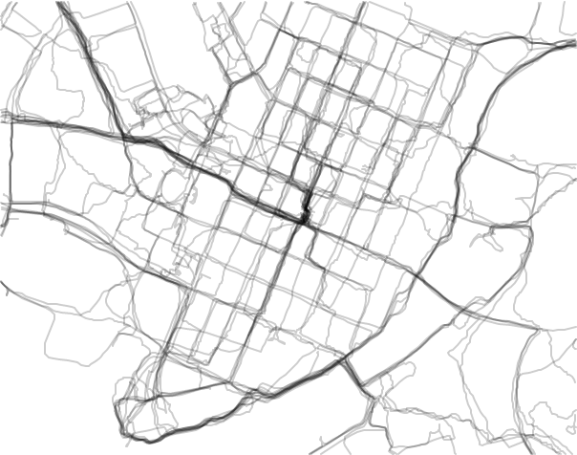
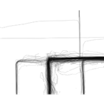
Evaluation
Chicago
42 %
28 %
10 %
75 %
J. Davies, A. R. Beresford and A. Hopper
“Scalable, distributed, real-time map generation”
IEEE Pervasive Computing, 5(4), pp. 47-54, 2006
S. Edelkamp and S. Schrödl
“Route planning and map inference with global positioning traces”
In Computer Science in Perspective, pp. 128-151, 2003
L. Cao and J. Krumm
“From GPS traces to a routable road map”
SigspatiaI’09, Seattle, Washington, USA, pp. 3-12
46 %
27 %
18 %
58 %
Joensuu
Visual
Clustering
Merging
CellNet

Slide 26
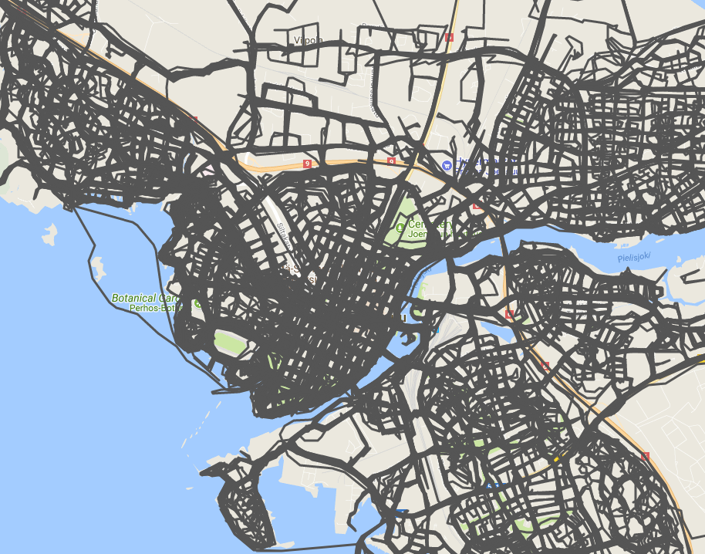
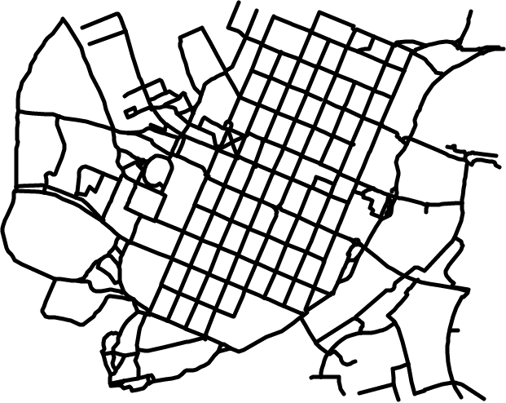
Conclusions
Showing multiple routes on the map – It can be done!
Gestures can be used to search for routes.
Road network can be inferred from route collections.

Slide 27
Thank you!
Notes:
I ask you, honourable professor, as the appointed opponent, to present those remarks, which you consider my thesis will require.
.
.
.
Anyone in this auditorium, who has anything to remark of object against my thesis, please ask the custos for permission to take the floor.

