Slide 1
LAMAD Location-aware mobile application development
Radu Mariescu-Istodor
19.3.2018

Slide 2
LAMAD (Spring 2018)
Website: http://cs.uef.fi/~radum/lamad
ETCS 5
Lectures (28h):
Monday 14-16
Tuesday 14-16
Exercises (12h):
Friday: 10-12
Group Project
Exam dates: 18.5. and 12.6.
Exercises
Project

Slide 3
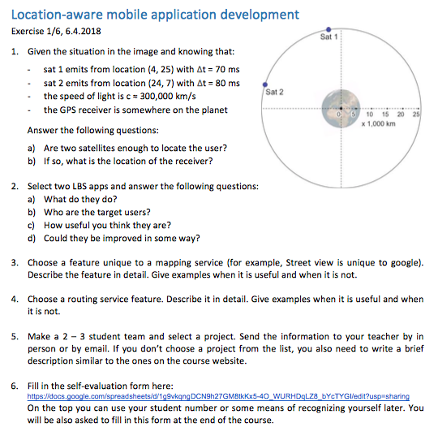
Course program - Exercises
19.3 Mon : Introduction
20.3 Tue : Positioning technologies
26.3 Mon : Projections and distances
27.3 Tue : Mapping & routing services
6.4 Fri : Ex 1
9.4 Mon : Web programming
10.4 Tue : Mobile programming
13.4 Fri : Ex 2
16.4 Mon : HTTP and JSON
17.4 Tue : Server-side APIs
20.4 Fri : Ex 3
23.4 Mon : Case study: Mopsi
24.4 Tue : Case study: Strava + Waze
27.4 Fri : Ex 4
7.5 Mon : GPS trajectories
8.5 Tue : API development
9.5 Wed : Ex 5
14.5 Mon : Case study: O-Mopsi
15.5 Tue : Case study: Pokemon Go
17.5 Thu : Project presentations

Slide 4
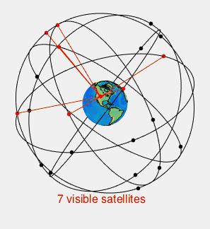
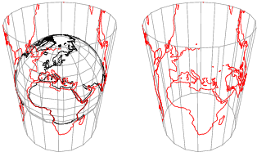
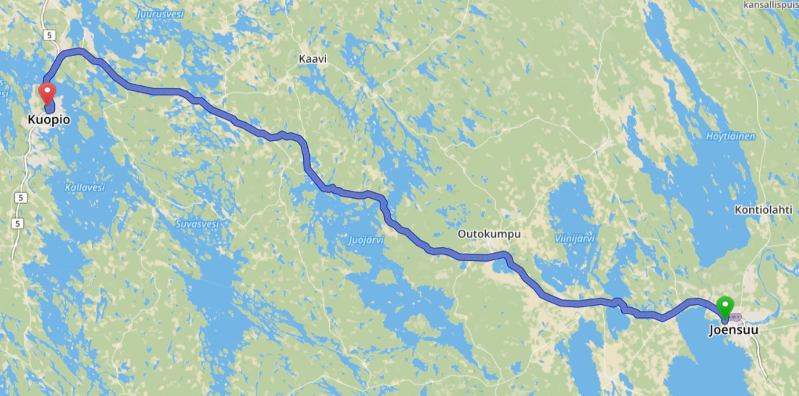
Course program - Fundamentals
19.3 Mon : Introduction
20.3 Tue : Positioning technologies
26.3 Mon : Projections and distances
27.3 Tue : Mapping & routing services
6.4 Fri : Ex 1
9.4 Mon : Web programming
10.4 Tue : Mobile programming
13.4 Fri : Ex 2
16.4 Mon : HTTP and JSON
17.4 Tue : Server-side APIs
20.4 Fri : Ex 3
23.4 Mon : Case study: Mopsi
24.4 Tue : Case study: Strava + Waze
27.4 Fri : Ex 4
7.5 Mon : GPS trajectories
8.5 Tue : API development
9.5 Wed : Ex 5
14.5 Mon : Case study: O-Mopsi
15.5 Tue : Case study: Pokemon Go
17.5 Thu : Project presentations
http://mathworld.wolfram.com
https://www.wikipedia.org
OSRM

Slide 5
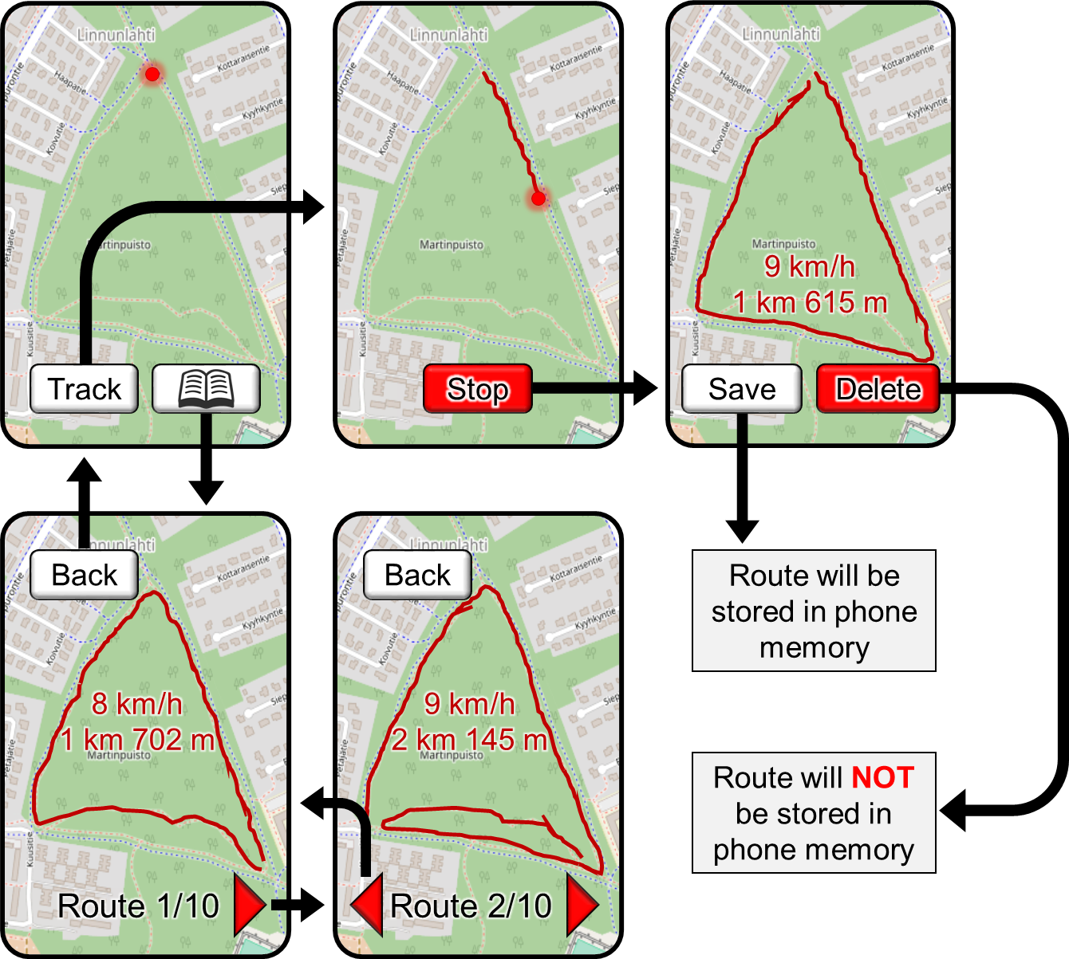
Course program - Development
19.3 Mon : Introduction
20.3 Tue : Positioning technologies
26.3 Mon : Projections and distances
27.3 Tue : Mapping & routing services
6.4 Fri : Ex 1
9.4 Mon : Web programming
10.4 Tue : Mobile programming
13.4 Fri : Ex 2
16.4 Mon : HTTP and JSON
17.4 Tue : Server-side APIs
20.4 Fri : Ex 3
23.4 Mon : Case study: Mopsi
24.4 Tue : Case study: Strava + Waze
27.4 Fri : Ex 4
7.5 Mon : GPS trajectories
8.5 Tue : API development
9.5 Wed : Ex 5
14.5 Mon : Case study: O-Mopsi
15.5 Tue : Case study: Pokemon Go
17.5 Thu : Project presentations

Slide 6
Course program - Development
19.3 Mon : Introduction
20.3 Tue : Positioning technologies
26.3 Mon : Projections and distances
27.3 Tue : Mapping & routing services
6.4 Fri : Ex 1
9.4 Mon : Web programming
10.4 Tue : Mobile programming
13.4 Fri : Ex 2
16.4 Mon : HTTP and JSON
17.4 Tue : Server-side APIs
20.4 Fri : Ex 3
23.4 Mon : Case study: Mopsi
24.4 Tue : Case study: Strava + Waze
27.4 Fri : Ex 4
7.5 Mon : GPS trajectories
8.5 Tue : API development
9.5 Wed : Ex 5
14.5 Mon : Case study: O-Mopsi
15.5 Tue : Case study: Pokemon Go
17.5 Thu : Project presentations
The biggest mistake we’ve made as a company is betting on HTML5 over Native

Slide 7
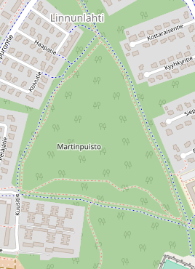
Course program - Server API
19.3 Mon : Introduction
20.3 Tue : Positioning technologies
26.3 Mon : Projections and distances
27.3 Tue : Mapping & routing services
6.4 Fri : Ex 1
9.4 Mon : Web programming
10.4 Tue : Mobile programming
13.4 Fri : Ex 2
16.4 Mon : HTTP and JSON
17.4 Tue : Server-side APIs
20.4 Fri : Ex 3
23.4 Mon : Case study: Mopsi
24.4 Tue : Case study: Strava + Waze
27.4 Fri : Ex 4
7.5 Mon : GPS trajectories
8.5 Tue : API development
9.5 Wed : Ex 5
14.5 Mon : Case study: O-Mopsi
15.5 Tue : Case study: Pokemon Go
17.5 Thu : Project presentations
Back
Back
16 km/h
8 km/h
1 km 702 m
Route 1/10
Route 1/10

Slide 8
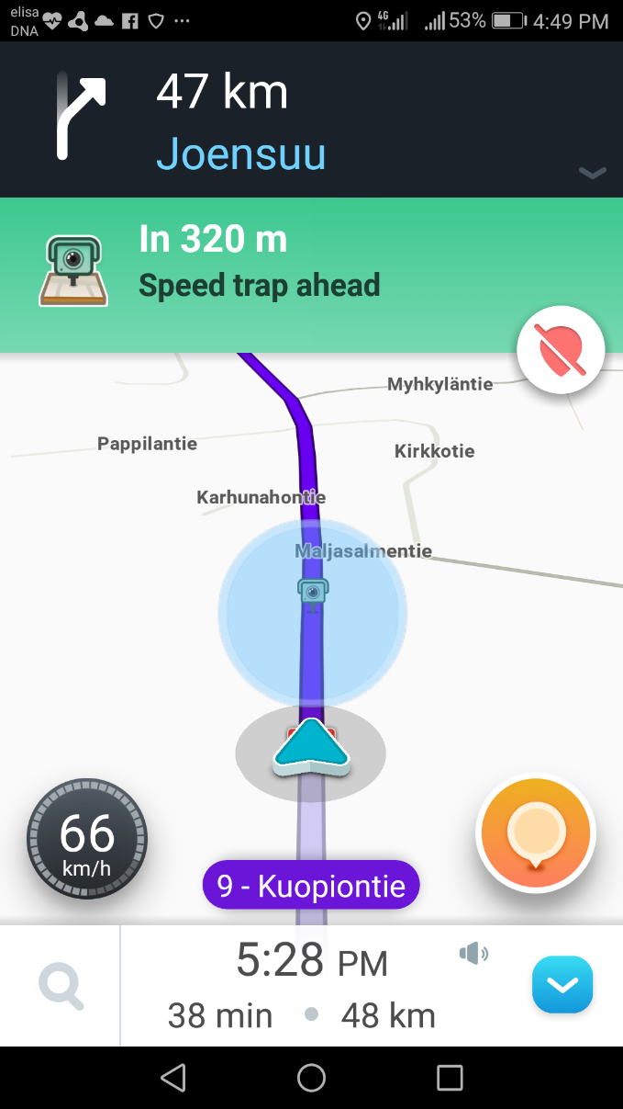
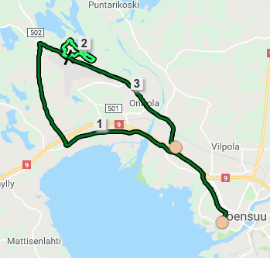
Course program - Case studies
19.3 Mon : Introduction
20.3 Tue : Positioning technologies
26.3 Mon : Projections and distances
27.3 Tue : Mapping & routing services
6.4 Fri : Ex 1
9.4 Mon : Web programming
10.4 Tue : Mobile programming
13.4 Fri : Ex 2
16.4 Mon : HTTP and JSON
17.4 Tue : Server-side APIs
20.4 Fri : Ex 3
23.4 Mon : Case study: Mopsi
24.4 Tue : Case study: Strava + Waze
27.4 Fri : Ex 4
7.5 Mon : GPS trajectories
8.5 Tue : API development
9.5 Wed : Ex 5
14.5 Mon : Case study: O-Mopsi
15.5 Tue : Case study: Pokemon Go
17.5 Thu : Project presentations

Slide 9
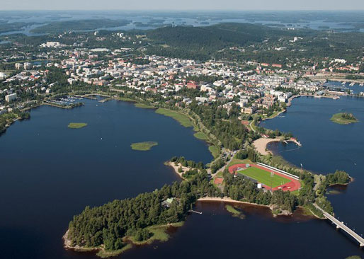
Course program - Kuopio
19.3 Mon : Introduction
20.3 Tue : Positioning technologies
26.3 Mon : Projections and distances
27.3 Tue : Mapping & routing services
6.4 Fri : Ex 1
9.4 Mon : Web programming
10.4 Tue : Mobile programming
13.4 Fri : Ex 2
16.4 Mon : HTTP and JSON
17.4 Tue : Server-side APIs
20.4 Fri : Ex 3
23.4 Mon : Case study: Mopsi
24.4 Tue : Case study: Strava + Waze
27.4 Fri : Ex 4
7.5 Mon : GPS trajectories
8.5 Tue : API development
9.5 Wed : Ex 5
14.5 Mon : Case study: O-Mopsi
15.5 Tue : Case study: Pokemon Go
17.5 Thu : Project presentations

Slide 10
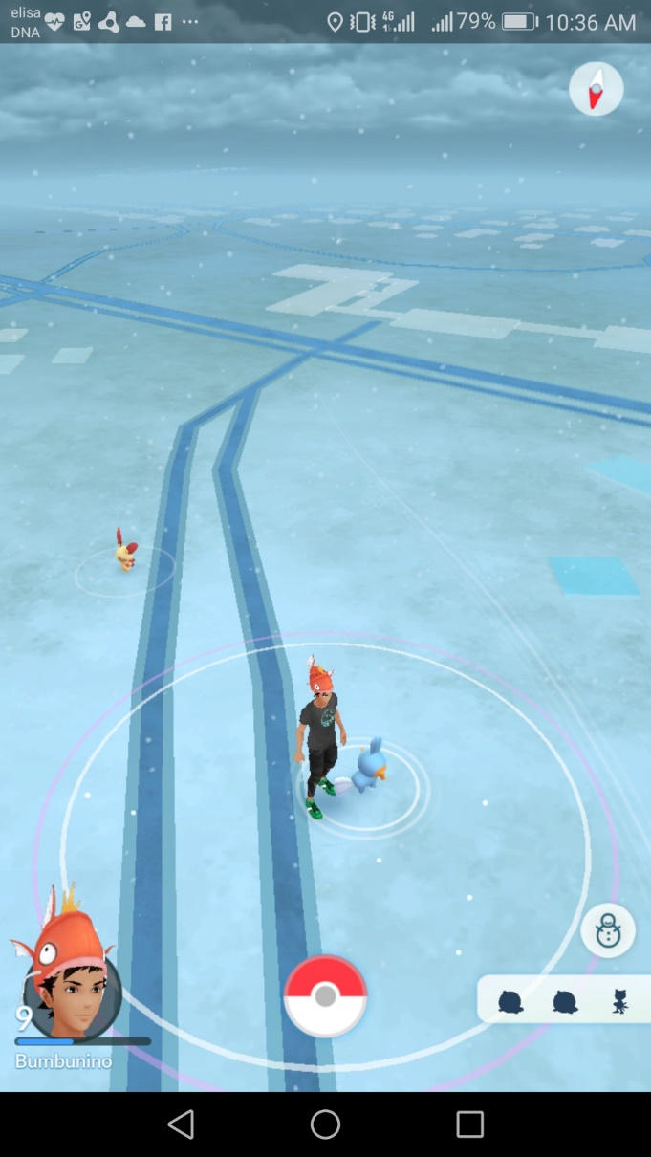
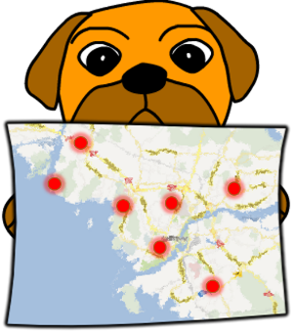
Course program - Case studies
19.3 Mon : Introduction
20.3 Tue : Positioning technologies
26.3 Mon : Projections and distances
27.3 Tue : Mapping & routing services
6.4 Fri : Ex 1
9.4 Mon : Web programming
10.4 Tue : Mobile programming
13.4 Fri : Ex 2
16.4 Mon : HTTP and JSON
17.4 Tue : Server-side APIs
20.4 Fri : Ex 3
23.4 Mon : Case study: Mopsi
24.4 Tue : Case study: Strava + Waze
27.4 Fri : Ex 4
7.5 Mon : GPS trajectories
8.5 Tue : API development
9.5 Wed : Ex 5
14.5 Mon : Case study: O-Mopsi
15.5 Tue : Case study: Pokemon Go
17.5 Thu : Project presentations

Slide 11
Why come to this course?
About 90% of US smartphone owners use location
Location based services (LBS) are popular
Notes:
On google play store:
Pokemon go and Waze have over 100,000,000 downloads
Facebook is not that far away at 1,000,000,000.
Strava lower at 10,000,000.

Slide 12
Why come to this course?
About 90% of US smartphone owners use location
Location based services (LBS) are popular
Everyone has a smartphone with location-sensing capabilities nowadays

Slide 13
What is a location-based service (LBS) ?
Provides user’s location
Information near the user
Interaction with the content

Slide 14
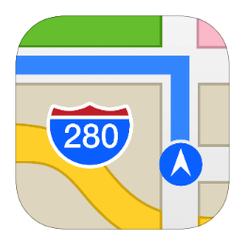
Types of LBS
Using: www.wordclouds.com
Notes:
First we find out how the weather is where we are
If good, we could go visit some places.
We then need to find the place using some map service, prefferably with navigation support
Alternatively, we might want to do some sports
Or play a game.

Slide 15
What is a location-based service (LBS) ?
Provides user’s location
Information near the user
Interaction with the content
GIS
Spatial Database
Web
GIS
Mobile
GIS
LBS
Internet
Mobile
Internet
Mobile

Slide 16
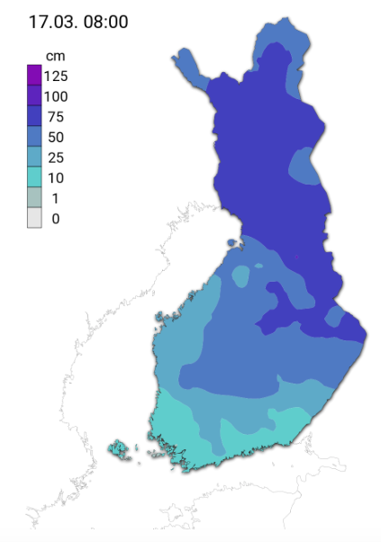
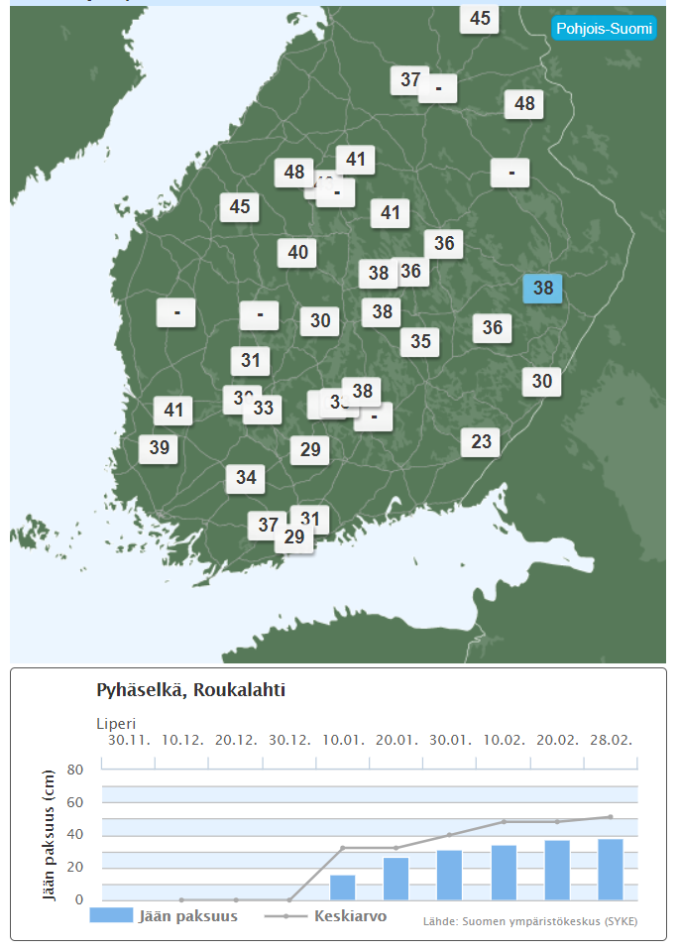
Geographic information systems (GIS)
http://ilmatieteenlaitos.fi
https://www.foreca.fi

Slide 17
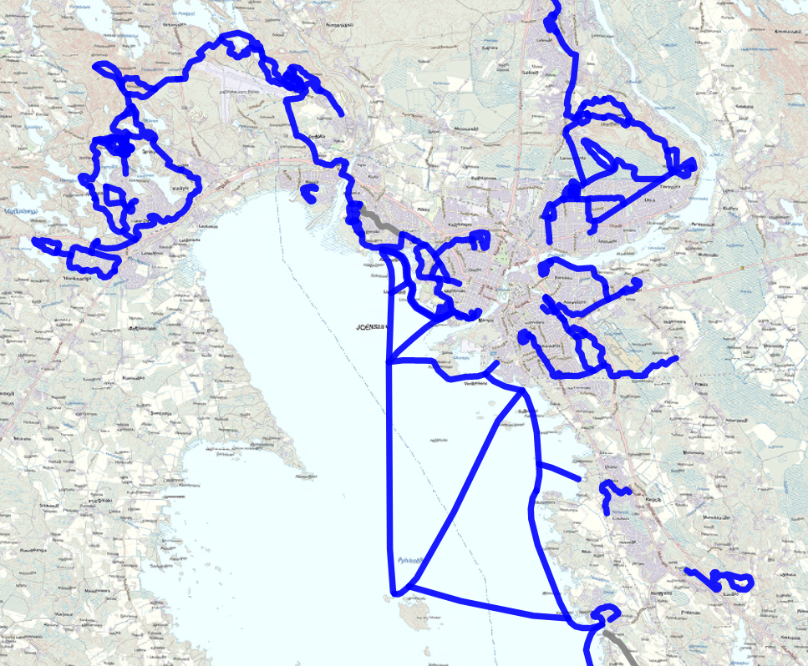
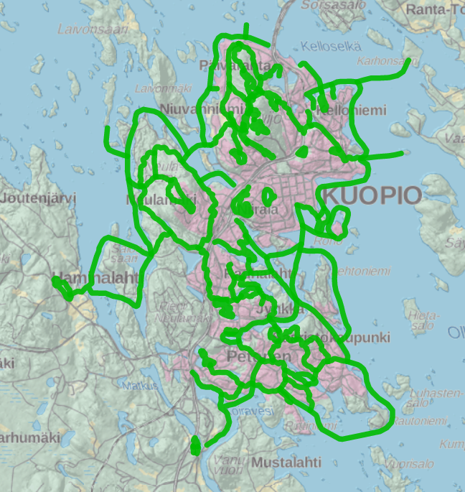
Geographic information systems (GIS)
Joensuu
Kuopio
http://kunto.jns.fi/LATUUI
https://kunto.softroi.fi/LATUKUOPIO

Slide 18
Group project

