Slide 1
LAMAD Positioning technologies
Radu Mariescu-Istodor
20.3.2018

Slide 2
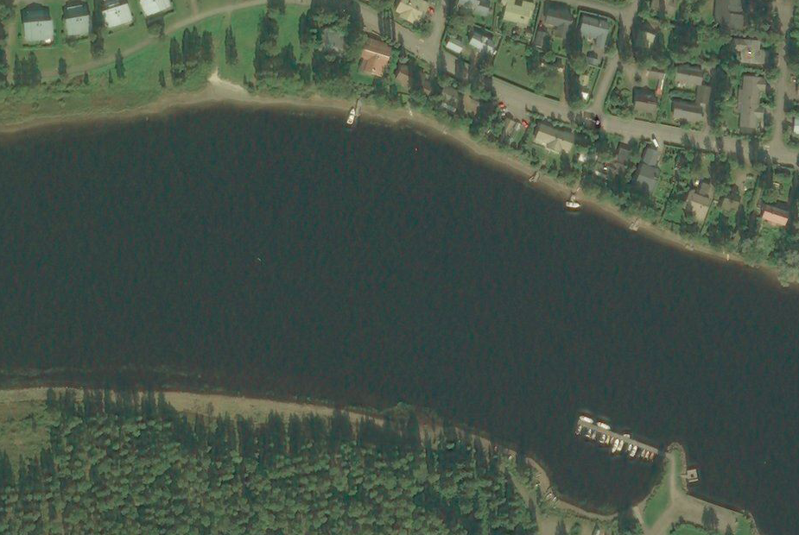
Triangulation
x

Slide 3
Triangulation
x
100 m

Slide 4
Triangulation
x
60^{O}
100 m
Notes:
tan (60) = x / 100 m
tan (60) = sqrt (3) = (approx) 1.73
=> x = 173

Slide 5
Height measurement
Treetop project*

Slide 6
Demo 1

Slide 7
Parallax
Distant
background
July:
SUN
Nearby
star
January:
July:
January:
Notes:
Parallax is the difference in apparent position of an object according to two different lines of sight.

Slide 8
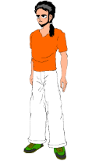
Mobile phone signal
R
r
r
R

Slide 9
Trilateration
4
( 1, 1 )
3
( 5, 4 )
Notes:
Bidirectional.
Not only you know how far the cell tower is, but cell tower also knows where you are ;)
That’s how police can track down criminals in some situations.

Slide 10
Trilateration
Notes:
Cell ID databases

Slide 11
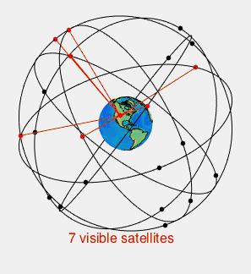
Global positioning system (GPS)
Demo 2
https://www.wikipedia.org
Notes:
Link to satellites is on Gif
Link to orbits is in title

