Slide 1
Snake Go
Bilal Soomro
Ziyad Tareq
Alvaro Garrudo

Slide 2
Catch your prey and get some exercise

Slide 3
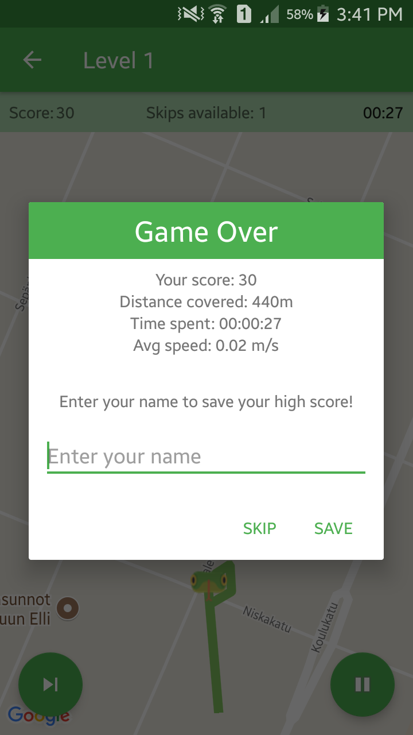
Features
Easily reachable targets
Difficulty levels
User has a tail that grows after visiting each target
If user intersect its tail then it's game over
Skip target button
Summary of game played (Distance covered, average speed, time spent)
Snake head rotates like compass to help user navigate
Save your high score and complete globally
Sounds

Slide 4
We learned
How to find information about various implementation of any features
How to generate targets that are physically reachable and not in some lake or inside building
Generating new target which are 100-400 meters away from previous target while still being inside specific radius from initial start location.
Detect line segment intersection to end game when snake touches own body

