Slide 1
RouteAverage
Mingyue Xie
17.05.2018

Slide 2
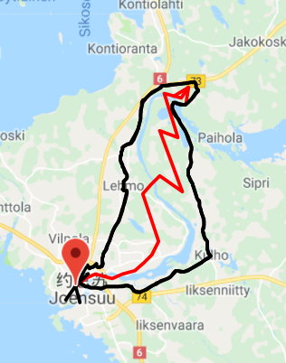
More super than other apps

Slide 3
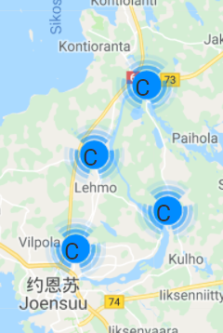
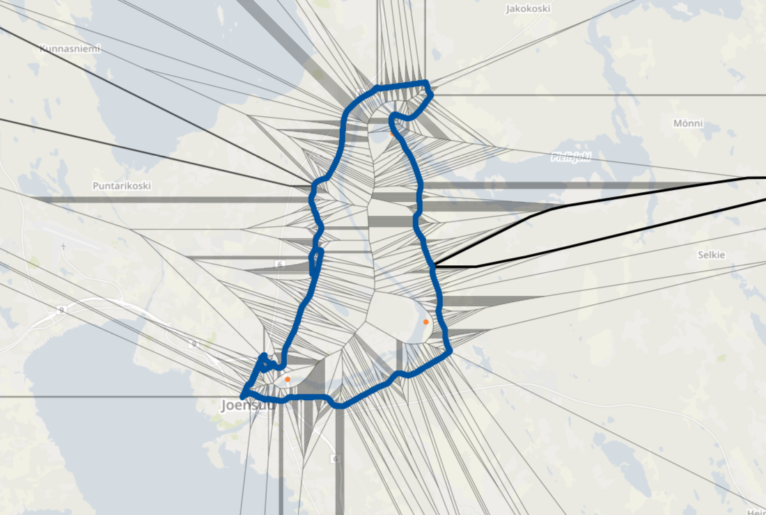
More super than other apps

Slide 4
Features
Route averaging with 2 methods
GPS points clustering
Voronoi graph
- Google map API related visualize

Slide 5
I learned…
Google Maps API provides many methods in visualizing GPS data.
OpenStreetMap api provides method in visualizing GPS data with voronoi graph.
There are many methods in calculating averaging routes, effeciency is important.
Data filtering is important in trajectory, avoiding the noise point make bad influence on the whole result.
Notes:
Voronoi: a Voronoi diagram is a partitioning of a plane into regions based on distance to points in a specific subset of the plane.

