Slide 1



Trajectory shape matching
Lasse Soininen and Juha Voutilainen

Slide 2
Get in shape with shape matching!
Jogging, running, cycling – all of them are more fun with trajectory shape matching
Record your route and let the application tell you what does it resemble

Slide 3
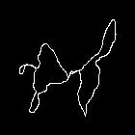
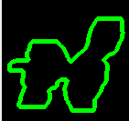
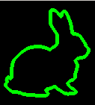
Features
Recognizes the shape of the given route automatically
  No need to scale, rotate or modify the route manually
Program recognizes basic shapes (circle, triangle, square, etc.) and some special shapes (Batman, bunny, seal, etc.)

Slide 4
How it's done?
  1. Importing coordinates and transforming them to meters
  2. Transforming meters to x and y coordinates
  3. Drawing the route on an image file (Python ImageDraw)
  4. Applying grayscaling, thresholding, dilation and other image modifications
  5. Finding contours
  6. Comparing contours with sample images (OpenCV2)

Slide 5
Results
We used three different contour matching methods with MatchShapes:
  cv2.CONTOURS_MATCH_I1: 6/10 correct
  cv2.CONTOURS_MATCH_I2: 2/10 correct
  cv2.CONTOURS_MATCH_I3: 5/10 correct
MatchShapes seems to be rotation and scale invariant (not much different results if images were rotated or scaled)

Slide 6
What we learned?
Transforming GPS-coordinates to x and y coordinates and further into an image file is not a trivial task
OpenCV was quite easy to use, but there were some functions that we didn't fully understand
MatchShapes function works with simple shapes pretty well, but struggles with more complicated trajectories
Making our own shape matching function from the beginning would have probably been the best way to go

