Slide 1

TSP Accessibility in
O-MOPSI
Nancy Fazal, Himat Shah
16-05-2018

Slide 2
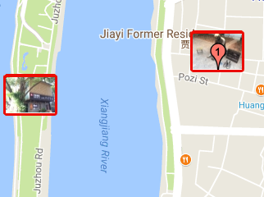
Inaccessible Target

Slide 3
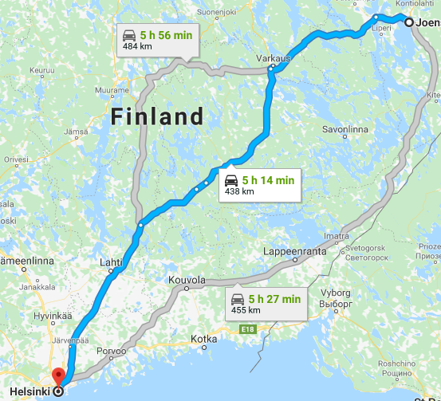
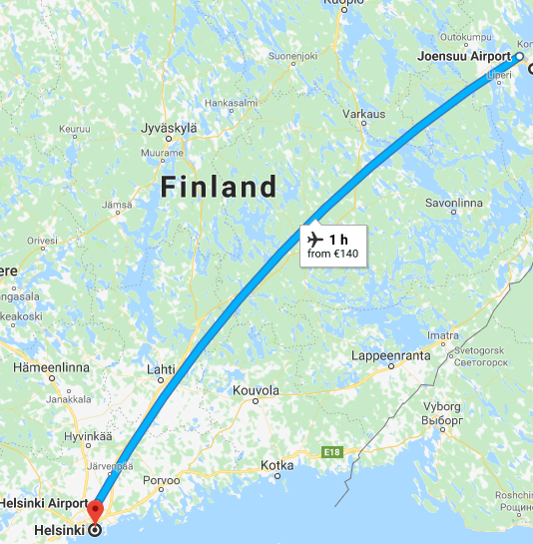
Comparing RoadNetwork Distance with Haversine Distance

Slide 4
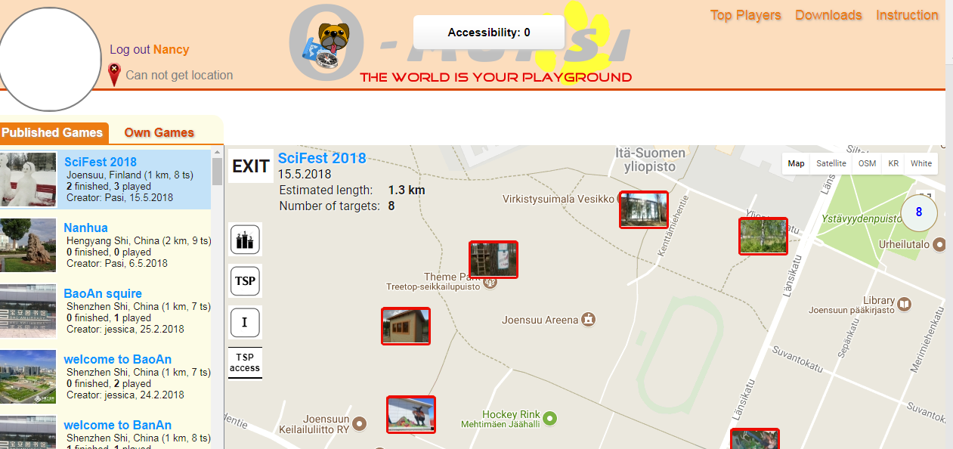
Measuring Accessibility
All targets are Accessible

Slide 5
Analyzing Accessibility Function
Rd = Road Network Distance
Hav = Haversine Distance
Game Name | No. of Targets | if (rd > 2*hav) | if (rd > 3*hav) | if (rd > 4*hav) | if (rd > 5*hav)
SciFest 2018 | 8 | 4 | 2 | 2 | 2
Nanhua | 9 | 12 | 6 | 0 | 0
BoAn squire | 7 | 24 | 8 | 2 | 2
welcome to BaoAn | 7 | 8 | 2 | 0 | 0
welcome to BanAn | 8 | 28 | 8 | 2 | 2
if (rd > 6*hav)
0
0
0
0
0

