Slide 1
TSP Mistakes in O-Mopsi
Lahari Sengupta

Slide 2
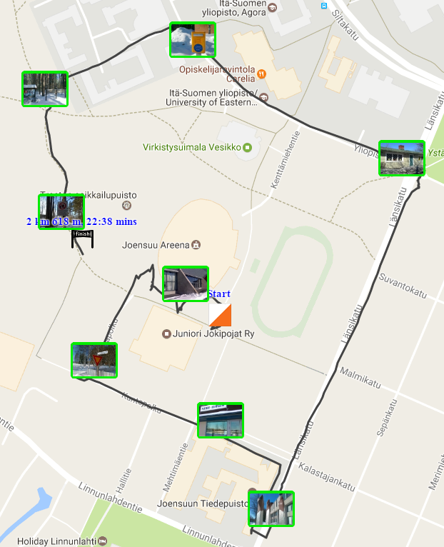
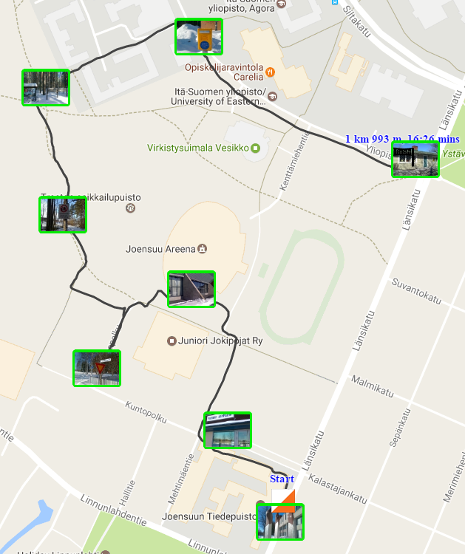
Can you solve TSP?
Player 2
Player 1
Which order is better?

Slide 3
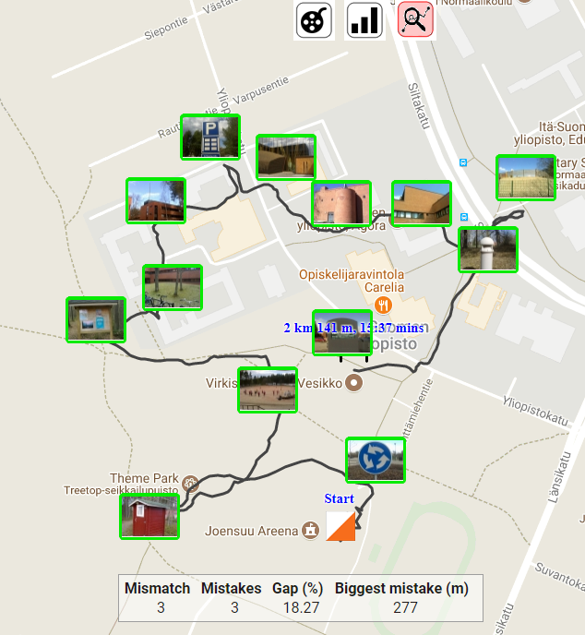
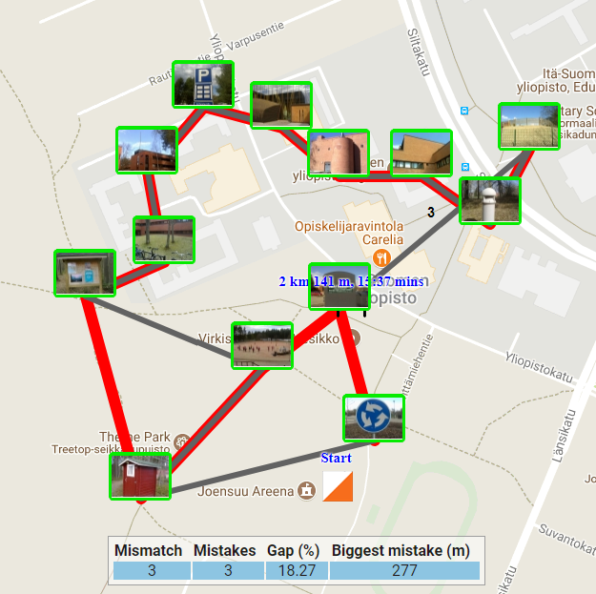
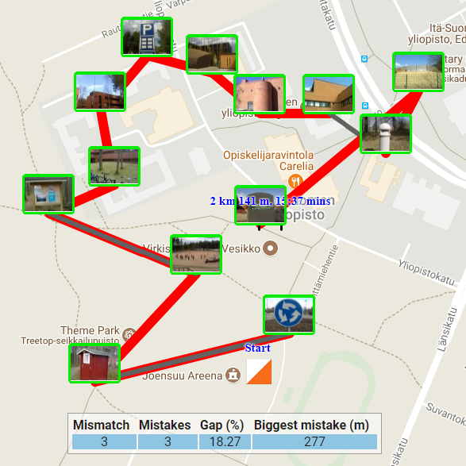
Analysis table
Mismatch links
Mistake links

Slide 4
I learned…
More about using javascript objects
More about handling server side and client side code
HTML 5 table
Google visualization table
Besides these, I learned native android development, more about javascript, many APIs, projection from the course.

