Slide 1


Cafet’info
Matthieu Alingrin
Laetitia Duret
17.05.2018

Slide 2
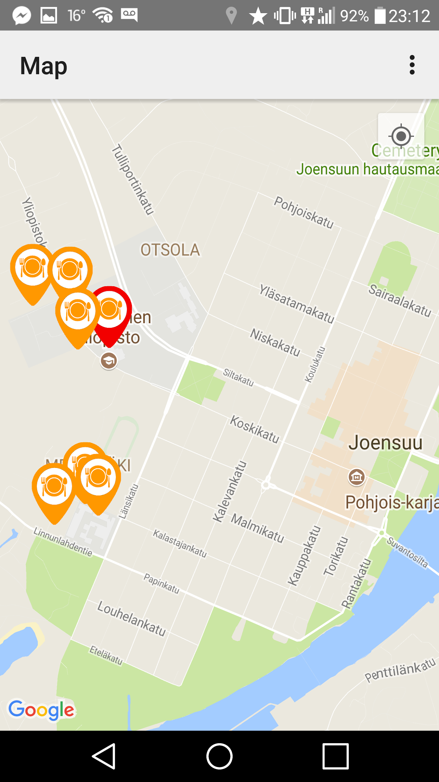
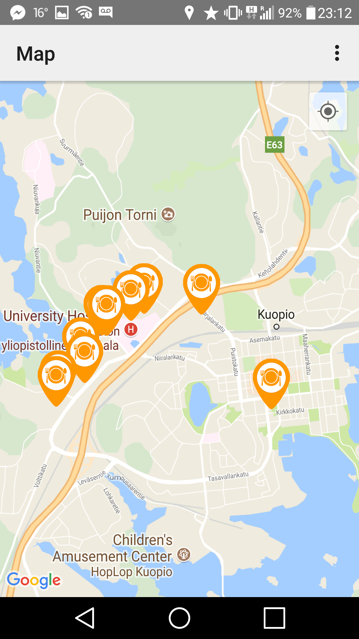
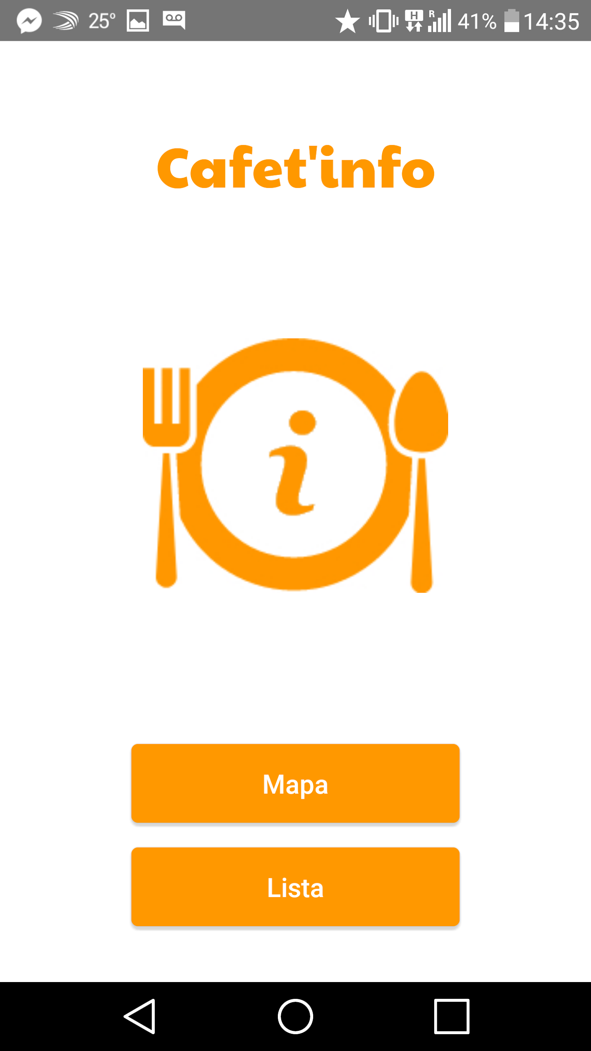
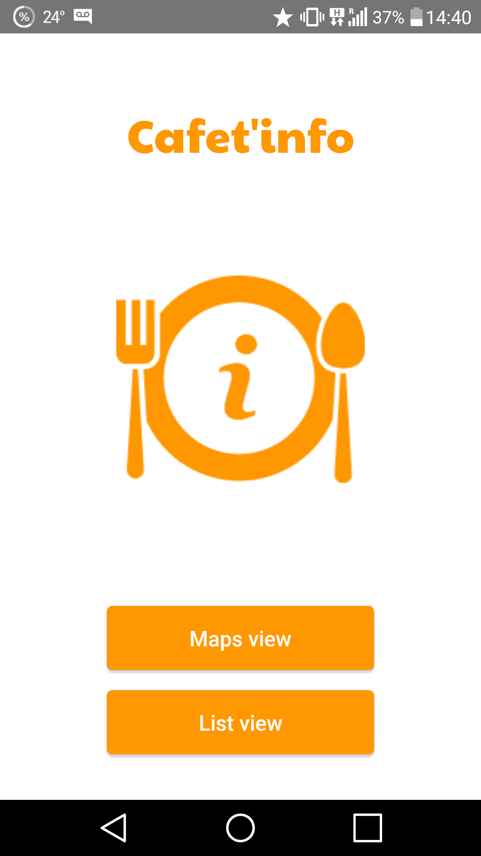
Our app is for every students !
Different languages (english, finnish, french, spanish)
Cafeterias of the two campuses

Slide 3
Features
show the list of the cafeteria sorted by distance
show the cafeterias on a map with the following information :
  address
  opening hours
  student price
  picture
highlight the nearest one on the map
link to the menu on the cafeteria webpage
different languages available (english, finnish, french, spanish)

Slide 4
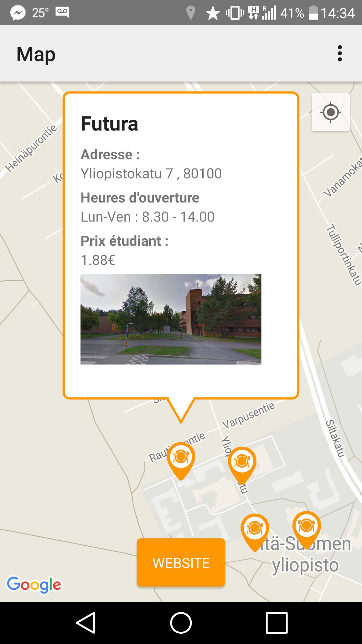
We learned how to :
use the google maps api
customize an info window
animate a button
handle permissions
use different languages

Slide 5
Thank you
Matthieu Alingrin matal@student.uef.fi
Laetitia Duret laetidu@student.uef.fi

