Slide 1


Cafeteria map app
Henrik Nenonen & Teemu Nenonen
17.5.2018

Slide 2
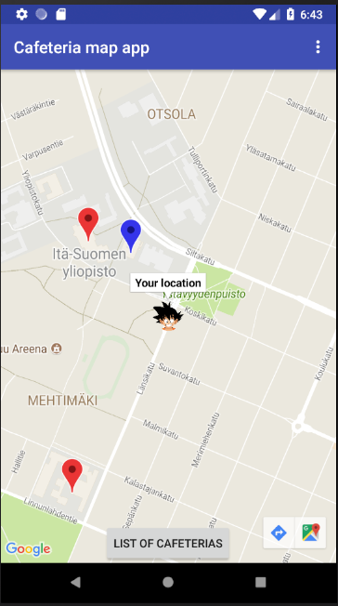
Powerful cafeteria application

Slide 3
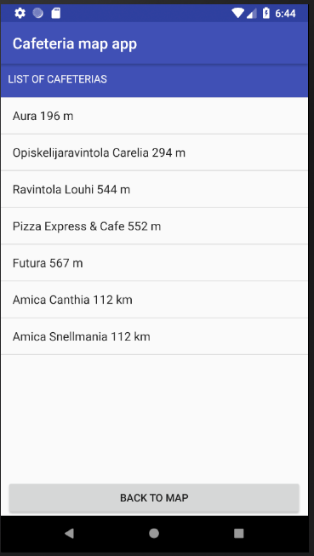
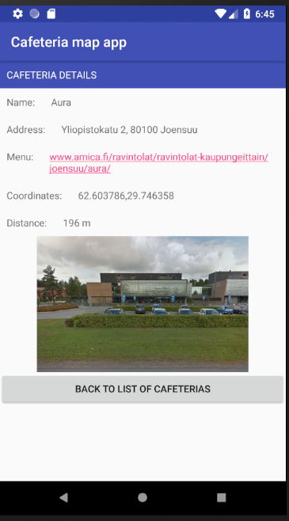
Features
Custom user marker & App icon
Shows cafeteria locations on map
Shows nearest cafeteria on different color
Cafeteria list updates when moving
  Nearest on top
Shows address, picture and links to menu in detail screen

Slide 4
We learned…
To make location aware android application
Making proper layouts is hard
Android studio breaks itself sometimes
Google Maps Android API has many useful features

