Slide 1

Super Duper StuCa App
Juhani Järviö and Tero Lommi

Slide 2
Better than Amica website.

Slide 3
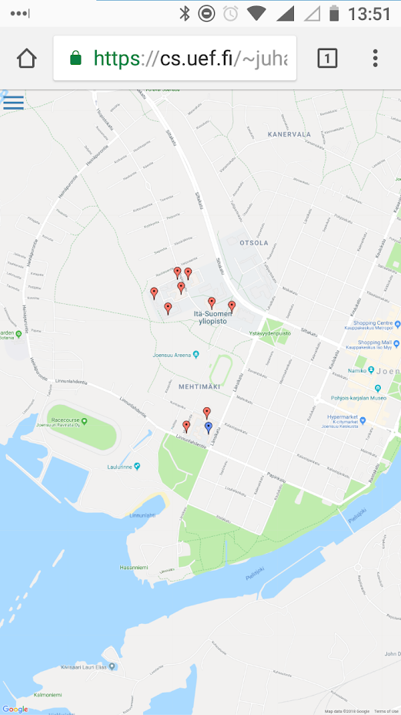
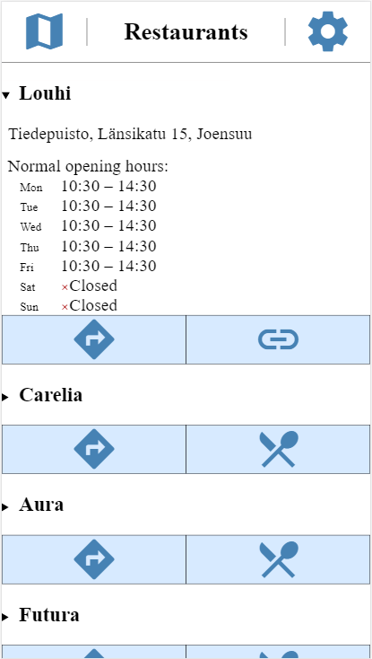
Features
list of restaurants / cafeterias
  and more info on each
map showing them, and your own location
links for websites, and for Amica restaurants menus in-app
Options
  show only vegetarian food
  don’t show cafeterias
  only show restaurants that have Kela support

Slide 4

We learned…
Google maps features.
Webdev for mobile devices.
Website:
  http://cs.uef.fi/~juhanj/superDuperStuCaApp/
Source:
  https://github.com/juhanj/SuperDuperStuCaApp

