Slide 1
Student Restaurants
Ville Suhonen, Kai-Markus Taipale, Jarmo Björkqvist

Slide 2
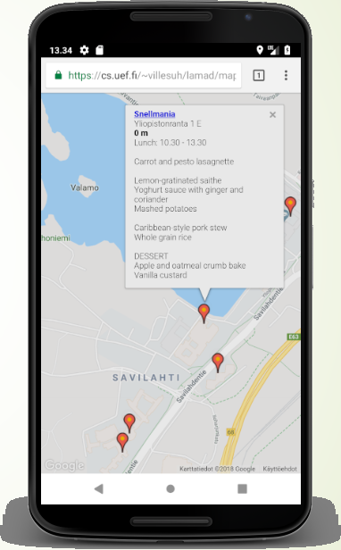
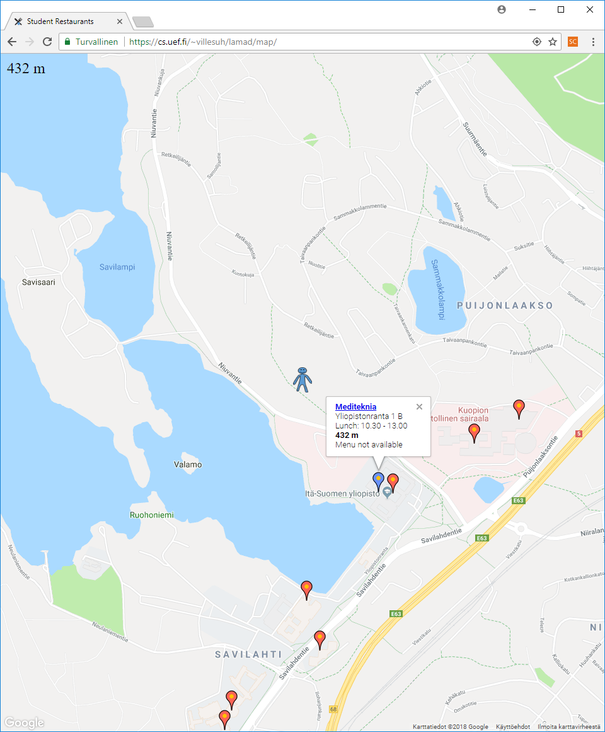
The Application / UI
Notes:
*The location can not be entered to browser of the Android emulator.

Slide 3
Features
Shows the nearby student restaurants on the map
Shows own position on the map with a human icon
The nearest restaurant has a blue marker
  Distances to nearby restaurants are displayed and updated (up to 100 km)
  Constantly displays the distance to the nearest restaurant
Picking one of the restaurants shows popup information
  Name and link to site
  Address
  Lunch time
  Distance to user (in km or meters)
  Menu of the day for most restaurants from JSON (when available) or parsed from html

Slide 4
We learned
How to use Google Maps JavaScript API in browser application
How to calculate the distances to locations
How to parse JSON, html (with BeautifulSoup for Python)
How to use Ajax, PHP
How to draw icons
How to use js/maps animations
How to present technical project
How to work together
https://cs.uef.fi/~villesuh/lamad/map

