Slide 1



IDO’s Weather App
Ceyda Demir

Slide 2


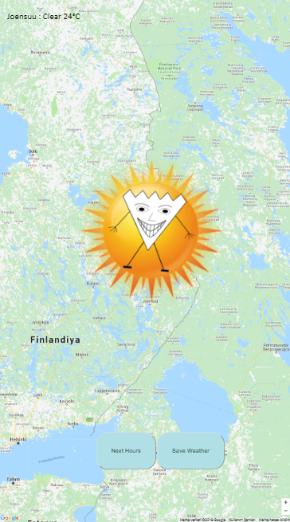
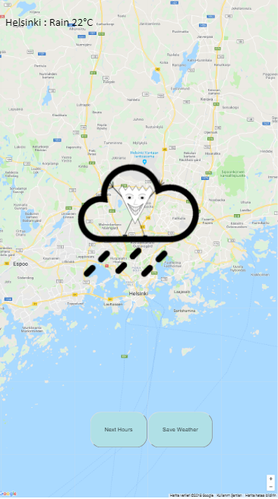



Slide 3
Features
  5 day forecast weather data every 3 hours
  Store the current weather data
  Icons with IDO
  Current location on map

Slide 4
I learned
- features of Google Maps Javascript API
- how to use local storage of a browser

