Slide 1
WeathrMAX
Miika Heiskanen

Slide 2



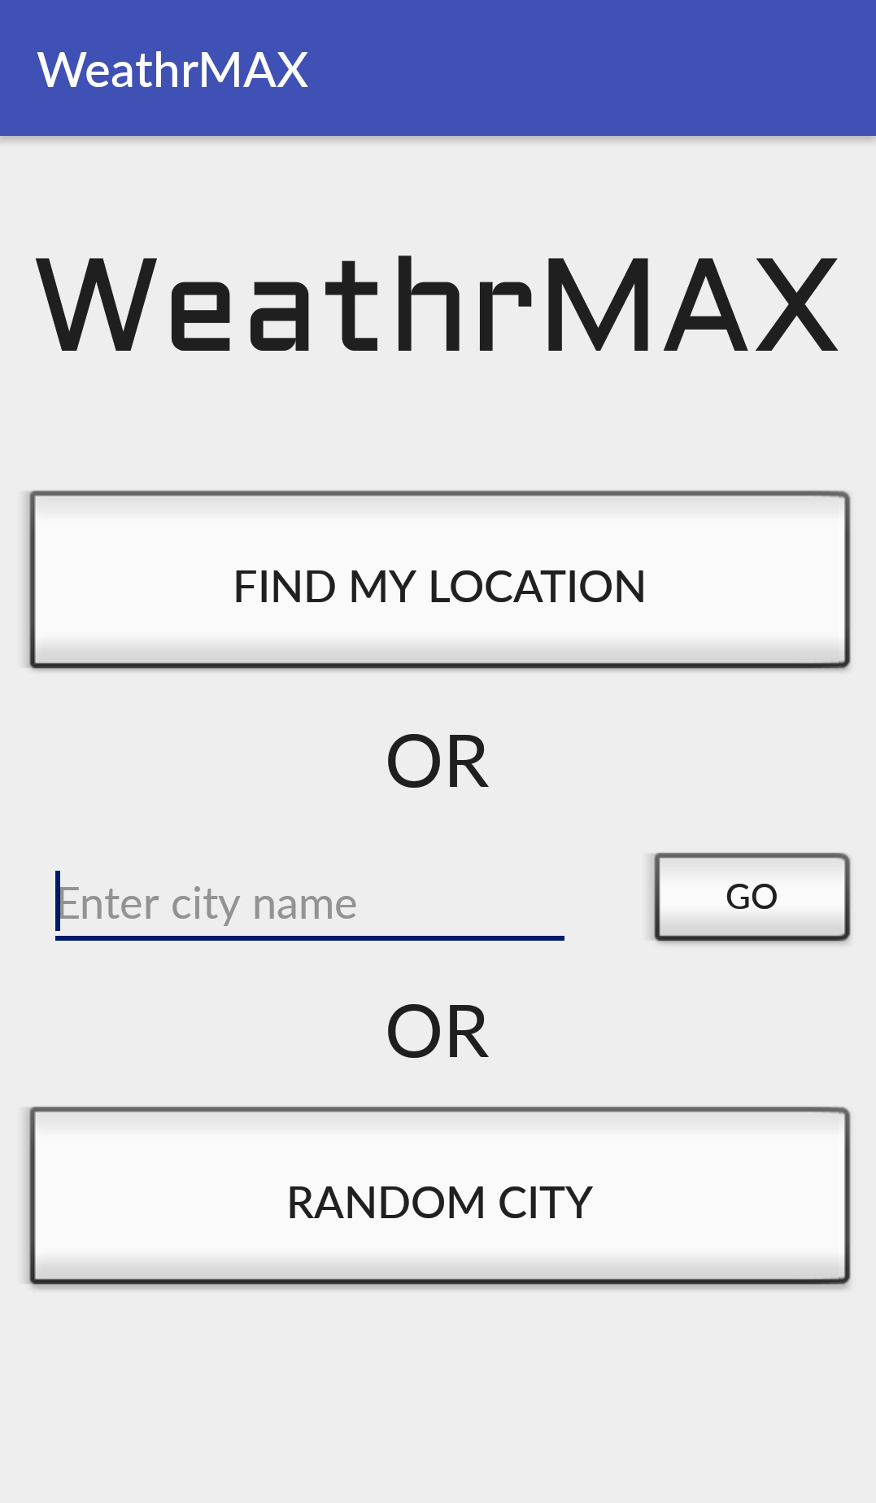
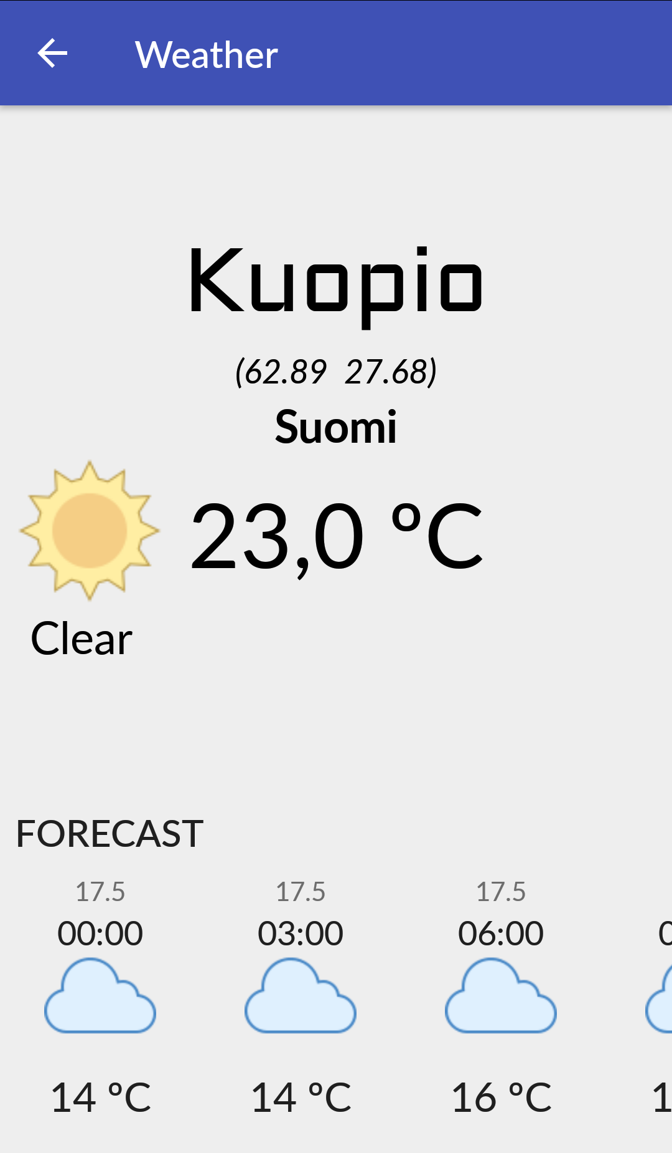
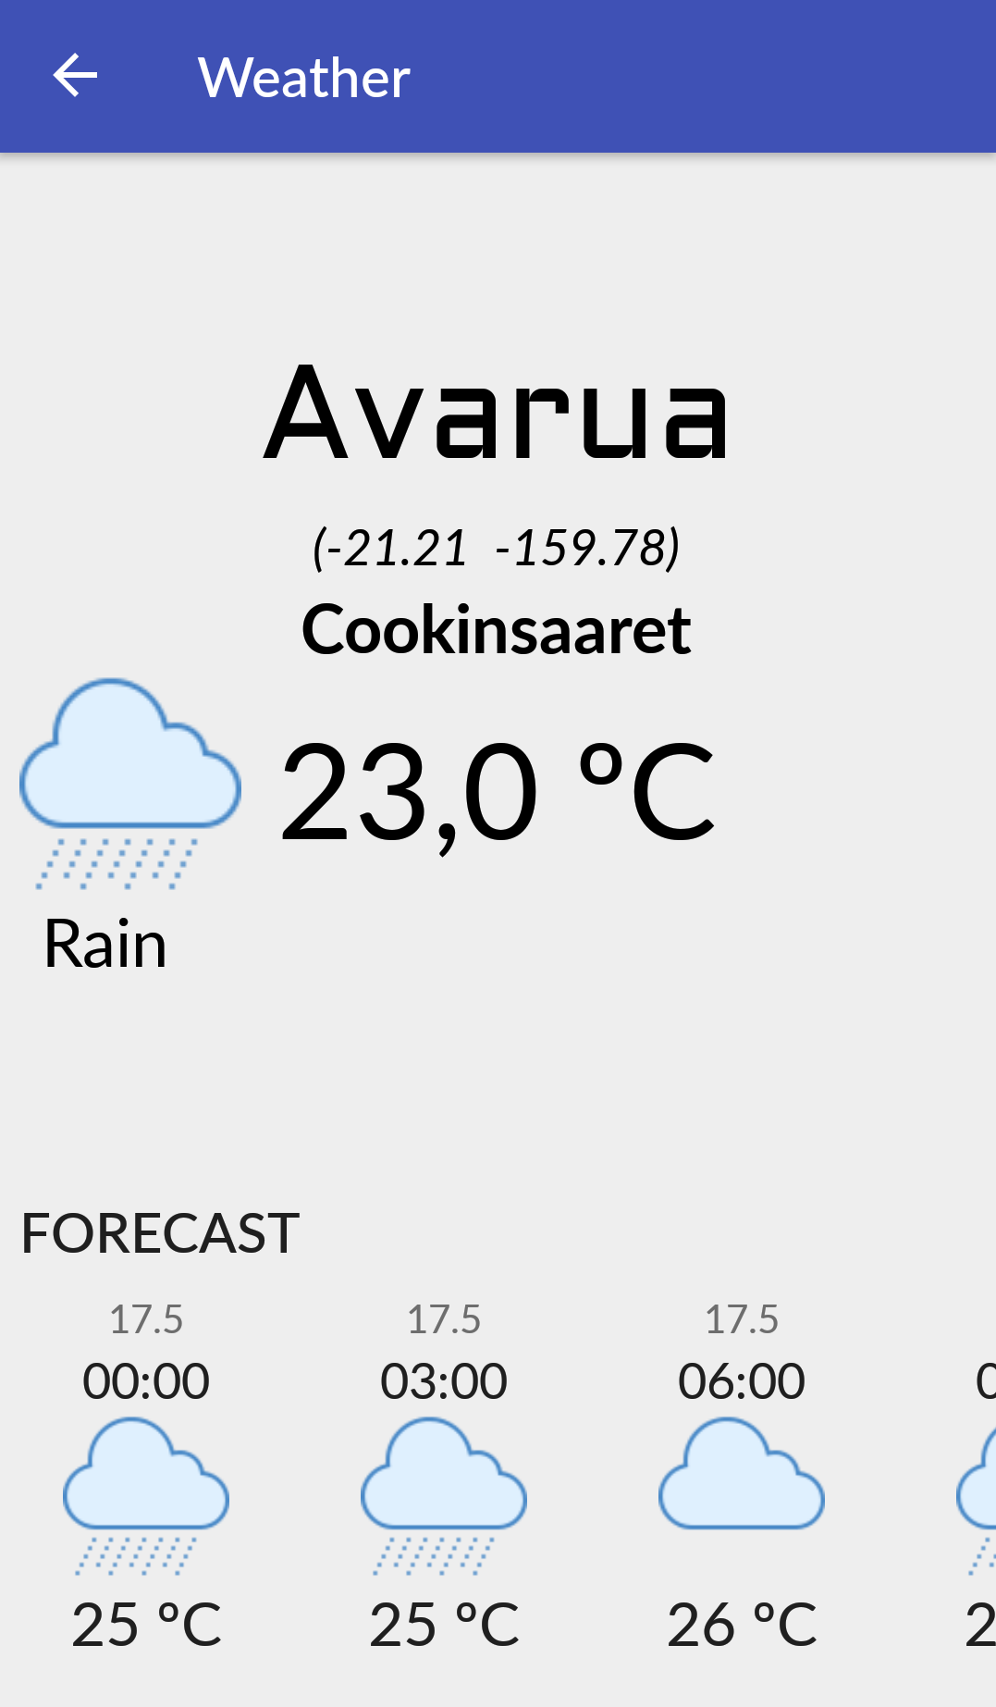




https://icons8.com

Slide 3
Features
Automatic location
Manual search
Random city
Forecasting in 3-hour intervals, up to 4 days

Slide 4
What I learned
Developing a location-aware mobile application
Using Android Studio
Using an API (OpenWeatherMap)
Using Volley (HTTP Library)

