Slide 1
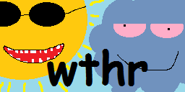
Olli Rantinoja &
Johannes Paappanen
LAMAD 2018

Slide 2
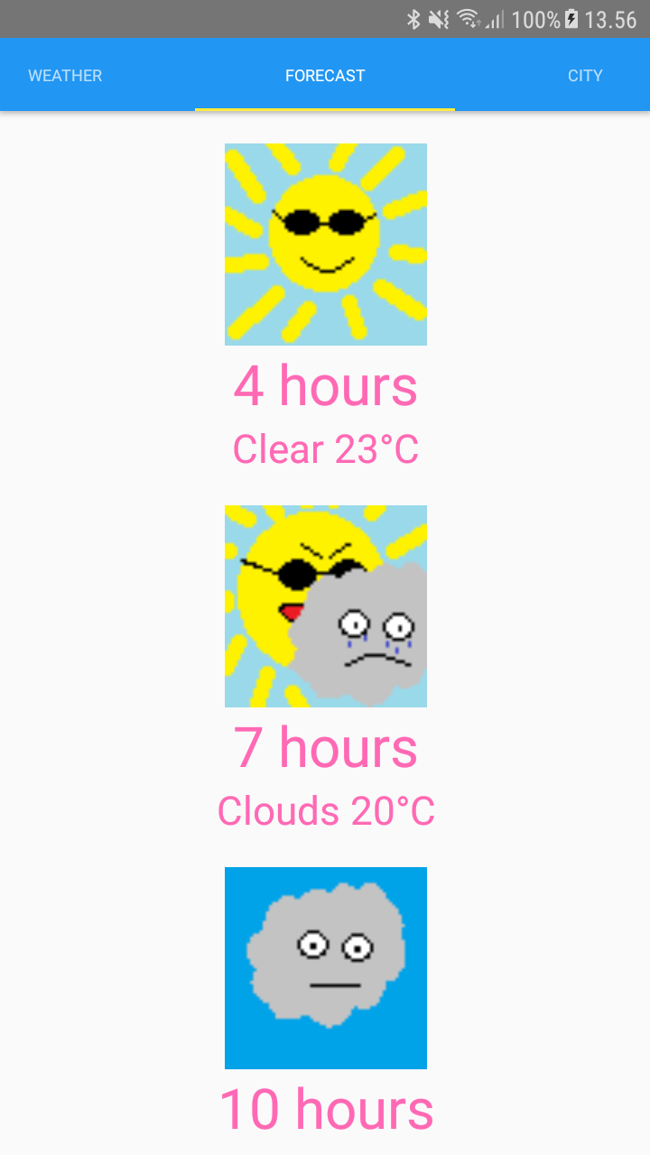
Features
Custom icons made with MS Paint
Weather report based on user’s coordinates
Forecast for the next 24 hours
Northern Lights Forecast map
Hidden easter egg feature

Slide 3
Technology stack
We built the application with React Native, so the language we used was JavaScript (ES6 and JSX to be more specific).
Android and iOS builds possible.
The source code is available: https://github.com/ollran/wthr
The application APK is also available on GitHub.

Slide 4
What we learned
Application publishing to Google Play
Some new React Native techniques
Distributing work between both of us with a DVCS
Reviewing each others code and pair programming skills
User interface designing
MS Paint skills

