Slide 1
LAMI Location-aware machine intelligence
Radu Mariescu-Istodor
16.1.2019

Slide 2
LAMI (2019)
Website: http://cs.uef.fi/~radum/lami
ETCS 5
Lectures (24h):
Wednesday 10-12
Thursday 10-12
Exercises (12h):
Monday 14-16

Slide 3
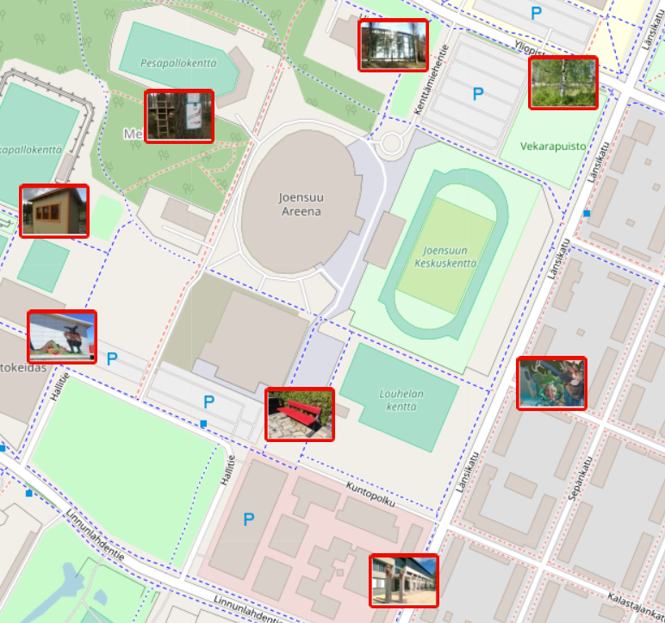
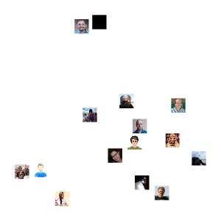
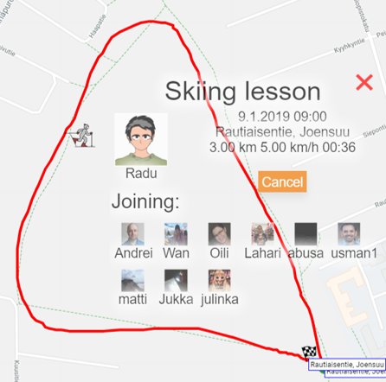
Course program
16.1 Wed : Introduction
17.1 Thu : Road Network extraction
21.1 Mon : Shape-based route search
23.1 Wed : O-Mopsi challenges
24.1 Thu : Traveling salesman
28.1 Mon : Presentations x 3
30.1 Wed : User similarity
31.1 Thu : Event recommendation
4.2 Mon : Presentations x 3
6.2 Wed : --
7.2 Thu : --
11.2 Mon : Presentations x 3
13.2 Wed : --
14.2 Thu : --
18.2 Mon : Presentations x 3
20.2 Wed : --
21.2 Thu : --
25.2 Mon : Project presentations
KUOPIO
O
USERS

Slide 4
How do I pass?
Participate to at least 10 lectures
Read 2 peer reviewed articles
Give a 30 min presentation
Be opponent to other presentations
Alternative / Bonus Project:
Implement a method described in a paper
Conceptualize / build (part of) a proposed project

Slide 5
Opponent roles: Content reviewer
Was the introduction / body / conclusion of the presentation convincing?
Did the presentation title correspond to the content of the presentation
Was the content correct for the target audience and was it useful?
Was the audience able to keep up with the content and was it clear?

Slide 6
Opponent roles: Design reviewer
Were the slides clear and easy to follow?
Did the slides contain too much or too little information?
Were the colors and sizes of the font and visual (pictures, graphs) adequate?
Were the main points of the presentation properly emphasized?

Slide 7
Opponent roles: Performance reviewer
Was the speech clear and well paced?
Did the presenter have good eye contact, posture and gestures?
Was the presenter able to keep the attention of the audience?
How the presenter managed the equipment?

Slide 8
Opponent roles: Q&A reviewer
How prepared was the presenter for the Q&A?
Did the presenter handle the questions well?
Did the presenter answer correctly to the question?
Did the presenter answer to the question that was asked?
?

Slide 9
Why come to this course?
Location based systems (LBS) are popular
Become more familiar with machine learning
Advance with your studies / research
Learn how to review papers
Practice how to give a good presentation
Or how to implement a
published method
build a research project

Slide 10
See You Tomorrow .

