Slide 1
O-Mopsi Challenges
Radu Mariescu Istodor
23.1.2019

Slide 2
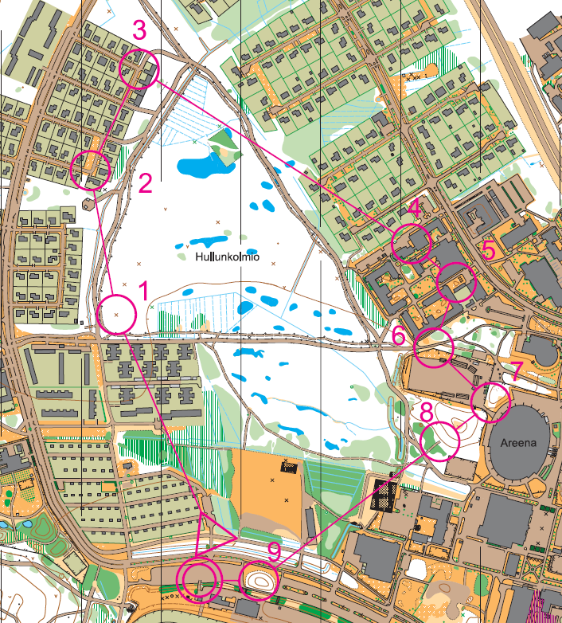
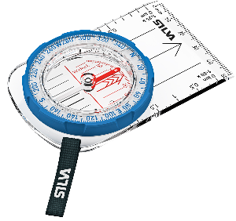
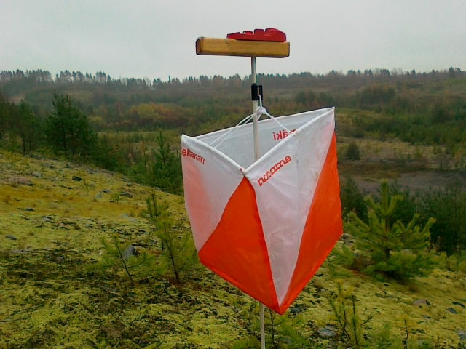
Classical orienteering
Devices: Map and compass
Rules:
Find all targets
In a given order
Fastest wins
Map of target locations
Target

Slide 3
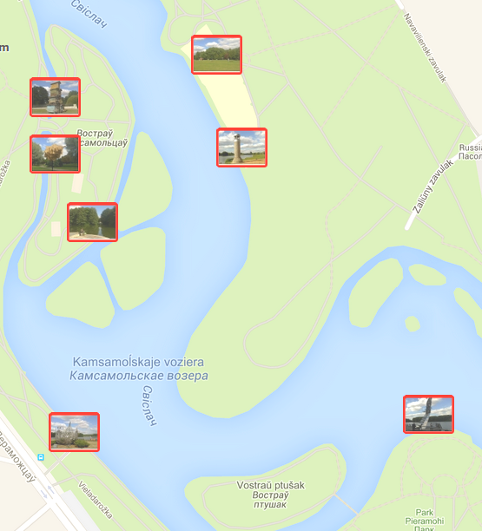
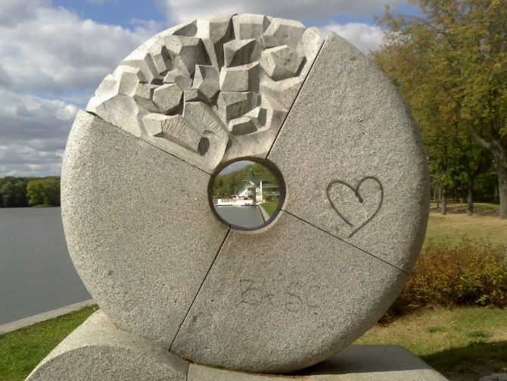
O-Mopsi orienteering
Rules:
Find all targets
In free order
Fastest wins
Smartphone and GPS
Map of target locations
Real objects

Slide 4
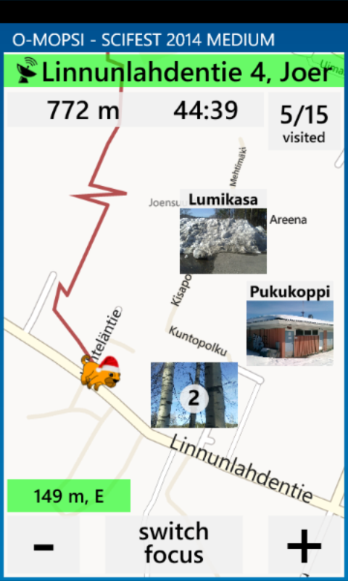
Additional clues to player
Zoomable map
Own location shown
Distance and direction to target
Sound guidance (Geiger)
100 m
200 m
300 m
400 m
500 m

Slide 5
Motivations to play

Slide 6
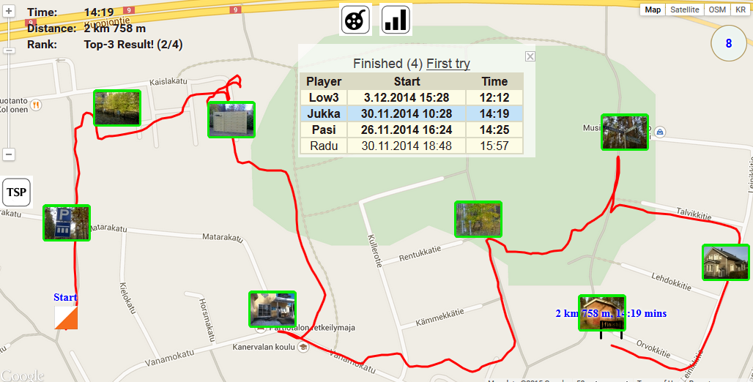
Competition

Slide 7
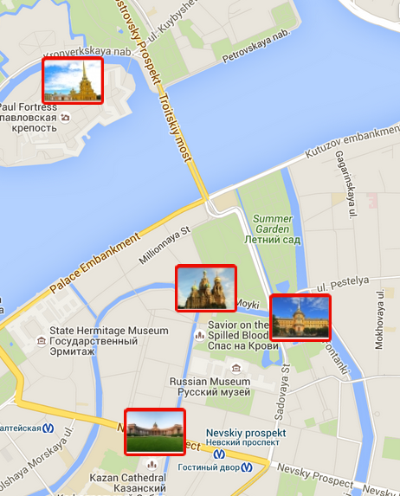
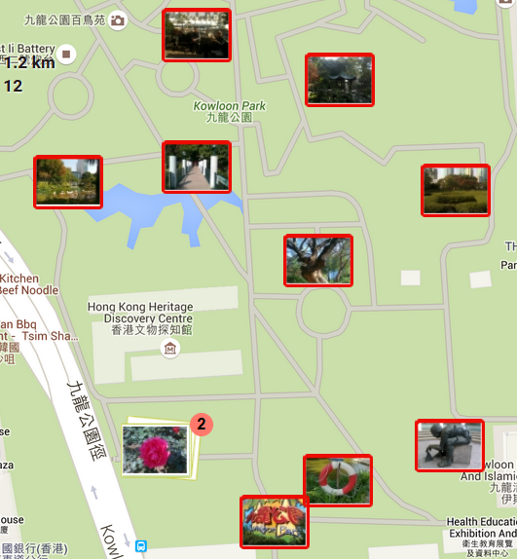
Touristic
Outdoor landmarks
Objects in park
User’s own travel pictures
Catherdals of
St. Petersburg
Kowloon park
Hong Kong

Slide 8
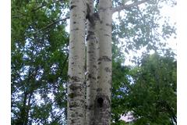
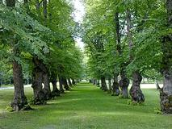
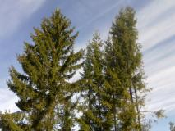
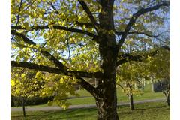
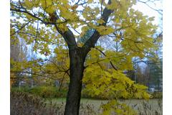
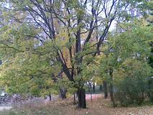
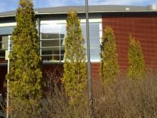
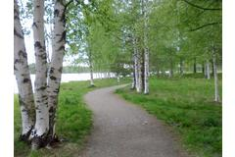
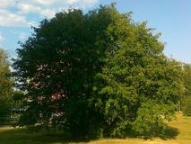
Educational
Exhibitions
Outdoor museums
Aspen
Biology
Botanical gardens
Geography
Architecture
Lime tree
City history
Spruce
Elm
Maple
Oak
Thuja
Birch
Rowan

Slide 9
Challenges

Slide 10
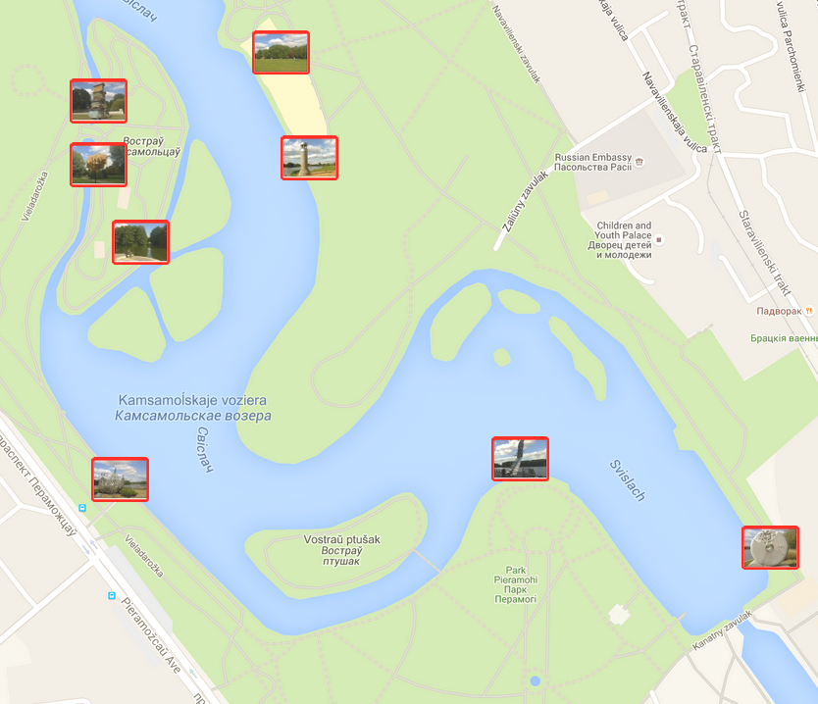
Challenges of playing
TOMORROW
Finding best order
Optimizing paths to targets

Slide 11
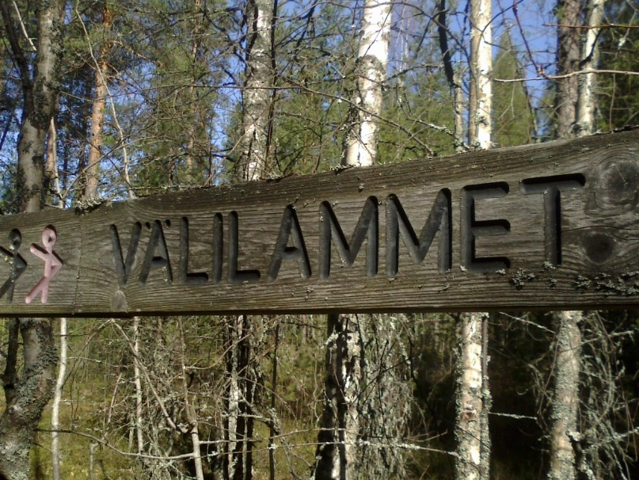
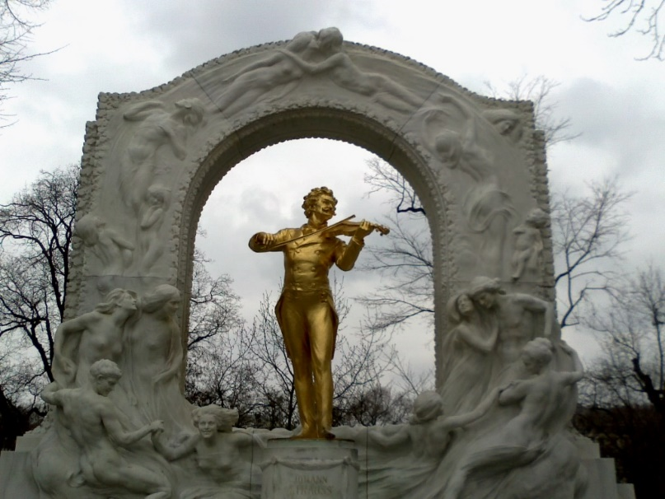
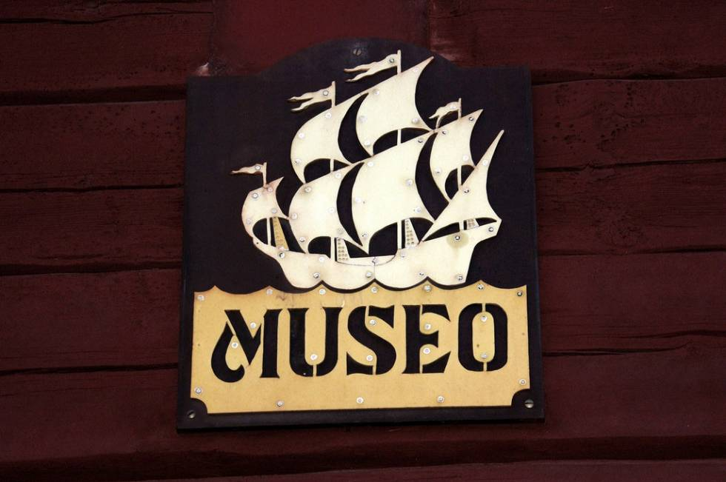
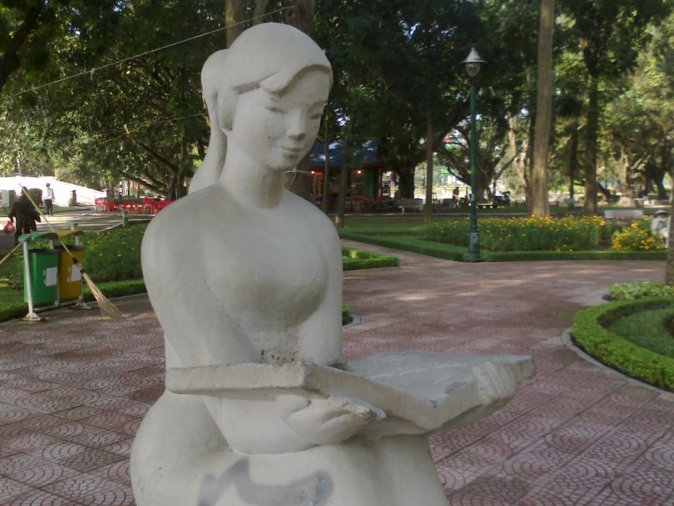
Photo content - Good
Viitta
Johan Strauss
Sea museum
Reading girl

Slide 12
Where to find Photos
Public photo databases (Instagram, Flikr)
GIS systems
Tourist websites https://www.aviewoncities.com
Crawling the web

Slide 13
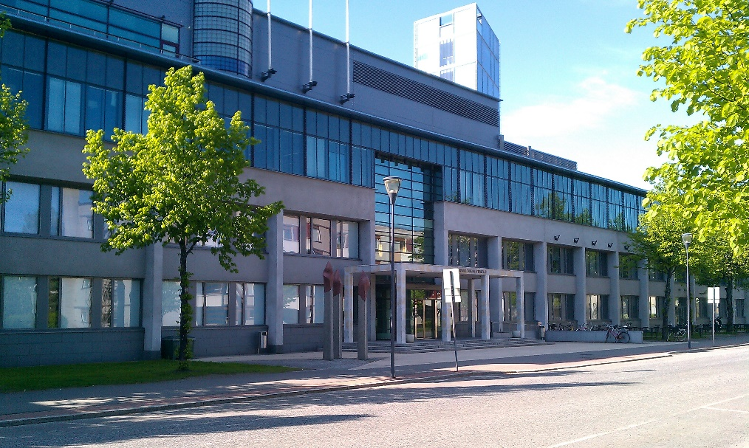
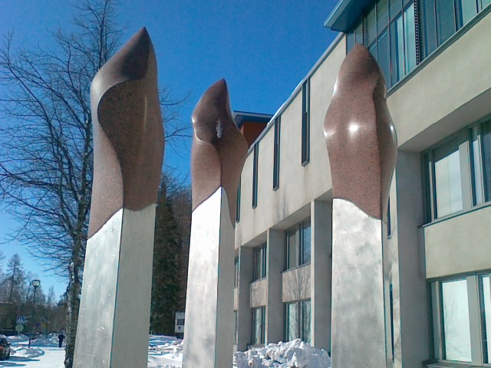
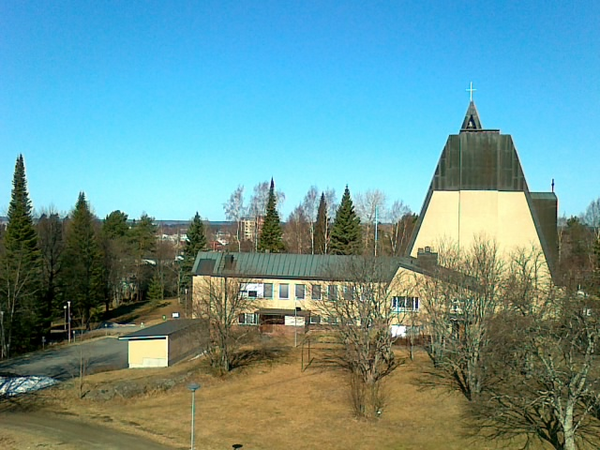
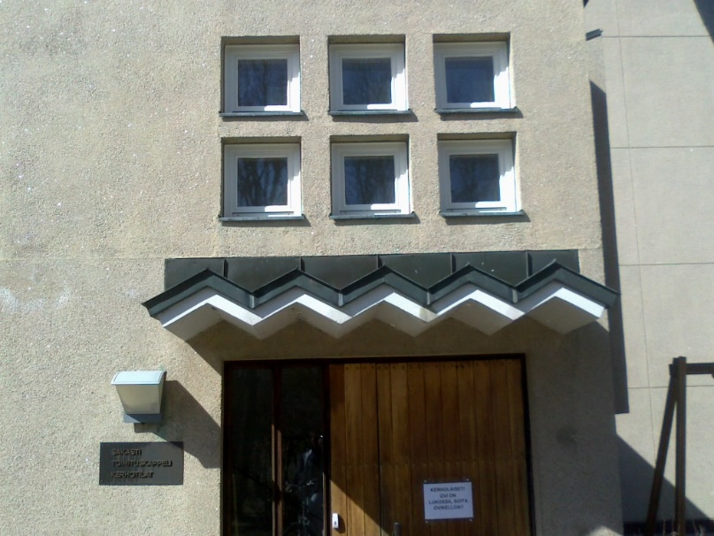
Photo content - Maybe
Maybe
⇒
Better
Science Park
Science Park
Church
Sakasti
Better
Reconsider
⇒

Slide 14
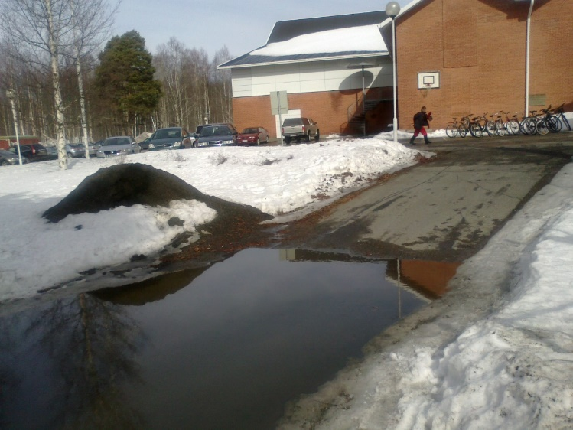
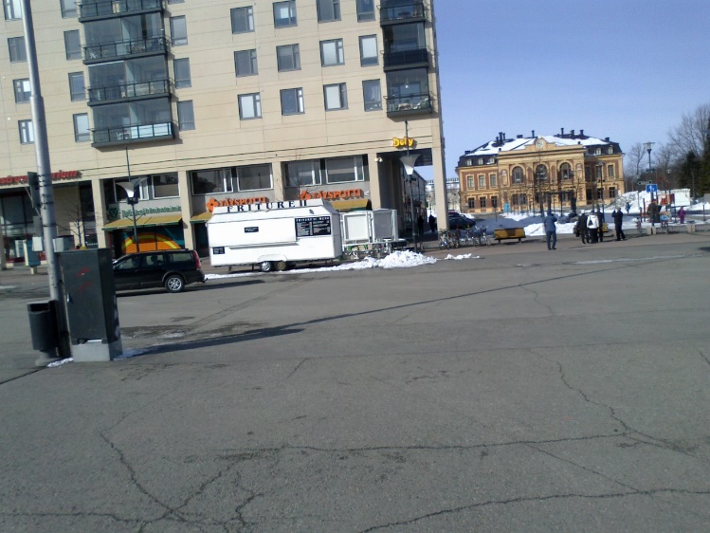
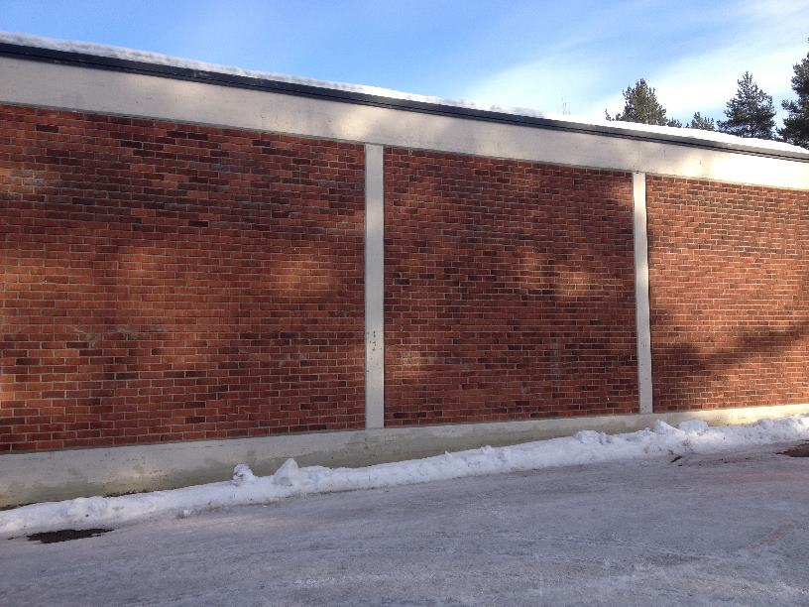
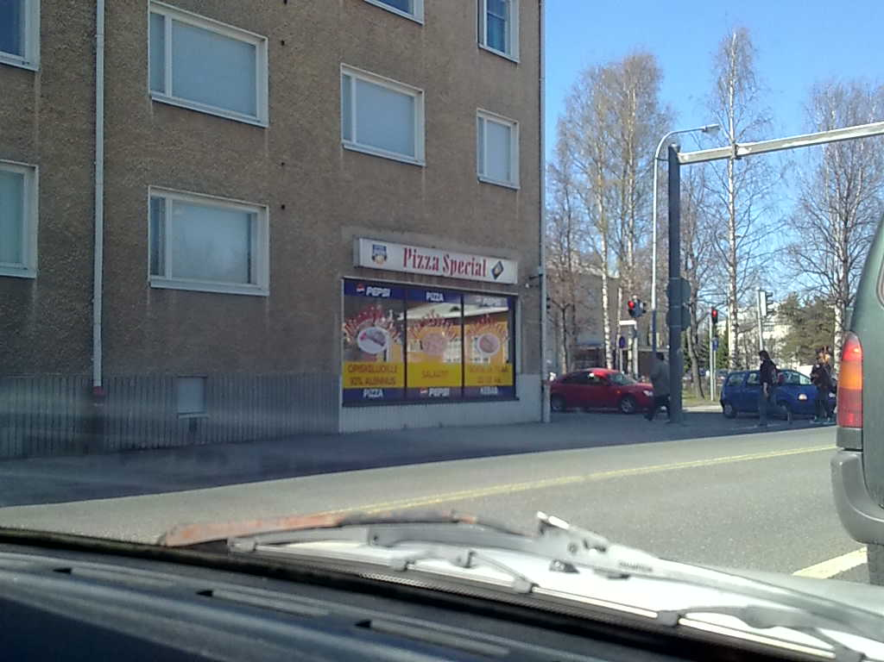
Photo content - Bad
Palloilukeidas
Art museum
Bad
?
Keidas = Oasis. The water???
Which one is it?
Tiiliseinä
Pizza special
Reconsider
Bad
Size = 3264x2448
Backyard of swimming hall
Can you find it…?

Slide 15
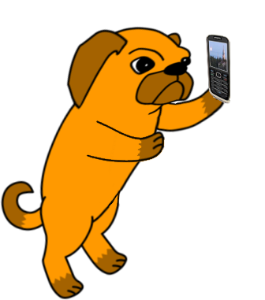
Tune the location
Location of Photo
Location of Target

Slide 16
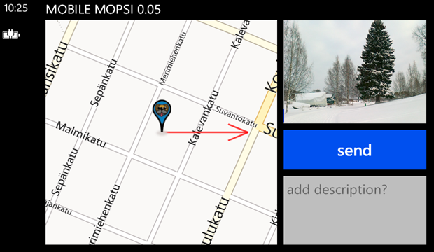
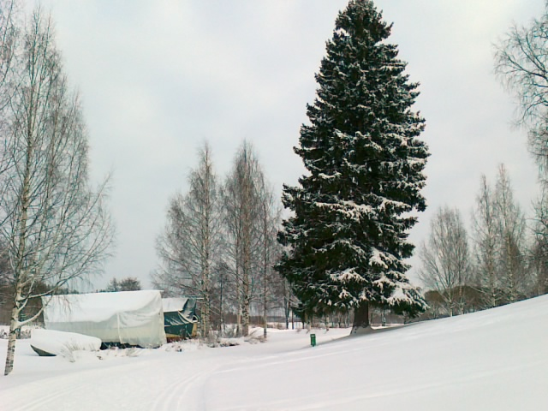
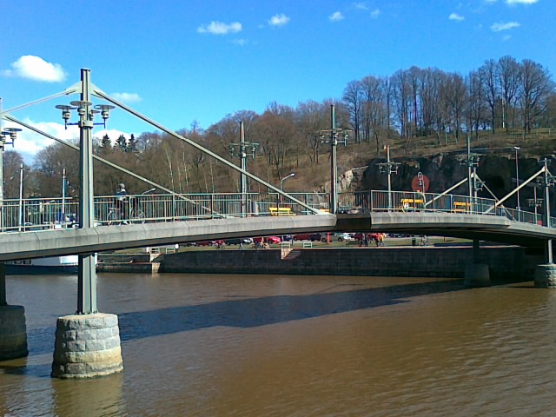
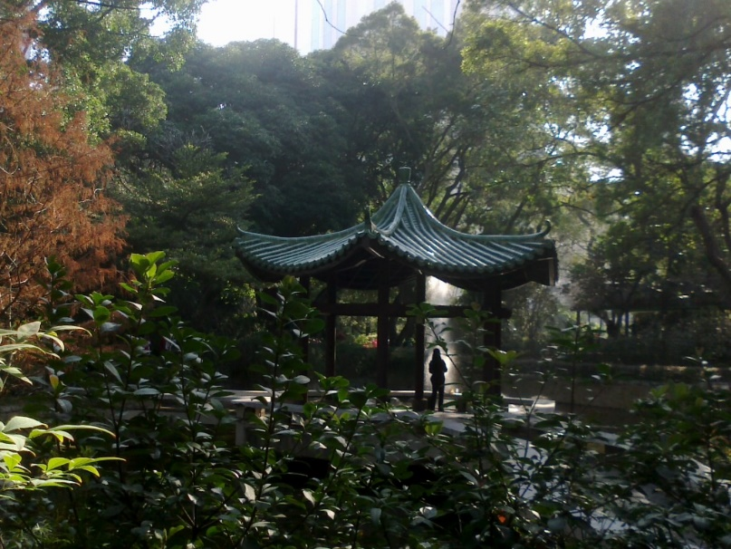
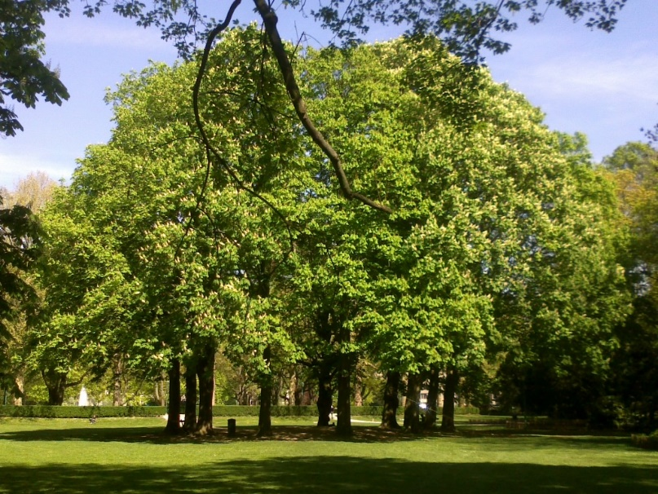
Tune the location
Spruce
Ok
Bridge
Clear target
Easy to identify
Good visibility
Expected location:
Middle?
30m
30m
15m
Shrine
Ok
Circle of trees
Ok
30m
50m

Slide 17
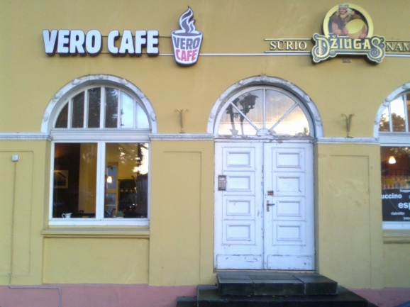
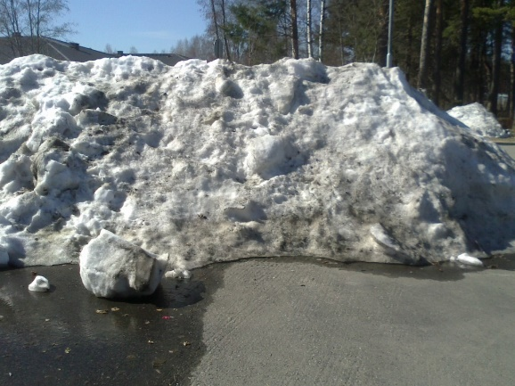
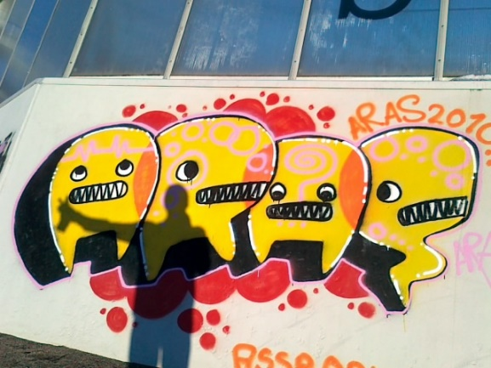
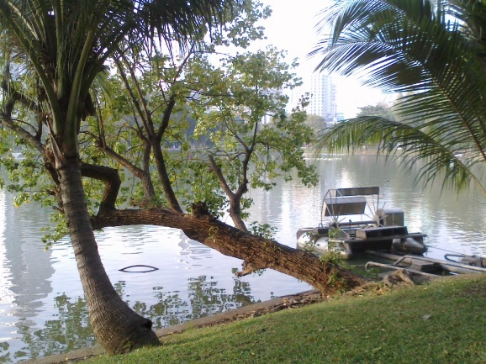
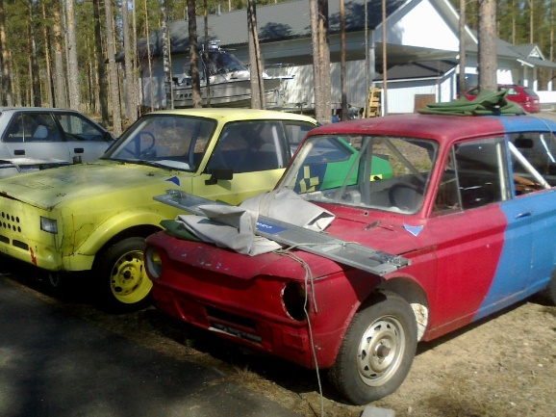
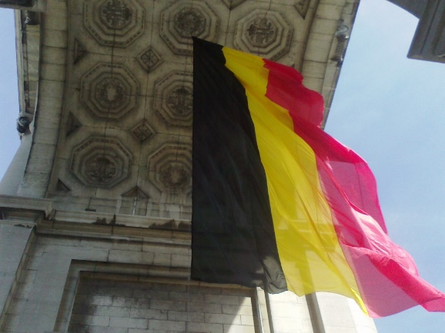
Recency
Grafiti
Snow
Cafe
Ok if building recognizable but cafés come and go.
Good for seasonal game but will vanish before the summer.
Already removed!
Cars
Flag
Falling tree
Next year might be fallen out already!
How longer the owner will keep them?
Will be there all the time?

Slide 18
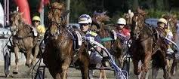
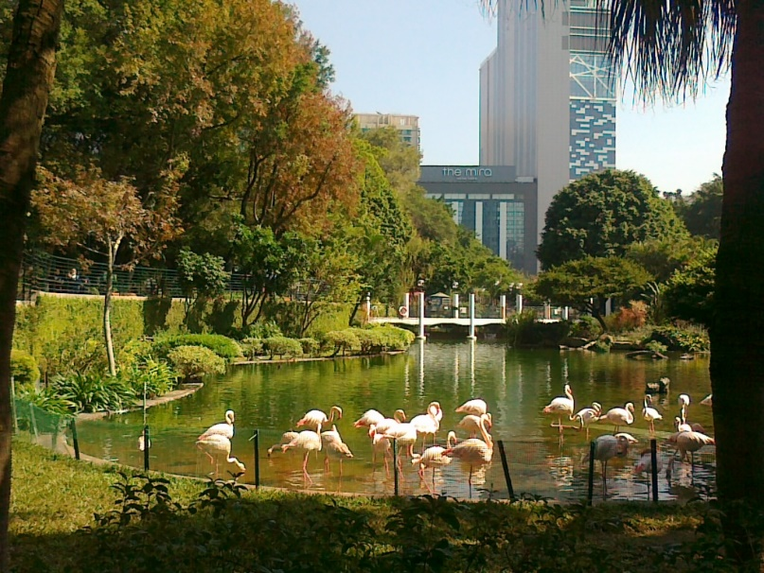
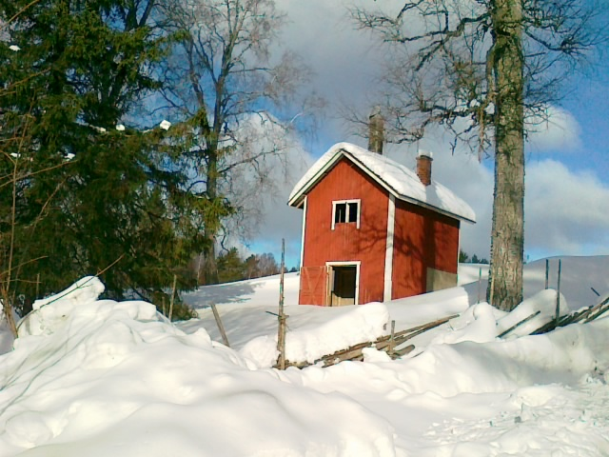
Accessibility
Horse race track
Flamingos
Nice but make the target at the entrance (outside), and not in the middle of track. Might be closed.
Fence
Good targets but as zoo, you cannot access. Location must be kept at the viewing point.
Hut
Good in summer. Snow might make it tougher.
Check the fence.

Slide 19
Reachability
River
Unreachable

Slide 20
Complexity
What makes the difficulty change?

Slide 21
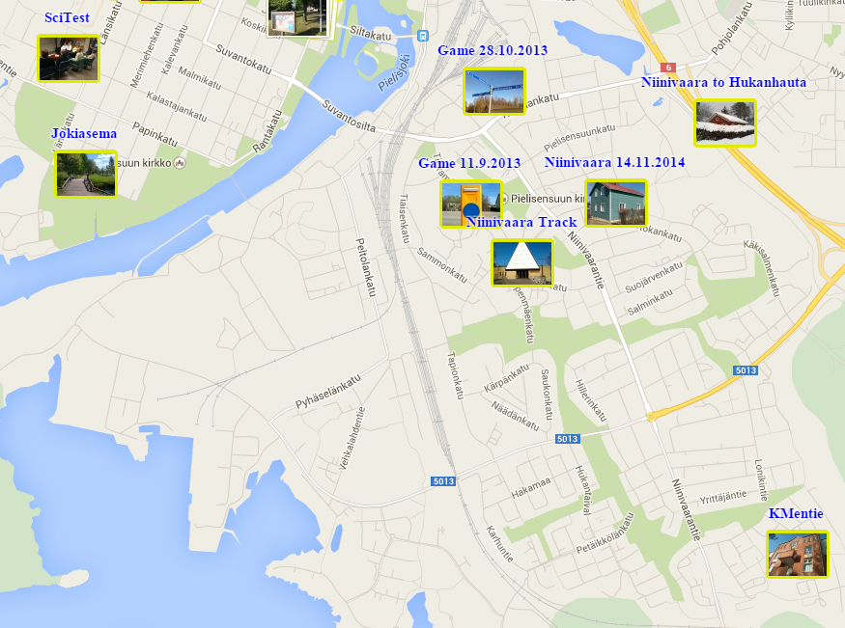
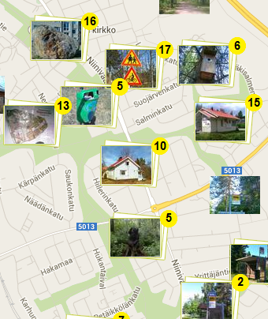
Automatic game creation
Want game
here!

Slide 22
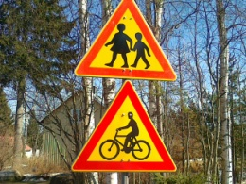
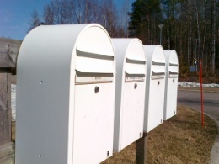
Simple algorithm
QUALITY
Select N Goals Randomly
Sort by quality Keep the best
No
Are they well distributed?
Yes
Threshold
100-400 m
Not accessible
Indoor
Missing title
New Game!

Slide 23
Thank You !
Radu Mariescu-Istodor
radum@cs.uef.fi

