Slide 1
Shape-based Route Search
Radu Mariescu Istodor
21.1.2019

Slide 2
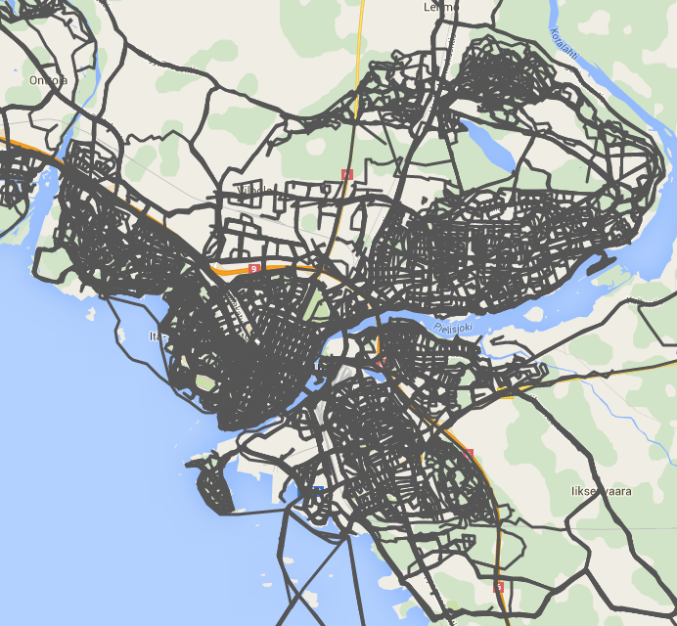
Problem
Large collections of GPS trajectories cause users to spend a long time to find the one they are looking for.
This is because:
Trajectory collections are large
Date and time is hard to remember exactly
Sometimes even year is difficult to remember
Trajectories are overlapping
Notes:
2

Slide 3
Solution – part 1
We propose a real-time search for routes in trajectory collections by using gestures and pattern matching. The gesture is a hand-drawn input in the form of a free shape done on a map. The shape approximates the locations where the targeted route passes through. According to [1], this gesture can be classified as of the symbolic type, implying that it has no meaning when performed in other contexts (not using a map). Referring to the taxonomy in [7] the result of the gesture is to trigger a command: search for route(s) with given spatial characteristics. This search works by computing the similarity between the input gesture and every route in the database. The most similar route candidates are provided to the user.
[1] Cirelli, M., Nakamura, R.: A survey on multi-touch gesture recognition and multi-touch frameworks. In: ACM Conference on Interactive Tabletops and Surfaces (ITS 2014),
Dresden, Germany, pp. 35–44 (2014)
[2] Karam, M., Schraefel, M.C.: A taxonomy of Gestures in Human Computer Interaction. ACM Transactions on Computer-Human Interactions (2015, in press)
Notes:
3

Slide 4
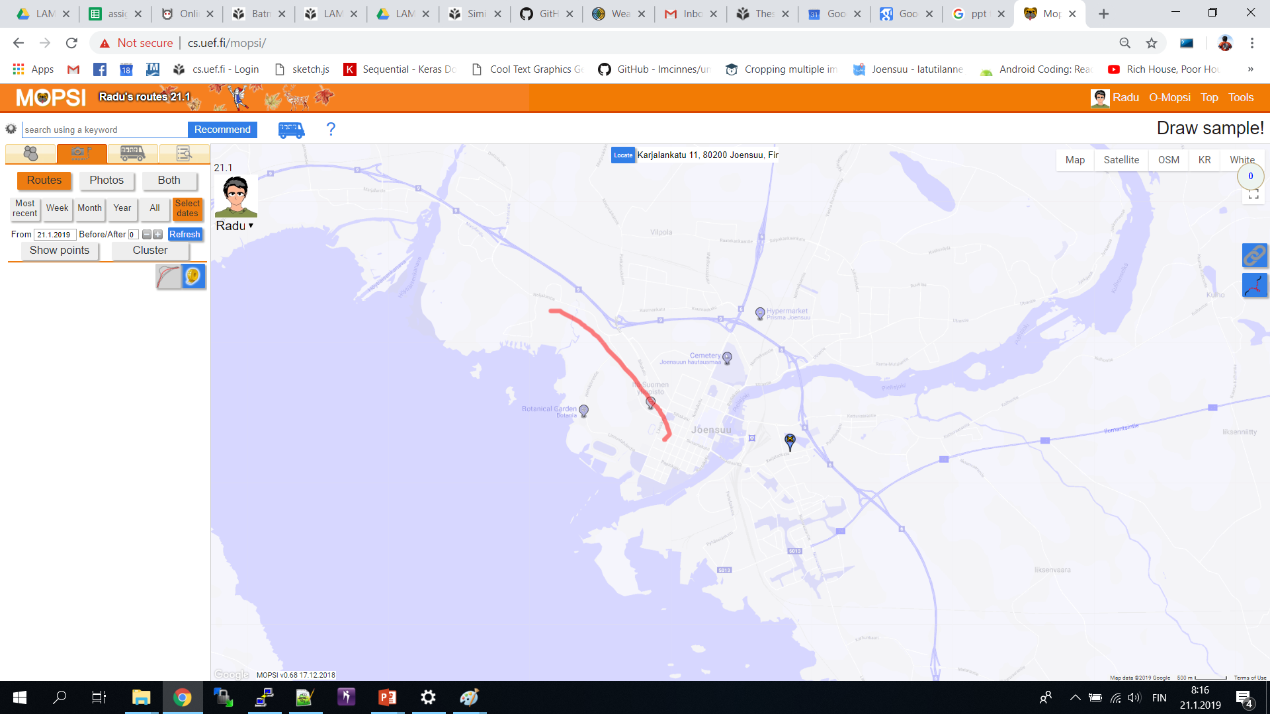
Solution – part 2
Notes:
4

Slide 5
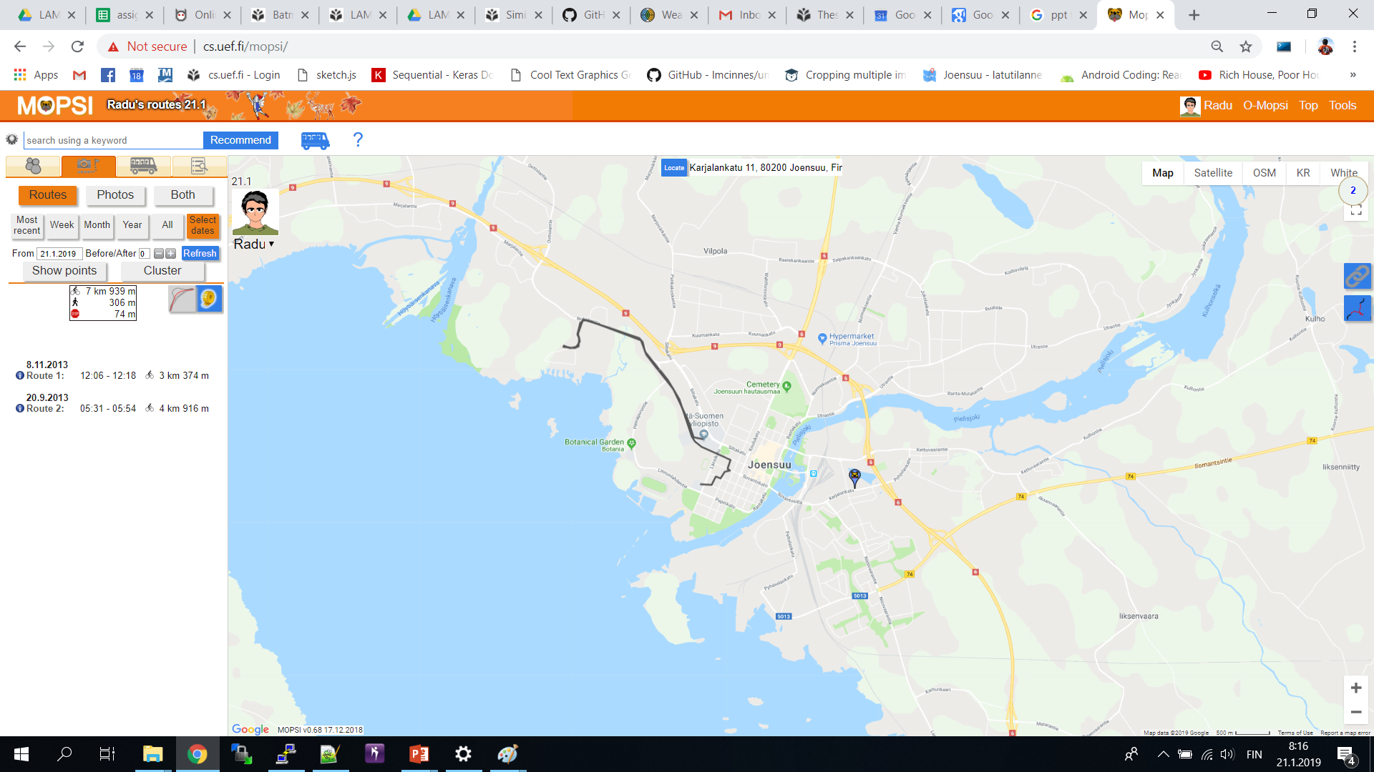
Solution – part 3
Notes:
5

Slide 6
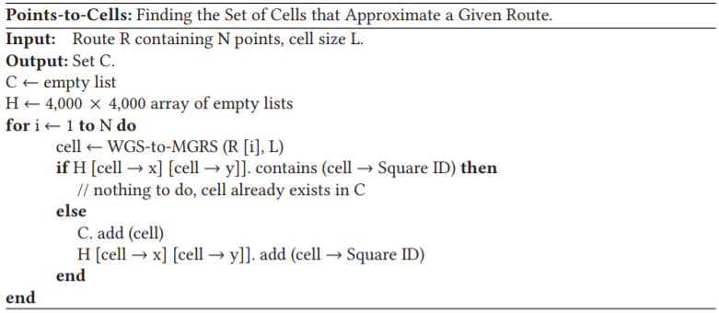
Algorithm - part 1
Interpolation
Notes:
6

Slide 7
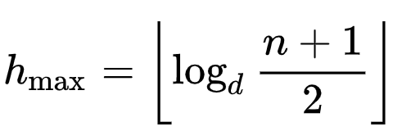
Algorithm - part 2
B-tree
Worst case
Notes:
7

Slide 8
Algorithm - part 3
Similarity function
Notes:
8

Slide 9
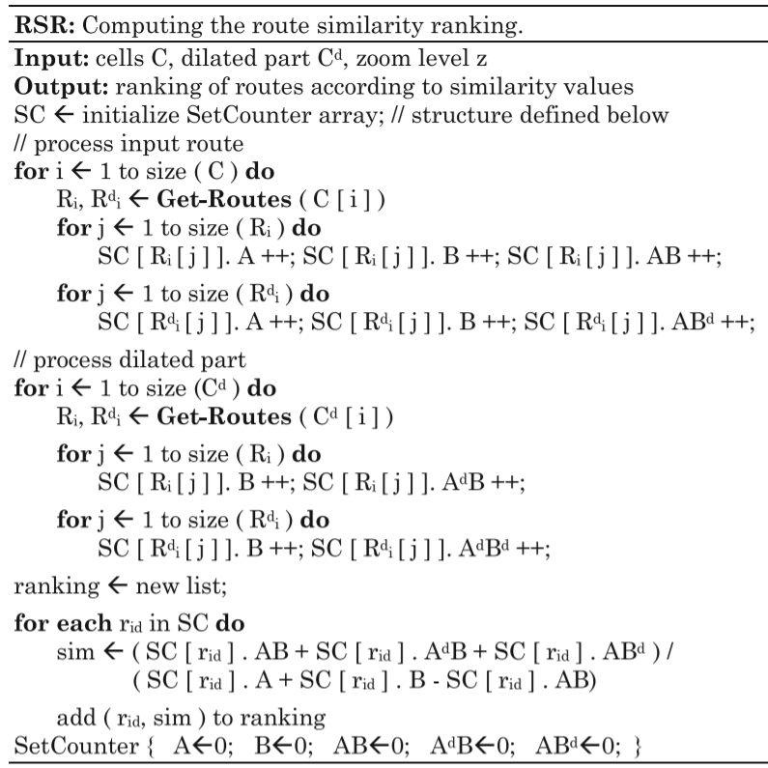
Algorithm - part 4
Notes:
9

Slide 10
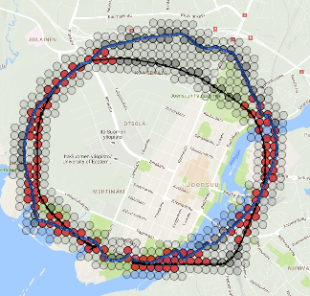
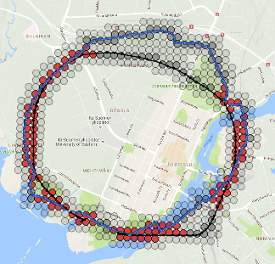
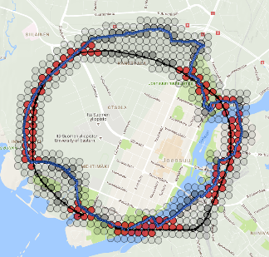
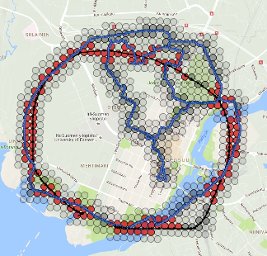
Algorithm: Result
62 %
61 %
59 %
56 %

Slide 11
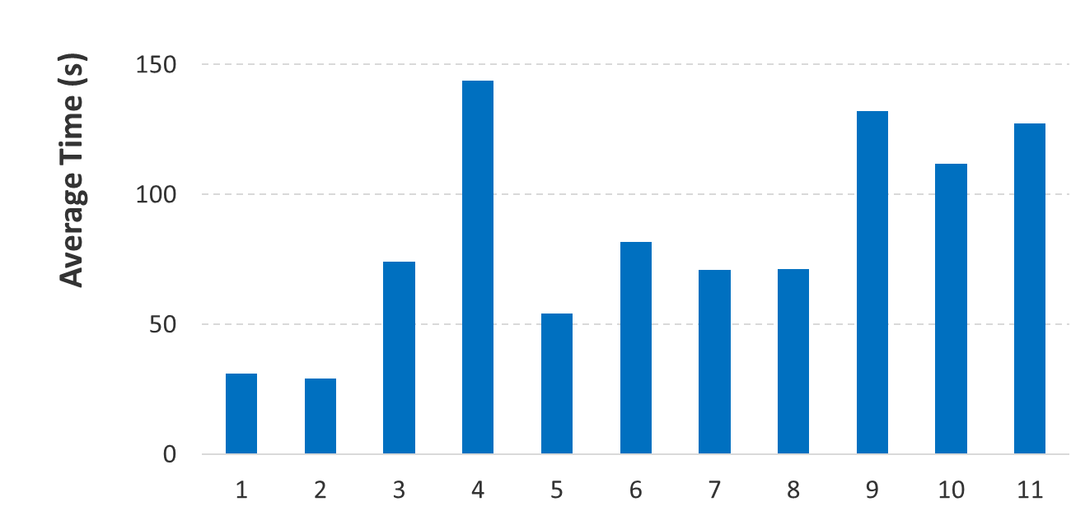
Evaluation 1
84
seconds
Notes:
11

Slide 12
Evaluation 2
Additional findings:
For the complexity measure, which is not obvious, we employ a polygonal approximation method which reduces the number of points to the minimum necessary to represent a trajectory while maintaining its shape. The number of points in this representation varies depending on the complexity of the trajectories = number of turns.
A Fast O(N) Multiresolution Polygonal Approximation Algorithm for GPS Trajectory Simplification
Minjie Chen, Mantao Xu and Pasi Fränti (2012)
Notes:
12

Slide 13
Conclusions
Fast: 84 seconds (on average)
Linear time similarity function
B-tree indexing

Slide 14
Thank you!
Notes:
14

