Slide 1
Shape-based Route Search
Radu Mariescu Istodor
21.1.2019

Slide 2
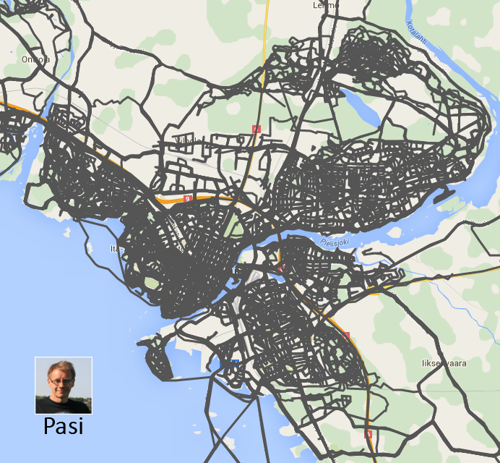
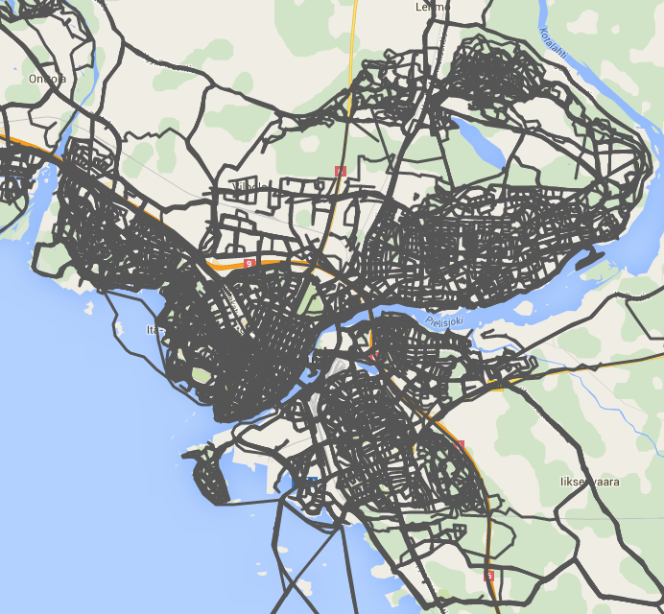
Too Many Routes!
Notes:
2

Slide 3
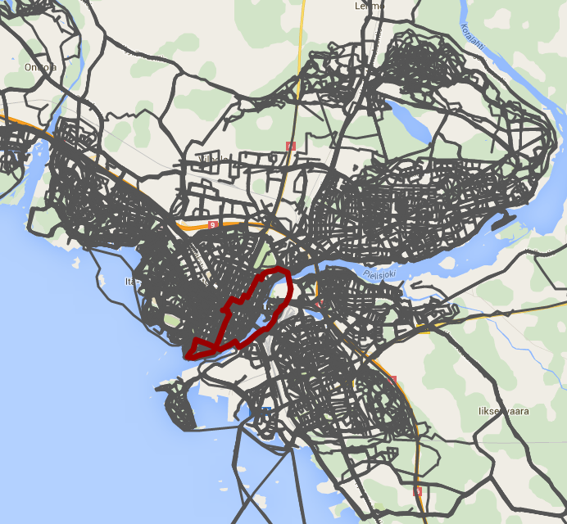
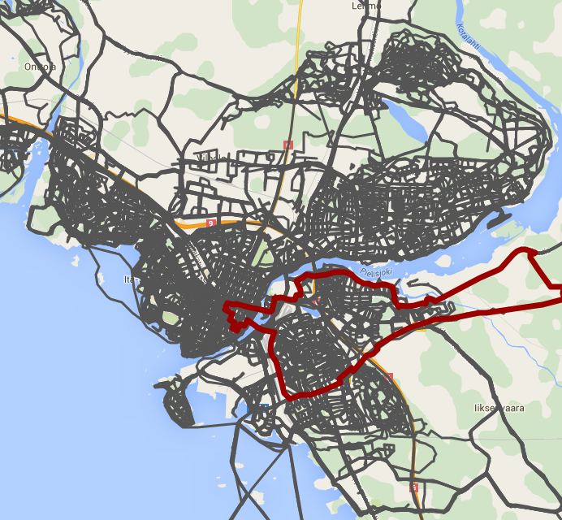
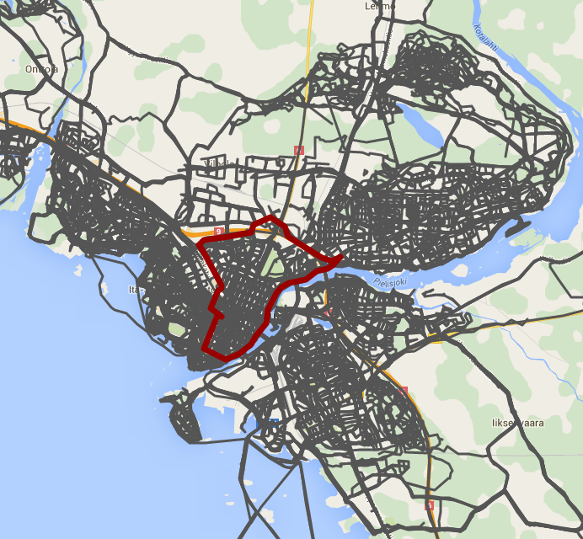
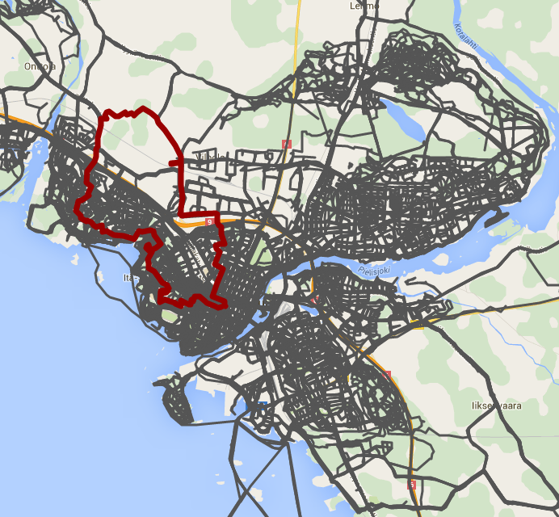
Too Many Routes!
Notes:
3

Slide 4
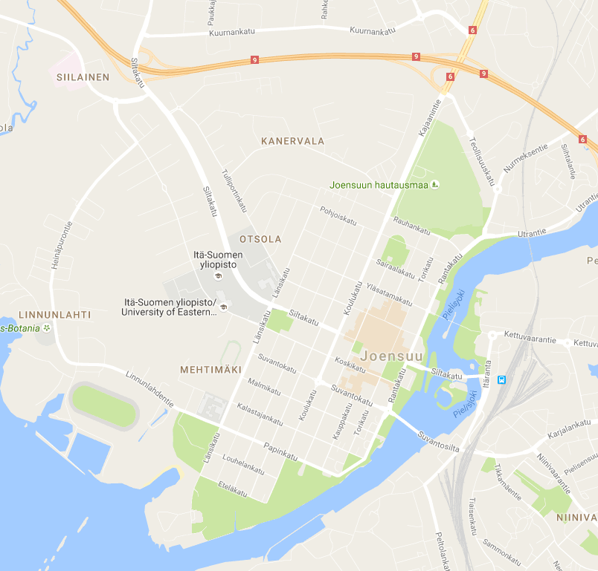
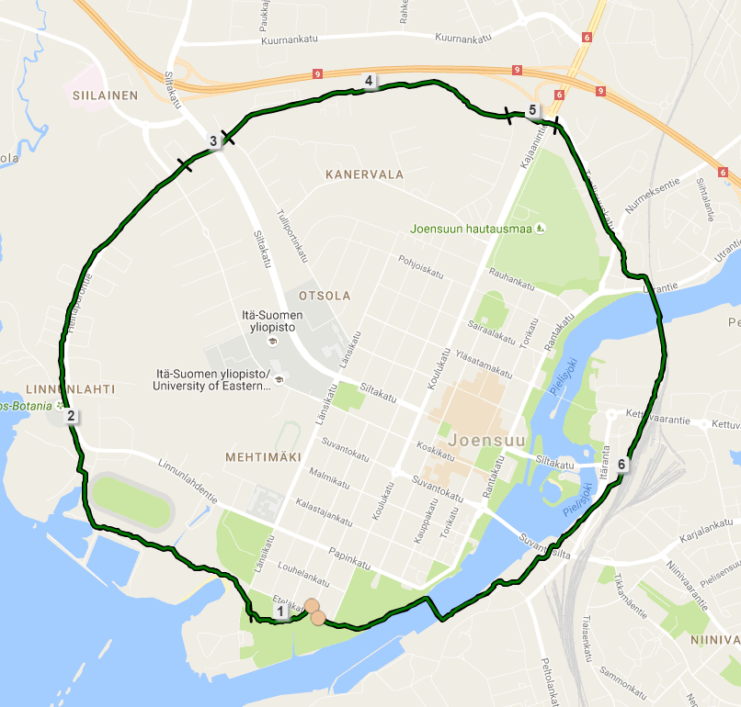
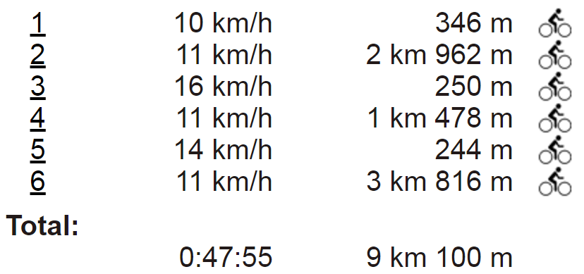
Draw the Route
Notes:
4

Slide 5
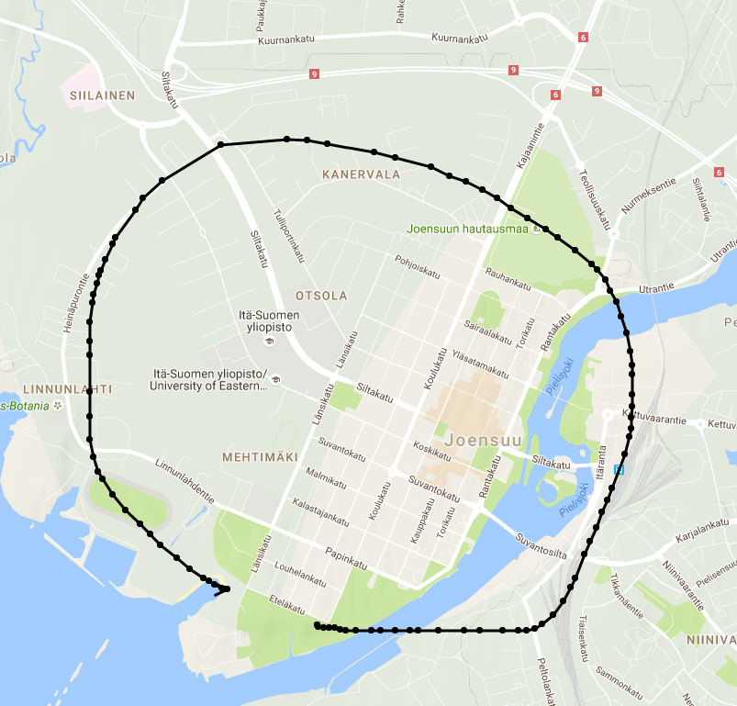
Input = Route
Notes:
5

Slide 6
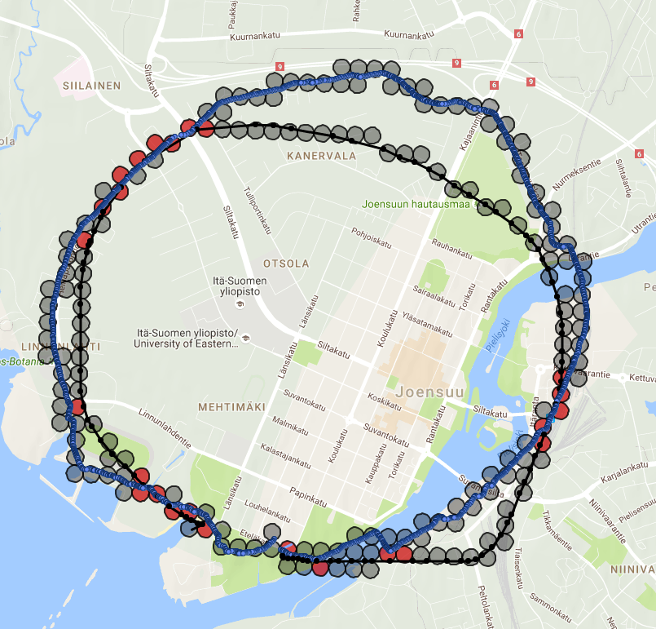
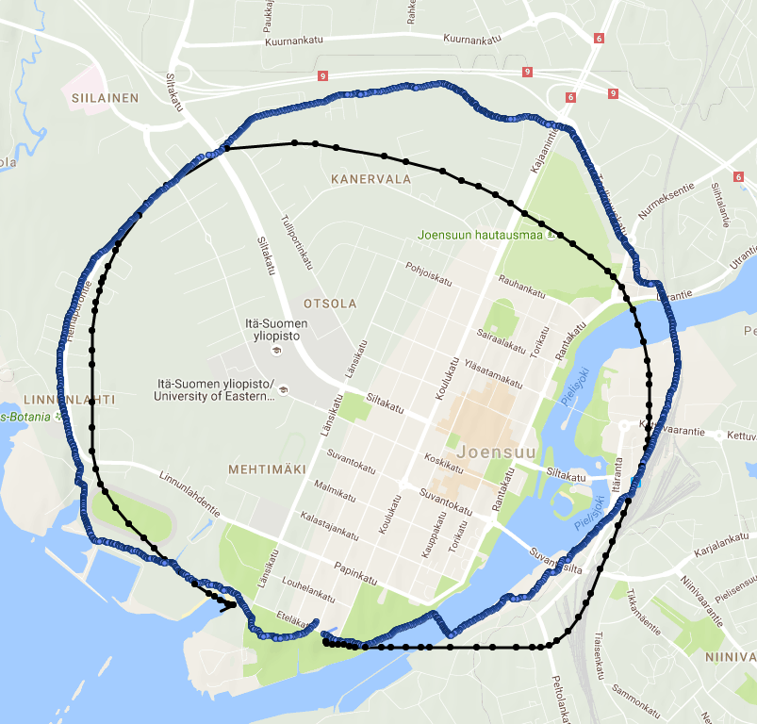
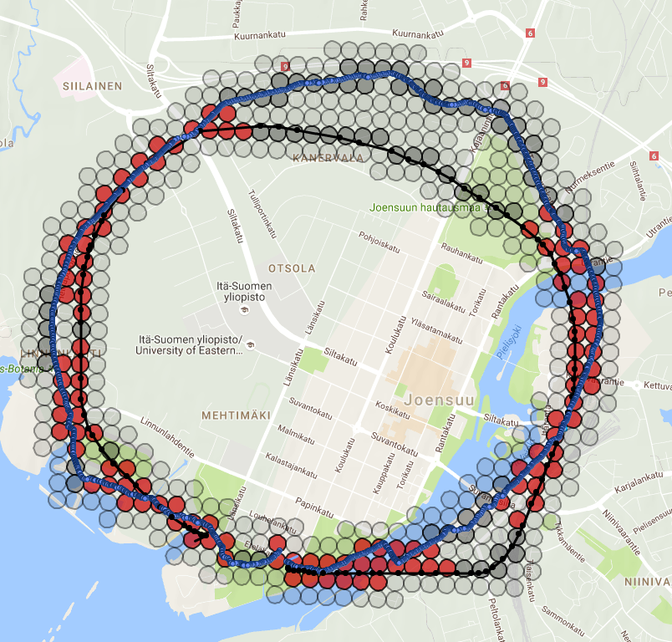
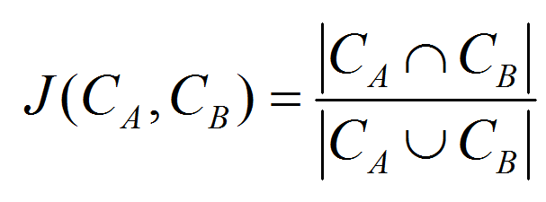
Route Similarity
Low Complexity Spatial Similarity Measure of GPS Trajectories
Mariescu-Istodor, Tabarcea, Saeidi and Fränti (2014)
62 %
13 %
Notes:
6

Slide 7
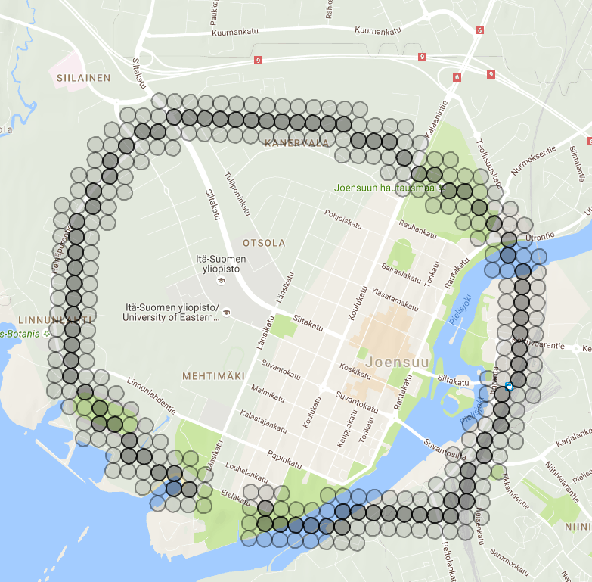
The Search
Input: cells A, dilated part A^{d}
Output: all similar routes
SC ← Array; // struct { AB←0; AB^{d}←0; A^{d}B←0; }
Notes:
7

Slide 8
The Search
Input: cells A, dilated part A^{d}
Output: all similar routes
SC ← Array; // struct { AB←0; AB^{d}←0; A^{d}B←0; }
for i ← 1 to size ( A ) do
R ← Get-Routes ( A [ i ] )
for j ← 1 to size ( R ) do
if R [ j ] passes through then
SC [ R [ j ]. id ]. AB ++;
else
SC [ R [ j ]. id ]. AB^{d}++;
A [30]
R_{id} = 2215
R_{id} = 439

Slide 9
The Search
Input: cells A, dilated part A^{d}
Output: all similar routes
SC ← Array; // struct { AB←0; AB^{d}←0; A^{d}B←0; }
for i ← 1 to size ( A ) do
R ← Get-Routes ( A [ i ] )
for j ← 1 to size ( R ) do
if R [ j ] passes through then
SC [ R [ j ]. id ]. AB ++;
else
SC [ R [ j ]. id ]. AB^{d}++;
for i ← 1 to size (A^{d} ) do
R ← Get-Routes ( A^{d} [ i ] )
for j ← 1 to size ( R ) do
if R [ j ] passes through then
SC [ R [ j ]. id ]. A^{d}B ++;
else
// A^{d}B^{d}
R_{id} = 119
R_{id} = 22
A [128]

Slide 10
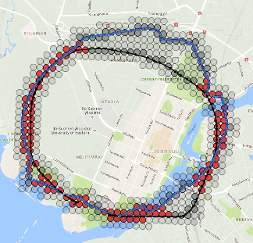
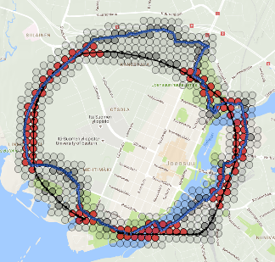
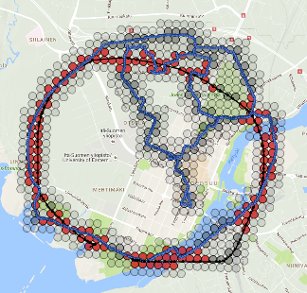
Search: Result
Input: cells A, dilated part A^{d}
Output: all similar routes
SC ← Array; // struct { AB←0; AB^{d}←0; A^{d}B←0; }
for i ← 1 to size ( A ) do
R ← Get-Routes ( A [ i ] )
for j ← 1 to size ( R ) do
if R [ j ] passes through then
SC [ R [ j ]. id ]. AB ++;
else
SC [ R [ j ]. id ]. AB^{d}++;
for i ← 1 to size (A^{d} ) do
R ← Get-Routes ( A^{d} [ i ] )
for j ← 1 to size ( R ) do
if R [ j ] passes through then
SC [ R [ j ]. id ]. A^{d}B ++;
else
// A^{d}B^{d}
for each r_{id} in SC do
Sim ← ( SC [ r_{id} ] . AB + SC [ r_{id} ] . A^{d}B + SC [ r_{id} ] . AB^{d} ) /
( size ( A ) + size ( r_{id} ) – SC [ r_{id} ] . AB )
Result. add (r_{id}, Sim )
62 %
O(Nlog(MN)+Q)
N – av. size of route in cells
M – number of routes in DB
Q – number of processed cells
61 %
59 %
M ~ 10,000 ➔ Real-Time
56 %

Slide 11
Multi-resolution Grids
90 m x 90 m
45 m x 45 m
Zoom x 2
Notes:
11

Slide 12
Evaluation
Volunteers | 11
No. Tasks | 10
Ttl. Tasks | ~200
Ttl. Time | 4.1 h
Av. Time / Task | 1.2 min
Task type | Gave up | Time
Traditional | 23%
Gesture | 9% | 41 % faster
Notes:
12

Slide 13
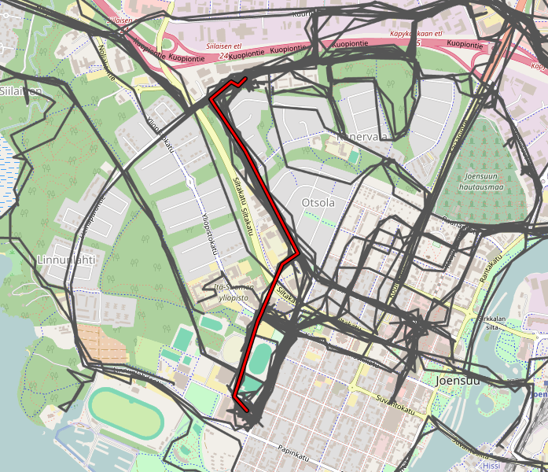
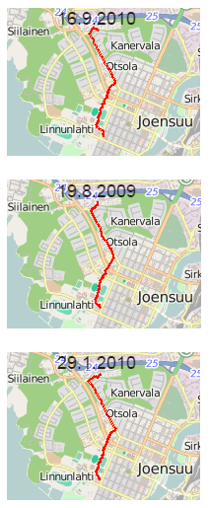
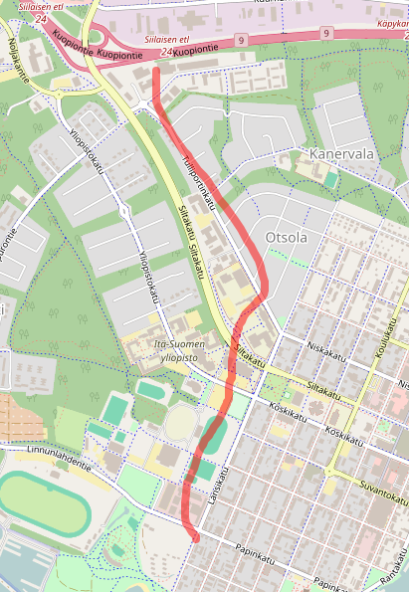
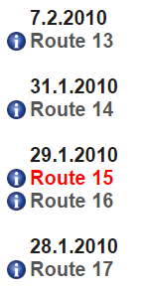
Evaluation
Volunteers | 11
No. Tasks | 10
Ttl. Tasks | ~200
Ttl. Time | 4.1 h
Av. Time / Task | 1.2 min
Candidates
Task type | Gave up | Time
Traditional | 23%
Gesture | 9% | 41 % faster
Notes:
13

Slide 14
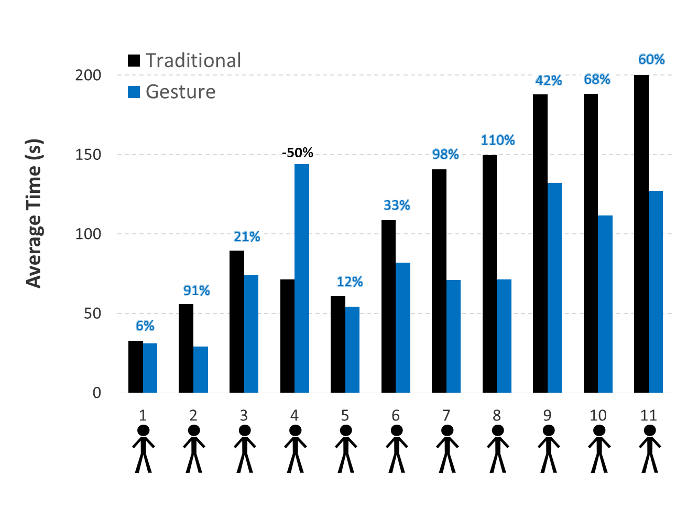
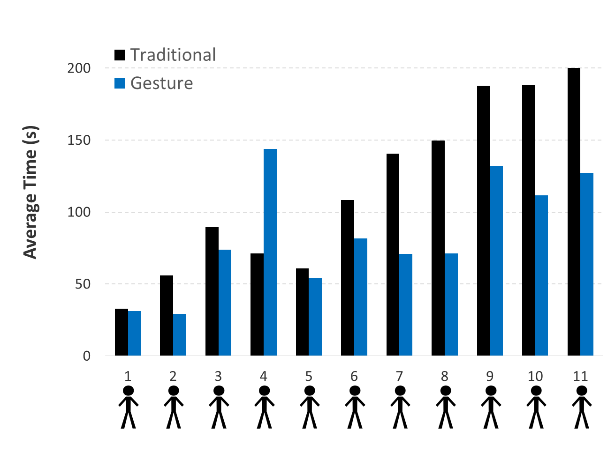
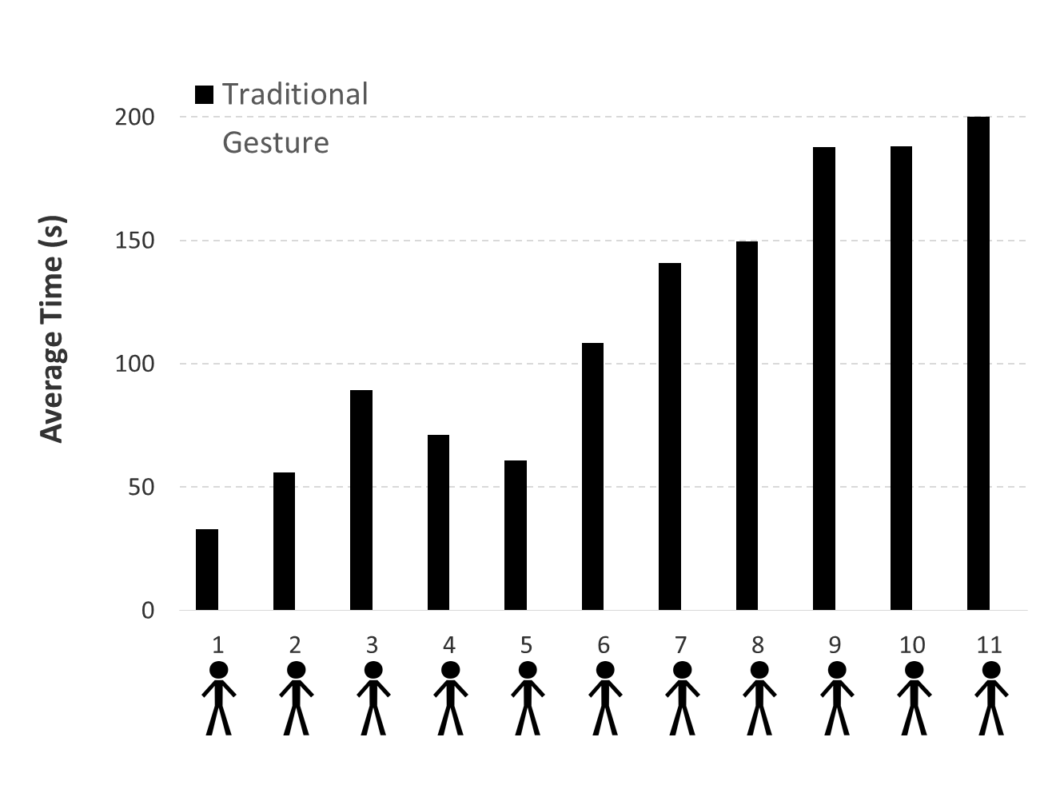
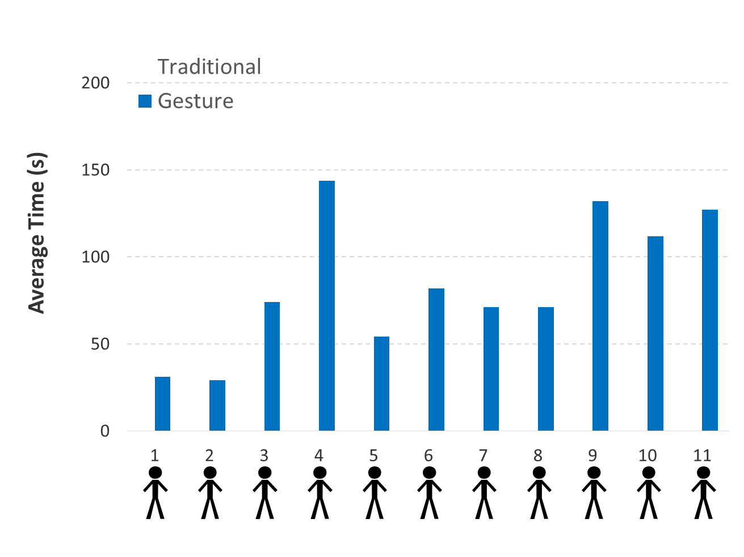
Individual Analysis
Notes:
14

Slide 15
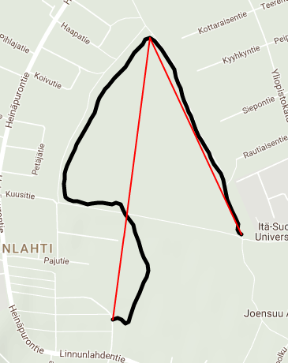
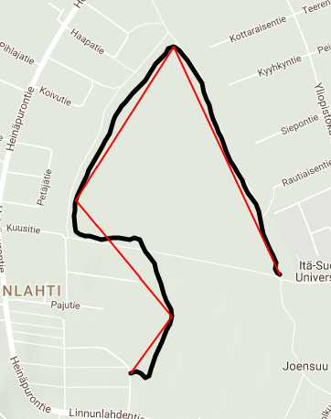
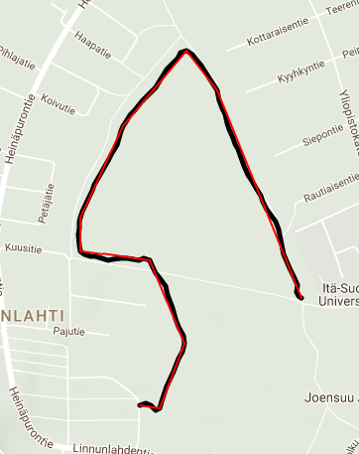
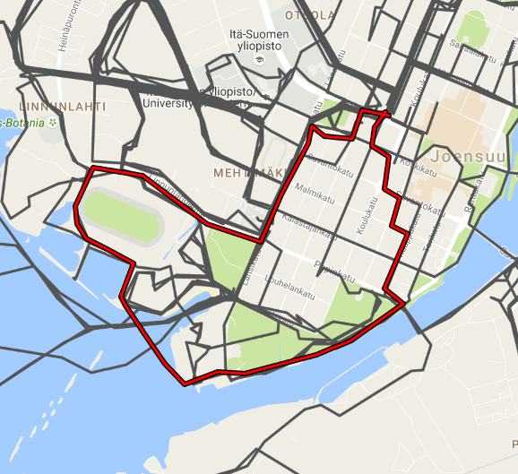
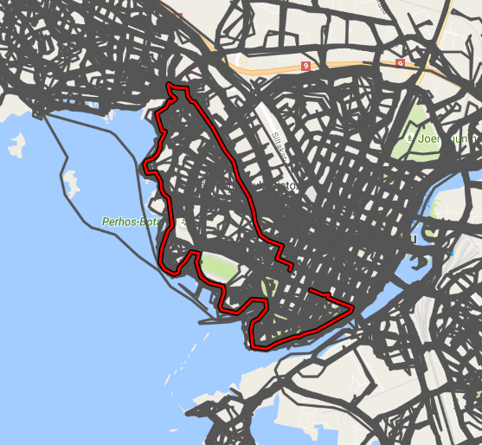
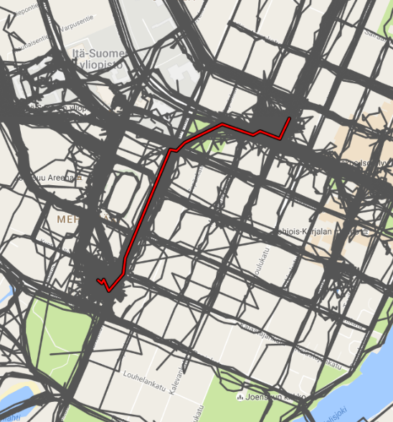
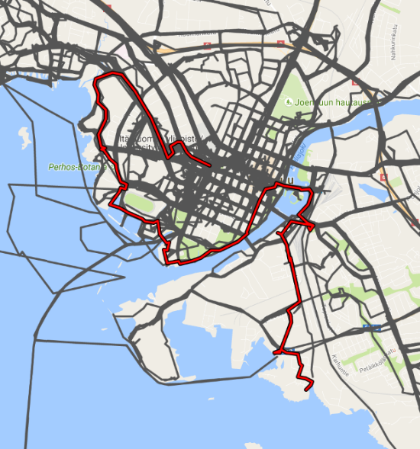
Deeper Analysis
 | Length |  | Complexity |  | Density
 | Short 2.7 km | Long 12.7 km | Low 31 pts | High 128 pts | Low 12 % | High 75 %
Traditional | 90 s | 116 s | 87 s | 120 s | 90 s | 117 s
Gesture | 64 s | 78 s | 65 s | 77 s | 54 s | 88 s
 | 30% | 33% | 25% | 36% | 30% | 24%
<
<
<
3 pts
5 pts
10 pts
30 %
A Fast O(N) Multiresolution Polygonal Approximation Algorithm for GPS Trajectory Simplification
Minjie Chen, Mantao Xu and Pasi Fränti (2012)
1 km
100 %
13 km
Notes:
15

Slide 16
Conclusions
41% faster
Real-time for up to 10,000 routes
Scales logarithmically

Slide 17
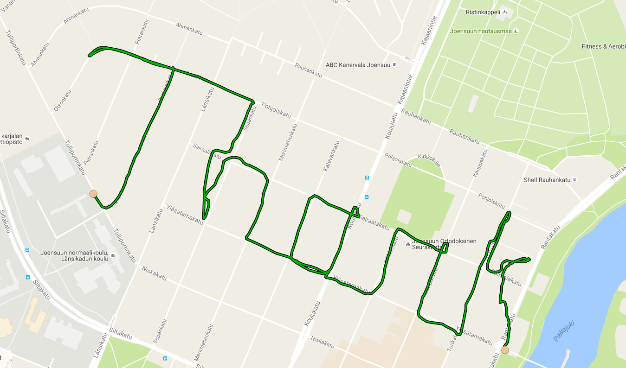
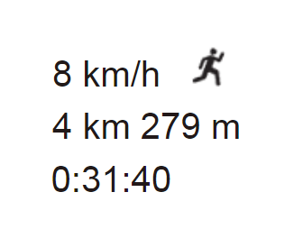
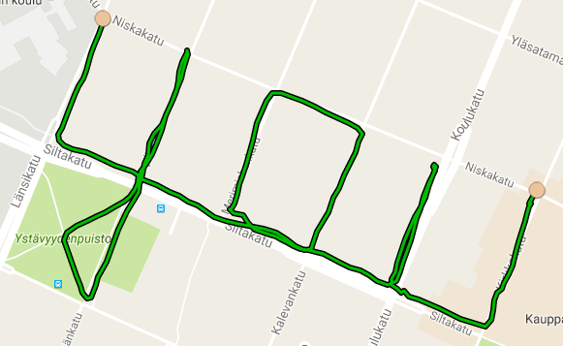
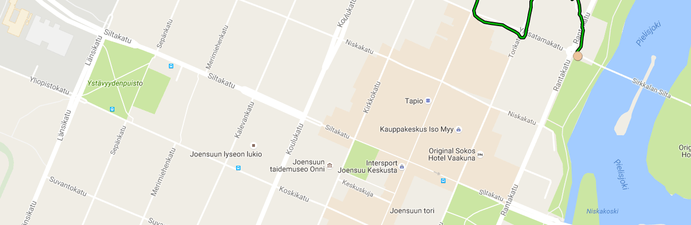
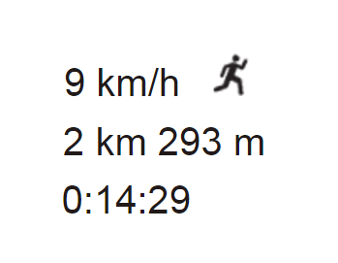
http://cs.uef.fi/mopsi
Radu Mariescu-Istodor
radum@cs.uef.fi
Notes:
17

