Slide 1
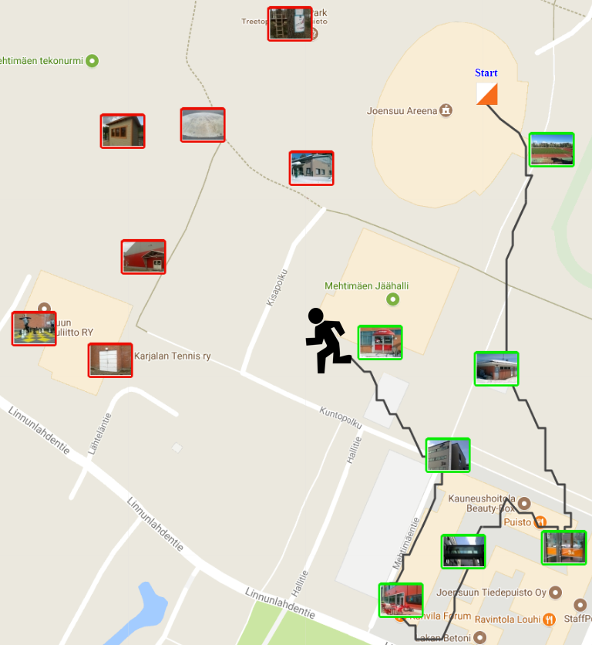
Traveling Salesman
Radu Mariescu Istodor
28.1.2019

Slide 2
Mathematical formulation
Given N points: p₁, p₂ … p_{N} find a permutation of the points $π$so that the following sum is minimized:
$$\sum_{i=2}^{N}{d\left(p_{\left.π(i−1\right)},p_{\left.π(i\right)}\right)}$$

Slide 3
Brute force
Permutation (a, n)
IF n = 1 THEN
IF len (a) < len (best) THEN
best ← a
END IF
ELSE
FOR i ← 1 TO n DO
Swap (a, i, n-1);
Permutation (a, n-1); Swap (a, i, n-1);
END FOR
END IF
Do I have to?
Permutation (a, n-1);
Notes:
Demo:
http://cs.uef.fi/paikka/Radu/clusterator/tsp.php

Slide 4
Branch and Bound
Permutation (a, n)
IF n = 1 THEN
IF len (a) < len (best) THEN
best ← a
END IF
ELSE
IF Oracle SAYS OK
FOR i ← 1 TO n DO
Swap (a, i, n-1);
Permutation (a, n-1); Swap (a, i, n-1);
END FOR
END IF
END IF
Permutation (a, n-1);
Notes:
Demo:
http://cs.uef.fi/paikka/Radu/clusterator/tsp.php

Slide 5
Branch and Bound
Notes:
Demo:
http://cs.uef.fi/paikka/Radu/clusterator/tsp.php

Slide 6
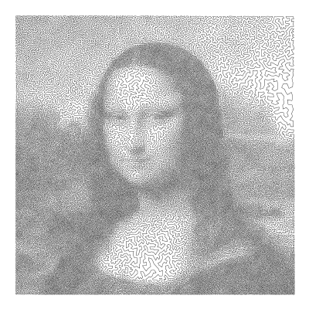
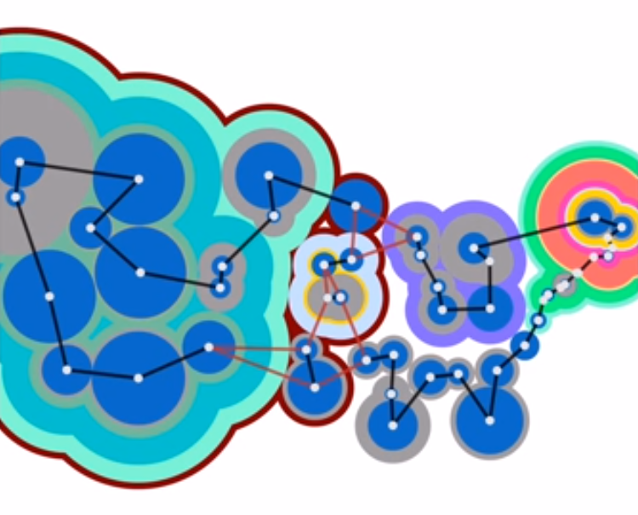
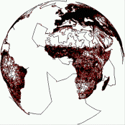
Cutting plane method
http://www.math.uwaterloo.ca/tsp/data/ml/monalisa.html
http://www.math.uwaterloo.ca/tsp/world/index.html
https://www.youtube.com/watch?v=STbkQbsIYVQ
Applegate, David, Ribert Bixby, Vasek Chvatal, and William Cook.
"Concorde TSP solver." (2006).

Slide 7
Back to Heuristics
RandomMix
Initialize order at random
FOR i ← 1 TO N DO // N is a fixed number of iterations (10,000)
Chose operation randomly
Do selected operation at a random location
Update solution if improvement was found
END FOR

Slide 8
Back to Heuristics
RandomMix
Initialize order at random
REPEAT
Chose operation randomly
Do selected operation at a random location
Update solution if improvement was found
UNTIL Oracle SAYS STOP

Slide 9
Model-based Oracle?
Prates, Marcelo OR, Pedro HC Avelar, Henrique Lemos, Luis Lamb, and Moshe Vardi.
"Learning to solve np-complete problems - a graph neural network for the decision tsp."
arXiv preprint arXiv:1809.02721 (2018).
Notes:
Demo:
http://cs.uef.fi/paikka/Radu/clusterator/tsp.php

Slide 10
Thank You !
Radu Mariescu-Istodor
radum@cs.uef.fi

