Slide 1
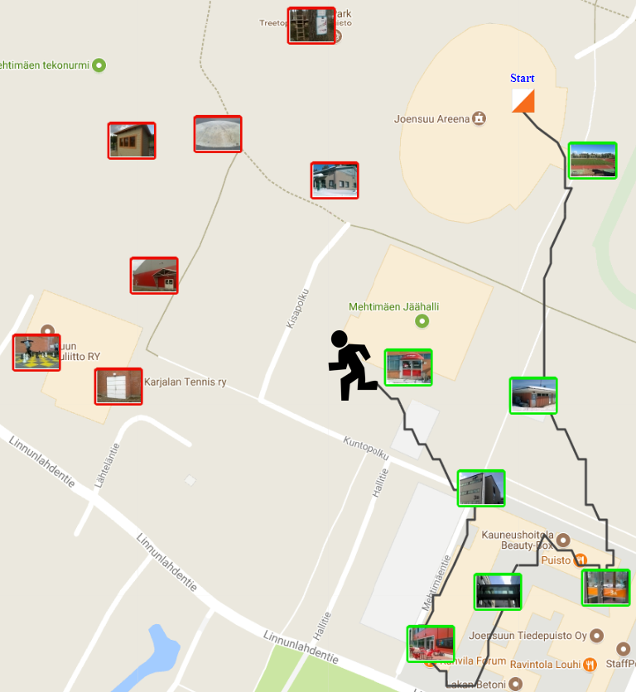
Traveling Salesman
Radu Mariescu Istodor
30.1.2019

Slide 2
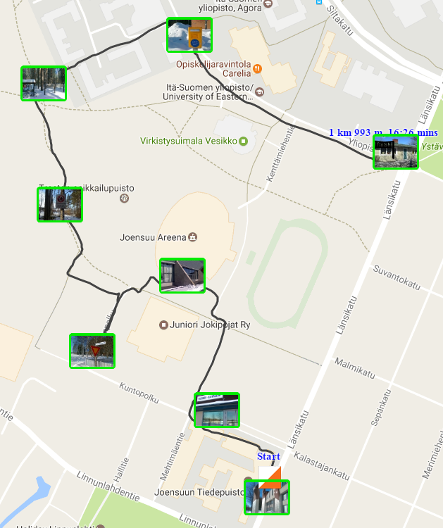
O-Mopsi TSP
Longer side
Shorter side
Likely direction of optimal route
Start

Slide 3
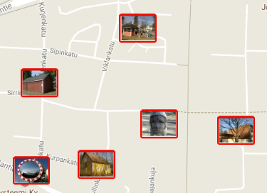
Grid
20% of the Width
Corner | Long edge | Corner
Short edge | Middle | Short edge
Corner | Long edge | Corner
Game Area
20% of the Height

Slide 4
Cell Frequencies
Longer side
8 | 3 | 4 | 4 | 13
5 | 1 | 1 | 1 | 5
6 | 1 | 0 | 1 | 4
4 | 1 | 0 | 1 | 6
14 | 2 | 1 | 3 | 11
Shorter side

Slide 5
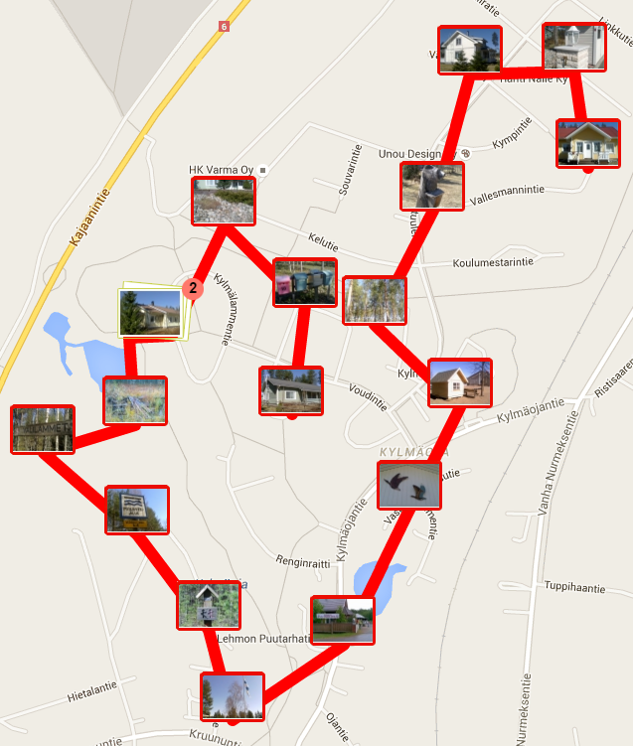
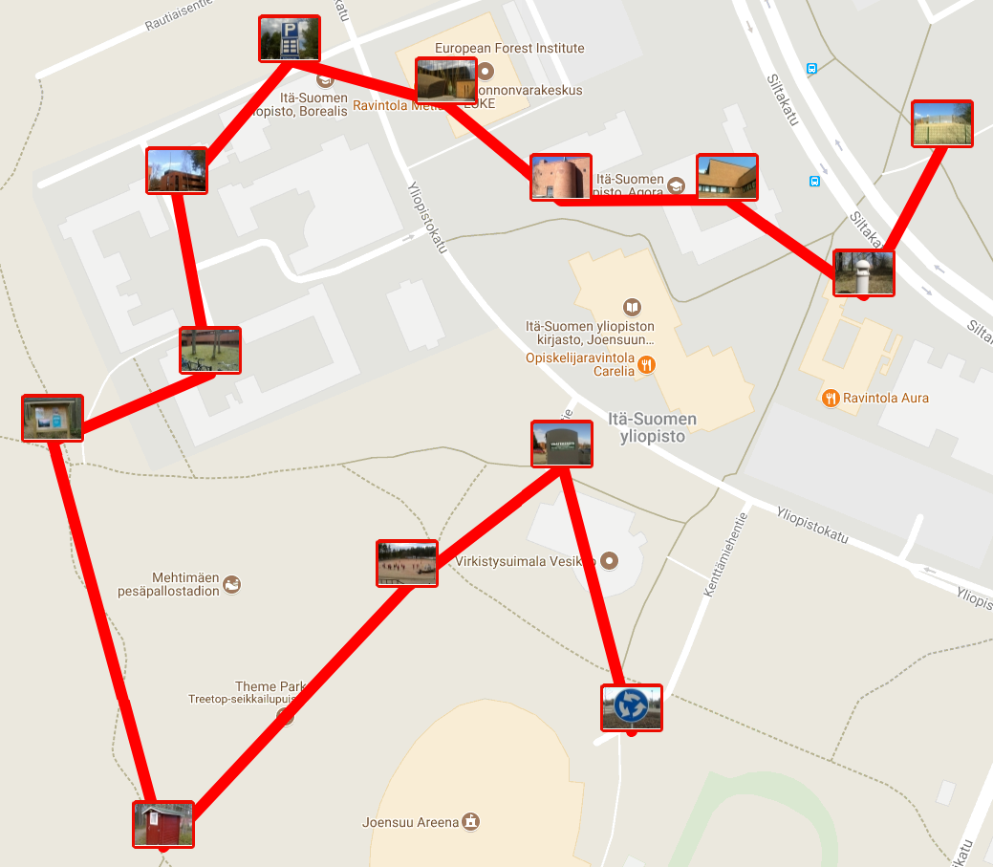
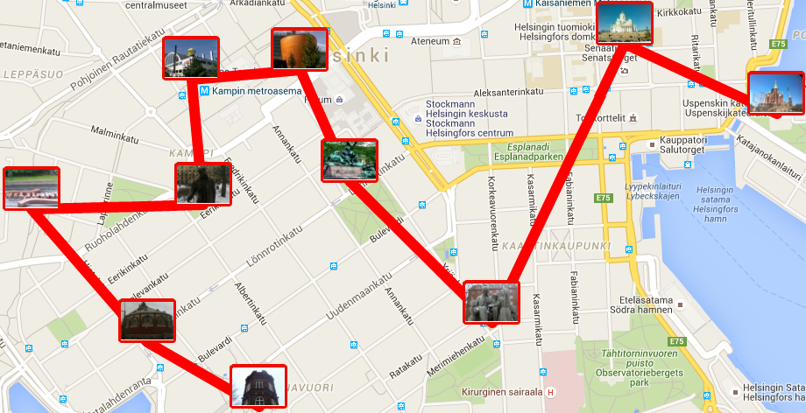
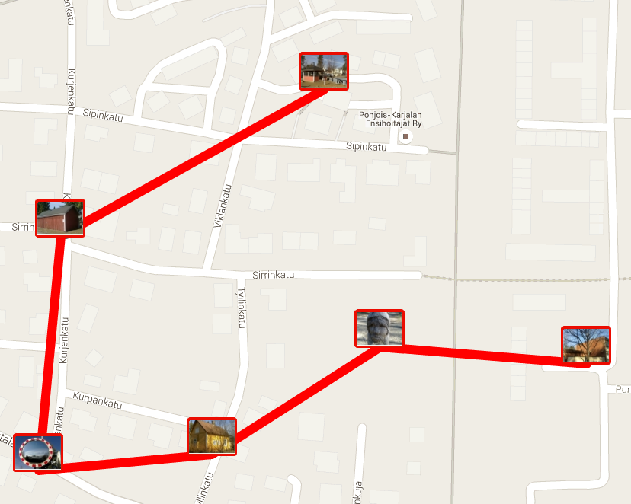
Examples
Middle
Corner
Long edge
Short edge
?
Which way would you go

Slide 6
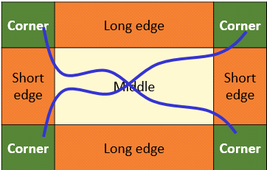
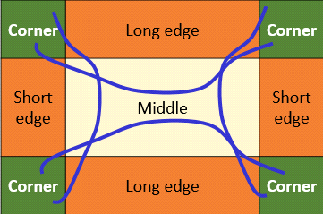
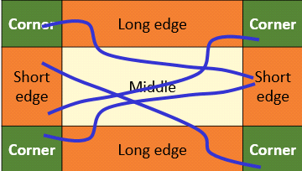
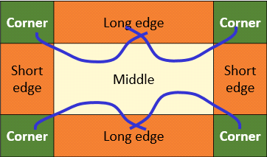
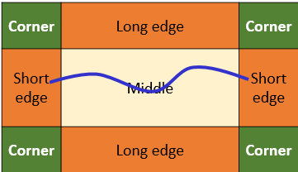
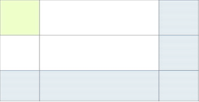
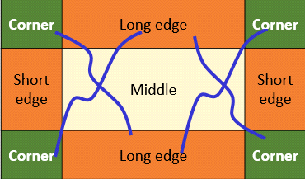
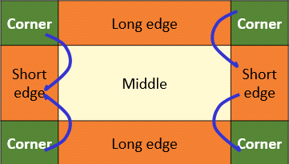
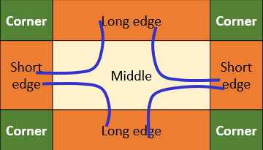
More statistics
Corner to opposite corner
Corner to same side corner
Corner to:
opposite corner
opposite short edge
opposite long edge
45%
Corner to opposite short edge
Corner to adjacent long edge
Short edge to short edge
Corner to:
same side corner
adjacent short edge
adjacent long edge
30%
Corner to opposite long edge
Corner to adjacent short edge
Long edge to short edge
Short edge to:
short edge
long edge
17%

Slide 7
Different start strategies
 | Probability to find best | Gap to best
Random | 3% | 8%
Middle | 9% | 9%
Corner | 32% | 7%
Short edge | 23% | 6%

Slide 8
Human playing evaluation
http://cs.uef.fi/~radum/StartPoint

Slide 9
Human performance
Gap to optimum

Slide 10
Game size

Slide 11
DAA course performance

Slide 12
Playing strategy

Slide 13
TSP really?
Notes:
Explain that targets found with 20 m tolerance.
And that shorter than birds distance is possible.

Slide 14
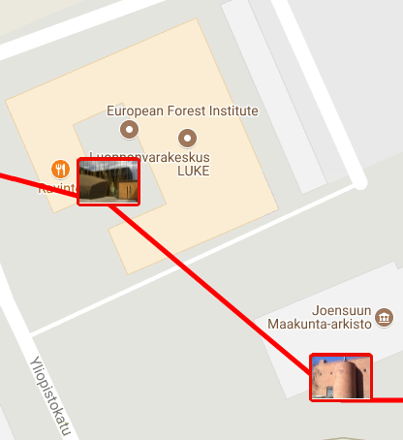
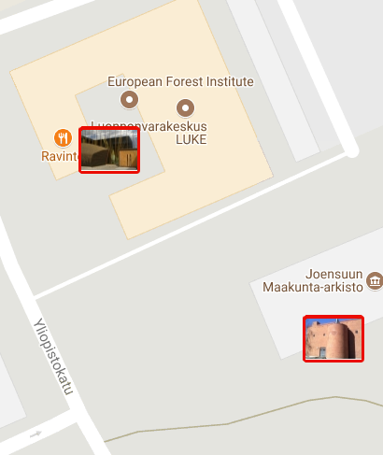
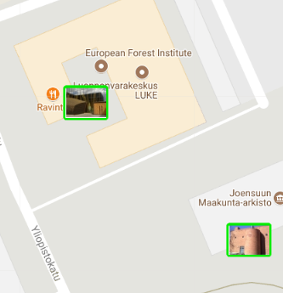
How people move?
Bird’s distance
Road distance
Real life

Slide 15
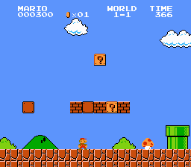
Game speedruns
https://www.youtube.com/watch?v=Gum4GI2Jr0s

Slide 16
Thank You !
Radu Mariescu-Istodor
radum@cs.uef.fi

