Slide 1
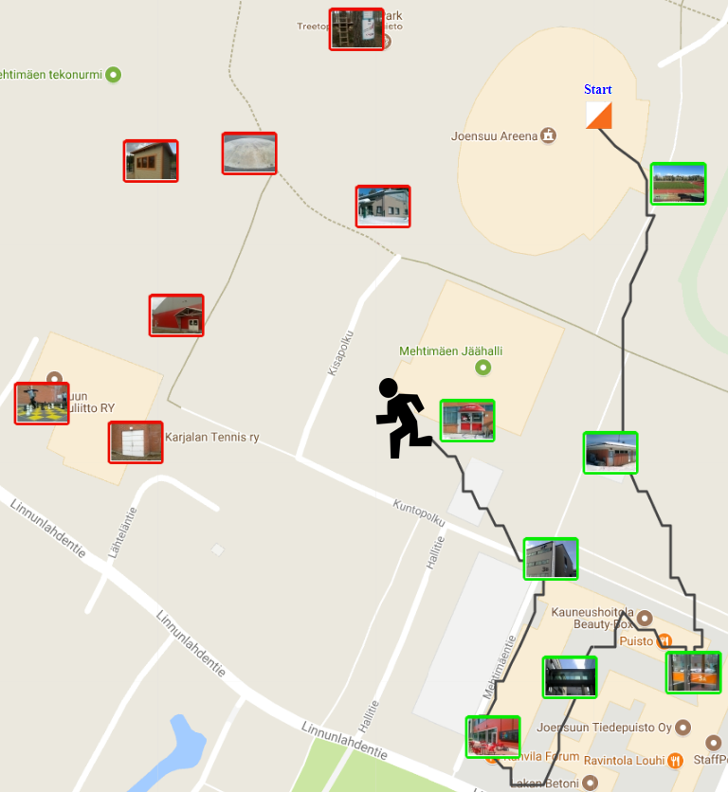
Traveling Salesman
Radu Mariescu Istodor
24.1.2019

Slide 2
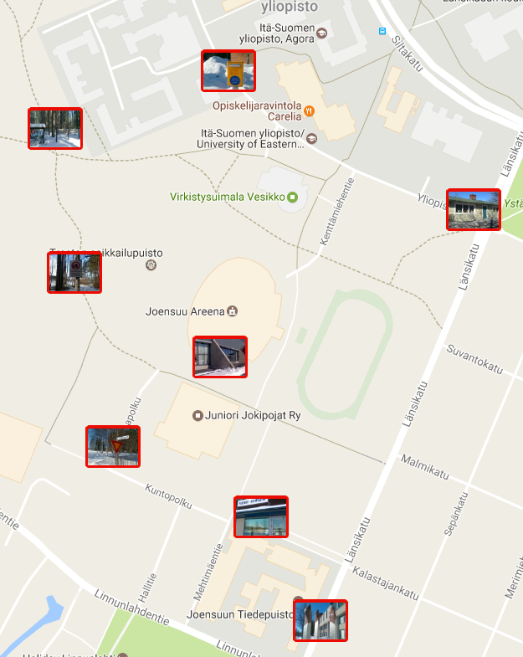
Traveling Salesman Problem

Slide 3
Mathematical formulation
Given N points: p₁, p₂ … p_{N} find a permutation of the points $π$so that the following sum is minimized:
$$\sum_{i=2}^{N}{d\left(p_{\left.π(i−1\right)},p_{\left.π(i\right)}\right)}$$

Slide 4
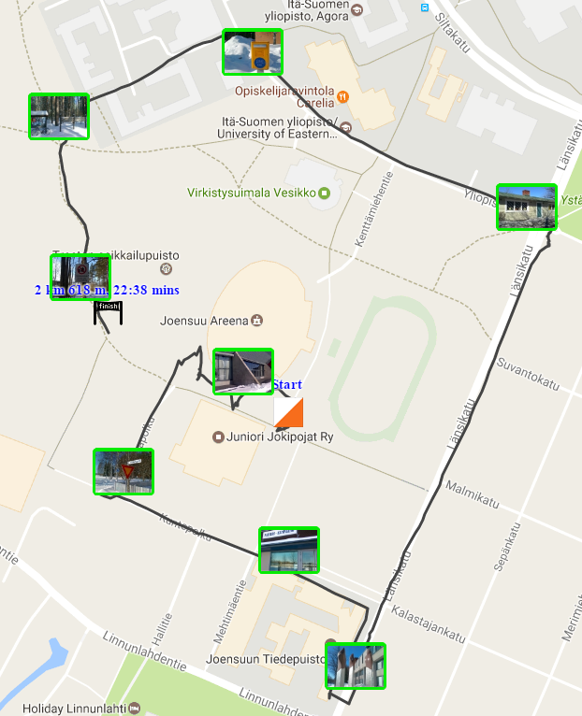
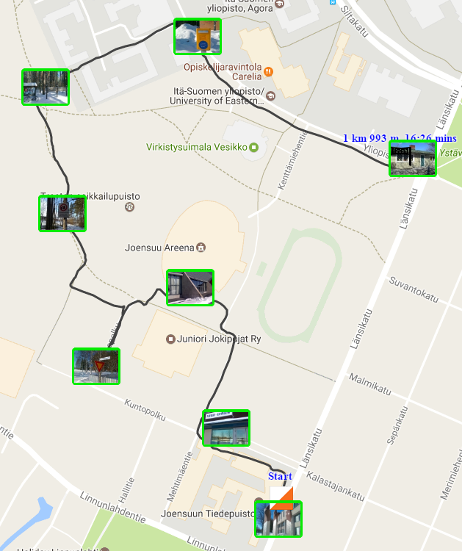
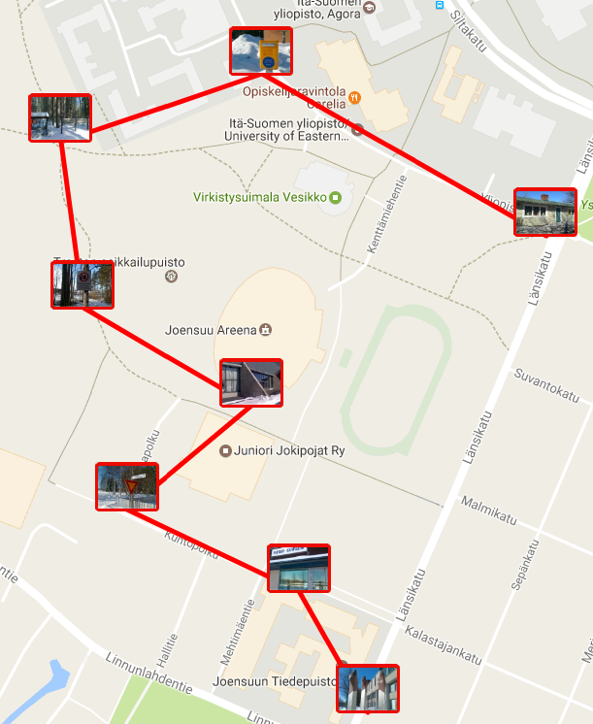
O-Mopsi TSP
Player 2
Player 1
Optimum
??

Slide 5
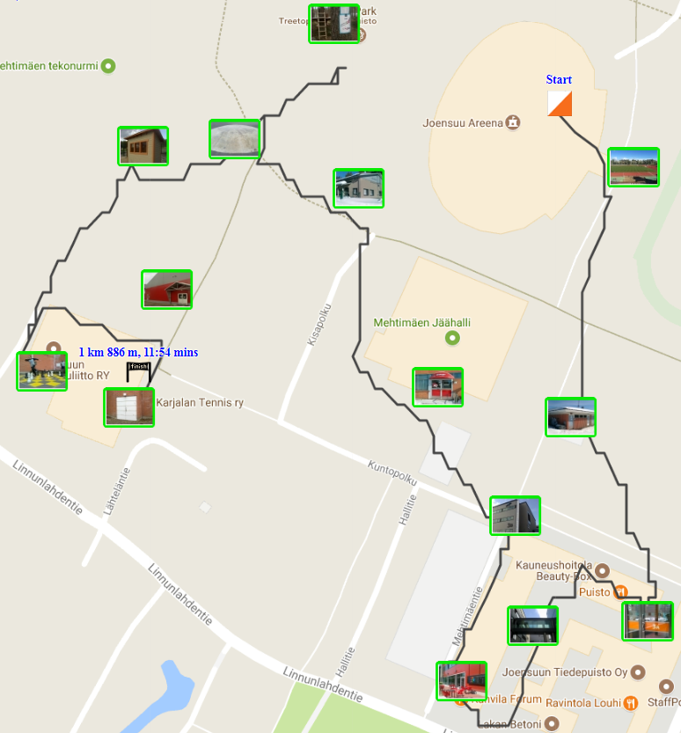
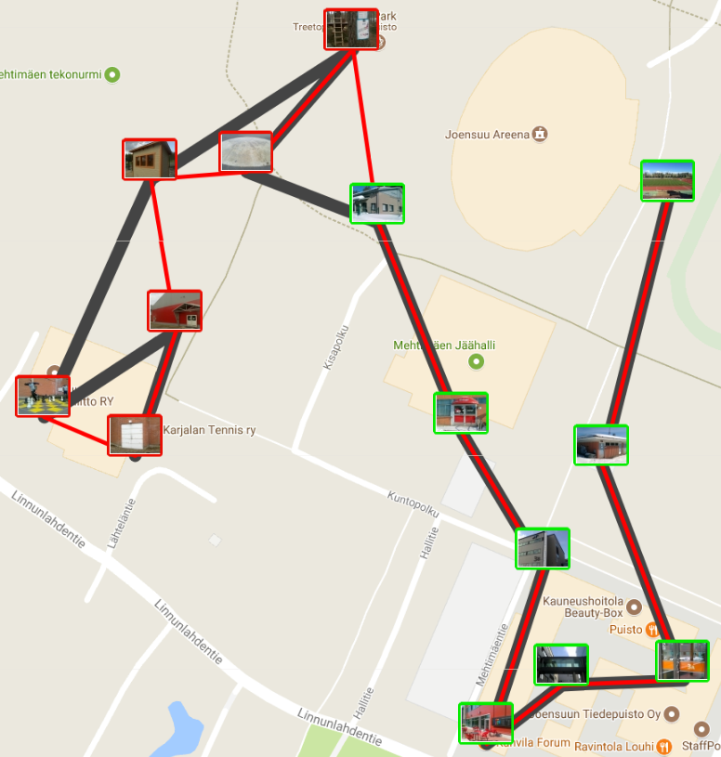
How good was the order?
Start
Optimum order
Player’s order
End
Player’s route
Mismatch
4
Notes:
Talk distance matrix
Distance vs time.
Is it symmetric?

Slide 6
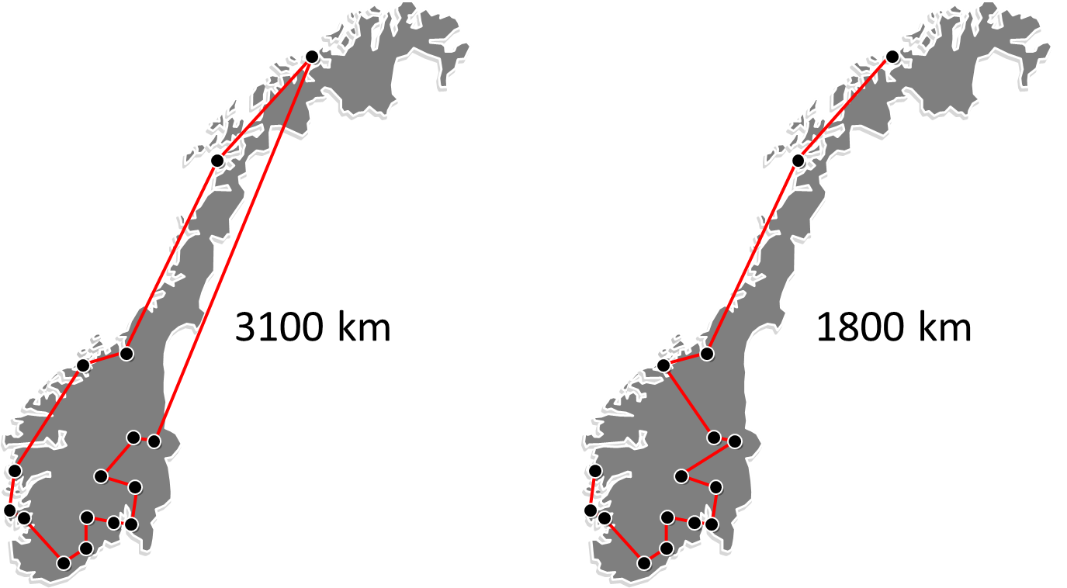
Cycle vs Path

Slide 7
Circuit board

Slide 8
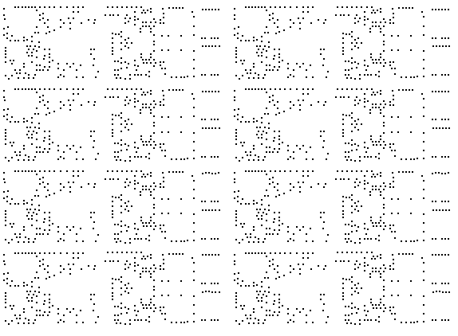
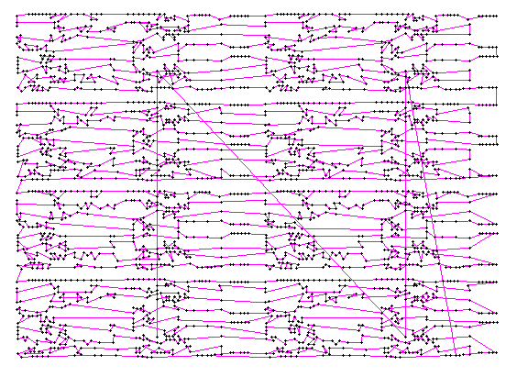
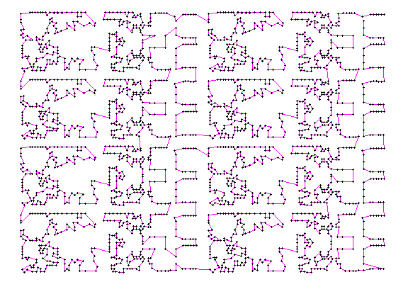
Circuit board
Martin Grötschel, 2013

Slide 9
Local search
HEURISTIC

Slide 10
Node Swap

Slide 11
2-optimization

Slide 12
Link Swap
T₁
B
T₂
A
1
2
3

Slide 13
Random Mix Algorithm
RandomMix
Initialize order at random
FOR i ← 1 TO N DO // N is a fixed number of iterations (10,000)
Chose operation randomly
Do selected operation at a random location
Update solution if improvement was found
END FOR

Slide 14
How it works?
DEMO
Notes:
TSP page demo SciFest game
2Opt is Remove crossing
http://cs.uef.fi/paikka/Radu/clusterator/lopsi.php

Slide 15
Why mix?
Node swap and link swap stops
2-opt solves
2-opt and link swap stops
Node swap stops
Node swap solves
Link swap or
2-opt solves

Slide 16
Local optima
Optimum

Slide 17
Recovery strategy:
Repeat the process

Slide 18
Improvement rate

Slide 19
How many iterations?

Slide 20
How many repetitions?
O-Mopsi
(145 games)
Notes:
http://cs.uef.fi/paikka/Radu/clusterator/lopsi.php

Slide 21
Thank You !
Radu Mariescu-Istodor
radum@cs.uef.fi

Slide 22
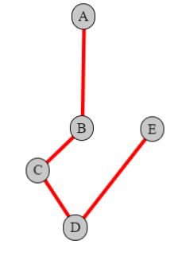
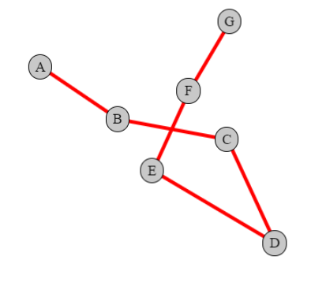
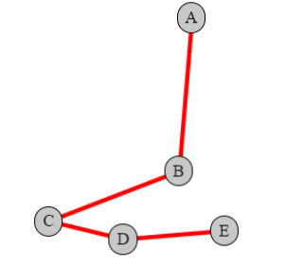
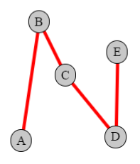
Only solved by
node swap
2opt
link swap
link swap
link swap
node swap
2opt
2opt
node swap
link swap
node swap
2opt

Slide 23
TSP tool setup
7 nodes

