Slide 1
Carmen: A Twitter Geolocation System with Applications to Public Health Dredze M., Michael J., Shane B. & Hieu T. (2013) Determining transportation mode on mobile phones Reddy, S., Burke, J., Estrin, D., Hansen, M., & Srivastava, M. (2008)
Antonio Serrano de la Cruz Parra (300201)
6.2.2019

Slide 2
Introduction
Twitter
Analysis of tweets
Location

Slide 3
Carmen: a Twitter Geolocation system
INPUT
SYSTEM
OUTPUT
Carmen
Tweets from Twitter API
Application of methods based on geocoordinates and user proﬁle information
Tweets’ Location
(id, coordinates, city, country, state)
Contribution to improve influenza (flu disease) tracking systems

Slide 4
How Carmen works: Places (1/3)
Place
City
State
Country
Find location
Twitter API JSON Object
Database of locations (alias)
Tweet location
detected
Only ~1% of analysed tweets contain Place object

Slide 5
How Carmen works: Coordinates (2/3)
Find location
(25 miles flexibility)
Coordinates
Latitude
Longitude
Twitter API JSON Object
Database of locations (alias)
Tweet location
detected
Google API
Only ~4% of analysed tweets contain Coordinates object

Slide 6
How Carmen works: User’s location profile (3/3)
Normalize location and find
User
Location
Description
Language
Remove (_/.!=?#;)
Extra spacing
Punctuation marks
Twitter API JSON Object
Database of locations (alias)
Tweet location
detected
For most of the tweets (~95%) we rely on user’s provided location

Slide 7
Results
56.167 random test Tweets with at least Places or coordinates
Accuracy based on:
Places/Coordinates are considered correct
Compare location based in user’s profile with known Places/coordinates
Countries match
States/counties match (if available)
Locations match if distance < K miles
Country | State/County | K<25 | K<50 | K<100 | K<250
90.74% | 64.72% | 54.51% | 59.80% | 65.77% | 75.27%
Accuracy of geolocated tweets based on user´s profile
K = accuracy in miles

Slide 8
Conclusion - Aplication
Improvement of Influenza surveillance
Method | US (CDC data 2009) | UK (HPA data 2009)
Lamb, Paul and Dredze (2013) – All tweets | .9604 | .5138
Carmen - US only | .9714 | .1982
Carmen - UK only | .9231 | .8827
Pearson correlations - Different methods and Government’s data
CDC = Centers for Disease Control and Prevention in US
HPA = Health Protection Agency in UK

Slide 9
Future work
Content-based geolocation
Include more specific locations (neighbourhoods, points of interest, etc.)
Extensions for other social media (e.g. Facebook)
Other applications (geographic trends)

Slide 10
Determining transportation mode on mobile phones Reddy, S., Burke, J., Estrin, D., Hansen, M., & Srivastava, M. (2008)
Antonio Serrano de la Cruz Parra
6.2.2019

Slide 11
Introduction
INPUT
SYSTEM
OUTPUT
Classificator
Data from GPS and acelerometter
Machine Learning Classiffiers
Transportation Mode
(still, walk, run, bike, motorized)
Contribution to Personal Environmental Impact Report (PEIR)

Slide 12
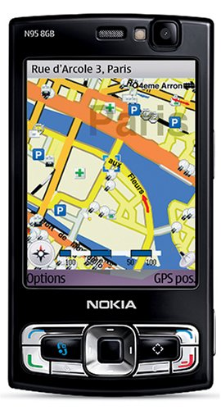
Approach
Hardware
Feature selection
Data collection
Nokia N95
3-axes accelerometer
GPS
Variance, mean, energy, FFT of magnitude of accelerometer
Speed from GPS
6 individuals
8mins exercise
5 different models
Different phone positions
Total: 20h of data

Slide 13
Results
Method (Classifier) | Accuracy
Naive Bayes | 87.2
Decision Tree | 95.7
KNN | 94.7
SVM | 93.4
CHMM | 94.4
DT-DHMM | 98.8
Position | Accuracy
All positions | 95.7
Arm | 97.1
Bag | 96.9
Chest | 96.1
Hand | 96.2
Pocket | 98.0
Accuracy Results for Classifiers
Phone Positions and Accuracy
KNN = K-Nearest-Neighbours
SVM = Support Vector Machine
CHMM = Continous Hidden Markov Model
DT-DHMM = Decision tree & discrete HMM Model

Slide 14
Conclusions
Transportation mode classification system based on DT and DHMM
Based on GPS receiver and accelerometer data
Great accuracy (98%) regardless position of mobile phone
Demand for projects such as Personal Environmental Impact Report
Still work needed in energy efficiency of classifier

Slide 15
Carmen: A Twitter Geolocation System with Applications to Public Health Dredze M., Michael J., Shane B. & Hieu T. (2013) Determining transportation mode on mobile phones Reddy, S., Burke, J., Estrin, D., Hansen, M., & Srivastava, M. (2008)
Thank you!
Antonio Serrano de la Cruz Parra
6.2.2019

Slide 16
Carmen
Twitter API Documentation: https://developer.twitter.com/en/docs/tutorials/filtering-tweets-by-location.html
Place | Coordinates | Profile
0.8% | 3.6% | 95.6%
City | County | State | Country
63.4% | 1.0% | 12.5% | 23.0%
Geolocation attributed to each field
Percentage of geolocations at eatch resolution

Slide 17
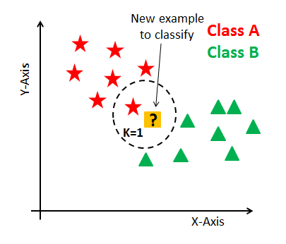
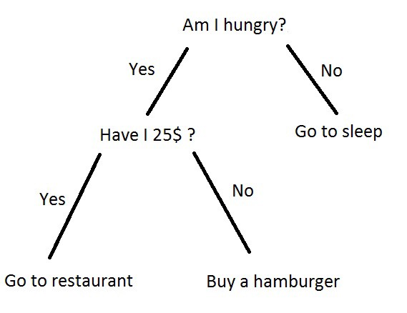
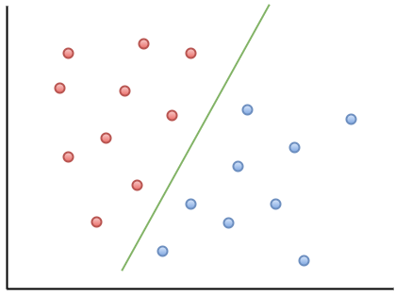
Classifiers
Decision Tree
SVM
KNN

Slide 18
GPS and accelerometer

