Slide 1
Exergames – Turning classic games into exercise
Hely Herranen
UEF

Slide 2
Introduction
Exergames
Why?
Features through examples
Papers
Augmented Invaders: A Mixed Reality Multiplayer Outdoor Game [Bonfert et al. 2017]
Turning the classic Snake mobile game into a location–based exergame that encourages walking [Chittaro et al. 2012]
Conclusion

Slide 3
Exergames
Health benefits of physical activity:
Improves health and quality of life
Lowers the risk of diseases
Decrease body fat
Reduce symptoms of depression
Video games often blamed for unsporty lifestyle
Excergames make exercising enjoyable and improve attitude

Slide 4
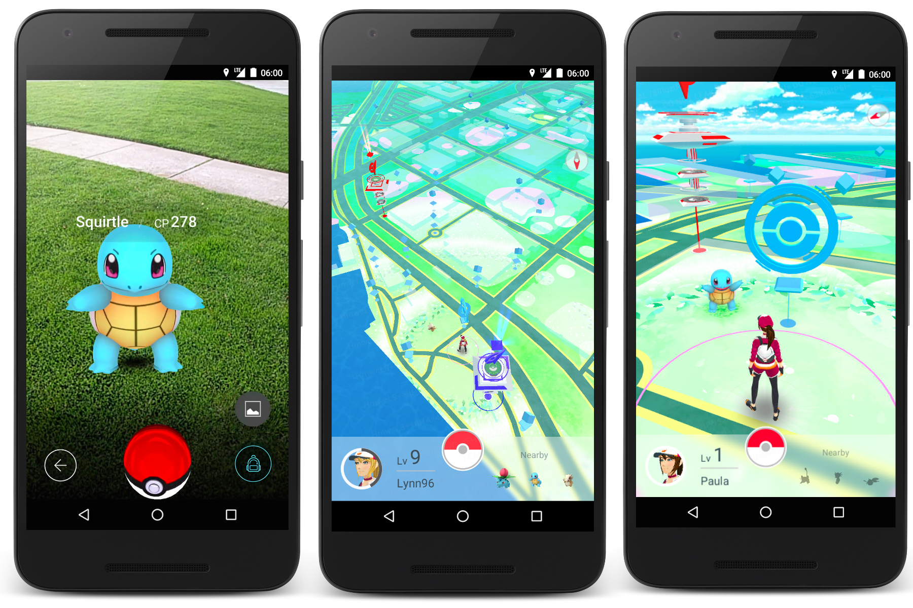
Image: GamesNosh

Slide 5
Location-based
gameplay advances through player’s location
Image: GamesNosh

Slide 6
AR
mix of game
content and
player’s reality
Image: GamesNosh

Slide 7
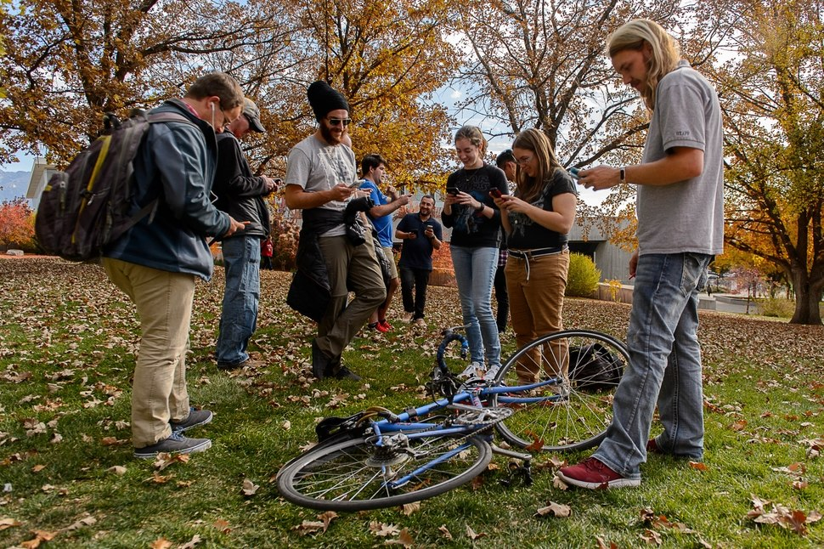
Image: Salt Lake Tribune

Slide 8
FEATURES OF EXERGAMES
AUGMENTED REALITY
LOCATION-BASED
SINGLEPLAYER

Slide 10
FEATURES OF EXERGAMES
AUGMENTED REALITY
LOCATION-BASED
SINGLEPLAYER
MULTIPLAYER

Slide 11
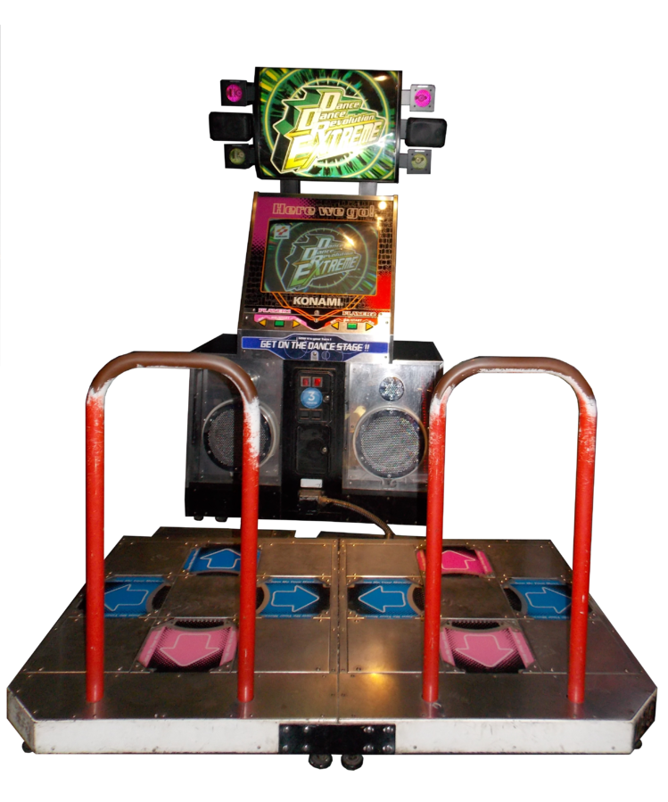
1998
Image: Wikipedia

Slide 12
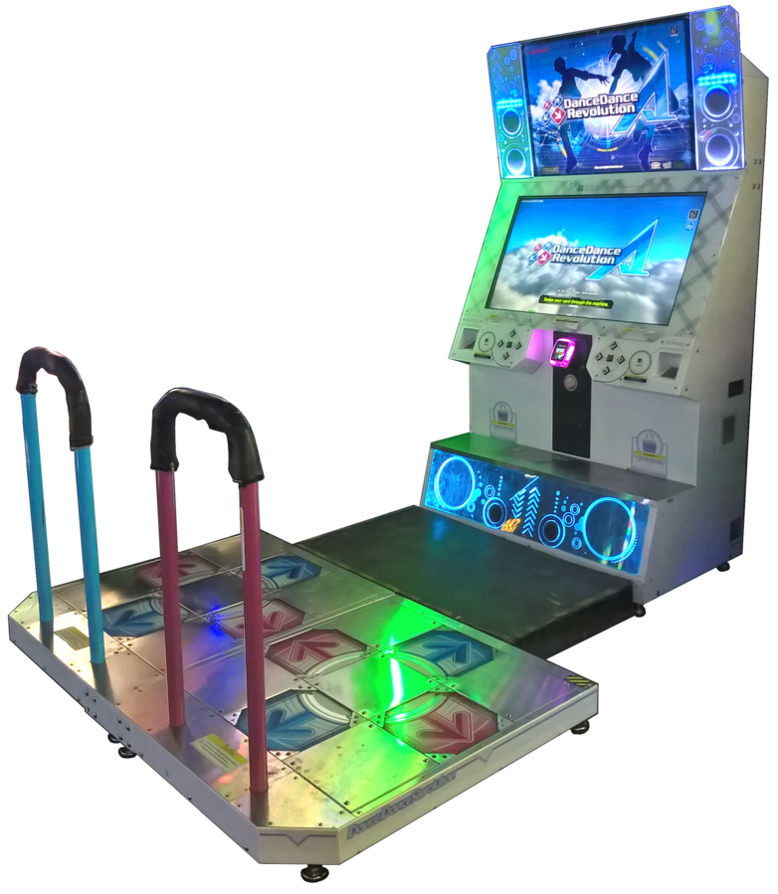
1998
2013
Image: Wikipedia

Slide 13
FEATURES OF EXERGAMES
AUGMENTED REALITY
LOCATION-BASED
SINGLEPLAYER
MULTIPLAYER
VARIOUS PLATFORMS

Slide 14
Pokéwalker
Image: Amazon

Slide 15
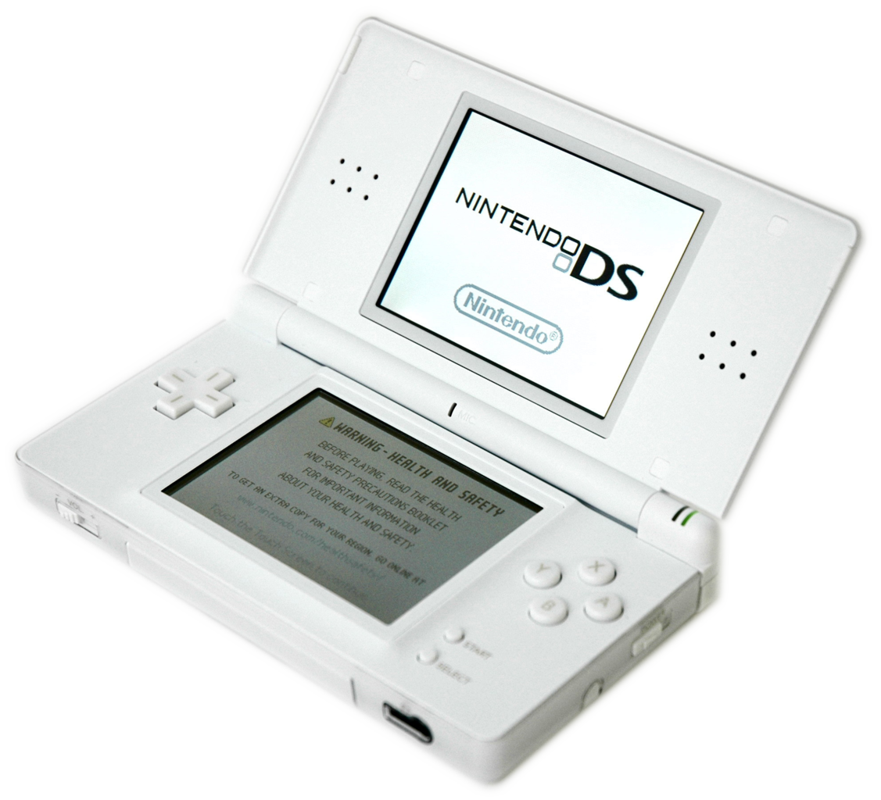
Image: Wikimedia

Slide 16
FEATURES OF EXERGAMES
AUGMENTED REALITY
LOCATION-BASED
SINGLEPLAYER
MULTIPLAYER
VARIOUS PLATFORMS
PHYSICAL ACTIVITY

Slide 17
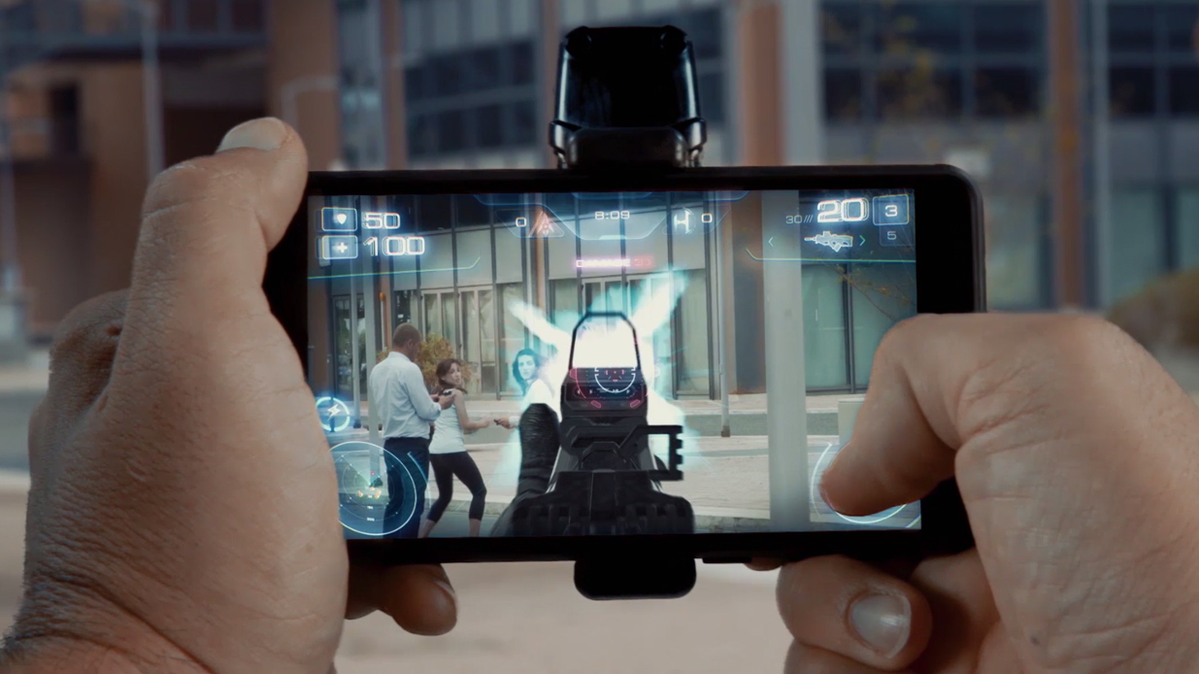

Slide 18
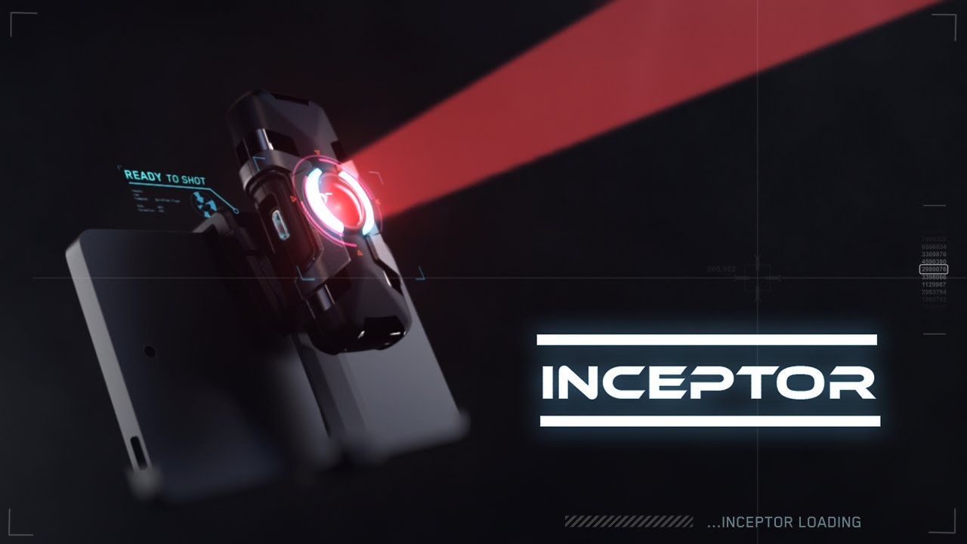

Slide 19
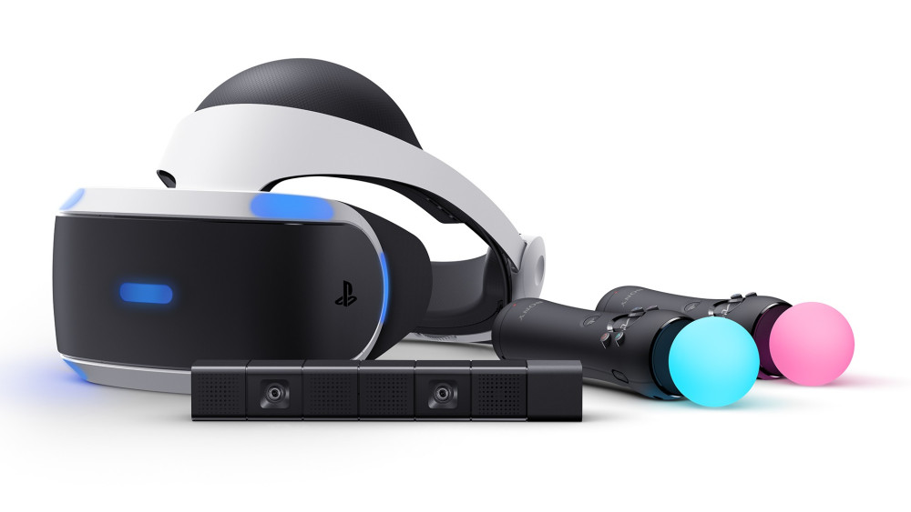
PlayStation VR

Slide 20
FEATURES OF EXERGAMES
AUGMENTED REALITY
LOCATION-BASED
SINGLEPLAYER
MULTIPLAYER
VARIOUS PLATFORMS
PHYSICAL ACTIVITY
ADDITIONAL GEAR

Slide 21
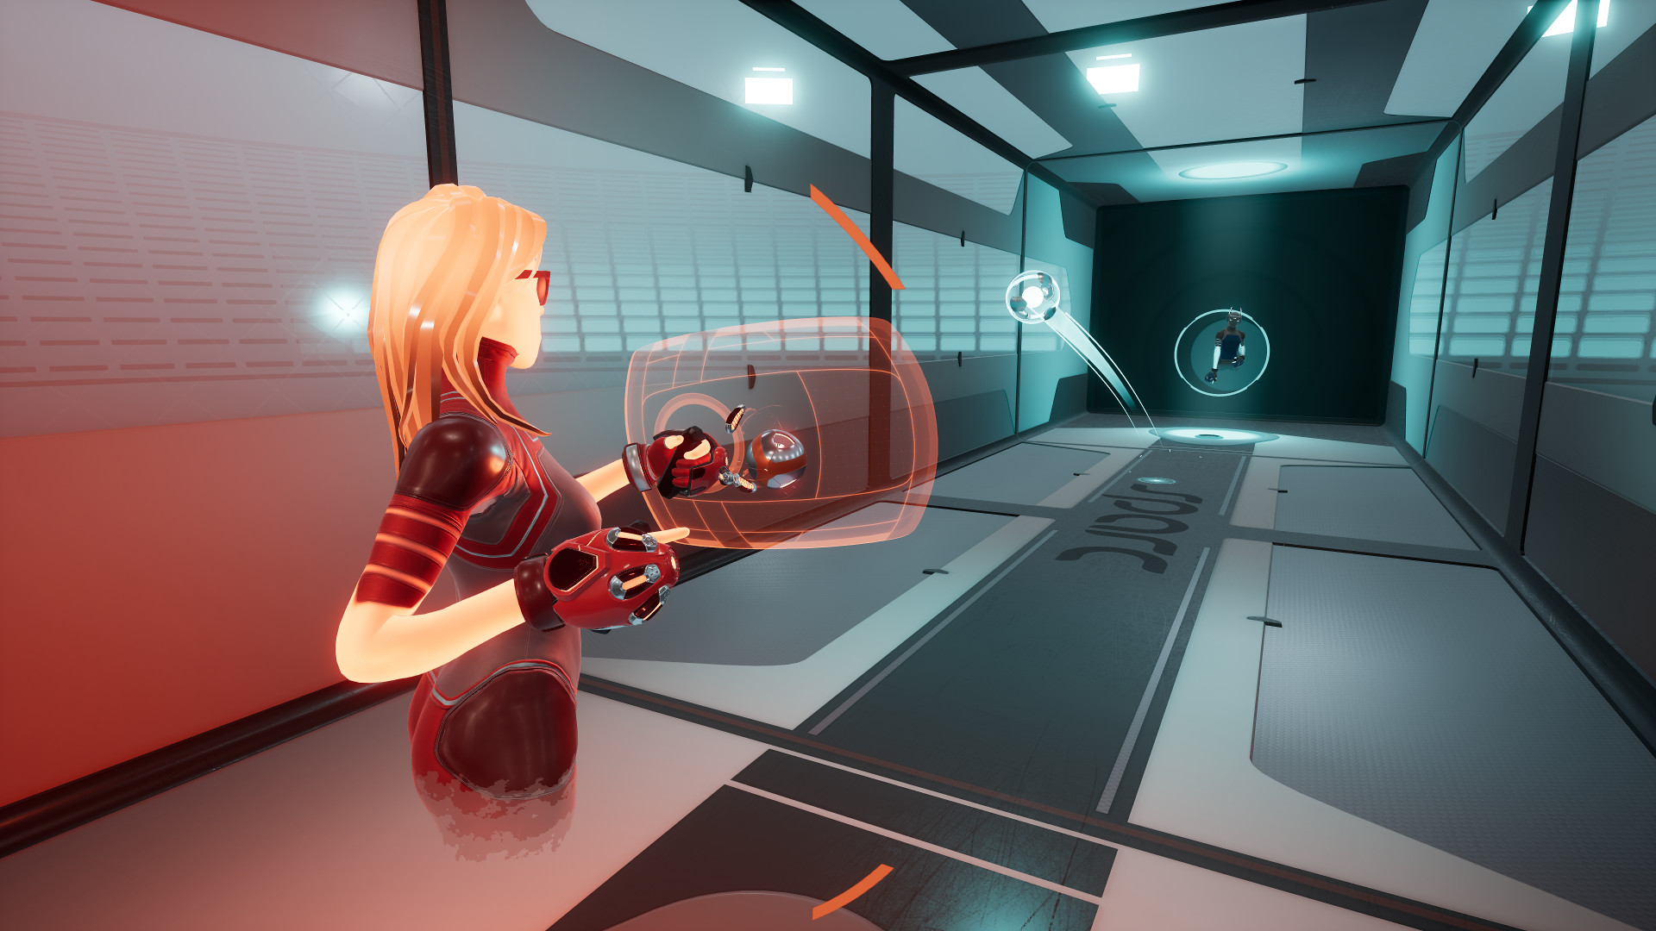

Slide 22
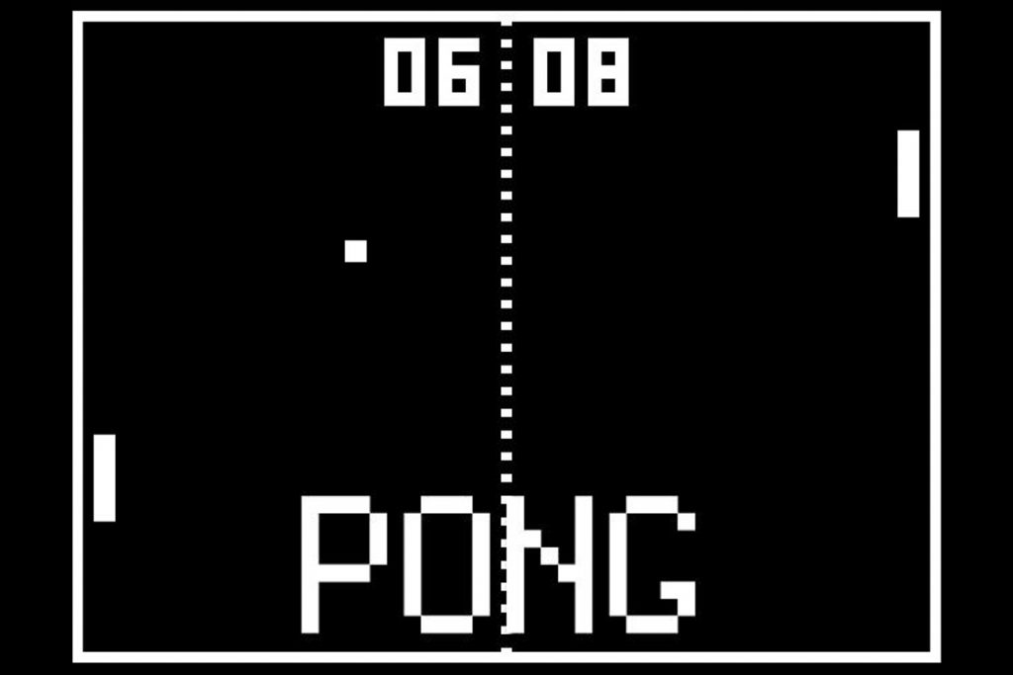

Slide 23
FEATURES OF EXERGAMES
AUGMENTED REALITY
LOCATION-BASED
SINGLEPLAYER
MULTIPLAYER
VARIOUS PLATFORMS
PHYSICAL ACTIVITY
ADDITIONAL GEAR
SIMPLE GAME CONCEPT

Slide 24
Augmented Invaders:
A Mixed Reality Multiplayer Outdoor Game
[Bonfert et al. 2017]

Slide 25
Augmented Invaders – tribute to Space Invaders
Accessibility:
cheap and mobile VR headsets
Augmented Reality:
enemy drones & laser beams
Outdoors game:
need of location services via GPS
Multiplayer – next up!

Slide 26
Augmented Invaders: Multiplayer features
fighting as a team
aim to destroy enemy invaders (shown at the same exact location for all players) by shooting with laser beams coming from players eyes
to shoot player pulls magnetic trigger of HMD

Slide 27
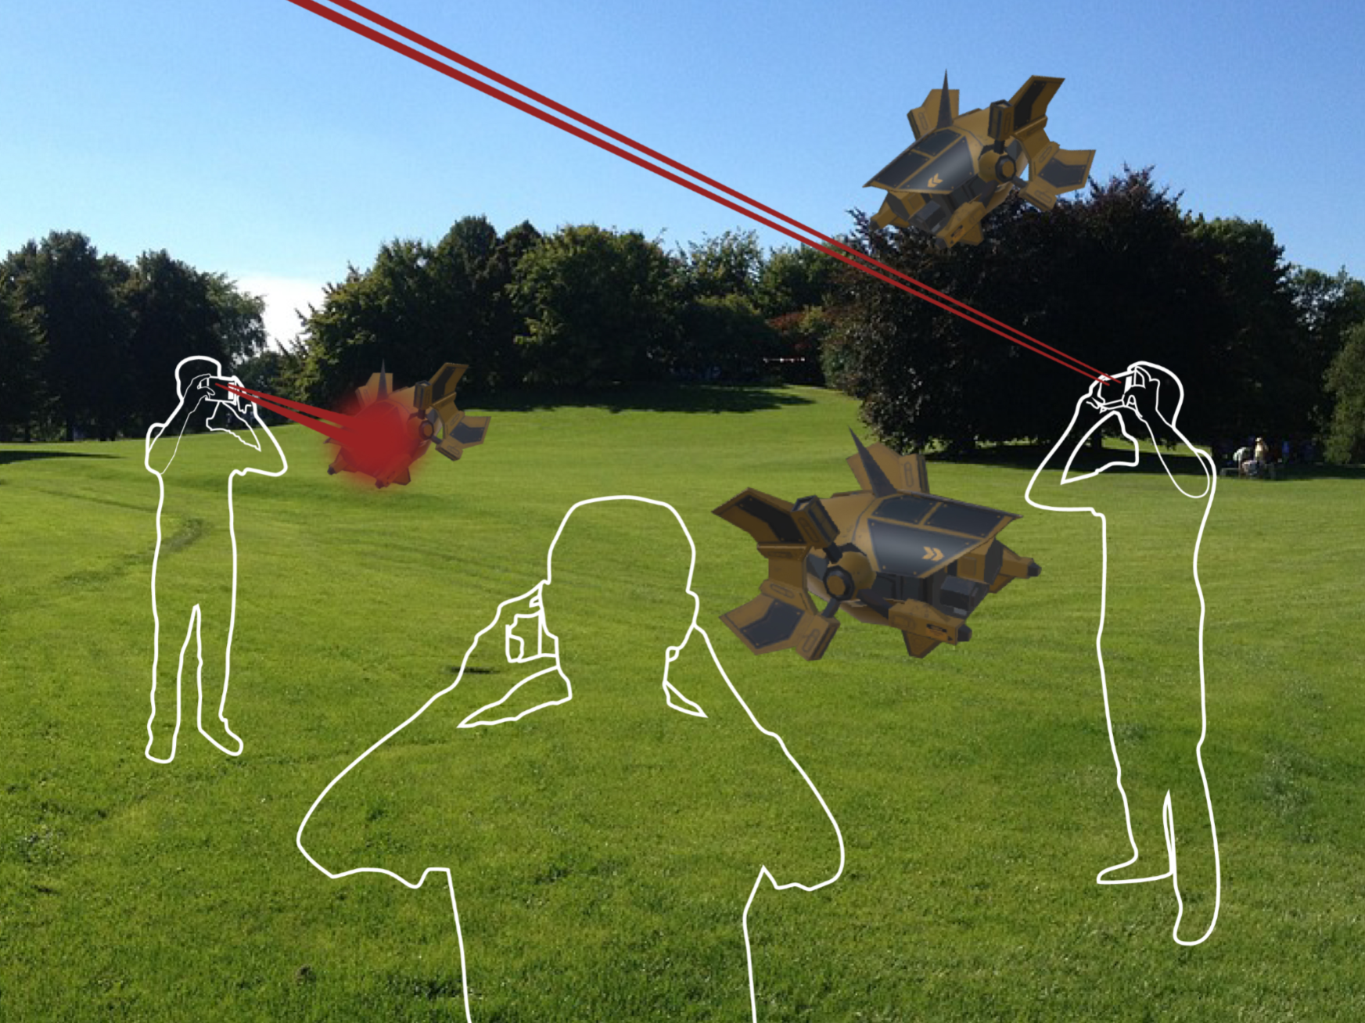

Slide 28
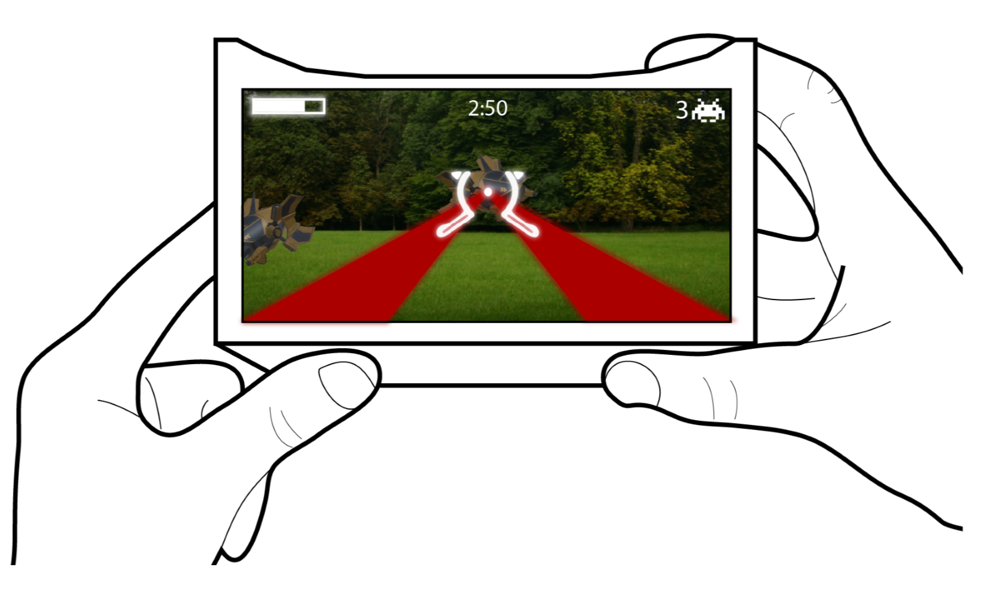

Slide 29
When timer ends, team score is displayed

Slide 31
Augmented Invaders: Implementation
Unity 3D Game Engine
Unet for multiplayer functions
Vuforia toolkit for rendering stereoscopic image
GPS – position converted to unity world

Slide 32
Augmented Invaders: Conclusion
Feasible to develop AR location-based multiplayer-game that enables strategic teamplay
Deficiencies:
players field of view limited
ground is cut-off
occlusion: drone is not covered by a tree or player
GPS signals lack precision

Slide 33
Augmented Invaders: Future
After improving and completing the prototype, the game will enable studies on:
strategic teamplay and group dynamics
playing with many players on a large scale
social acceptance of spontaneous, inclusive game sessions

Slide 34
Turning the classic Snake mobile game
into a location–based exergame
that encourages walking
[Chittaro et al. 2012]

Slide 35
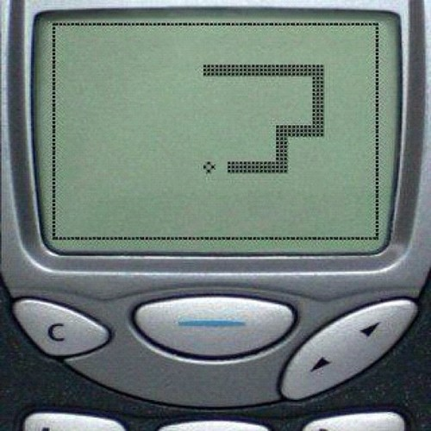
Image: GamesGRABR

Slide 36
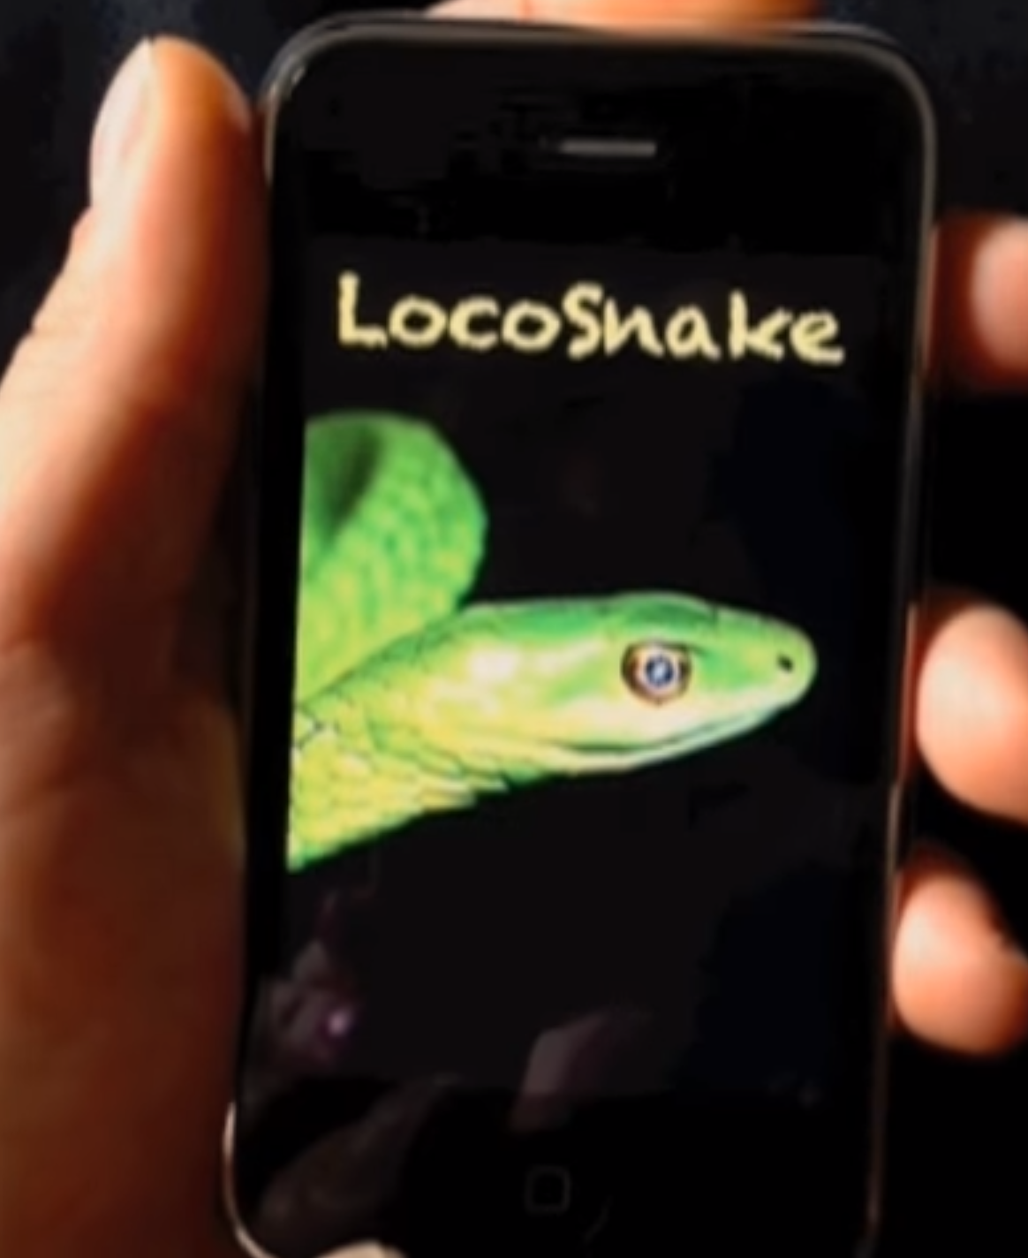

Slide 37
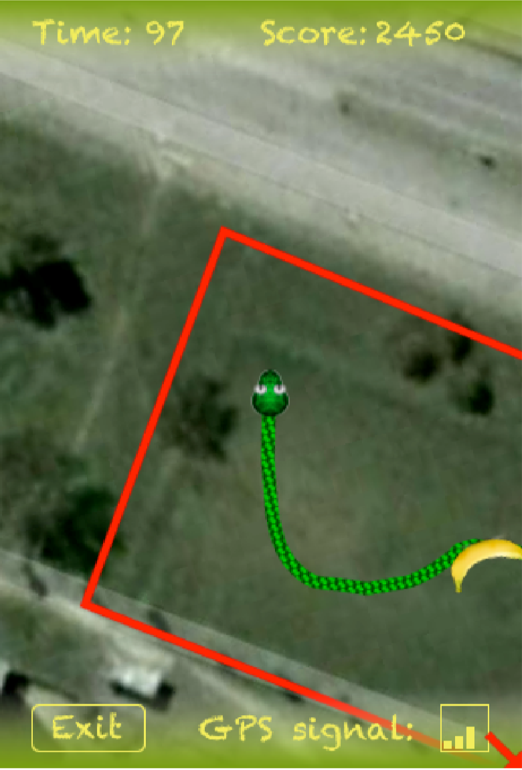
LocoSnake: THE AIM
Engage players in moderate physical activity
Measure players enjoyment and attitude in relation with their lifestyle concerning physical activity

Slide 38
LocoSnake: THE GAME
Detects player's position and retrieves the satellite photograph of the area
Player controls the snake: where player walks, snake follows
When fruit is eaten: Vibration and sound effects, snake tongue animation, tail grows

Slide 39
LocoSnake: RESEARCH
Two scenes:
Walking with LocoSnake 5 min
Walking without LocoSnake 5 min
Testers:
15 (14 male, 1 female)
Computer scientists and mathematicians
Aged 22-39
Previous video game usage: 14 do not play mobile exergames

Slide 40
LocoSnake: RESEARCH MEASUREMENT
ENJOYMENT: Player Enjoyment Scale (PES)
ATTITUDE: Physical Activity Enjoyment Scale (PACES)
EXHAUSTION: Borg’s Rating of Perceived Exertion (RPE)
LIFESTYLE: Global Physical Activity Questionnaire (GPAQ)
Walking speed (by using GPS)

Slide 41
LocoSnake: HYPOTHESIS
People with sedentary lifestyle would respond better than already physically active people in terms of both enjoyment and attitude change

Slide 42
LocoSnake: RESULTS
Is LocoSnake enjoyable?
Generally enjoyed
Does the exergame affect attitudes towards physical activity?
For people with more sedentary lifestyles: yes
Relation between enjoyment and effect on attitude
Players who enjoyed game more, had bigger difference in attitude change as well
Active people: focusing on game made walking less pleasant
In addition:
Exhaustion level estimated higher when playing game
Walking speed slightly faster when playing game

Slide 43
LocoSnake: LIMITATIONS AND FUTURE
LIMITATIONS
No evaluation of long term effects
All but one testers male, all testers from science department (homogeneous group)
FUTURE
Multiplayer features with multiple snakes competing on same field
Automatic diary: to record distance walked during game sessions
User: Self-monitoring
Experimenter: Analyzing changes in users behavior

Slide 44
Conclusion

Slide 45
Updating classic games into exergames by adding AR/VR/Location-based features
= Recipe for success?

Slide 46
Fun, proven concepts to work
Familiar, easy to understand, optimal learning curve

Slide 47
CONCLUSION
Exergames make sports more fun for people who do not like sports otherwise
May improve attitude towards physical activity
There is plenty different types of games to choose from
Designing and implementing a location-based exergame is fairly simple: great tools exist, ideas are simple

Slide 48
THANK YOU!

Slide 50
LocoSnake: OPEN QUESTION RESULTS
What you liked about LocoSnake?
Link between game and real world
Feedback provided by game
What you did not like?
GPS related problems
Did you experience difficulties during game?
Snakes ability to follow
How would you like to see it improved?
Position accuracy

