Slide 1
Geometry-Based Image Retrieval in Binary Image Databases
Naif Alajlan, Mohamed S. Kamel, Fellow, IEEE, and George H. Freeman
IEEE TRANSACTIONS ON PATTERN ANALYSIS AND MACHINE INTELLIGENCE, VOL. 30, NO. 6, JUNE 2008
Jarmo Koponen

Slide 2
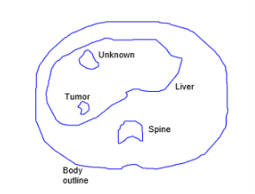
Introduction
Imaging technology advances rapidly, producing large amounts of images

Slide 3
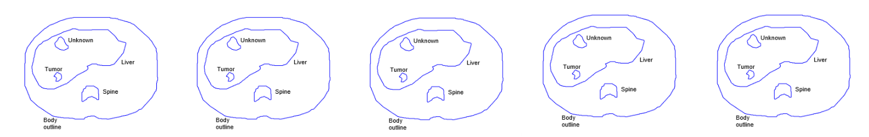
In large image datasets, textual annotation has become impractical and inefficient for multiobject images
Problem

Slide 4
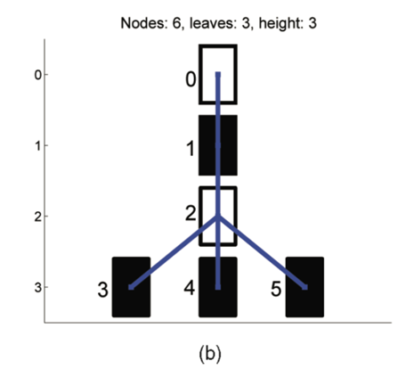
Proposed solution
Curvature Tree ->
Structural representation of multiobject image

Slide 5
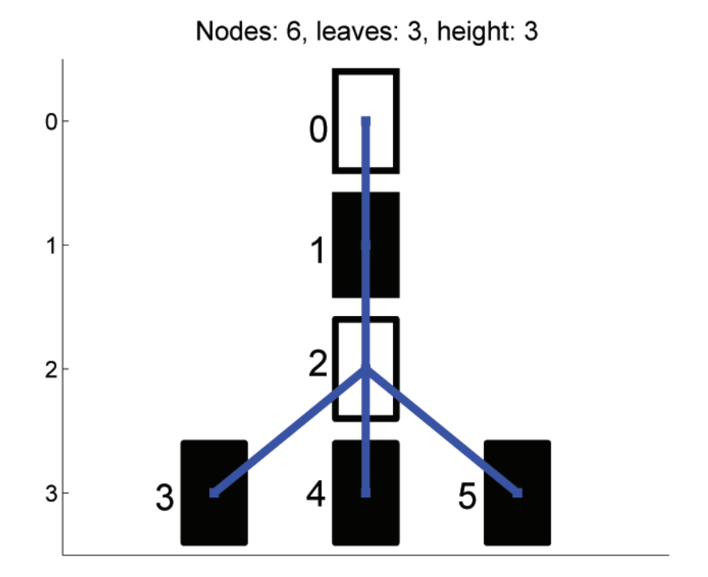
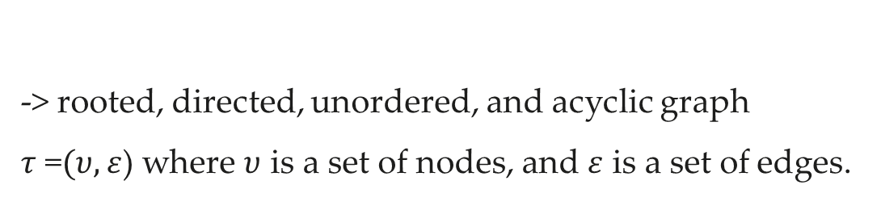


Curvature Tree (CT)
-> rooted, directed, unordered, and acyclic graph
$τ$ =$(υ,ε$) where $υ$ is a set of nodes, and $ε$ is a set of edges.
$ε$
$υ$

Slide 6
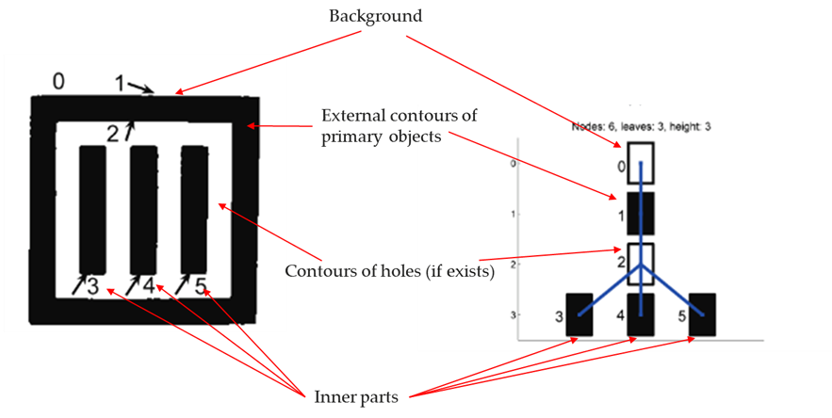
Curvature Tree hierarchy
Each node contains details of corresponding level, objects and holes shapes

Slide 7
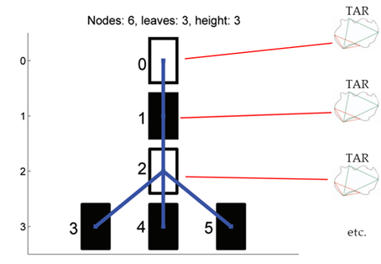
Triangle Area Representation (TAR)
Each objects shape is measured by boundary points
+ stored CT’s corresponding node

Slide 8
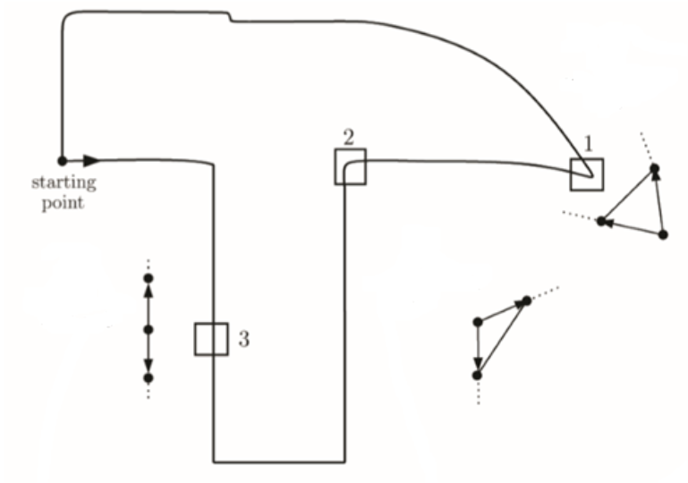
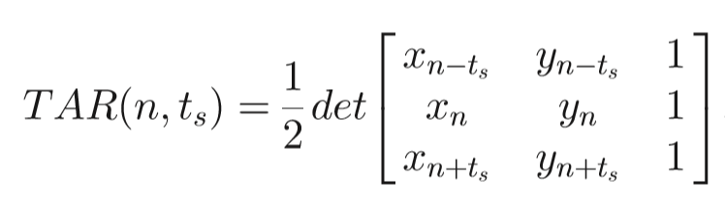


TAR- shapes boundary points measuring
For each three concecutive points ($x_{n−t_{s}},$ $y_{n−t_{s}}){(x}_{n},$ $y_{n}), (x_{n+t_{s}}, x_{n+t_{s}}$),
The (signed) Area of Triangle Formed by them is:
where det is the
matrix determinant.
n ϵ $\left\langle 1,\right.\left.N\right\rangle$ -contour points
ts ϵ $\left\langle 1\right.$, $\left.\text{Ts}\right\rangle$ - triangle side length

Slide 9
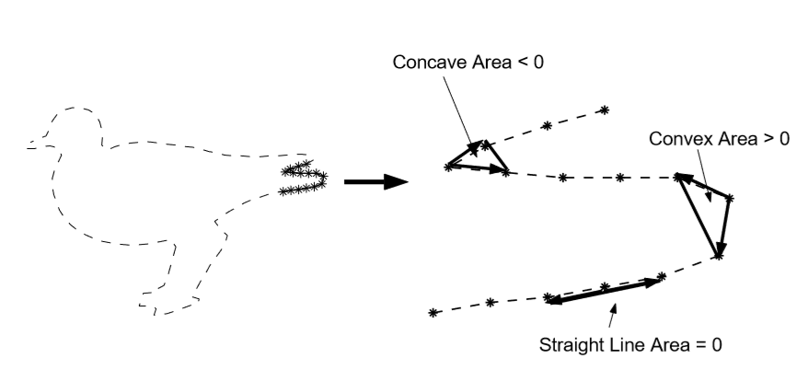
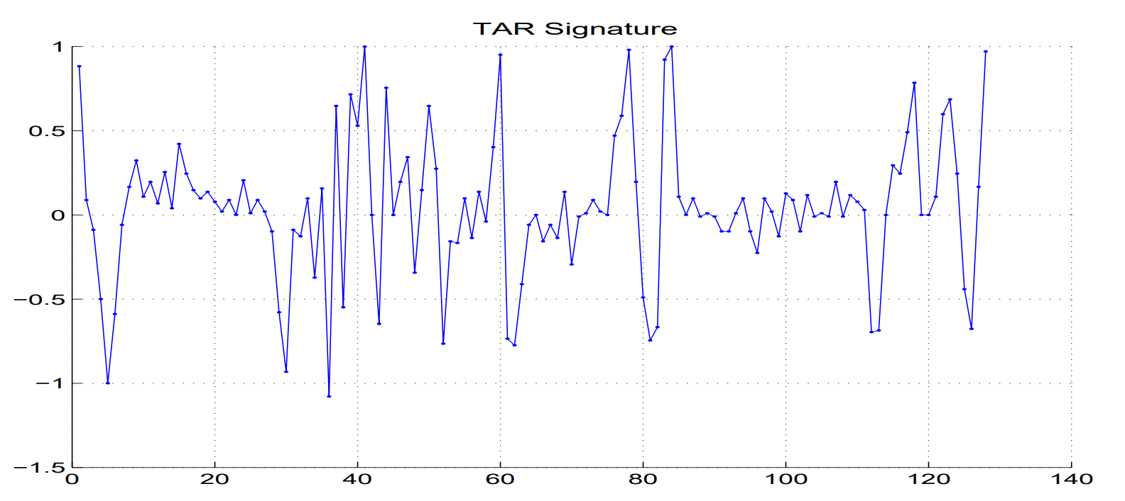
TAR – contour shape measuring
When the contour is travesed in counterclockwise direction
Positive values - convex area
Negative values - concave area
Zero values - straight line area
1)
Triangle-area values
Y axis, triangle side lenght
X axis, contour points locations
1) El rube, Ibrahim & Alajlan, Naif & Kamel, Mohamed S. & Ahmed, Maher & H.freeman, George. (2006). Mtar: a Robust 2d Shape Representation.. International Journal of Image and Graphics. 06. 10.1142/S021946780600232X.

Slide 10
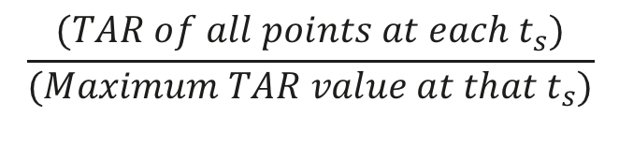
TAR- normalization
Large object size - high TAR values
Normalization ensures equal contribution of TAR signatures
$$\frac{(TAR of all points at each t_{s})}{(Maximum TAR value at that{ t}_{s})}$$

Slide 11
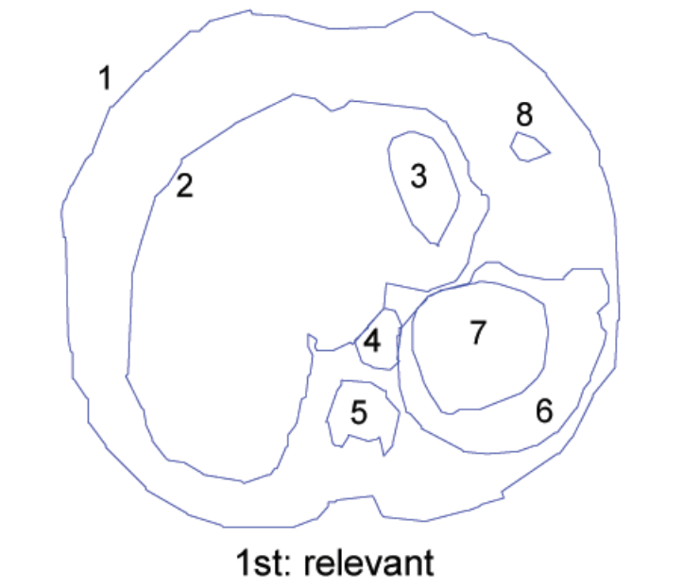
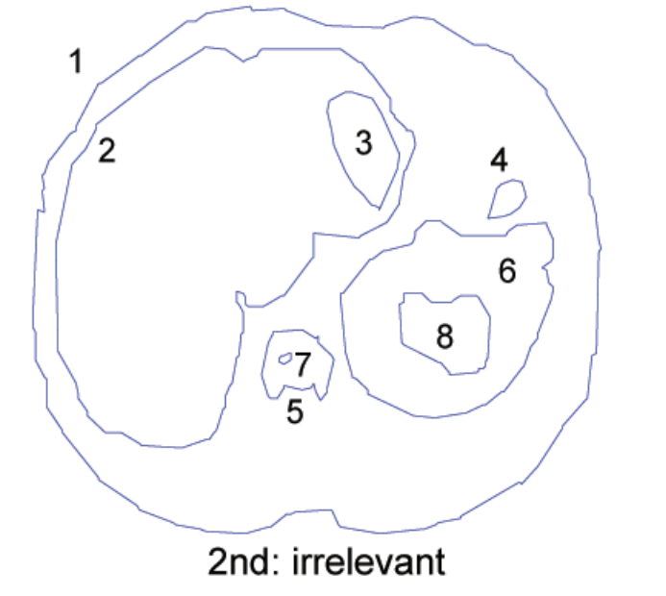
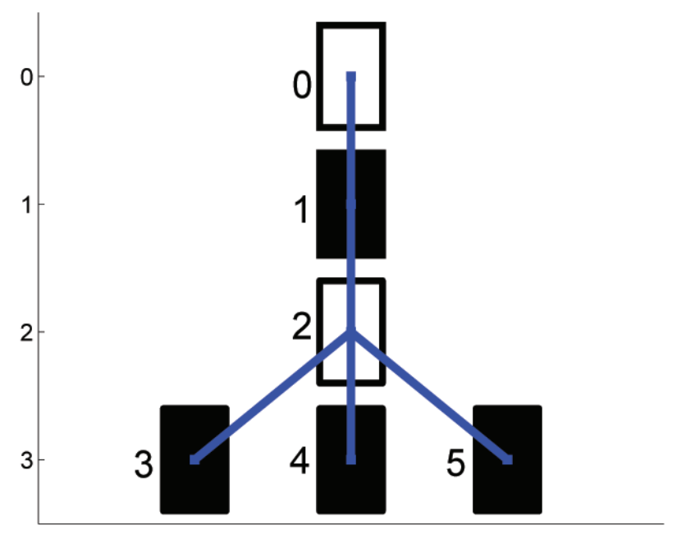

Similarity in psychology
Similarity should follow one-to-one correspondence between stucutred representations of two images
Paper propose similarity function based on Maximum Subtree Similarity Isomorphisms between Two CT’s.

Slide 12
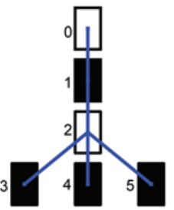
Similarity Function
T1= (V1, ε1, σ1)
T2= (V2, ε2, σ2)
T1= (V1, ε1, σ1)
T2= (V2, ε2, σ2)
Proposed apporach - Similarity between CT’s measured based on the MSSI
-> select the one yielding the maximum similarity
Isomorphism ensures:
Similar nodes are paired
MSSI must include at least one root node of two trees -> number of it’s candiadats reduced to n+m

Slide 13
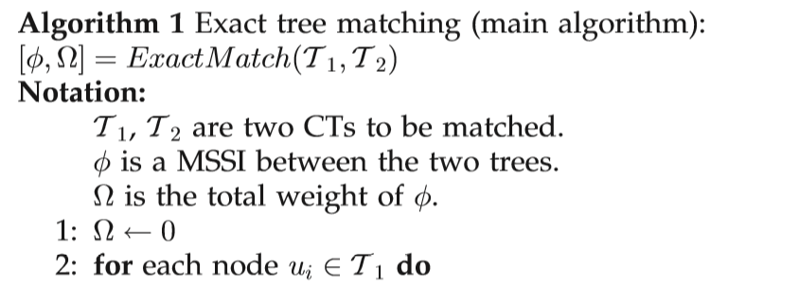
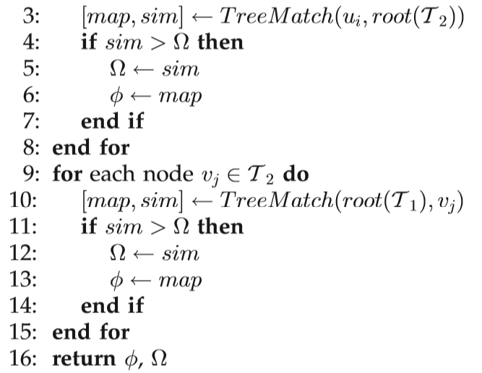
Algorithm 1 -MSSI solving
For searching all possible isomorphisms
Input: Two Curvature Trees
Examines all subtree isomorphism between
one CT all nodes <- > another CT’s root node
and vice versa
Output: Maximum Subtree Similarity Isomorphism
along its weight

Slide 14
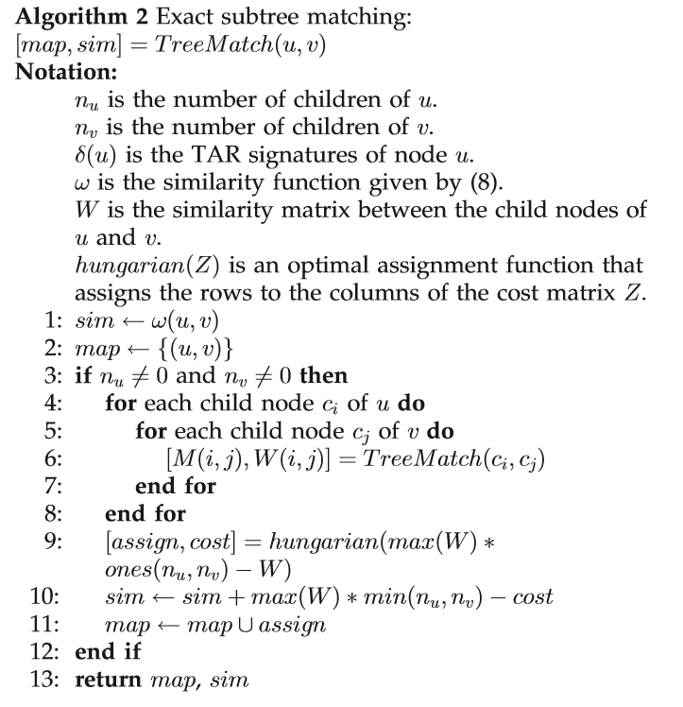
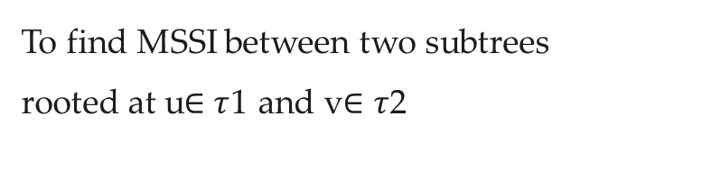
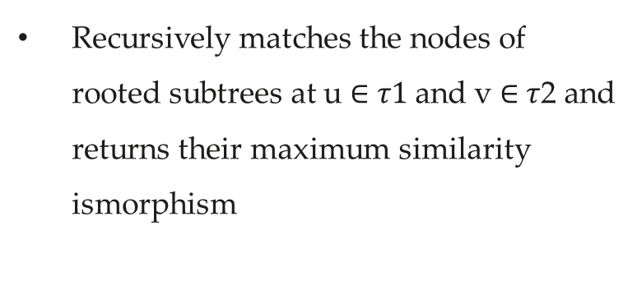
Algorithm 2 - MSSI solving
To find MSSI between two subtrees
rooted at u$∈τ$1 and v$∈τ$2
Recursively matches the nodes of
rooted subtrees at u $∈$ $τ1$and v $∈$ $τ$2 and
returns their maximum similarity
ismorphism

Slide 15
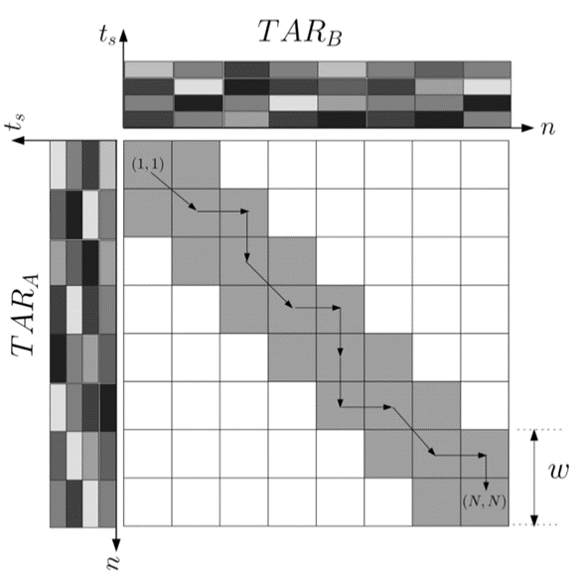



Dynamic Space Warping (DSW)
Dynamic matching method for TAR based similarity function calculation
between two nodes
Distance Table (DT) used to find (calculate) Optimal Correspondence between the points of two boundaries
TAR
Notes:
Dynamic space warping algorithm it measures similarityof two nodes based on their TAR values.
Distance Table is to constructed to find optimal correspondence between the points of two boundaries

Slide 16

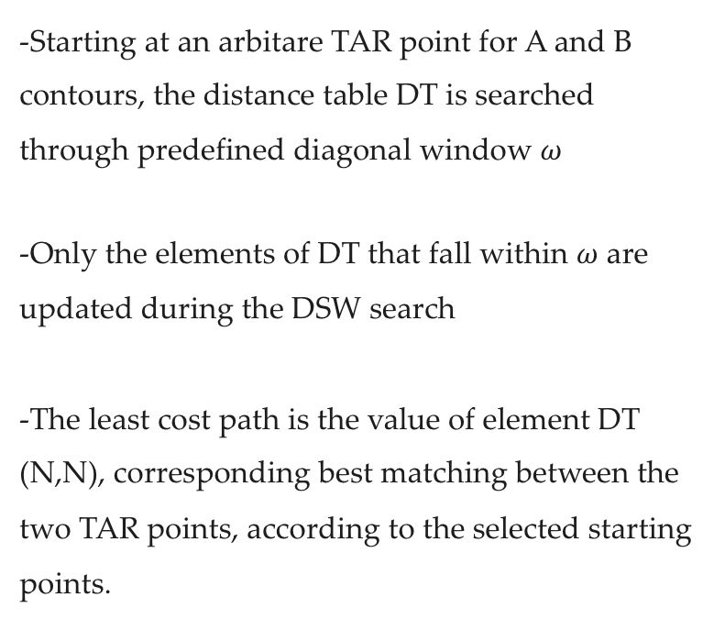
DSW - Distance Table working principle
-Starting at an arbitare TAR point for A and B contours, the distance table DT is searched through predefined diagonal window $ω$
-Only the elements of DT that fall within $ω$ are updated during the DSW search
-The least cost path is the value of element DT (N,N), corresponding best matching between the two TAR points, according to the selected starting points.

Slide 17
Computational Complexity
Complexity of each stage is evaluated separately:
  Image query
  Curvatre Trees Matching (more critical)
  Images retrieval from database (can be calculated prior matching)

Slide 18
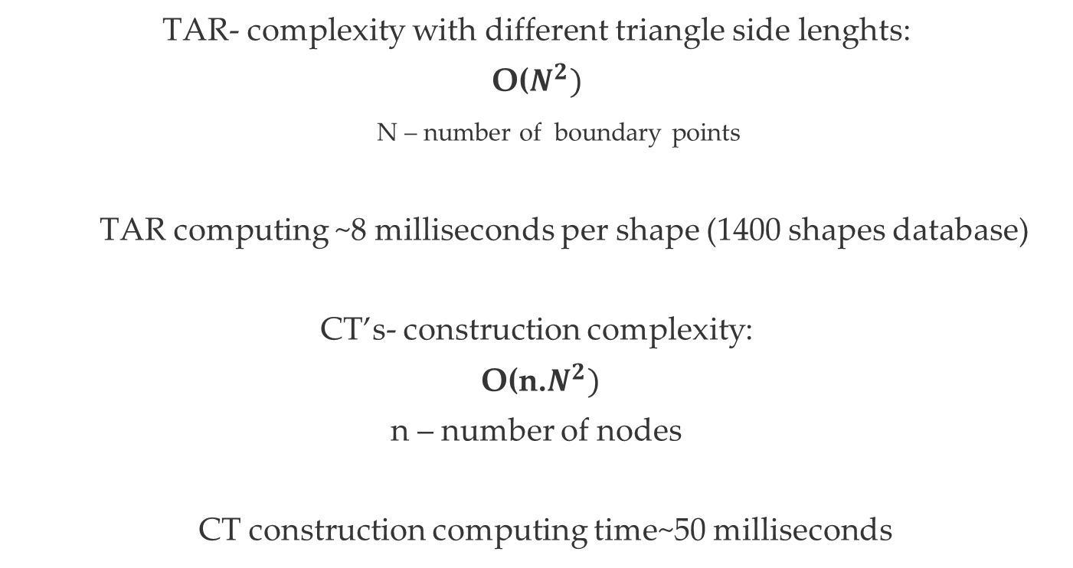
Computational Complexity
TAR- complexity with different triangle side lenghts:
O($N^{2})$
N – number of boundary points
TAR computing ~8 milliseconds per shape (1400 shapes database)
CT’s- construction complexity:
O(n.$N^{2})$
n – number of nodes
CT construction computing time~50 milliseconds

Slide 19
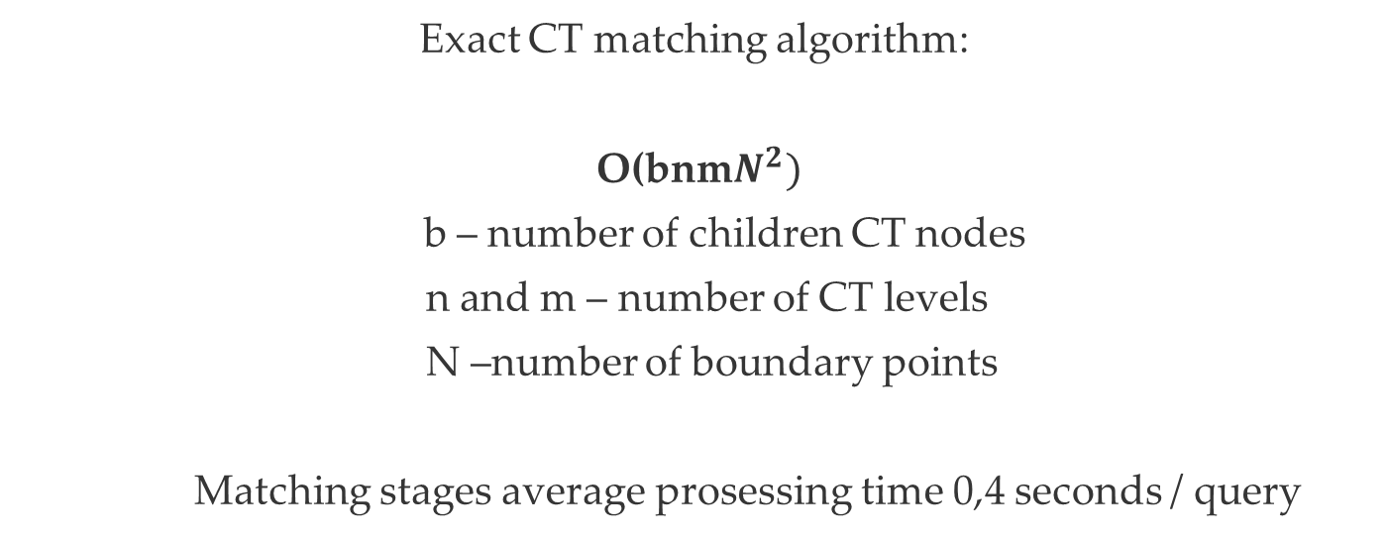
Computational Complexity
Exact CT matching algorithm:
O(bnm$N^{2})$
b – number of children CT nodes
n and m – number of CT levels
N –number of boundary points
Matching stages average prosessing time 0,4 seconds / query

Slide 20
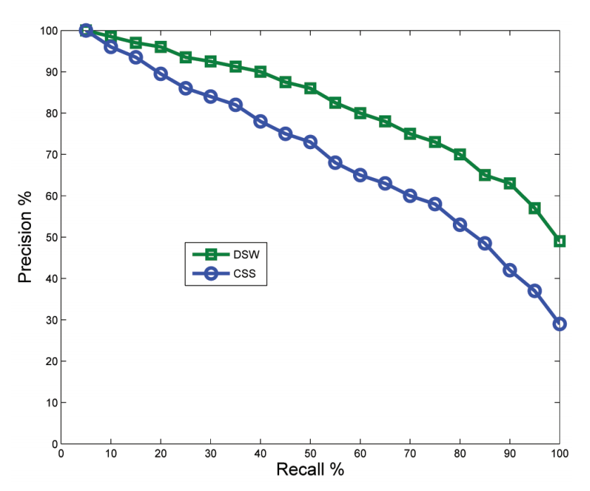

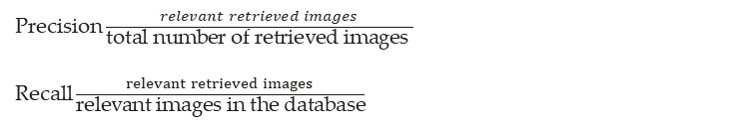
Proposed system experimental results
1st test: Shape retrieval; each shape used as a query - number of correct matches then counted in the first 40 retrieved images
best
1400 shapes database - semantically
classified into 70 classes

Slide 21
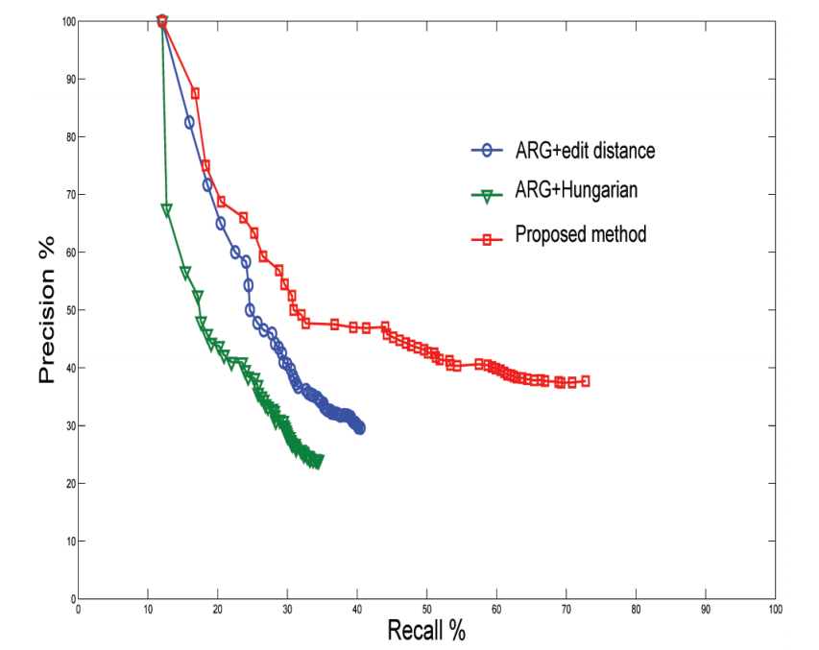
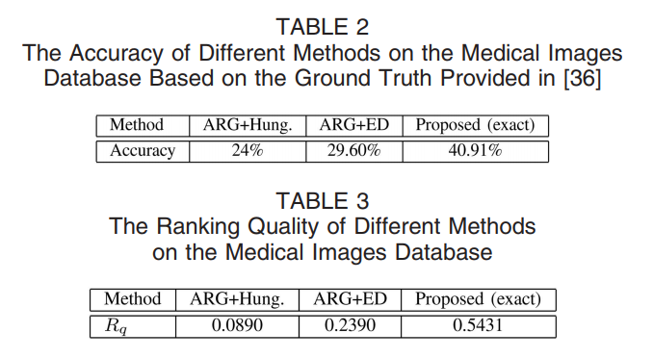
Proposed system experimental results
Retrieval test, 20 query images for each query, system retrieves
best 50 matches out of the 13 500 database images
-> number of relevant and irrelevant images are counted -> accuracy of each query is computed
#1
Notes:
Ranking quality measures the goodness of the retrieval ranking, that is, the method retrieves relevant images before the irrelevant images.
The higher the value of Rq, the better the ranking quality of a method, and vice versa. Note that Rq is independent from the accuracy. Rq is computed as follows:
Each retrieved image is assigned a rank number according to its order and judged as relevant or irrelevant with respect to the query image.
Pairs of the retrieved images are taken such that each pair contains a relevant and irrelevant images, and the relevant one is first, and the irrelevant is second.
Let Sþ be the number of pairs with the relevant image’s ranking better than the ranking of the irrelevant image, S is the number of pairs with the irrelevant image’s ranking better, and S ¼ SþþS. Rq is computed as

Slide 22
Other methods from experimental results

Slide 23
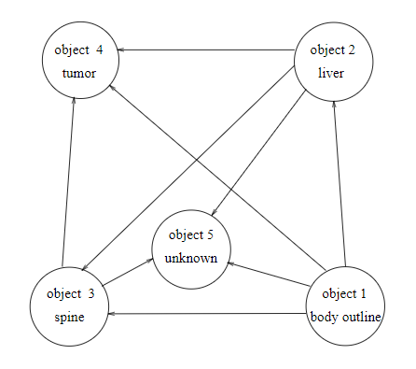
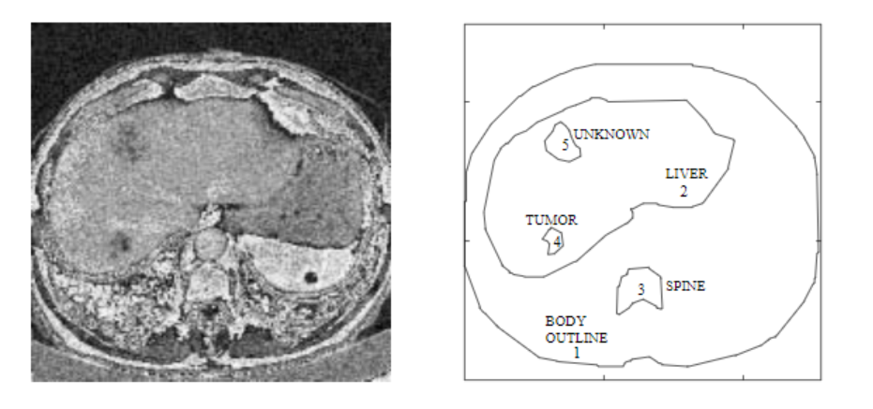
Attributed Relational Graphs (ARG) for images retrieval
Objects or regions are represented as graph nodes -> their relationships are represented by arcs
Image matching is treated as an error-correction ARG matching problem
ARG method has exponential time and space complexity
Petrakis, E.: Design and evaluation of spatial similarity approaches for image retrieval. Image and Vision Computing 20, 59-76
October 2001Image and Vision Computing 20(1):59-76
DOI: 10.1016/S0262-8856(01)00077-4

Slide 24
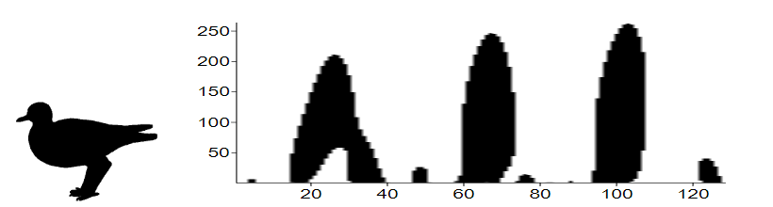
Curvature scale space (CSS) –shape descriptor
best-known estimator
Combines different algorithms / algorithm ensemble
-limited to concave segments
-it failures to discriminate a shallow concavity from a deep ones
-totally convex shapes like squares and triangles have the same CSS image - which is only the background
-requires a large number of scales to obtain the CSS image (may exceed 200)
Scales
Source: Mtar: a Robust 2d Shape Representation.. Available from: https://www.researchgate.net/publication/263874369_Mtar_a_Robust_2d_Shape_Representation [accessed Feb 17 2019].

Slide 25
Conclusions
matching of two CTs is formulated as a maximum similarity subtree isomorphism (MSSI) problem
matching algorithm is developed, which works in polynomial time and guarantees finding an exact solution to the MSSI problem
methods accuracy > 11,3% better than others + shape retrieval tests shows 6% better results than CSS- method *
*(Database of 13500 images and 1400 shapes)

Slide 26

Question
uef.fi

Slide 27
Thank You!!
uef.fi

