Slide 1
Detection of Anomalous Taxi Trajectories from GPS Traces
Jiawei Yang
2019.02.20

Slide 2
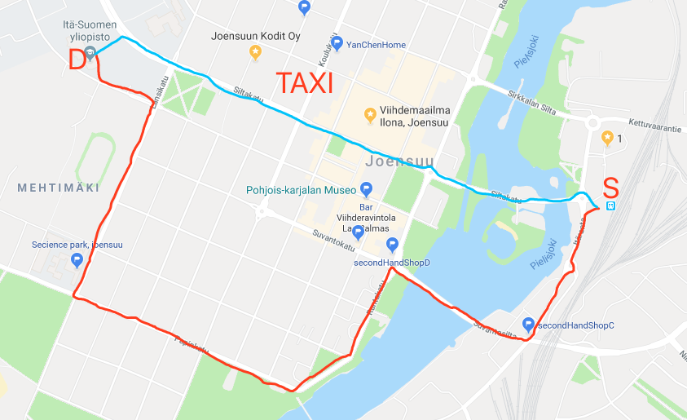
Application
Automatically detect taxi driving frauds
Road network change in modern cites

Slide 3
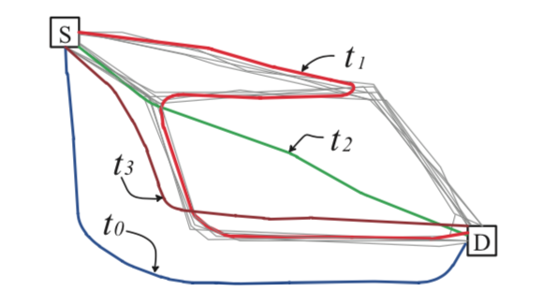
How to define “anomaly”?
Distance: fails on t2
Density: fails on t1
“few” and “different”

Slide 4
Methods: iBAT [1] versus iBOAT [2]
Different:
iBAT detects anomalous trace after taxi arrives at the destination.
iBOAT detects anomalous trace both before and after taxi arrives at the destination.
Common: both calculate anomaly score for each trace
[1] Daqing Zhang, Nan Li, Zhi-Hua Zhou, Chao Chen, Lin Sun, and Shijian Li, iBAT: detecting anomalous taxi trajectories from GPS traces. In Proceedings of the 13th international conference on Ubiquitous computing (UbiComp '11), 99-108, 2011
[2] Chao Chen, Daqing Zhang, Pablo Samuel Castro, Nan Li, Lin Sun, Shijian Li, Real-Time Detection of Anomalous Taxi Trajectories from GPS Traces, International Conference on Mobile and Ubiquitous Systems: Computing, Networking, and Services, 63-74, 2011

Slide 5
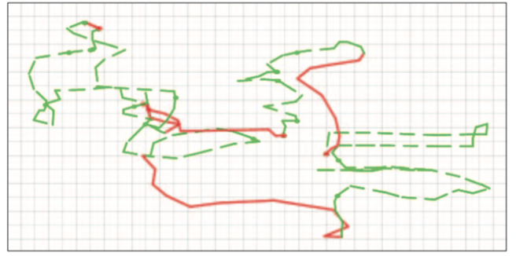
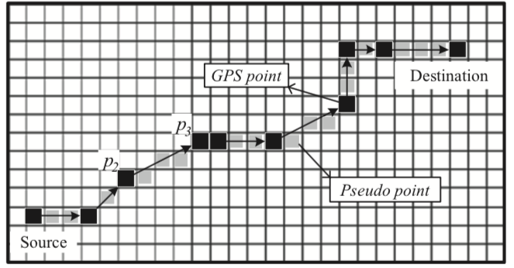
Preprocess GPS data
To equally represent taxi trajectories in the system
One taxi’s GPS trace in two hours
Augment trajectory
GPS point:
[latitude, longitude, time, status]
City map -> grid-cells of equal size.
Insert gray cells between GPS points.
status : vacant or occupied
t: p₀ -> … -> p₂ -> p₃-> …-> p_{n}
t: p₀ -> ... -> p₂ -> g₁ -> g₂ -> g₃ -> p₃-> … -> p_{n}

Slide 6
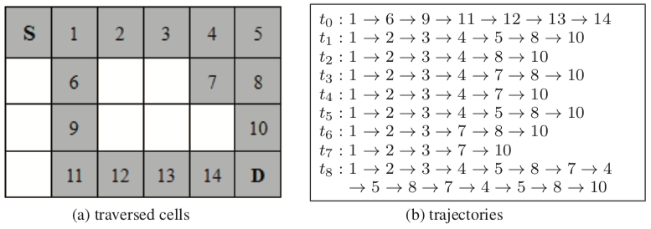
Preprocessed GPS data
Trace set: T= {t₀, t₁, t₂, t₃, t₄, t₅, t₆, t₇, t₈}
Trajectory set: P = {p₁, p₂, p₃, p₄, p₅, p₆, p₇, p₈, p₉, p₁₀, p₁₁, p₁₂, p₁₃, p₁₄}

Slide 7
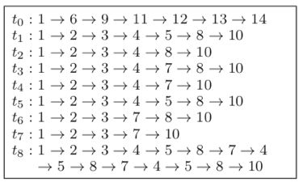
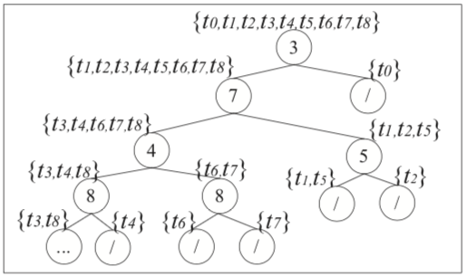
Idea of iBAT
hasTrajectory( T, p_{j} ); p_{j} $∈t$_{i}
Path length n(t):
t₀ : 1
t₈ : 2
t₃ : >4
Anomaly score: s(t, N)=$2^{−\frac{E(n(t))}{c(N)}}$
C(N)=2ln(N-1)+ 0.57721566 -2(N-1)/N

Slide 8
iBAT to iBOAT
iBAT
hasTrajectory( T, p_{j} ) ; p_{j} $∈t$_{i}
iBOAT
$$\text{hasTrajector}\text{ies}\text{(}\text{T}\text{i} \text{, <}\text{p}\text{a}\text{, }\text{p}\text{b}\text{, }\text{p}\text{c}\text{>}\text{)}$$
$$\text{hasTrajector}\text{ies}\text{(}\text{T}\text{, <}\text{p}\text{a}\text{, }\text{p}\text{b}\text{, }\text{p}\text{c}\text{>}\text{)},\text{p}\text{a}\text{, }\text{p}\text{b}\text{, }\text{p}\text{c} ∈t$$

Slide 9
Idea of iBOAT : fix k window
$$support=\frac{\text{|}\text{hasTrajectories}\text{(}\text{T}\text{, <}\text{p}\text{a}\text{, }\text{p}\text{b}\text{, }\text{p}\text{c}\text{>}\text{)}|}{|T|};\text{p}\text{a}\text{, }\text{p}\text{b}\text{, }\text{p}\text{c} ∈t$$
$\text{Ongoing} \text{trace} t$:$\{ , , , , , …\}$
$$p1$$
$$p2$$
$$p3$$
$$p11$$
$$p5$$
>$θ$
<$θ$
Anomalous trajectories: {$p2 ,p3,p11$}
Anomaly score:
s(t) =$distance\left(p1 ,p2\right)+distance\left(p2 ,p3\right)+distance\left(p3 ,p11\right)$

Slide 10
Idea of iBOAT : adaptive window
$$support=\frac{\text{|}\text{hasTrajectories}\text{(}\text{T}\text{i}\text{-1 }\text{, <}\text{p}\text{a}\text{, }\text{p}\text{b}\text{, }\text{p}\text{c}\text{>}\text{)}|}{|\text{T}\text{i}\text{−1}|};\text{p}\text{a}\text{, }\text{p}\text{b}\text{, }\text{p}\text{c} ∈t$$
$$\text{T}\text{i}\text{+1}=\left\{\begin{aligned}\text{T}\text{i}\text{，}\text{if} \text{p}\text{i}\text{+1 }\text{is} \text{a}nomlous trajactory \\ \text{hasTrajectories}\text{(}\text{T}\text{0}\text{, <}\text{p}\text{a}\text{, }\text{p}\text{b}\text{, }\text{p}\text{c}\text{>}\text{)}, otherwise\end{aligned}\right.$$
Ongoing trace$t$:$\{ , , , , , …\}$
$$p6$$
$$p2$$
$$p3$$
$$p4$$
$$p5$$
$$\text{T}\text{0}$$
$$\text{T}\text{0}$$
$$\text{T}\text{1}$$
<$θ$
>$θ$
>$θ$
$$\text{T}\text{1}\text{=}\text{hasTrajector}\text{ies}\text{(}\text{T}\text{0}\text{, <}\text{p}\text{2}\text{, }\text{p}\text{3}\text{, }\text{p}\text{4}\text{>}\text{)},$$
Anomalous trajectories: {$p6 ,p2,p3$}
Anomaly score:
s(t) =$distance\left(p6 ,p2\right)+distance\left(p2 ,p3\right)$

Slide 11
Experiment: data sets
7600 taxis in Hangzhou, China
Sample rate= entry/minutes
Collected over a period of twelve months
Focused range: [120.0◦E, 120.5◦E] and [30.15◦N, 30.40◦N],
Each grid cell is roughly 250 $m^{2}$
Picked 9 source-destination pairs (T-1 toT-9) (trajectories : min 450, avg. 1000)
Three volunteers to manually label whether trajectories are anomalous or not (avg. 5.1%)

Slide 12
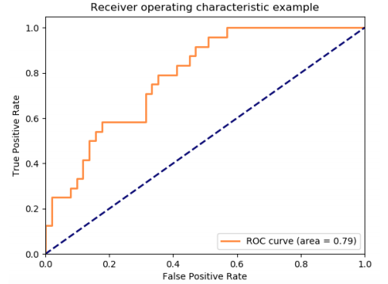
Experiment: ROC measurement
TPR=$\frac{TP}{TP+FN}$
FPR=$\frac{FP}{FP+TN}$
ROC=1 indicates perfect prediction!

Slide 13
Experiment: Results

Slide 14
Conclusion: iBAT v.s. iBOAT
Equally good performance for tested data sets
iBOAT has two advantage over iBAT:
Able to work in real-time, does not require full trajectories as input.
Able to determine which parts of a trajectory are anomalous.

Slide 15
Thank you
Q&A

