Slide 1
LAMI presentation
Joonas Pussinen

Slide 2
Comparing maps with point matching
Hackeloeer, A., Klasing, K., Krisp, J.M. and Meng, L., 2015. Comparison of Point Matching Techniques for Road Network Matching. Uncertainty Modelling and Quality Control for Spatial Data, p.213.

Slide 3
Map matching
There are differences between maps
How to identify a point across different maps?
Map is a graph
Nodes = Intersections
Edges = Roads

Slide 4
Point matching
Are these the same intersection?
How to calculate similarity between points?
Geometrical matching: Euclidean distance

Slide 5
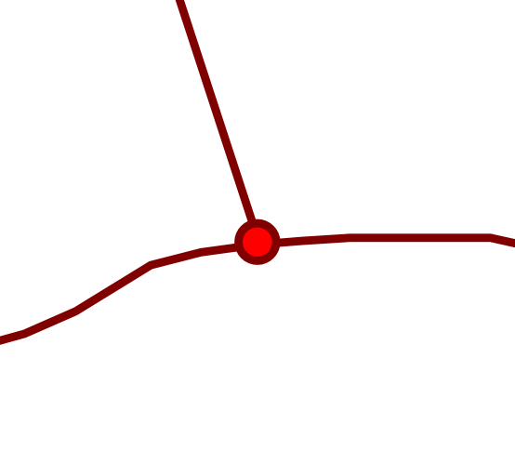
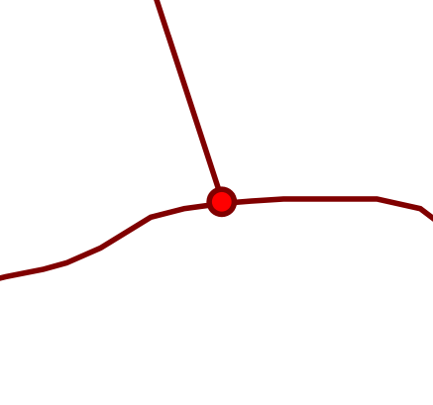
Topological point matching
2
3
1
Node valence
How many lines connect to a node?
Spider index
Check for lines in 8 sectors
Compare sectors between two points
Exact angular index (EAI)
Sum of minimum angles
Add 180° for each missing line
Combine with Euclidean for more accuracy
1
0
0
1
1
0
0
0
20°
5°
= 70°
45°

Slide 6
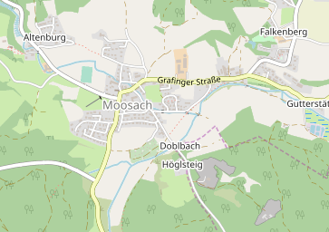
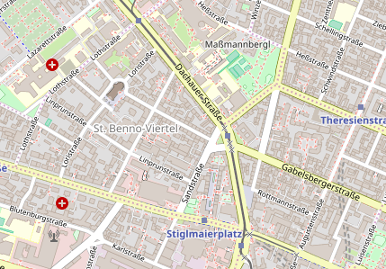
Evaluation
2 different locations, 2 map sources each
Ground truth matches
Number of correct matches
Number of false positives and false negatives
Moosach, Germany
Munich, Germany

Slide 7
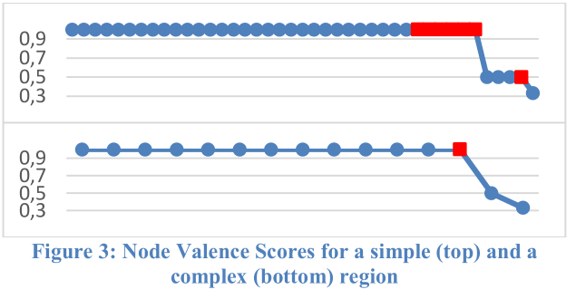
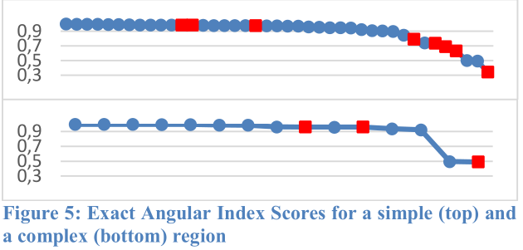
Results
Euclidean fairly poor method
Node valence has good accuracy, but is too coarse
EAI has good accuracy, and a threshold can be set
Adding distance to EAI lowers accuracy

Slide 8
Conclusion
Geometrical methods:
Not precise enough
Topological methods:
Accurate and precise
Can be combined with geometrical methods

Slide 9
Finding easy to drive routes
Krisp, J.M. and Keler, A., 2015. Car navigation–computing routes that avoid complicated crossings. International Journal of Geographical Information Science, 29(11), pp.1988-2000.

Slide 10
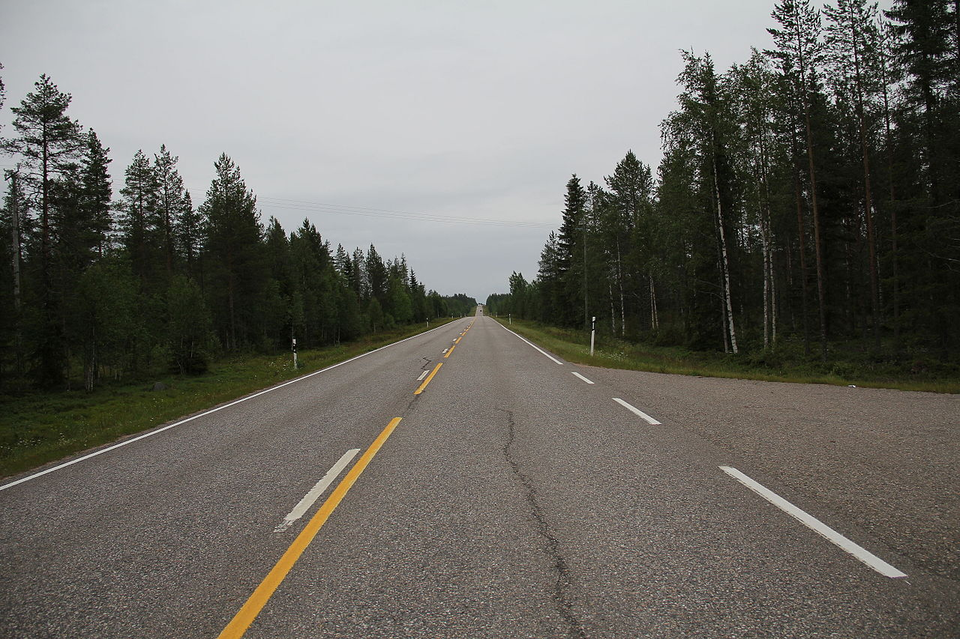
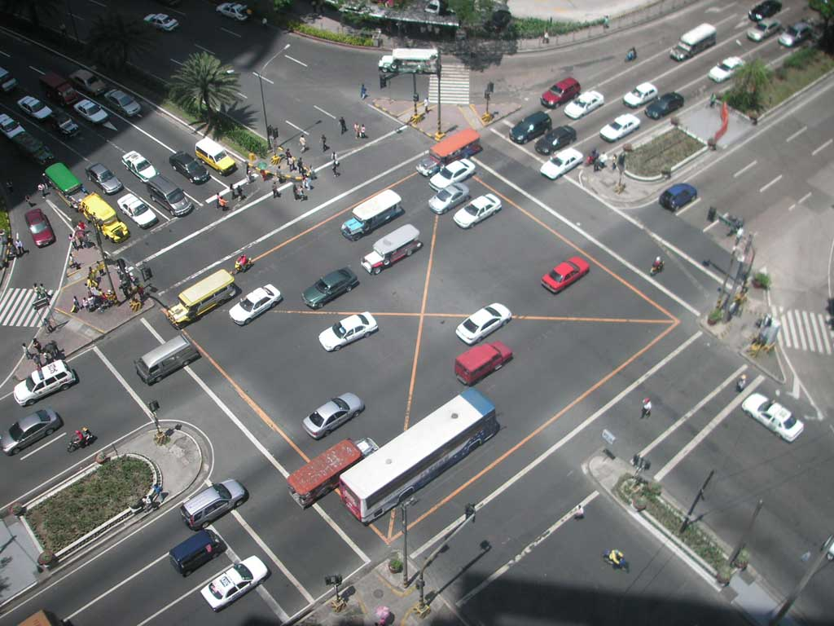
What is an easy route?
Most navigators find fast or short routes
What would an easy route be like?
Driving on the highway
Complicated crossings are hard
https://commons.wikimedia.org/wiki/File:Kantatie_78_Karhum%C3%A4ki_2.JPG
https://commons.wikimedia.org/wiki/File:Makati_intersection.jpg

Slide 11
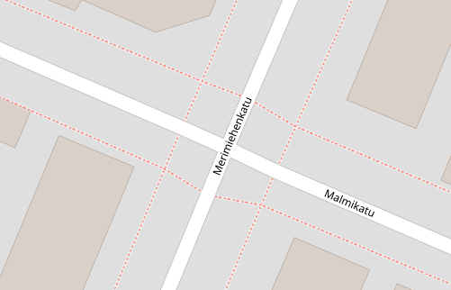
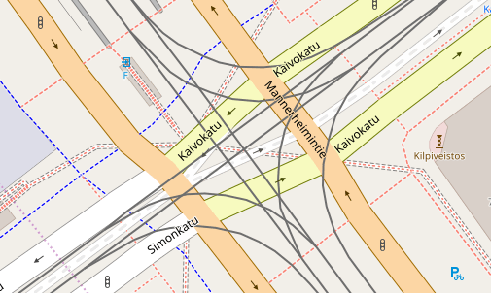
Finding complicated crossings
From OpenStreetMap data
Areas with high node density

Slide 12
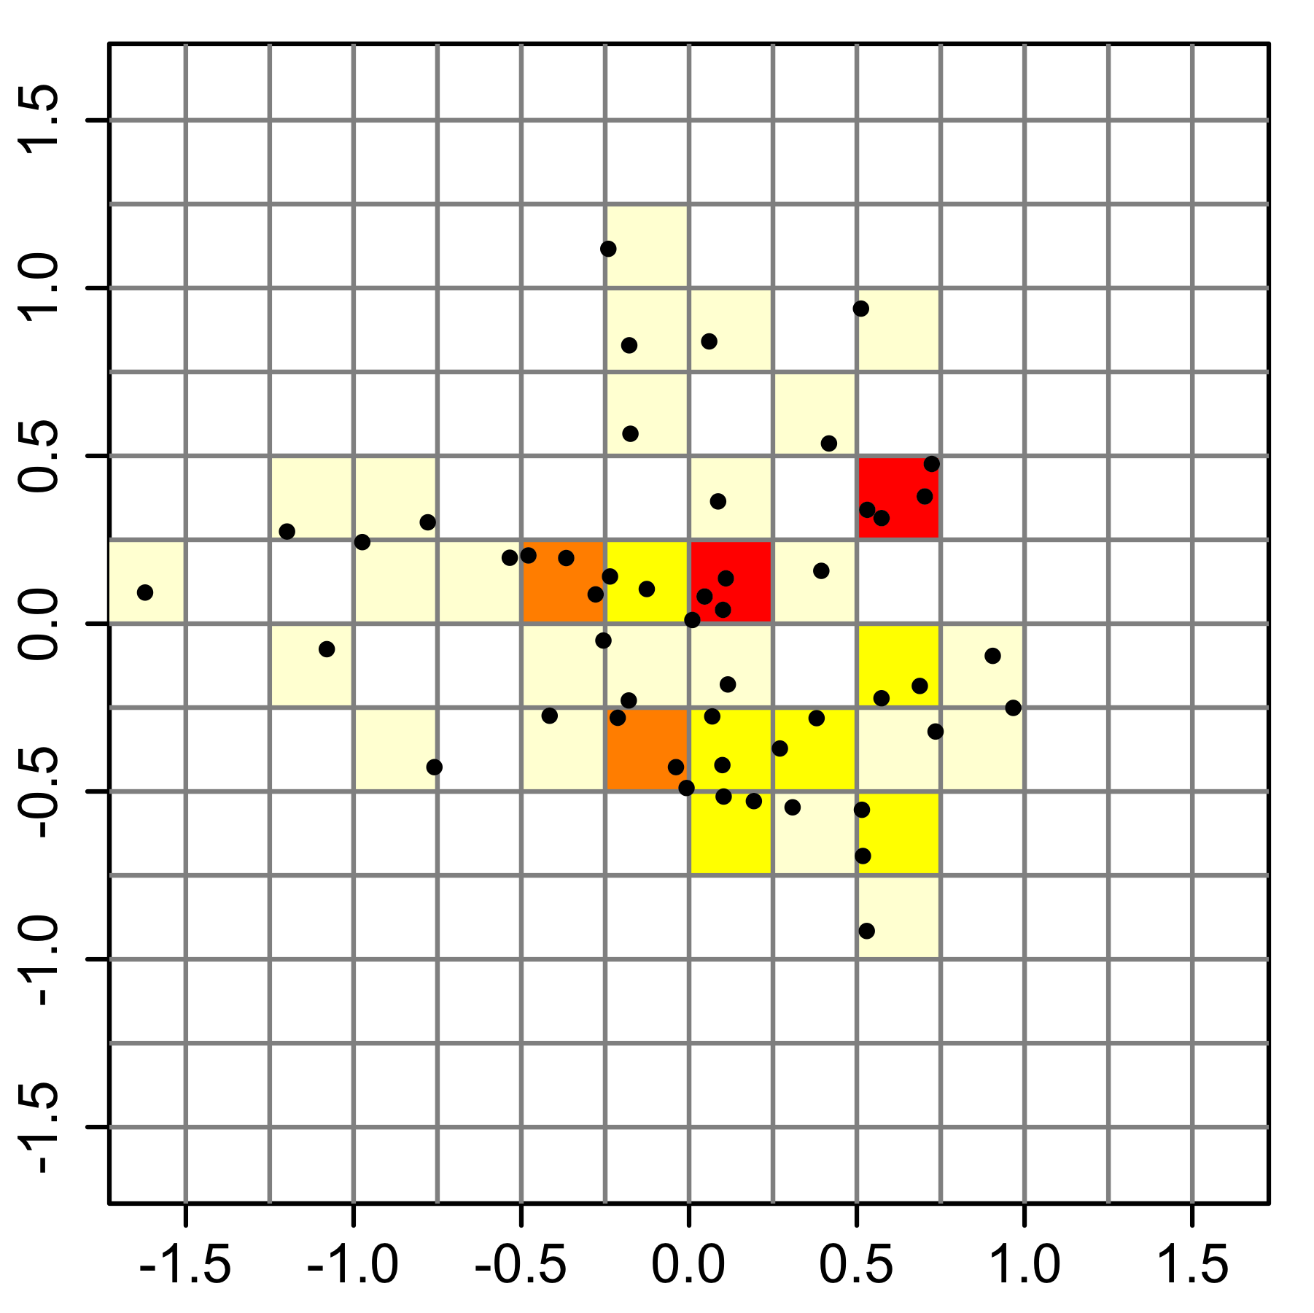
Estimating density
Kernel density estimation for nodes
Polygons around dense cells
https://commons.wikimedia.org/wiki/File:Synthetic_data_2D_histograms.png

Slide 13
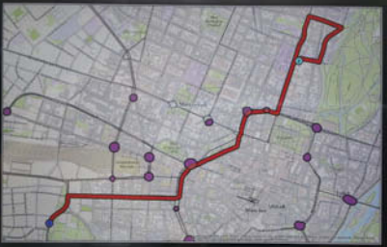
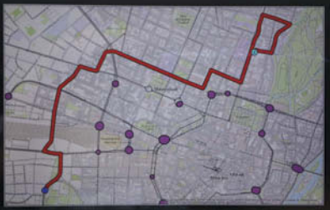
Results
Shortest route
Easiest route
Routes calculated with Dijkstra’s algorithm

Slide 14
Results
On average: 16.86% longer, 11 more turns

Slide 15
Conclusion
Finding easy to drive routes is possible
Many false positives
Requires more user testing

Slide 16
Thank you

Slide 17
Extra #1: Point matching scores
Euclidean distance
Calculating score from Node Valence
Calculating score from Euclidean distance
Calculating score from Spider Index

Slide 18
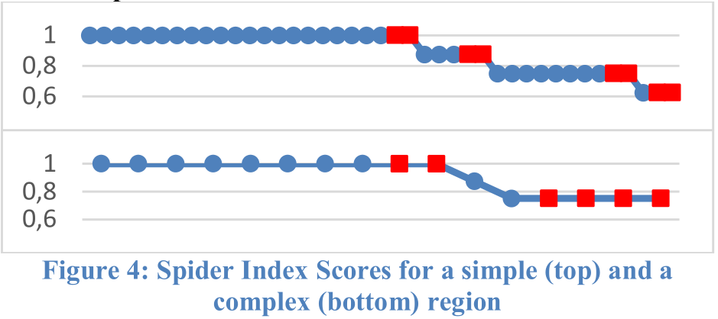
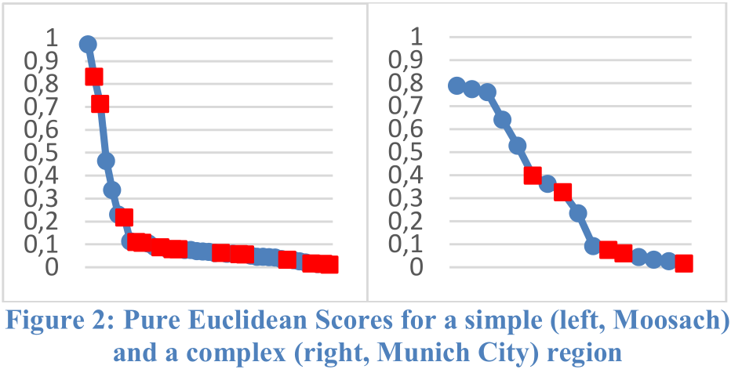
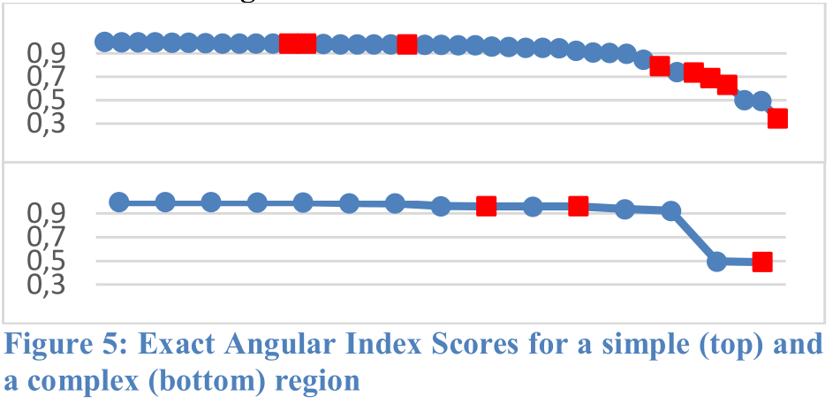
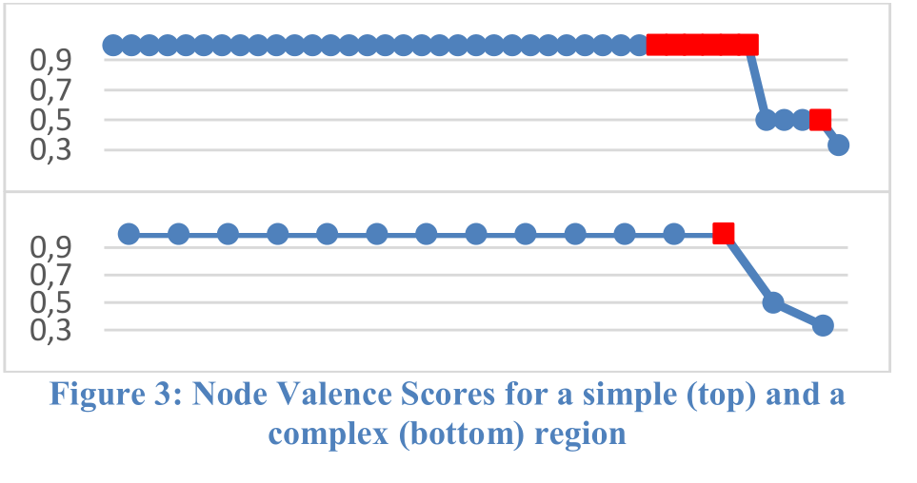
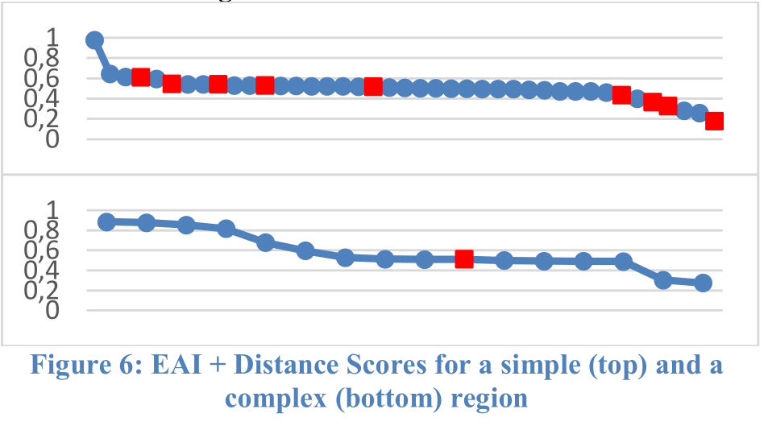
Extra #2: Point matching results

Slide 19
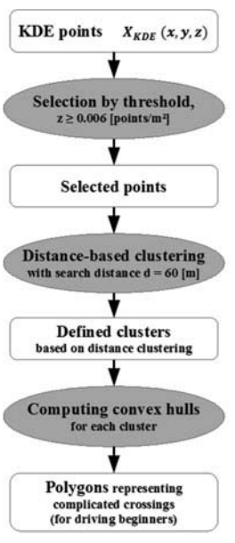
Extra #3: Generating polygons

