Slide 1
Augmented Invaders: A Mixed Reality Multiplayer Outdoor Game
Michael Benfort, Inga Lehne, Ralf Morawe, Melina Cahnbley, Gabriel Zachman, Johannes Schoning
Muhammad Hassan
300176

Slide 2
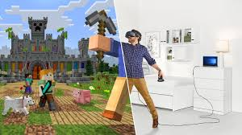
Augmented & Mixed Reality
Pokemon Go
Target Audience: Smart Phone Users
No external device
https://www.digitalartsonline.co.uk/news/hacking-maker/youll-soon-be-able-use-pokemon-gos-tech-make-your-own-ar-games-experiences/
Minecraft
Target Audience: Windows Machine
Headset & Motion Controller are needed
https://twitter.com/windows/status/934572413936955393

Slide 3
The Playroom VR (Japan Studios, 2013)
Multiplayer
Playstation VR
6 gaming modes
One HMD only
Ghosthouse (game mode)
https://www.playstation.com/en-gb/games/the-playroom-vr-ps4/

Slide 4
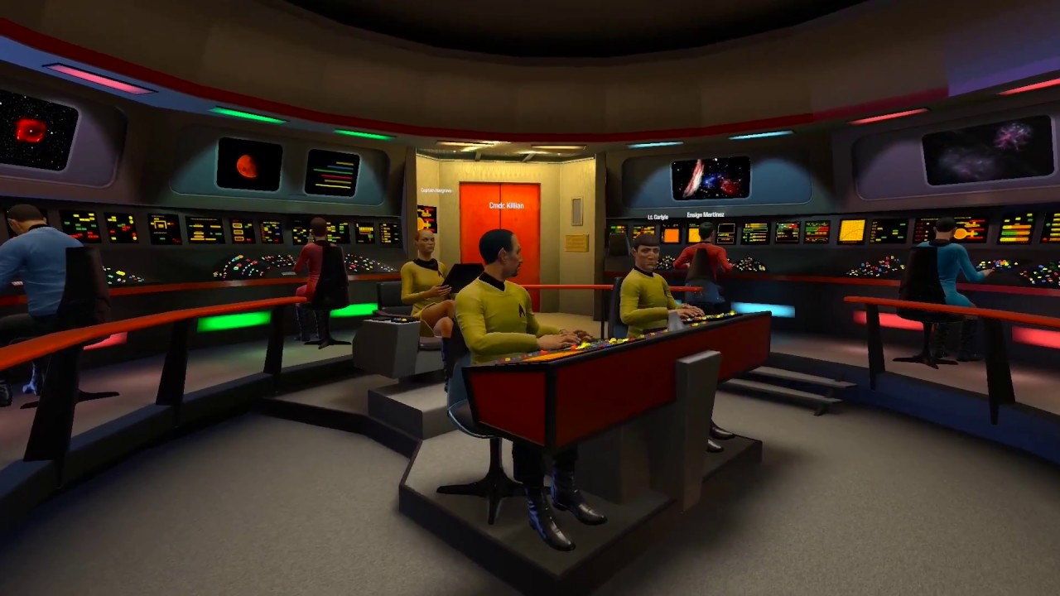
Star Trek: Bridge Crew (Red Storm Ent, 2017)
Multiplayer
Multi VR headsets
Physically at distant locations
Team game
https://www.youtube.com/watch?v=Vy4nfSwpNMA
https://www.androidcentral.com/you-can-be-captain-upcoming-vr-game-star-trek-bridge-crew

Slide 5
Sky Invaders
Multiplayer
Augmented Reality
Outdoor game
Additional hardware with several sensors
https://www.complex.com/pop-culture/2012/02/the-10-coolest-augmented-reality-apps/

Slide 6
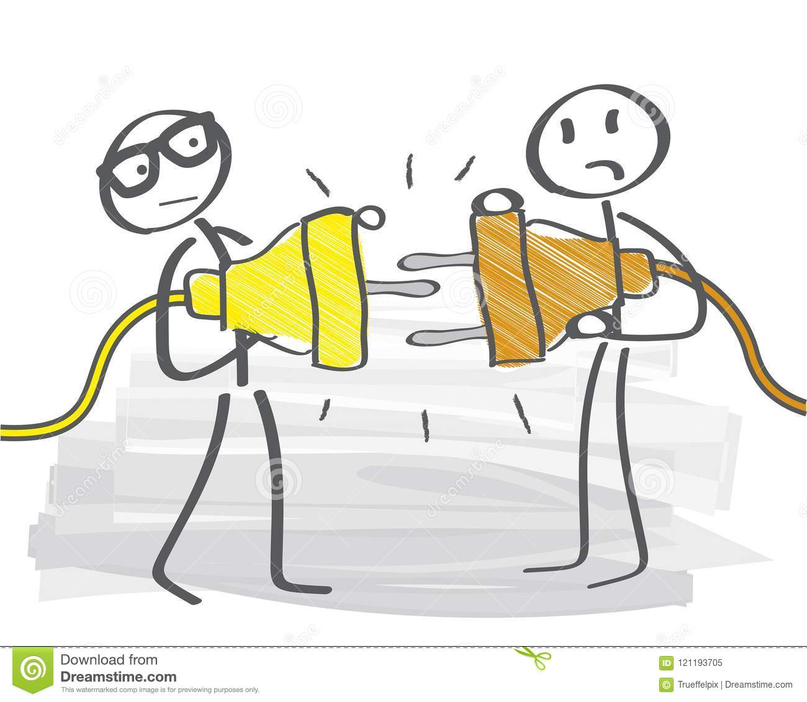
Issues
http://www.affinityvr.com/top-vr-gadgets-2016/
https://www.dreamstime.com/two-plugs-unable-to-be-joined-together-incompatible-two-plugs-unable-to-be-joined-together-bad-team-work-communication-image121193705
https://www.privateschoolreview.com/blog/which-is-the-most-expensive-private-school

Slide 7
Proposed Game
Augmented Invaders
Smartphones (Android & iOS)
Multiplayer
Mixed reality
First-person experience
https://www.youtube.com/watch?v=TzdO7HgaNGo

Slide 8
Design & Concept
Easily accessible
GPS tracking
Free moving areas
Tutorial
Rendering via rear camera
Virtual alien drones
Augmented laser beams
Synchronization of drones & beams

Slide 9
Implementation
https://support.unity3d.com/hc/en-us
https://www.percallgroup.com/en/ptc-vuforia-reseller-iot.php
https://blogs.unity3d.com/2018/08/02/evolving-multiplayer-games-beyond-unet/
https://www.freelancer.com/contest/GPS-tracking-service-company-Logo-design-387601-byentry-8712818

Slide 10
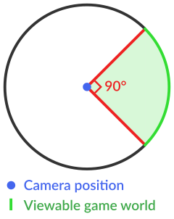
Conclusion
Feasible to develop Multiplayer MR location based game
Slow wandering while playing
Limitations
FOV dependency on phone’s screen
Does not consider occlusion
Insufficient tracking accuracy
Future Work
Use of gyroscope data
Massively multiplayer
Strategic team play

Slide 11
Turning the classis Snake mobile game into a location-based exergame that encourages walking
Luca Chittaro & Riccardo Sioni
HCI Lab, University of Udine, Italy (2012)

Slide 12
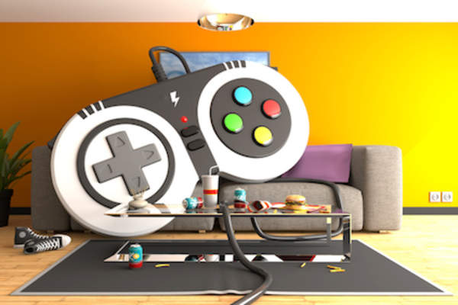
Introduction
Physical Activity
ᴕ
Health Benefits
Video Games
Sedentary lifestyle
Health risks
Children & Teenagers
https://www.healthcentral.com/slideshow/ways-video-games-are-bad-for-your-health

Slide 13
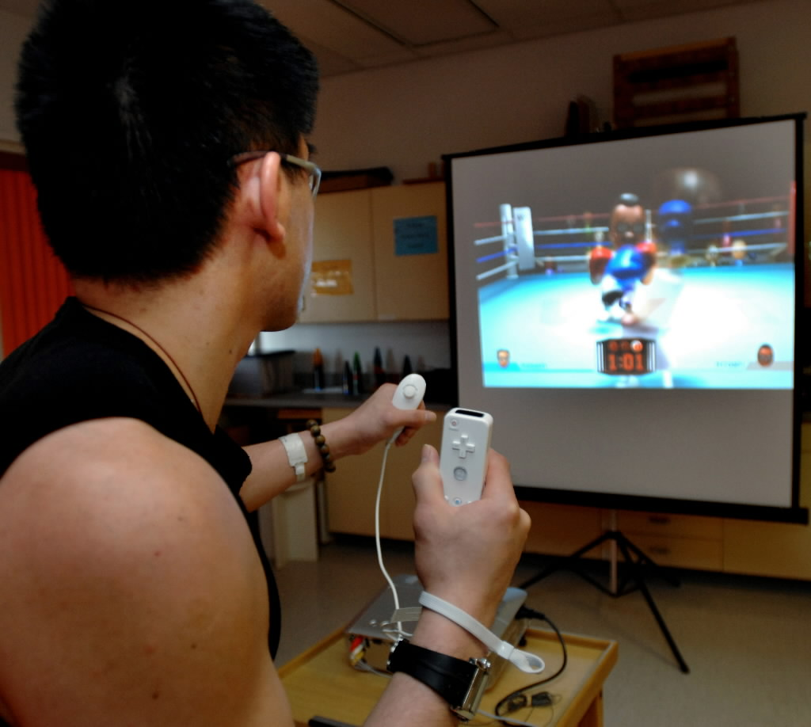
Exergames
Concept
Enjoyable
Health advantages
For easy to carry devices (Mobile devices etc.)
Examples
Nintendo’s Wii Sports
http://www.healthylompoc.org/are-wii-fit/
Nintendo’s Wii Fit
https://familyrated.com/item/wii-fit-plus/

Slide 14
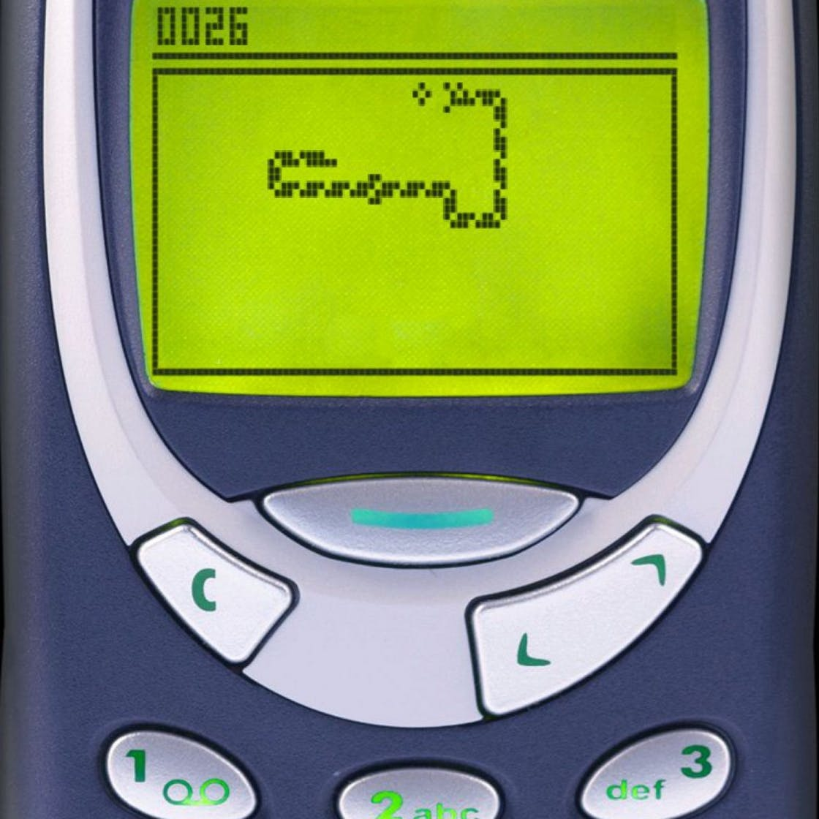
Objectives
Design Exergame
Target device: Mobile Phone
Enjoying
Easy to understand
Locosnake
https://www.shortlist.com/tech/gaming/google-doodle-play-snake-online/327607
Evaluate Exergame
Solid basis
Standardized measures
Different lifestyles w.r.t physical activity

Slide 15
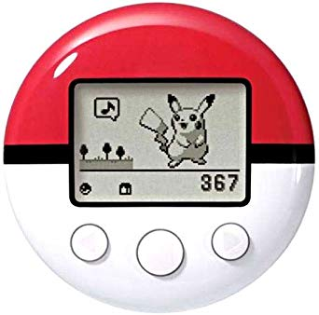
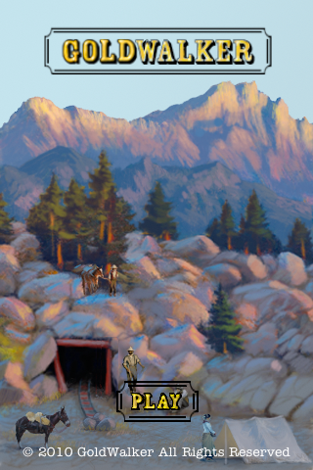
Existing Exergames
Nintendo’s Pokewalker
Small handheld device
Pedometer (Counting steps)
Load and take Pokemon for a walk
https://www.amazon.com/Pokemon-Nintendo-Pokewalker-entertainment-system/dp/B003EMT4LM
GoldWalker
iPhone game
Internal Sensors (Accelerometer & GPS)
Store gold, recruit workers, Mine camps
http://appshopper.com/healthcare-fitness/goldwalker

Slide 16
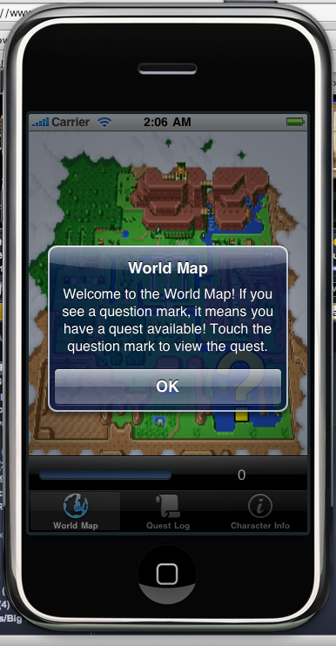
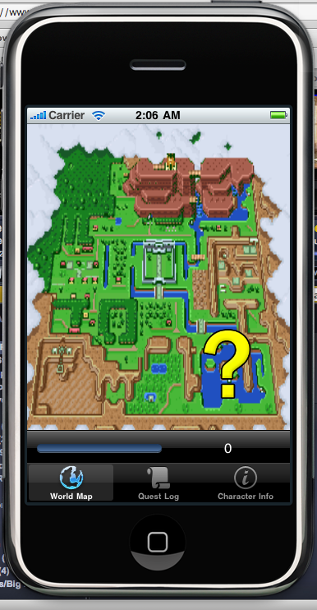
Existing Exergames
World of Workout
iPhone game
RPG (role-playing game)
Quests completion on walking
http://www.game2learn.com/?page_id=90
The Hidden Park
iPhone game
Find magical creatures by walking
Find magical creatures by solving puzzles
https://noisydecentgraphics.typepad.com/design/2009/09/the-hidden-park-iphone-game.html

Slide 17
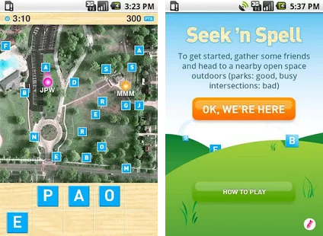
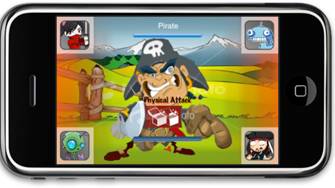
Existing Exergame
Seek ‘n Spell
iPhone & Android
Collect virtual letters by walking
Spell words to earn points
https://www.apkmonk.com/app/com.retronyms.android.seeknspell_heavy/
PiNiZoRo
iPhone game
Find enemies by walking into them
Defeat enemies by solving puzzles
http://www.ianlivingston.ca/pinizoro/

Slide 18
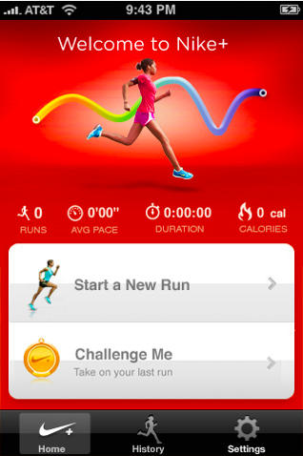
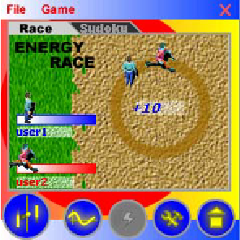
Existing Exergames (supplementary sensors)
Nike+
iPhone Application
Use sensor inside Nike shoes
Compare activity with others
https://www.cultofmac.com/58168/nike-gps-now-in-app-store-track-your-runs-without-19-shoe-sensor/
NEAT-o-Race
Virtual Race
Compete with buddies
Requires accelerometer
https://www.researchgate.net/publication/234787345_NEAT-o-Games_Blending_physical_activity_and_fun_in_the_daily_routine

Slide 19
Existing Exergames (supplementary sensors)
UbiFit Garden
Make personal goals
Achieve goals to beautify garden
Requires fitness device
https://slideplayer.com/slide/14690505/
Health Defender, Monster&Gold
Reads user’s HR
Requires heart rate sensor

Slide 20
Evaluation Techniques
Health Defender: User’s opinions & remarks
PiNiZoRo: Carrying out pilot study
World of Workout: Measuring heart rate before & after game
Monster&Gold: Questionnaire to assess understandability
UbiFit Garden: 3-week field trial, interview at beginning as well as during trial

Slide 21
Locosnake
Game Design
Based on classic snake
Player embodies snake
Movement in real world to control snake
Head of the snake is at player’s location
Eat on-screen items to gain points
Gaining points grows tail longer
Avoid colliding with tail
User sets four sided playing field using GPS localization
Snake in the closest position if player goes outside

Slide 22
Game Concept
Self generated playing field
Three difficulty levels
Easy
Medium
Hard
Fruit persistence time is proportional to field size
Snake head always at center
Forward-up map orientation
Customize Intensity of physical exercise

Slide 23
User Interface

Slide 24
User study
Main Aspects
Enjoyable?
Persuasive enough?
Relation among user’s lifestyle, enjoyment and effect on attitude towards walking?
Participants
15 users (14 M, 1 FM)
iPhone with 3GS

Slide 25
User study

Slide 26
Evaluation Measures
Player Enjoyment Scale (PES)
13 bipolar statements
Positive & negative
Scores from 1 to 7
4 Open Questions about usability & likeness
Perceived Exertion & walking speed
Borg’s Rating of Perceived Exertion (RPE)
Measure walking speed

Slide 27
Evaluation Measures
Physical Activity Enjoyment (PACES) & attitude change
18 bipolar statements
Scores from 1 to 7
Before and after playing Locosnake
Global Physical Activity Questionnaire (GPAQ)
16 Question
At work
While traveling
While doing recreational activities
Answer in metabolic equivalent in terms of minutes per week (METM)

Slide 28
Evaluation Procedure
Guided users to a lawn
Asked to evaluate game for iPhone
Profiles were recorded (gender, age etc.)
Answered GPAQ & filled first PACES
Walk while playing (LS)
Walk while not playing (NLS)
1 min tutorial in the beginning
5 min session for both LS & NLS
Easy difficulty level
After game session for LS, fill RPE scale, second PACES and mPES
After walk session for NLS, fill RPE scale only
Rating of Perceived Exertion (RPE)
Physical Activity Enjoyment Scale (PACES)
Player Enjoyment Scale (mPES)

Slide 29
Results
Mean Enjoyment Score (mPES): 60.13 out of 77
Walk while Playing (LS) Walk while Not Playing (NLS)
Mean RPE score
9.07 7.80
Average walking speed
1.62 m/s 1.45 m/s
Mean PACES (out of 126)
After game : 99.53
Before game : 102.07
Rating of Perceived Exertion (RPE)
Physical Activity Enjoyment Scale (PACES)
Player Enjoyment Scale (mPES)

Slide 30
Correlations
Rating of Perceived Exertion (RPE)
Physical Activity Enjoyment Scale (PACES)
Player Enjoyment Scale (mPES)
Higher METM, lower ΔPACES
Higher METM, lower mPES
Higher mPES, higher ΔPACES

Slide 31
Open Questions
Like
Link between game & real world
Concept/Idea
Feedback
Dislike
GPS-related problems
Game graphics and background music
Difficulties
GPS inaccuracy
Improvements
GPS accuracy
More type of fruits
Better Visuals
Side effects to some fruits
Add multiplayer feature

Slide 32
Conclusion
Generally enjoyed
Good understandability
Higher physical exertion
Walking speed was proportional to distance between user & fruit
More successful for people with sedentary lifestyle

Slide 33
Future Work
Replicate user study with female participants
Add multiplayer feature
Add social dimensions
Record distance walked & time spent
Maintain automatic diary to support self monitoring

Slide 34
Thank you

