Slide 1

Exploiting Semantic Annotations for Clustering Geographic Areas and Users in Location-based
Social Networks
Noulas, A., Scellato, S., Mascolo, C., & Pontil, M. (2011, July). In Fifth international AAAI conference on Weblogs and social Media.
Nancy Fazal
21.2.2019

Slide 2

Location-based Social Networks (LBSN)
http://geoawesomeness.com/wp-content/uploads/2012/11/location-based-social-networks.jpg

Slide 3
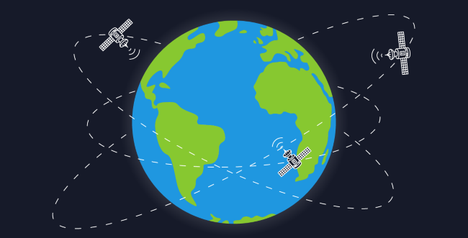
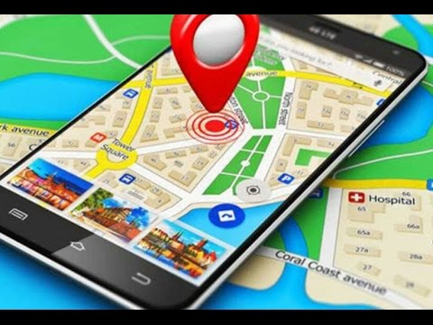
Location-based Social Networks (LBSN)
https://www.google.com/

Slide 4
Problem Definition
Model Human activity and geographical areas using LBSN places
Recommendation systems and digital tourist guides

Slide 5

Foursquare City Guide
Let user search Nearby POI’s
Tips and Expertise
Personalized recommendations
Ratings

Slide 6
Foursquare Dataset
Rate limited access from API
Collected public stream of tweets with Foursquare check-ins
12 million time stamped location check-ins by 679 thousand users
3 million recorded locations on planet
Between May, 27th 2010 – September, 14th 2010

Slide 7
Spatio-Temporal margin of Dataset in NewYork
Arts & Entertainment
College & Education
Shops
Food
Parks & Outdoors
Travel
Nightlife
Morning
Night
Home/Work/Other

Slide 8

Representation of Geographic Areas
g
A

Slide 9


Representation of Geographic Areas
a
Datapoint input
Representation: Categories of nearby places, attached social activity

Slide 10
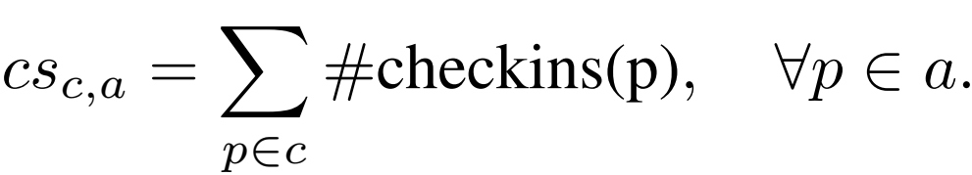
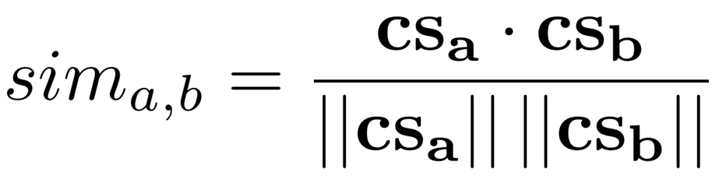
Representation of Geographic Areas
Similarity between two areas a and b
Notes:
A signal is a fucntion that conveys information about the behaviour or attributes of a phenemena.
Cosine similarity measures the cosine between two feature vectors projected in a multi-dimensional space.
Think of vector as a way of representing data. It is a kind of matrix which shows the input values. A vector of N elements is a N-dimensional vector.
Feature is an individual meansurable property of a phenomena being observed.
Feature vector is just a collection of the measured values of a particular feature.
Defined the similarity equation between the input data points
Create weight matrix W and degree matrix D used by Spectral Clustering Algorithm
Apply K-means
Graph Laplacian L

Slide 11
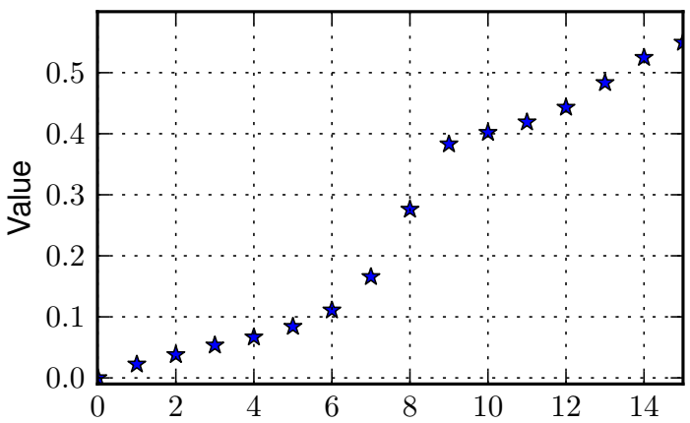
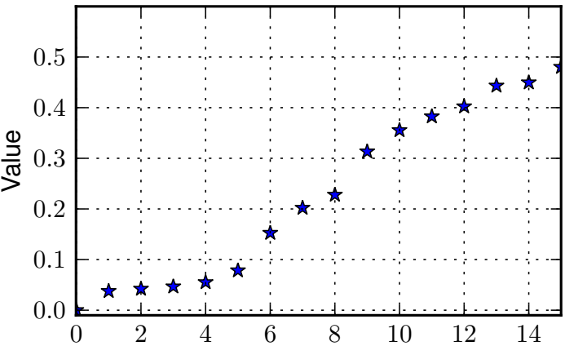
Eigenvalue Distribution of Graph Laplacian
New York Areas
London Areas

Slide 12
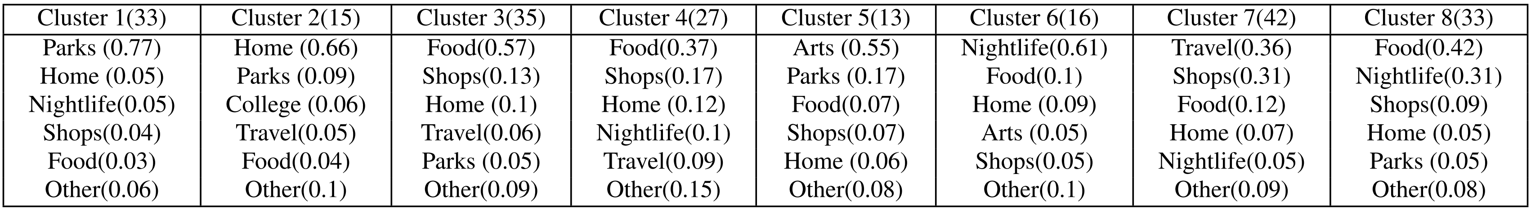
Area Clustering Results (NewYork)
Cluster 1
Cluster 2
Cluster 3
Cluster 4
Cluster 5
Cluster 6
Cluster 7
Cluster 8
Notes:
Area = 10 * 10 km2
Threshold of atleast 30 checkins
228 Areas for London
214 Areas for Newyork

Slide 13
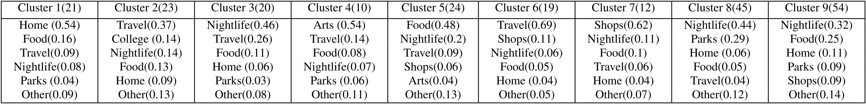
Area Clustering Results (London)
Cluster 1
Cluster 2
Cluster 9
Cluster 3
Cluster 4
Cluster 5
Cluster 6
Cluster 7
Cluster 8

Slide 14
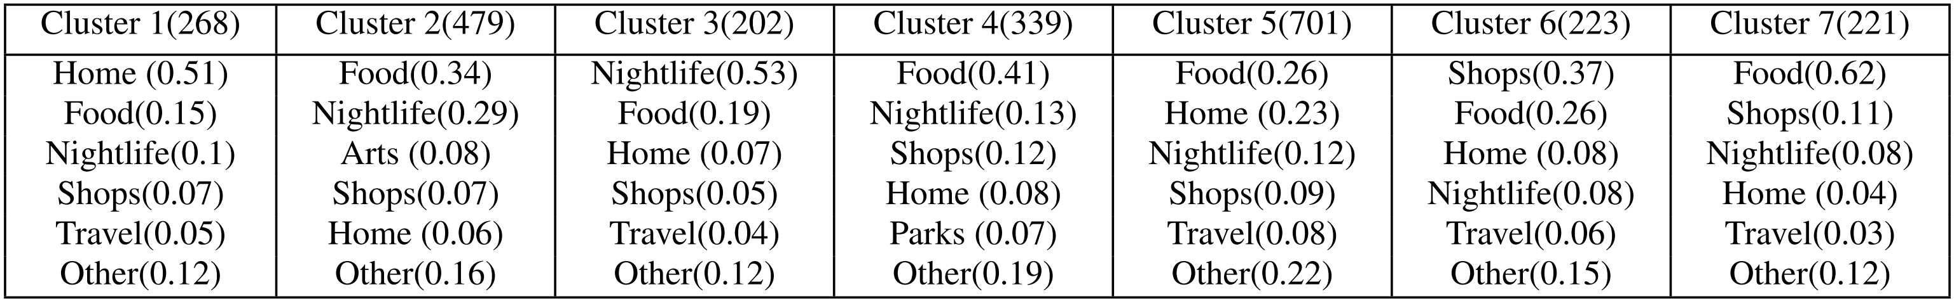
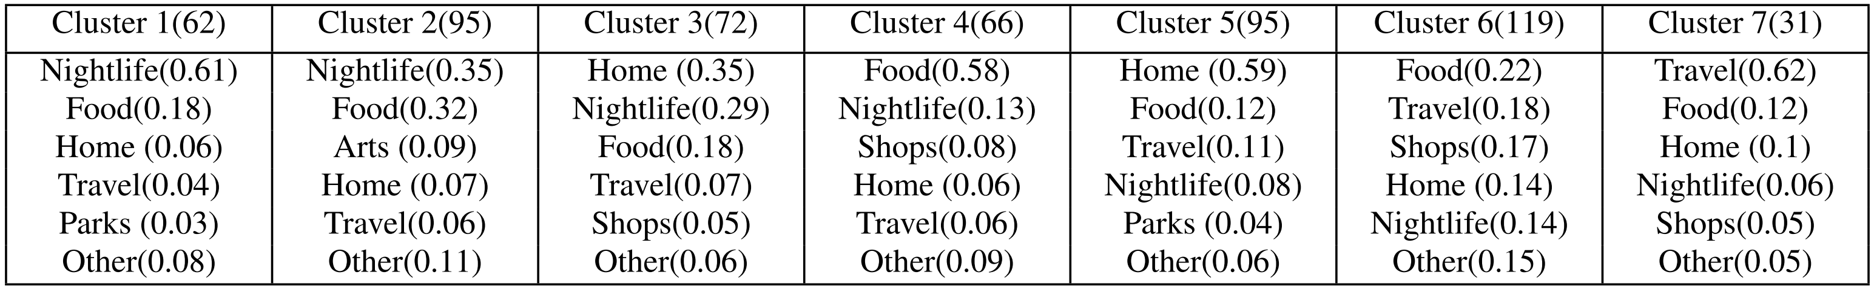
User Clustering Results
New York
London

Slide 15
Travel Recommedation Using Geo-tagged Photos in
Social Media for Tourist
Memon, I., Chen, L., Majid, A., Lv, M., Hussain, I., & Chen, G. (2015). Wireless Personal Communications, 80(4), 1347-1362.

Slide 16

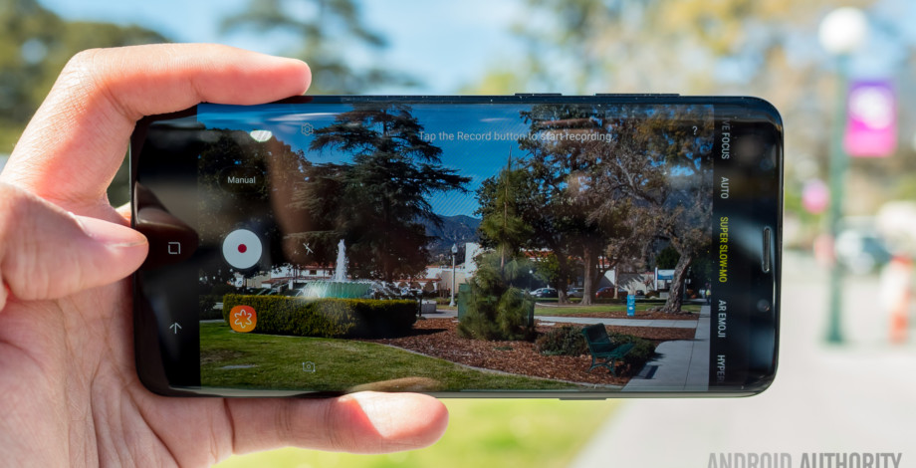
Advancement in Technology
https://www.androidauthority.com/best-camera-phones-670620/
https://www.amazon.com/Polaroid-Waterproof-Instant-Portable-Handheld/dp/B01LX0U5VN

Slide 17




Social Media Services

Slide 18
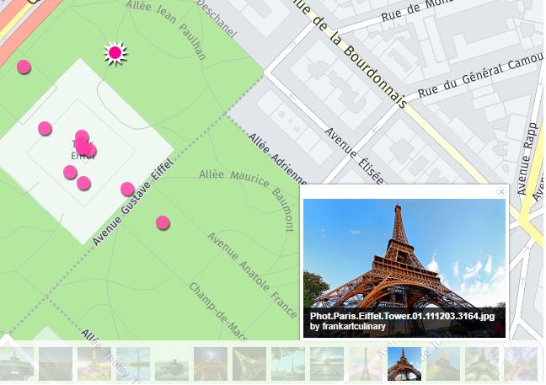
Geo-tagged Photo
Latitude: 48.85906
Longitude: 2.29486

Slide 19
Problem Definition
Geo-tagged Social Media
Locate Tourist Location and Build Traveling History
Derive Travel Preferences
Recommend New Places

Slide 20
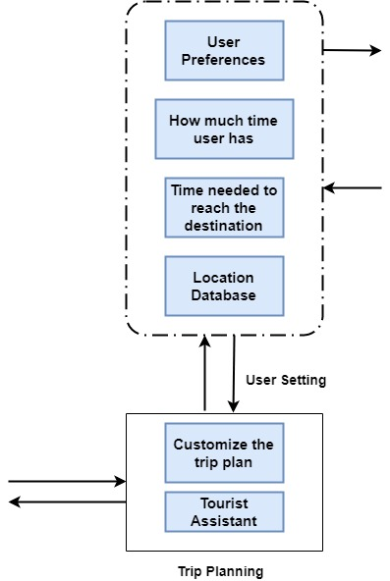
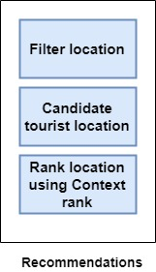
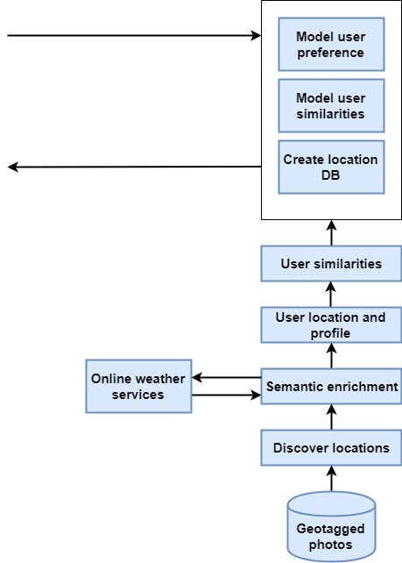

Tourists location recommendation system

Slide 21
Discover Locations
Cluster photos geographically
DBSCAN (Density-based spatial clustering of applications with noise)

Slide 22
Semantic Enrichment
Derive representative tag for each location cluster
1
Extract POIS using webservices, like Google Places
2

Slide 23
Location and User’s Profiling
Build profile of locations and users
User-Location matrix
User-User similarity matrix

Slide 24
Model User Preference and Similarities
Analyze Photos geo-location information to model user’s similarity
Kernel Density Estimation to model user’s travel preference
Kullback-Leibler Divergence to calculate similarity between users
Notes:
The kernel density estimation algorithm is nonparametric way of estimating an unknown probability distribution based on a set of data samples which
are independently drawn from the unknown distribution.
The Kullback-Leibler divergence between two probability distributions is a measure of how different the two distributions are.

Slide 25
Data set Acquisition
1,376,886 photographs with spatial and temporal context (Flickr API)
Eight different cities of China (Name of cities in different languages)
Between January 01, 2000 and November 17, 2013

Slide 26
Data set Summary

Slide 27
Performance Comparison

Slide 28

Baseline Methods
Popularity Rank (PR)
Collaborative Filtering Rank (CFR)
Classic Rank (CLR)
Personalized Context Method
Context Rank (Proposed Method)
Notes:
Users created contents like photos or videos can be measured in popularity while some users want to see popular photos that many other users have seen, others may want to see photos that are regarded to have high expertise. The number of unique visits made to those locations, we can determine rank the location on the general popularity score .
Collaborative filtering is a method of making automatic predictions (filtering) about the interests of a user by collecting preferences or taste information from many users (collaborating).
Classic Rank (CLR).
The Hypertext Induced Topic Search (HITS) based Inference method to calculate the location’s interest and user’s travel experiences in terms of authority score and hub score by exploiting the reinforcement relationship between users and locations.

Slide 29
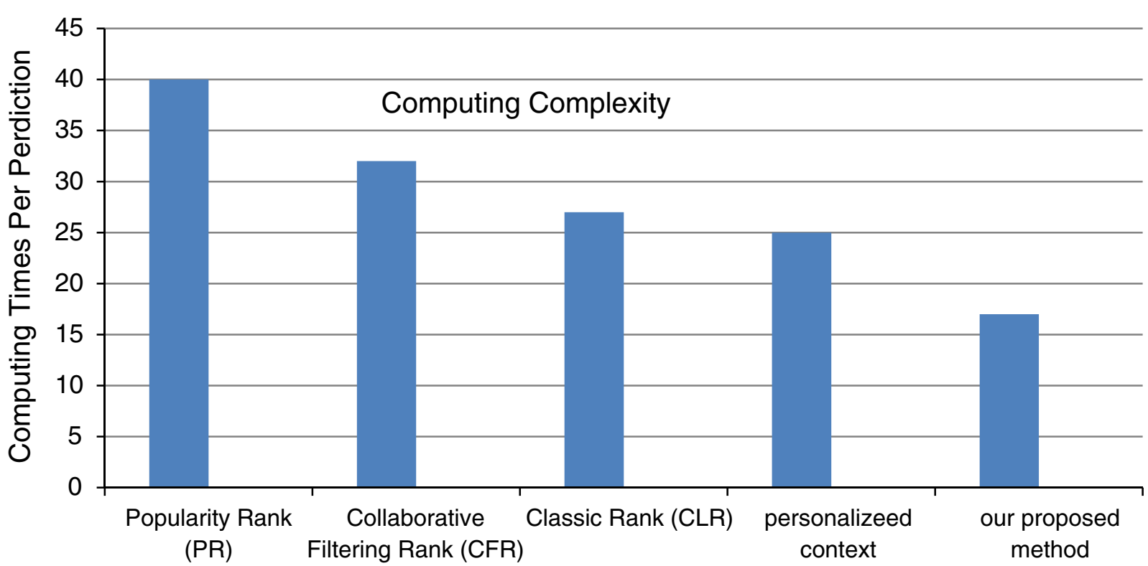
Time Consuming Computation Prediction
Context Rank (Proposed)
Methods

Slide 30
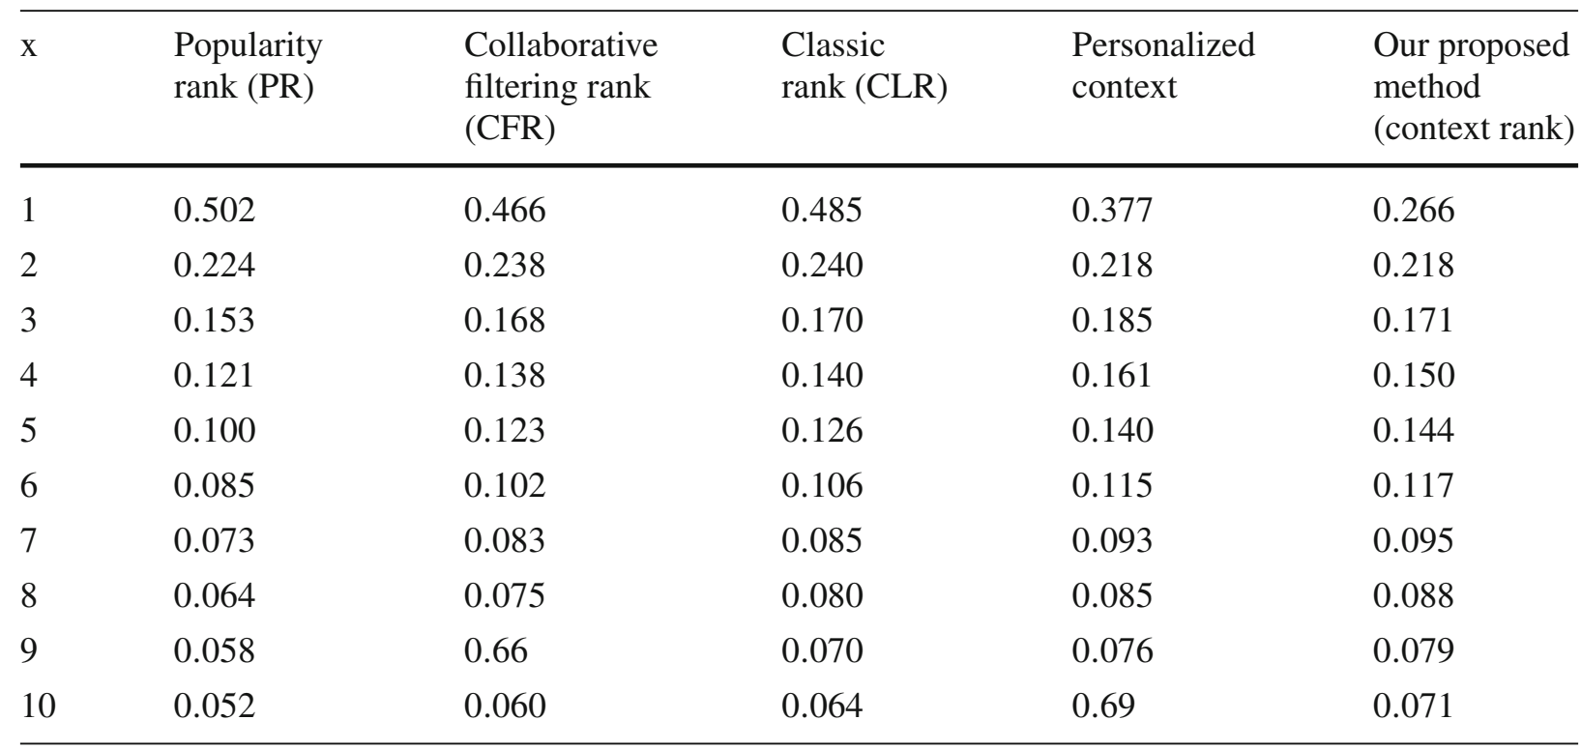
MAP (Mean Average Precision) Comparison
Notes:
Mean average precision (MAP@n) is a widely used evaluation metric to measure the ranking effectiveness that is mean over the precision values after each correct recommendation in the top-n.
The average precision is precision averaged across all values of recall between 0 and 1
Recall is a fraction of relevant instances that have been retrieved over the total amount of relevant instances.

Slide 31
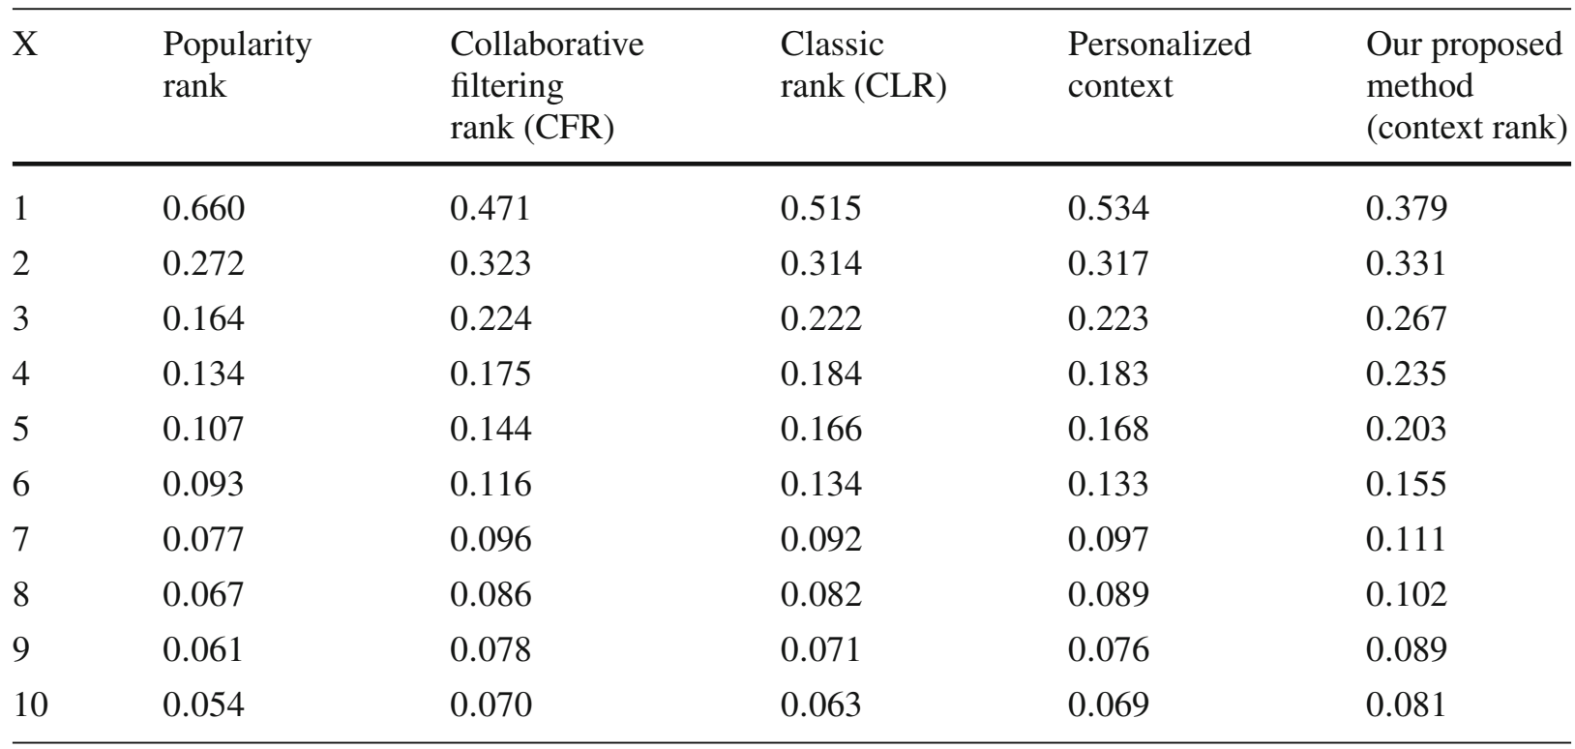
MRR (Mean Reciprocal Rank) Comparison
Notes:
The mean reciprocal rank is a statistical measure for evaluating any process that produces a list of possible responses to a sample of queries, ordered by probability of correctness.

Slide 32
Conclusion
Better recommendations and Prediction
Short and targeted visits are easier to predict using methods based on Popularity.
Collaborative filtering Methods ease in long tourist visits.

Slide 33
Thank You!

Slide 34
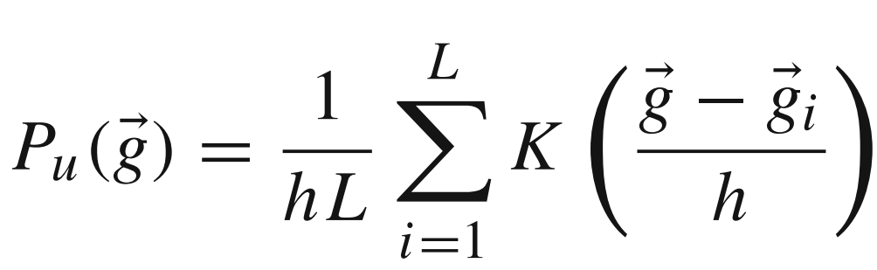
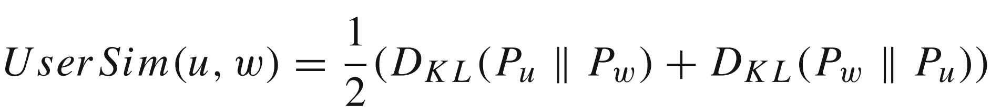
Model User Preference and Similarities
User u’s travel performance:
Similarity between Users:

Slide 35
Semantic Enrichment
Derive representative tag for each location cluster
1
Location Cluster
LC = (Pc,gc)
2
Score each tag (x) using TF-IDF
3
High score
=
More distinctive tag
4
Extract POIS using webservices, like Google Places
5

Slide 36
Discover Locations
1,376,886 photographs with spatial and temporal context (Flickr API)
Eight different cities of China
Between January 01, 2000 and November 17, 2013
Clustered photos geographically to describe locations using DBSCAN (Density Based Clustering Algorithms)

Slide 37
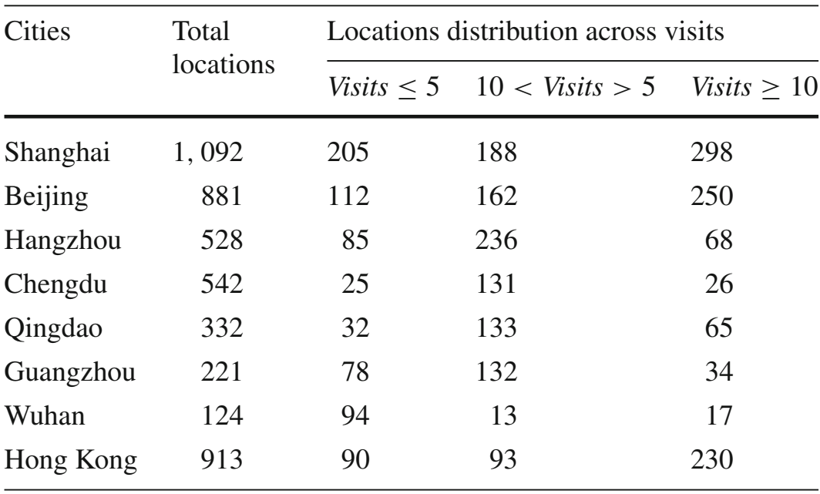
Overview of Location Distribution and Popularity

Slide 38
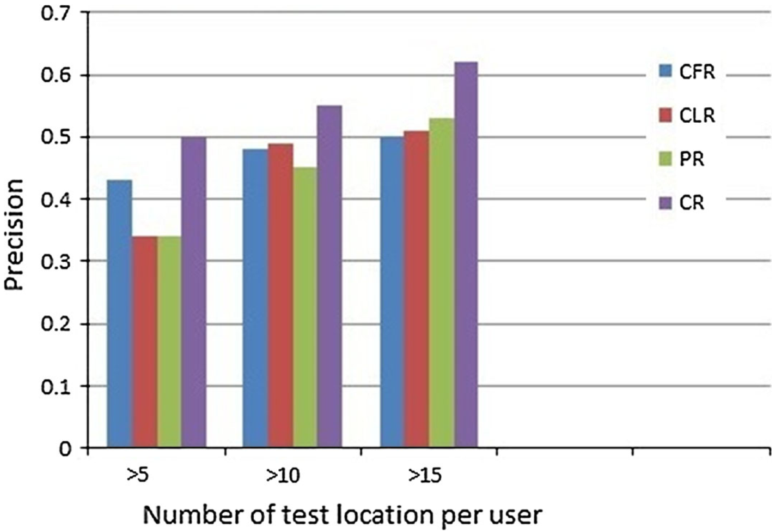
Prediction Recommendation
Collaborative Filtering Rank
Classic Rank
Popularity Rank
Context Rank

Slide 39
MAP (Mean Average Precision) Comparison
Nq = Total number of queries
Api = AP for query i

