Slide 1
Real-Time Clustering of Large Geo-Referenced Data for Visualizing on Map
Presenter: Rushikesh Sane
Course: LAMI, Spring 2019
6th February2019

Slide 2
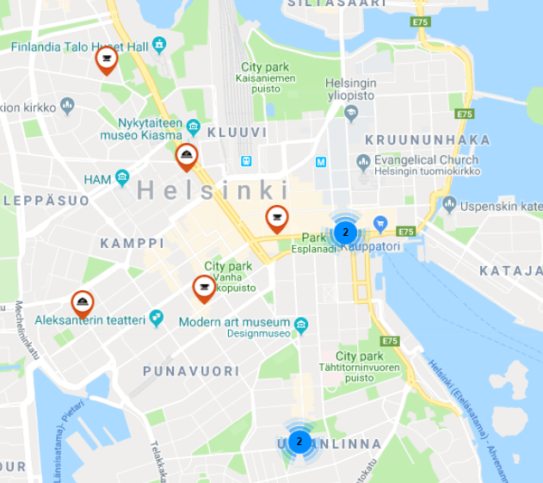
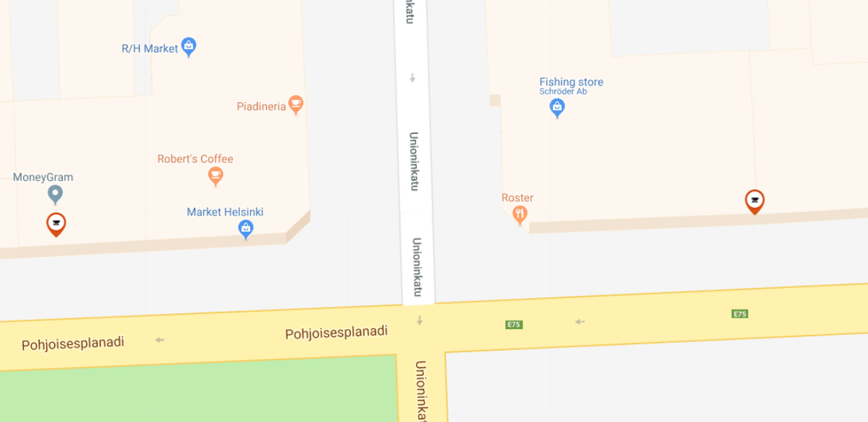
Clustering
Real-Time
Geo-Referenced Data
Notes:
Clustering – Grouping similar objects from a given criteria or to observe
Opening a cluster – automatic zoom happens so that objects in the cluster and displayed on the map.

Slide 3
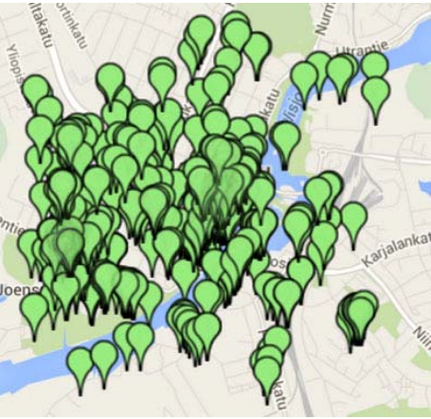
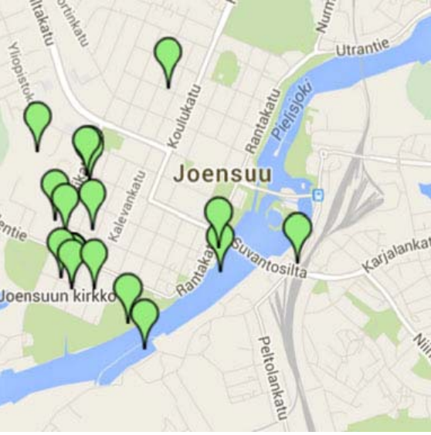
Visualizing LARGE amount of data
Clutter
Slowness
Predefined Filters
Notes:
Clutter – Overlapping of the markers.
Slowness – When the data contains thuosands of records, images
Pre-defined filter – sort by ratings, prices etc.

Slide 4
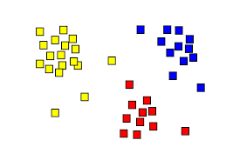
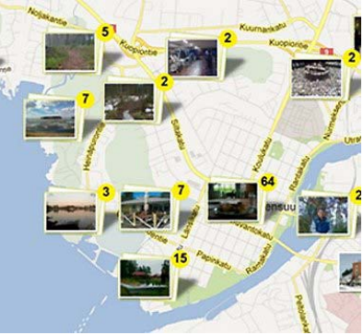
Clustering Problem
Number of Clusters
Minimizing SSE

Slide 5
Why not these?
K Means
DBSCAN
Has different
objective
Need to determine
k in advance
High time complexity O(N³)
Hierarchical

Slide 6
Grid-based Clustering

Slide 7
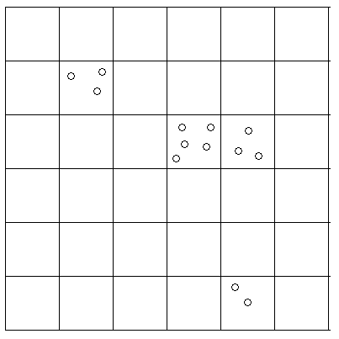
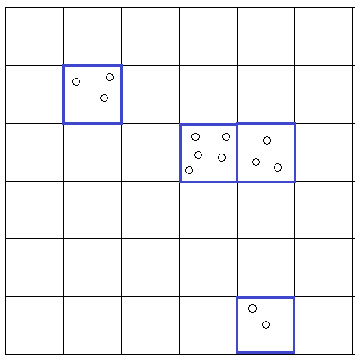
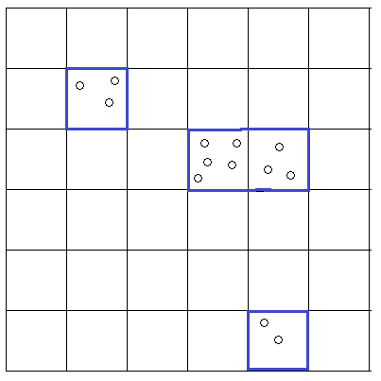
Grid-based Steps
Grid Construction
Initial Clustering
Grid Construction

Slide 8
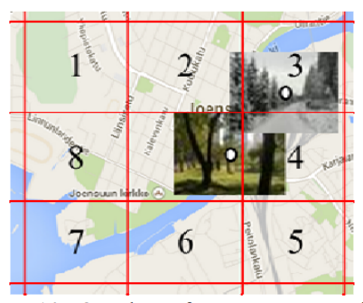
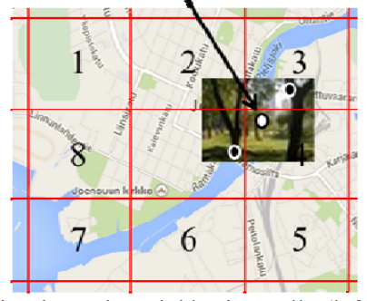
Grid-based approach in clustering
Overlapping Clusters
Cluster after merge

Slide 9
Proposed approach
Client
Server
Prepare Query
and Parameters
Query from
database
Overlap Across
Neighboring cells
Grid construction
Initial Clusters in the cell
Display cluster
on Map
Information of
each cell

Slide 10
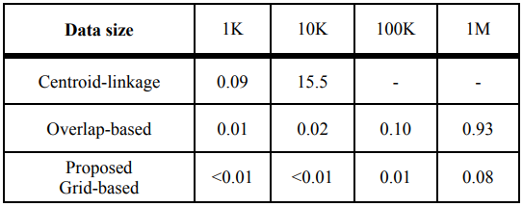
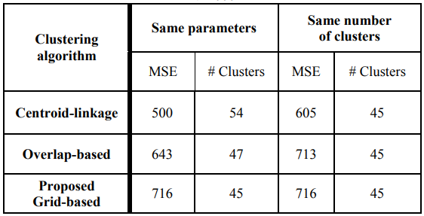
Experiments
Processing time of 3 clustering approaches
Clustering quality with 100 data points
Very fast!
Comparison with Google cluster marker API

Slide 11
A possible grid-growing clustering algorithm

Slide 12
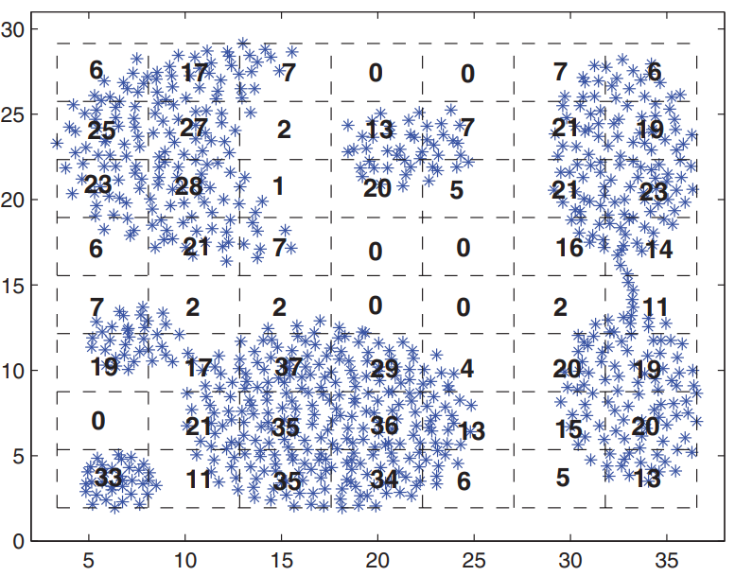
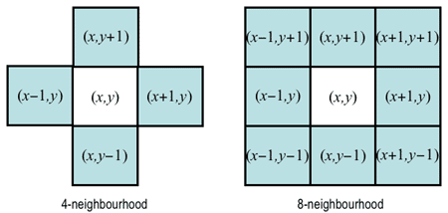
Steps
Grid Construction
Borders pass through max & min co-ordinates
Initial seeds (random or top m dense)
2. Grid Growing
m initial seeds
4 or 8 neighbors
3. Partitioning
4-neighborhood
8-neighborhood

Slide 13
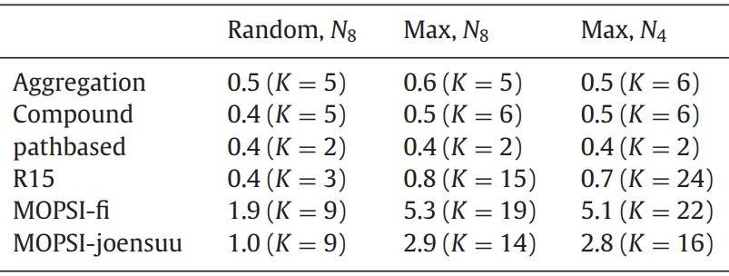
Experiments
Least time
Litekmeans: Fastest implementation of k means in matlab
GEM: Greedy expectation-maximization algorithm (gaussian mixture model)
DBSCAN: Density based clustering algorithm
LSC: Landmark spectral clustering (graph based algorithm)
PRS: Pairwise random swap
GG: Grid Growing
Optimal strategy suggested by authors
Time required
Least clusters detected
Maximum clusters detected
Efficiency of algorithm & number of clusters detected

Slide 14
Conclusion
Novel idea of web mapping system based on clustering to make real time queries.
First ever system to allow fetching query results up to 1M objects.
Suitable for real time applications having low bandwidth.
The proposed grid-growing algorithm posseses the advantages of both k-means and DBSCAN.
Time complexity is O(nlogn).
Overcomes all difficulties related to geo-tagged real time applications.

Slide 15
Thank you
Real-Time Clustering of Large Geo-Referenced Data for Visualizing on Map
Mohammad Rezaei, Pasi Franti
Link: http://cs.uef.fi/sipu/pub/aece_2018_4_8.pdf
A grid-growing clustering algorithm for geo-spatial data
Qinpei Zhaoa, Yang Shi Qin Liua , Pasi Fränti
Link: http://cs.uef.fi/sipu/pub/Grid_growing_Zhao_2015.pdf
Other References: Gifs on slide 5 –
https://giphy.com/gifs/dendrogram-dashee87githubio-scikit-pSNCWCEAsgrAs
https://giphy.com/gifs/dbscan-dashee87githubio-scikit-OVJBPIB6oL3a0
https://giphy.com/gifs/needs-dashee87githubio-scikit-3NKUcoyBzkXQc

Slide 16
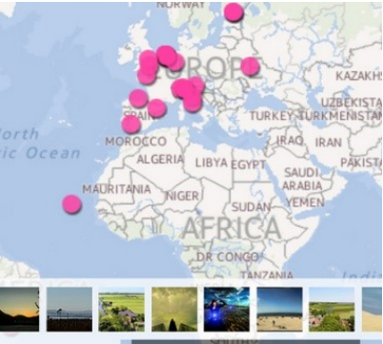
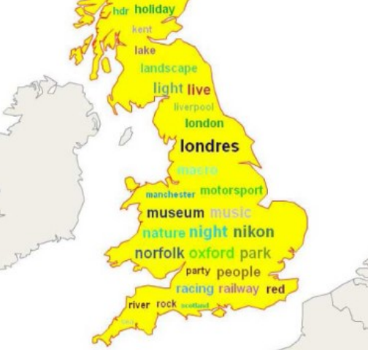
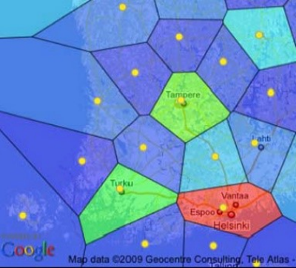
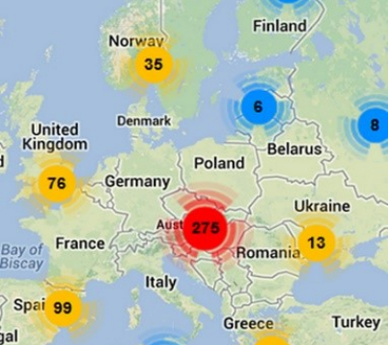
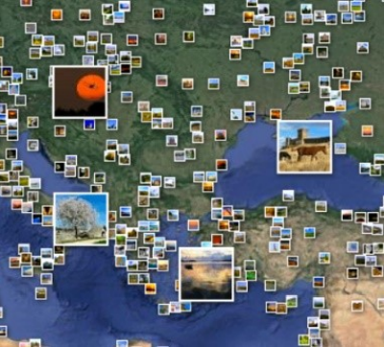
Techniques to Visualize Data
Technique for Data Reduction
Showing Density
Representation of Cluster
Showing Distribution
Opening a Cluster
Details on Demand

Slide 17
Resistance to Problems due to Panning
Panning Problem
Solution: Initialize the grid only one at the beginning. A point assigned to one box will remain assigned to
it even after panning. But we take only those objects into consideration which are completely or partially
Visible in the current view.

Slide 18
Voronoi Diagram
In mathematics, a Voronoi diagram is a partitioning of a plane into regions based on distance to points
in a specific subset of the plane. That set of points (called seeds, sites, or generators) is specified
beforehand, and for each seed there is a corresponding region consisting of all points closer to that seed
than to any other. These regions are called Voronoi cells.

Slide 19
What if data point and grid-line overlap?
Point could be placed in any of the adjacent cells. It’s a trivial issue. One can place it in more dense cell.

Slide 20
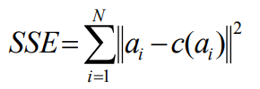
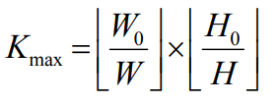
SSE & number of clusters formula

