Slide 1
Location Aware Machine Intellignece (LAMI) Presentation
Honeycomb geometry: Rigid motions on the hexagonal grid
Kacper Pluta, Pascal Romon, Yukiko Kenmochi, Nicolas Passat
Weighted Distances on the Trihexagonal Grid
Gergely Kovacs, Benedek Nagay, Béla Vizvari
Salseng Mrong
IMPIT, School of Computing
University of Eastern Finland

Slide 2
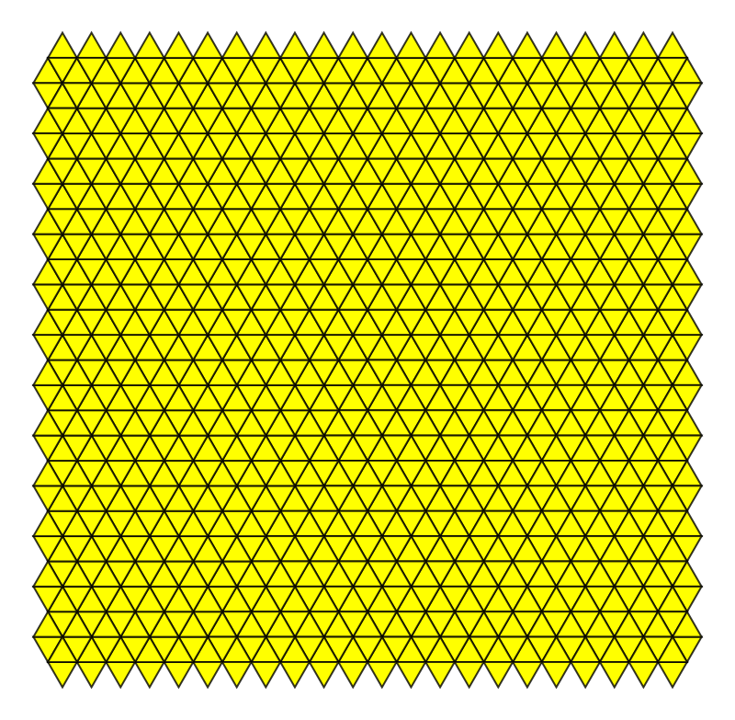
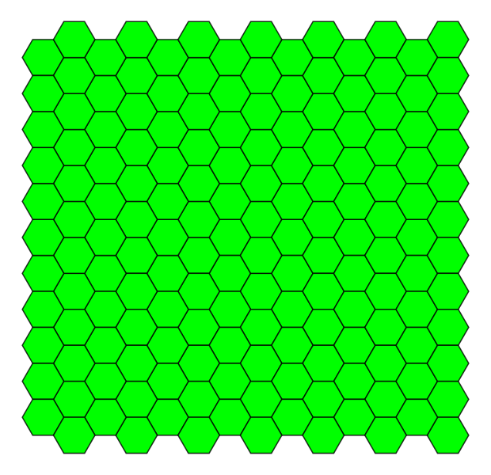
Tiling in the Euclidean plane
Triangular Tiling
Square Tiling
Hexagonal Tiling
Image source: wikipedia.org

Slide 3
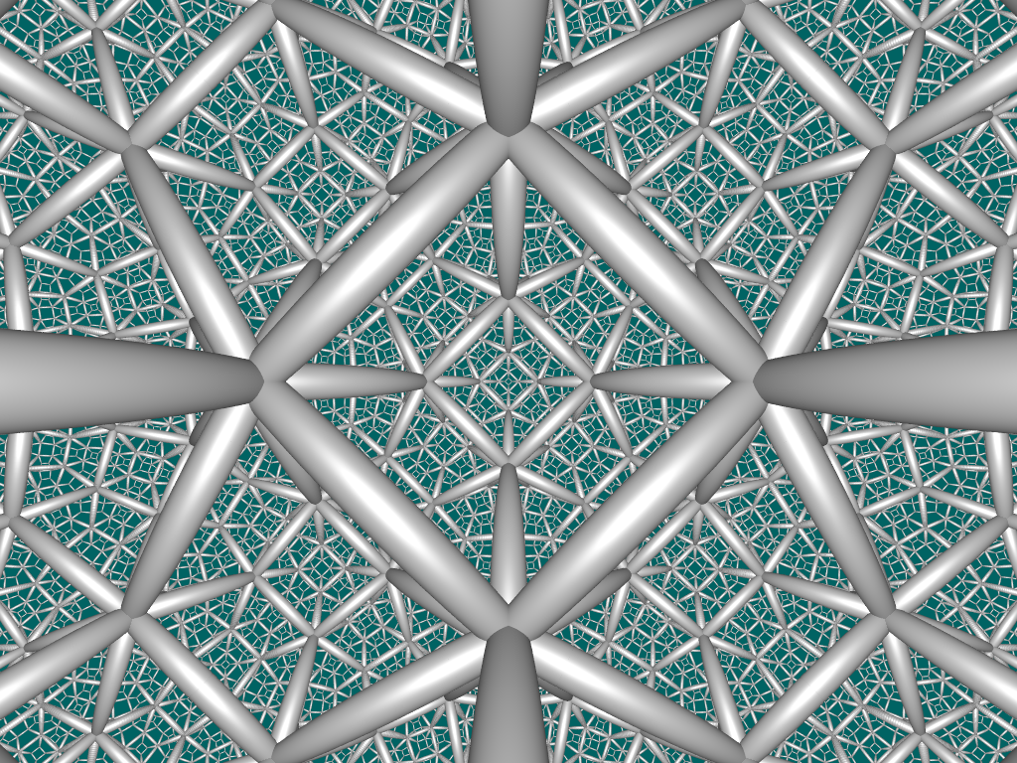
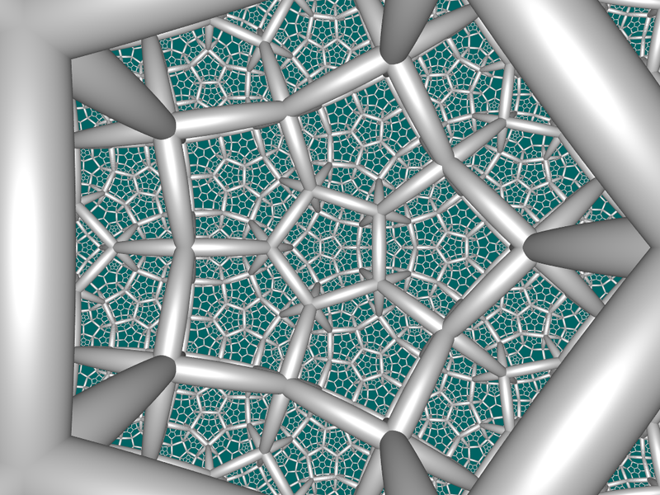
Honeycomb geometry
Close packing of polyhedrals or higher dimensional cells
Usually constructed in ordinary Euclidean space
Can also be in non-Euclidean space
Order 4 dodecahedral honeycomb
Order 5 dodecahedral honeycomb
Image source: wikipedia.org

Slide 4
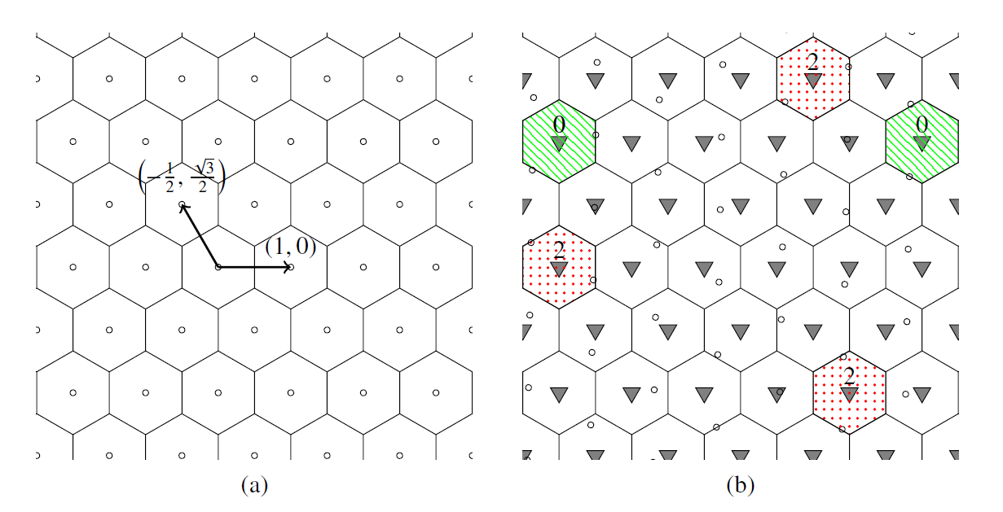
Digitizing on hexagonal grid
Figure: (a)Visualization of hexagonal grid (b) Arrows are the base of the underlying lattice

Slide 5
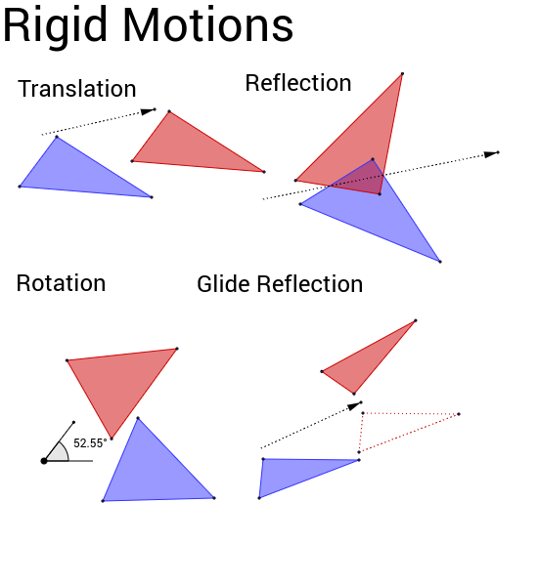
Rigid motion
Relative distance between points remain the same
Relative position of the points remain the same
Image source: cdn.geogebra.org

Slide 6
Rigid motion on digitized grids

Slide 7
Weighted Distances on the Trihexagonal Grid

Slide 8
Trihexagonal tiling
Building Block
Hexagons
Triangles
Features
6 triangles surround 1 hexagon
3 hexagons surround 1 triangle
2 types of triangle

Slide 9
Neighborhood in trihexagonal tiling (Hexagon)
Neighbors
3 Triangles (Type 1)
3 Triangles (Type 2)
Semi-neighbors
6 Hexagons

Slide 10
Neighborhood in trihexagonal tiling (Triangle)
Neighbors
3 Hexagons
Semi-neighbors
3 Opposite triangles

Slide 11
Coordinate
+Z
+X
Coordinate Triplet – (X Y Z)
Absolute value of the Sum of coordinate triplet is either 0, 1, or 2
0 – Triangle
2 – Opposite triangle
1 – Hexagon
(0 0 0)
+Y

Slide 12
Weighted distances
α
β
γ
Step to neighbors
+/- 1 step
Step from hexagon to sem-neighbor hexagon
Changes two coordinates, one by +1 and other by -1
Step from triangle to sem-neighbor triangle
Changes two coordinates, either by +1 or by -1

Slide 13
Change of weights
α
γ
β
+Z
(1 0 1)
α = 1
+X
(0 0 1)
(1 0 0)
(0 0 1)
(1 0 0)
(0 0 0)
(0 1 1)
(0 1 0)
+Y

Slide 14
Minimal Weighted Path
For known values of α, β and γ optimal search algorithms can be used
For regular structure of the grid, direct formulae can be used to compute the Minimal Weighted Path
Table: Value of d(p, q; α, β, γ) depending on the cases of respective relations of the weights

Slide 15
Square vs. Hexagonal
Square
Hexagonal
Trihexagonal

Slide 16
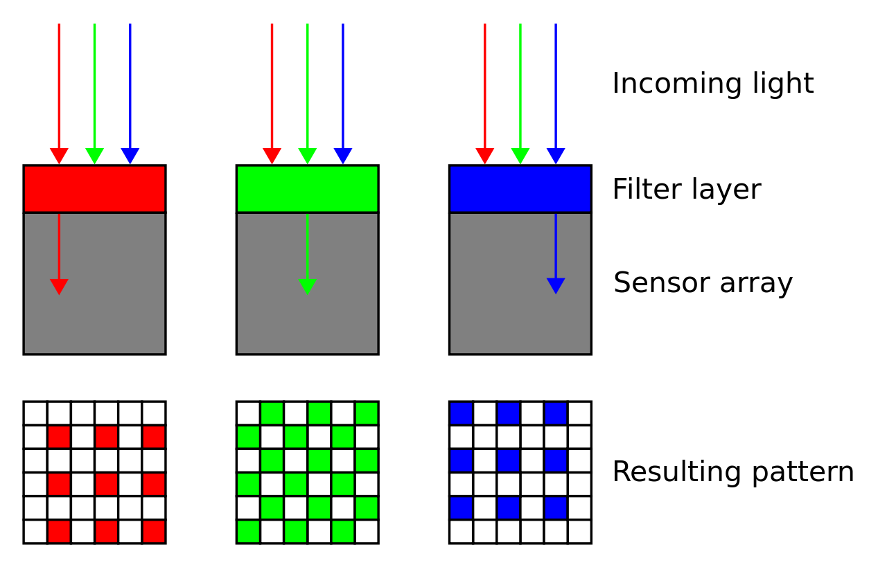
Square grid still has the advantage
It has both software and hardware support
Bayer pattern
Image source: wikipedia.org

Slide 17
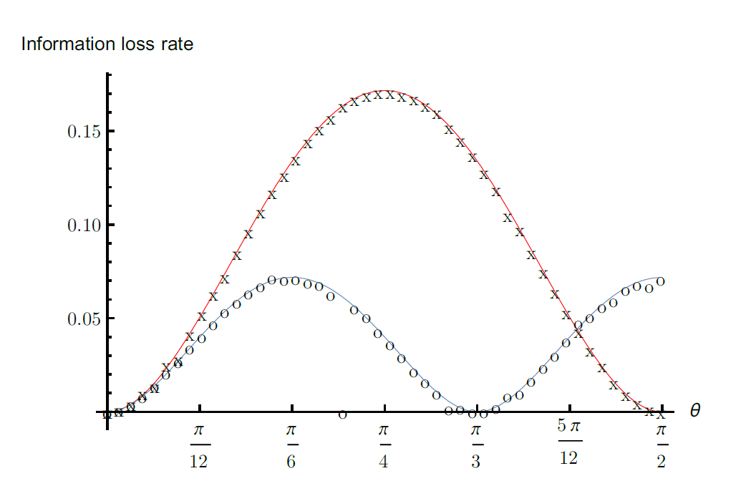
Loss rate
Ratios between the areas of non-injective zones and the remainder range.

Slide 18
Conclusion
The loss of information induced by rigid motion on the hexagonal grid is relatively low
Trihexagonal or hexagonal are computationally expensive

